Slide 1
Impact of GDPR on AI Startups
James Bessen, Boston University, Technology & Policy Research Initiative
Stephen Michael Impink, New York University, Stern School of Business
Lydia Reichensperger, Boston University, Technology & Policy Research Initiative
Robert Seamans, New York University, Stern School of Business

Slide 2
Surveys of AI Startups
Survey 1, Summer 2018
Survey 2, Fall 2019
Survey 3, Fall 2020
Contacted 1,200+ Firms
160 Responses
Contacted 2,000+ Firms
~200 Responses
31 repeat firms
Upcoming
New sections on the ethics in AI and COVID-19

Slide 3
Survey Questionnaire
Firm Demographics (size, location)
Customer Demographics (size, location, industry, occupation)
Technology (speech recognition, image recognition, etc.)
Algorithm (neural network, ensemble learning, etc.)
Data Type (transactions, unstructured text, images), Source (proprietary, customer, public) and Protections (legal contracts, APIs, data encryption, etc.)
Data Protections (legal contracts, encryption, password, logged access, etc.)
General Data Protection Regulation (GDPR) questions

Slide 4
GDPR as a competitive barrier?
GDPR and regulations that protect consumer privacy may also reduce data availability.
Cost of collecting and using customer data may asymmetrically impact smaller firms in some industries (Johnson & Shriver 2020, Bessen et al. 2020), especially in Europe (Jia et al. 2018).
Enforcement of GDPR has led to a reduction in the number of smaller web technology vendors used by larger firms, leading to increased concentration of more established, larger firms in this industry (Johnson & Shriver 2020).
Online sales revenues dropped for EU firms by 10 percent in 2018 due to the impact of GDPR (Goldberg et al. 2019), and there are additional concerns that GDPR adversely affects entrepreneurial ventures in Europe.

Slide 5
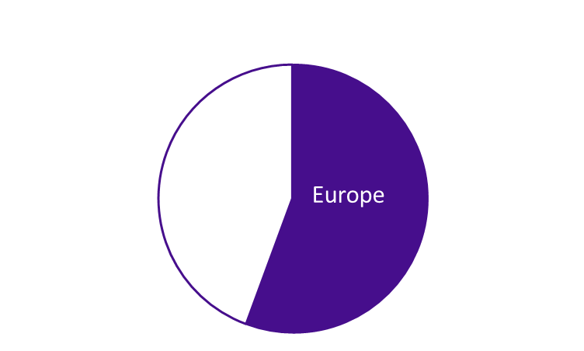
Data Protection by Cust & HQ Location
% of participants that use a type of data protection
55% of firms have customers in Europe

Slide 6
GDPR Questions
Have you created a new position to handle GDPR compliance? 39% of total respondents (Yes)
Have you reallocated resources to handle GDPR compliance? 49% of total respondents (Yes)
Have you deleted data in order to comply with GDPR? 37% of total respondents (Yes)

Slide 7
Takeaways
Substantial entry/entrepreneurship around AI (several thousand new “AI”-tagged startups in Crunchbase emerged last year). But, possibly, data availability creates a barrier to growth, not entry (Lambrecht & Tucker 2015, Sokol & Comerford 2016).
Variation in data protections and GDPR response by customer and firm location.
AI startups that are not located in Europe and do not have customers in the EU are still impacted by GDPR. Lack of compliance with GDPR could impact VC funding options.
Impact of other data privacy regulation could also be broader (i.e., California Consumer Privacy Act (CCPA) in California impacting other states).
Given that the average size of these startups is small (<50 employees), reallocation of resources and hiring a new compliance-focused employee could be costly.

Slide 8
Impact of GDPR on AI Startups
James Bessen, Boston University, Technology & Policy Research Initiative
Stephen Michael Impink, New York University, Stern School of Business
Lydia Reichensperger, Boston University, Technology & Policy Research Initiative
Robert Seamans, New York University, Stern School of Business

