Slide 1
Dynamism, Entrepreneurship, & Mobile Human Capital
Matt Marx (BU & NBER)
Any opinions and conclusions expressed herein are those of the author(s) and do not necessarily represent the views of the U.S. Census Bureau. All results have been reviewed to ensure that no confidential information is disclosed. This research uses data from the Census Bureau's Longitudinal Employer Household Dynamics Program, which was partially supported by the following National Science Foundation Grants SES-9978093, SES-0339191 and ITR-0427889; National Institute on Aging Grant AG018854; and grants from the Alfred P. Sloan Foundation.

Slide 2
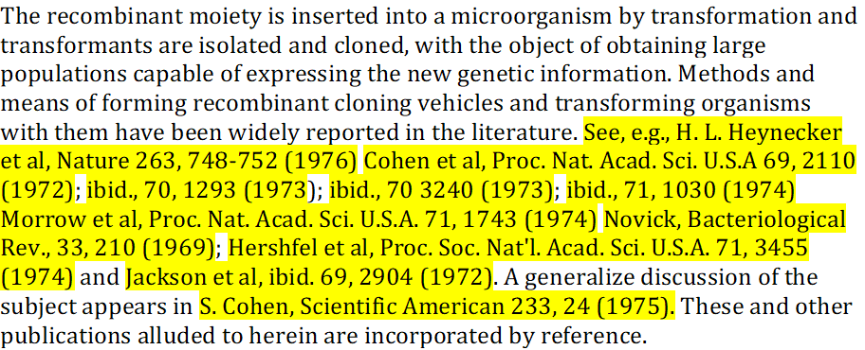
Open dataset @ relianceonscience.org
30+ million patent citations to scientific articles, 1836-present

Slide 3
Entrepreneurship as Dynamism

Slide 4


Slide 5
Which factors drive entrepreneurship?
Culture (Hofstede’01; Saxenian’94; Florida’05)
University spillovers (Rosenthal/Strange’03; Jaffe/et.al’93)
Anchor tenants (Duranton/Puga’01, Agrawal/Cockburn’03)
Financial capital (Samila/Sorenson’11; Grilli/Murtinu’14)
Glaeser/Kerr’09: skilled human capital explains 60-80% of variance
  “probably the crucial ingredient for most new entrepreneurs”
  Or does talent move to entrepreneurial opportunity?

Slide 6
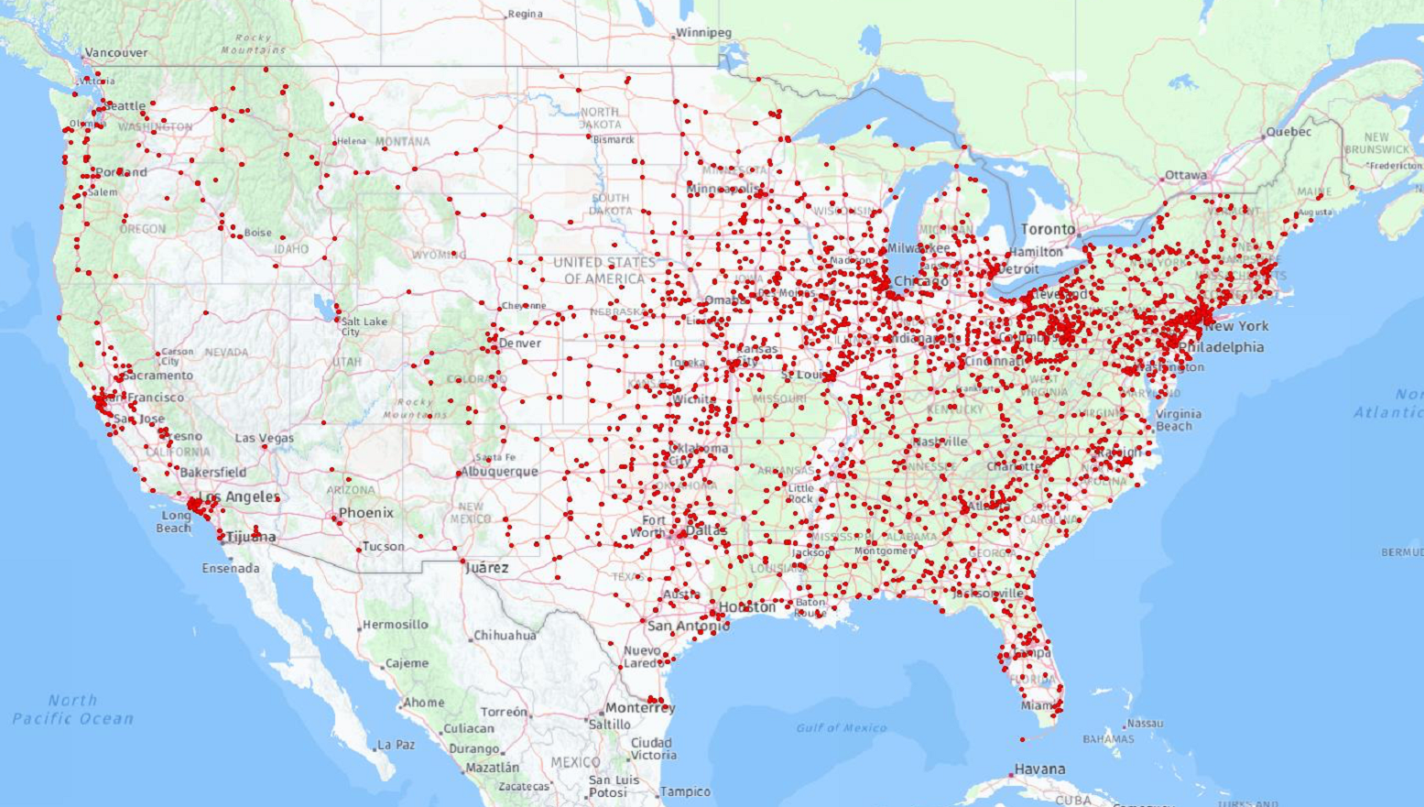
“Fleming” in 1940 Census

Slide 7
Shift-share/leave-out instrument
$$\tilde{{Inv}_{dt, leave−out}}=\sum_{n}{\frac{P_{dn}^{1940}}{P_{n}^{1940}}} ∙{Inv}_{\left.nt, leave−out(n,d\right)}$$
131MM respondents to 1940 Census
County-level “shares” of surnames (Bartik’91)
  3.1MM names in 3,100 counties → variation (Goldsmith-Pinkham/et.al’20)
Omit focal county’s inflows from “shift” (Hunt’17; Buchardi/et.al’20)
Arrival of 55 inventors leads to a high-growth startup
Similar results for scientists
Highly localized; neighboring counties negatively affected

Slide 8
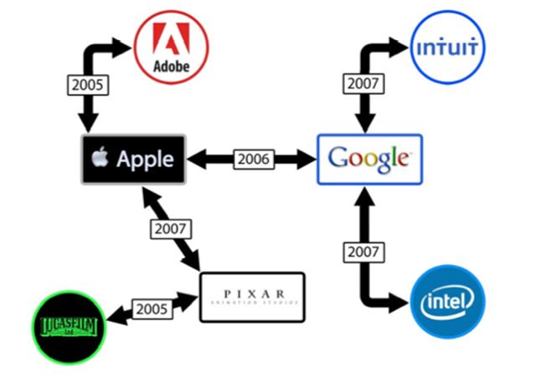

Slide 9
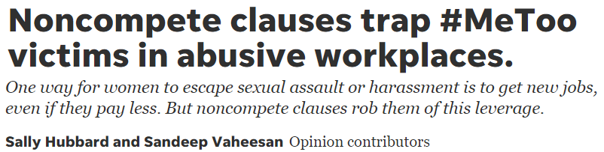
Non-competes and the startup gender gap
Most startups fail; founders with experience succeed (Klepper’05)
NCs: block starting a rival firm (Stuart/Sorenson’03; Starr/et.al’18)
Women more sharply penalized for failure
  Female financial advisors more likely fired for misconduct (Egan/et.al’17)
  Female cardiologists receive fewer referrals after patient deaths (Sarsons’20)

Slide 10
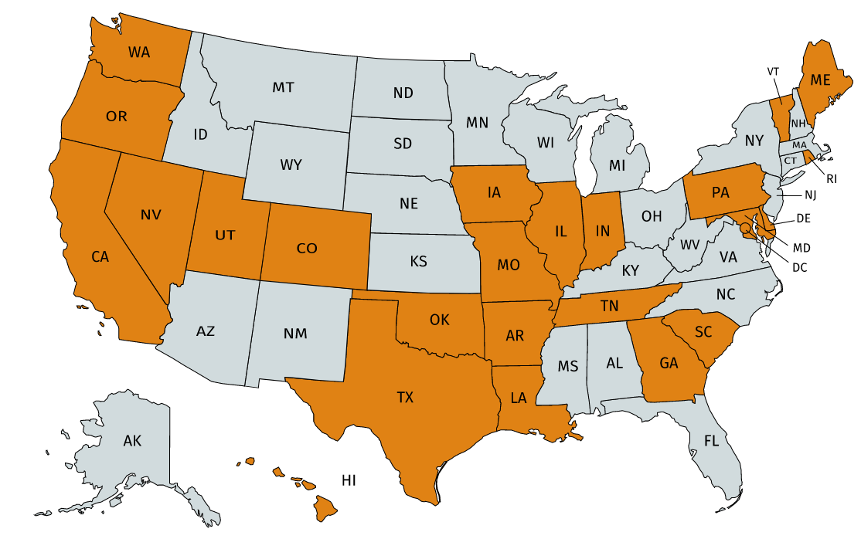
5.7 million workers in 25 states, 1990-2014

Slide 11
Empirical results
→ ~15% lower likelihood of women vs. men founding a rival
Only in same 6-digit NAICS, not 2-digit
Only in occupations with high levels of NC use (Starr’19)
Wage penalty for women who abandon their startups

Slide 12
What are we waiting for??
@marxmatt
http://relianceonscience.org

Slide 13
Wrap
Entrepreneurship is dynamism
High-growth entrepreneurship driven by skilled, technical labor
Non-competes discourage entepreneurship among women

Slide 15
Non-competes and the startup gender gap
  Women disproportionately penalized for failure (Egan/et.al’17; Sarsons’20)
    Earn less than men when returning to workforce after entrepreneurial failure
  Possibly more averse to risk of lawsuit (Bertrand’11)
→ Examine all workers in 25 states, 1990-2014
~15% lower likelihood of women vs. men founding a startup
Not in same 2-digit NAICS, only 6-digit

Slide 17
My first non-compete (July 1995)
Mr. Marx agrees not to work for any company in the speech recognition industry, anywhere in the world, for a period of two years after leaving Applied Language Technologies.

Slide 18
My first non-compete (July 1995)
Mr. Marx agrees not to work for any company in the speech recognition industry, anywhere in the world, for a period of two years after leaving Applied Language Technologies.

Slide 20
What drives Entrepreneurship?
Glaeser/Kerr’09: skilled human capital ←→ entrepreneurship
  Moving to opportunity?
  Outsourcing @ Slack, Skype, Whatsapp, Alibaba, BaseCamp
RQ: Does arrival of an inventor in a county spur entrepreneurship?
  Strong correlations in naïve regression
Instrument inventor arrival via surname similarity (Darlu et al., 2011)
  Shift-share Bartik (1991) w/leave-out (Buchardi et al. 2020)

Slide 21

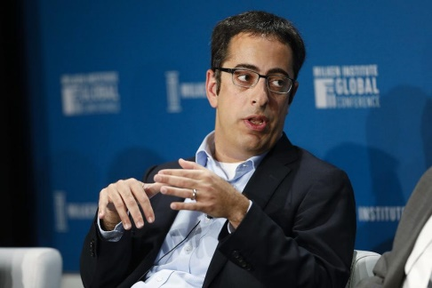

$243MM
NDA
$128MM
non-solicit
1 YEAR
non-compete

Slide 22
Human Capital & Entrepreneurship

Slide 23

1. Do ex-employers target women in lawsuits?
Women more likely to be sued?
  Lexis/Nexis incomplete; instead use
  Coded gender of ~12,000 defendants in NC lawsuits from 2003-2017
  26.7% female, but prior depends on occupational distribution of lawsuits
  Predict 44-50% female from lawsuit occupations * BLS gender/occupation
Conclusion: women not overrepresented in non-compete lawsuits
Might be more risk-averse (Bertrand’11) but hard to show

Slide 24
2. Higher relative costs of legal defense?
P1 | P1 | P1 | E2 | E2 | P3 | P3 | P4 | E5 | P6
Pre-entrepreneurship earnings
Women have lower pre-entrepreneurial earnings ($145k vs. $247k)
  Lower salaries
  Fewer years of work experience before founding a firm
  Holds within 6-digit NAICS sectors
Even if no more likely to be sued, defense is more costly

Slide 25
3. Wage penalty after abandoning startup?
P1 | P1 | P1 | E2 | E2 | P3 | P3 | P4 | E5 | P6
Pre-entrepreneurship earnings
Post-entrep
earnings
Population: abandoned startup to return to paid employment
  Shutdown
  Left in the hands of co-founders
  NOT acquired
DV = annual earnings, post-entrep / pre-entrep

Slide 26
Non-competes: a brake on entrepreneurship
NCs depress entrepreneurship (Samila/Sorenson’11; Starr/et.al’18)
Women are disproportionately penalized for failure
  Female financial advisors more likely to be fired for misconduct (Egan/et.al’17)
  Female cardiologists receive fewer referrals after deaths (Sarsons’20)
NCs may disproportionately discourage female entrepreneurship
Notes:
By the end of 5 minutes, be here!

Slide 27
Conclusions
Non-compete agreements discourage women from entrepreneurship
Not driven by lawsuits, but
  Fewer financial resources to mount a legal defense
  Lower wages after returning to paid employment
Restrictions on NCs could help close the gender gap…quickly

Slide 28
Mechanisms
Women not sued more often
  (possibly more risk averse)
Women have fewer financial resources to defend against lawsuit
Penalty for women who abandon startups, return to wage work

Slide 30
Entrepreneurship and industry experience
Most new ventures fail
Successful founders usually have industry experience (Klepper)

Slide 31


Use of prior experience governed by post-employment restraints:
Use of ex-employer’s resources
  Non-disclosure
  Non-solicitation
Type of work the ex-employee may engage in: non-compete (NC)
  List of competitors or “field of service”
  Time limit: 1-2 years, sometimes geographically bounded
  NC policy determined at the state level
$243MM
$128MM

Slide 32

$243MM
NDA
$128MM
non-solicit
1 YEAR
non-compete

Slide 35
Spillovers vs. displacement
Local entrepreneurship benefits entire region?
But VCs invest nearby (Stuart/Sorenson’03; Bernstein/et.al’16)
→ add “spatial lags” for inventors moving to surrounding counties, exclude those moving from surrounding counties (Moretti/Wilson’14)

Slide 36
55 inventors → 1 high-growth startup
Robust to: dropping common/wealthy names, DV = VC-backed/REPI, calculating IV as distance from surname centroid

Slide 37
Shift-share/leave-out instrument
$$\tilde{{Inv}_{dt, leave−out}}=\sum_{n}{\frac{P_{dn}^{1940}}{P_{n}^{1940}}} ∙{Inv}_{\left.nt, leave−out(n,d\right)}$$
131MM respondents to 1940 Census
County-level “shares” of surnames (Bartik’91)
  3.1MM names in 3,100 counties → variation (Goldsmith-Pinkham/et.al’20)
Omit focal county’s inflows from “shift” (Hunt’17; Buchardi/et.al’20)

