Slide 1
The Diffusion of New Institutions: Evidence from Renaissance Venice’s Patent System Stefano Comino (University of Udine) Alberto Galasso (University of Toronto and NBER) Clara Graziano (University of Udine and CESifo)
BOSTON UNIVERSITY
27 July 2018

Slide 2
Motivation
Social, economic, legal and political organizations of a country- its “institutions” are key for economic growth. New economic institutions (new forms of contracts or property rights) have an impact only if they are adopted and displace older institutions (Acemoglu and Johnson, 2005)
Understanding the (macro and micro level) factors that explain the diffusion of new institutions is a central question in the development economics literature (Acemoglu et al., 2001; Glaeser et al., 2004; Tabellini, 2010; Ashraf and Galor, 2011).
This paper studies the pattern of local diffusion of one of the main economic institutions which governments use to increase innovation incentives: patent rights

Slide 3
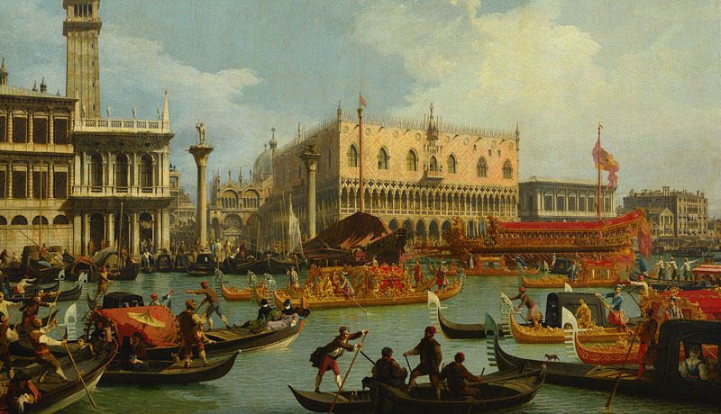
Our Setting: Renaissance Venice
“All modern patent regimes consist of a series of footnotes to the Venetian patent statute of 1474”
(Nard, 2014)

Slide 4
The 1474 Patent Act
Very first regularized patent system. Act regulated the granting of patents for novelty, ingenuity, and utility. An administrative-centered system, strikingly similar to the modern Anglo-American system (Merges and Duffy, 2013)
The patents awarded in the late fifteenth century in the Venetian Republic provide a unique opportunity to study the diffusion of a new economic institution. What innovators, industries, cities revealed immediate interest for this new form of property rights?

Slide 5
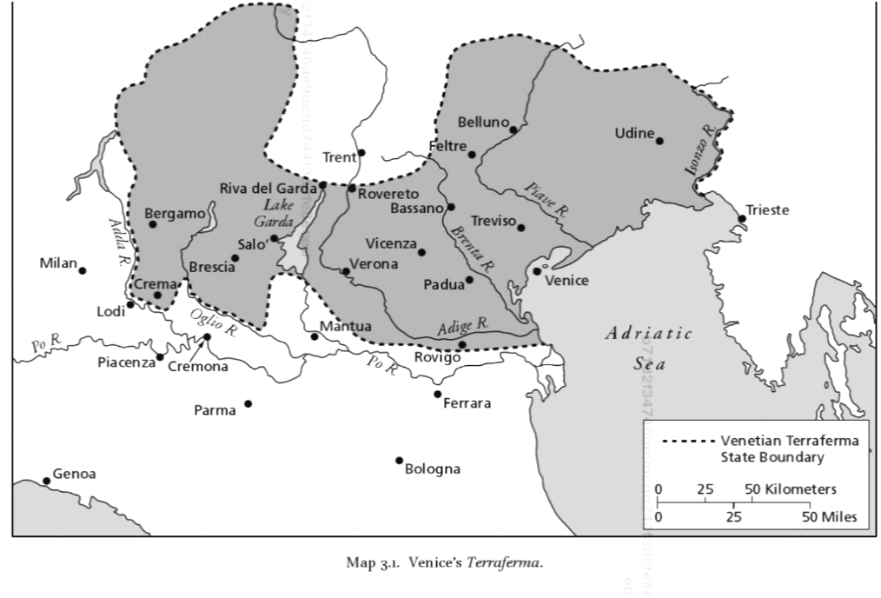
The ‘Serenissima’ Republic of Venice
Venice + Terraferma
One of the largest regional economies in Renaissance Europe, ~100,000 inhabitants in 1500
Economy of Venice driven by trade (spices, silk, cotton, slaves, glass and precious metals) and shipbuilding (arsenal). Agriculture, silk and wool production in Terraferma

Slide 6
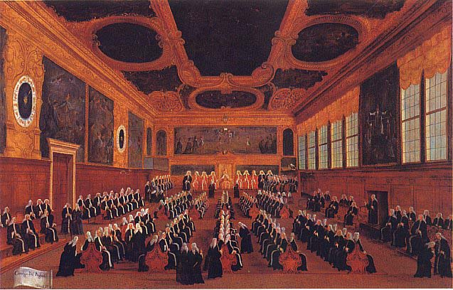
Political Structure
Following the ‘Serrata’ (closure) in 1297 political functions were restricted to a hereditary nobility sitting in the Great Council
Great Council elected the Doge and the Senate (legislative functions)
Senate had 300 members with various roles (parte/ballotta) among them three “Provveditori di Comun” special competences on infrastructure, trade and patents (Borelli, 1980; Zaggia, 2004; Di Stefano, 2011)

Slide 7
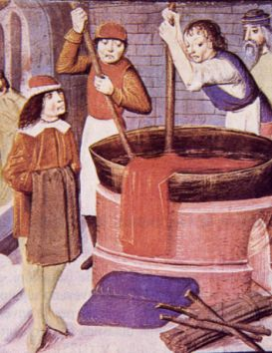
Economic Structure
Merchants and craftsmen organized in guilds, self-governed organizations which controlled various aspects of the economic activity
Guilds were industry-city specific (goldsmiths of Verona, silk guild of Venice, etc…)
Guild statutes regulated entry, apprenticeship and competition
The Venetian government fostered guild membership (tax revenue), and about 20 percent of the population of the city of Venice belong to a guild in 1500 (Constantini, 1987)

Slide 8
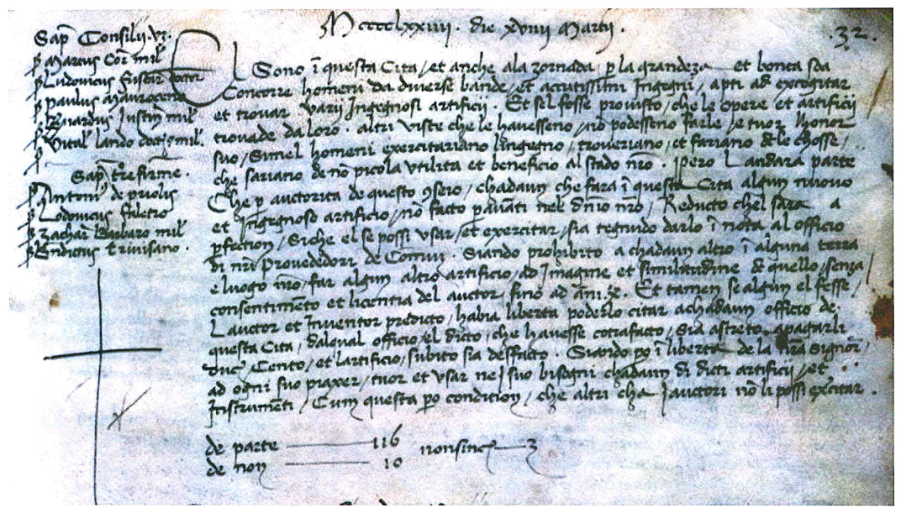
The 1474 Patent Act
19 March 1474 Act of the Senate:
Patent applications or `suppliche' were granted after Senatorial approval
The subject matter to be patented was required to be a "new and ingenious device" and the effect of a patent was to “stop every other person in any of our territories and towns to make any further device conforming with and similar to said one without the consent and license of the author"

Slide 9
Key features of Venetian patent system
Patents granted to all inventors regardless of their citizenship status or guild membership `negative' rights to exclude but also `positive' rights to practice the invention and enter guilds (Mandich, 1948; Sichelman and O’Connor, 2012)
- Florentine inventor Cosmo Scatini patent for high quality black silk dying
Guilds often involved in the patent granting process, through the evaluation of the novelty content. Many examples of opposition (Mola’, 2000)
- Iseppo Giovan Perin Mattiazzo hydraulic mill, spinning machine patent application of Urbano Bonturelli
Patent holders expected to share the technology with guild members with the payment of an appropriate licensing fee (Berveglieri, 1995)
- "discrete sum”, "adequate reward"

Slide 10
Model
Three firms: two are members of a guild, third firm is an outsider
Guild regulates entry and competition with a statute of strength $θ$. Higher $θ$ implies greater (collusive) rents by guild members and more difficult entry for outsider without patent
Each firm can get an idea which increases surplus$.$ Innovator can apply for a patent which costs c
Guild members can oppose a patent with cost $κ.$If patent is opposed, technology is appropriated and shared by guild members
Outsider’s entry is guaranteed with a patent not opposed. Technology has to be licensed to guild members

Slide 11
Effects of statute strength
Reduces likelihood of patenting by insiders (high profits without patents and low rent from licensing)
Increases likelihood of opposition (high rent with appropriation, and costly to let someone else in)
Ambiguous effect on outsider’s patent applications (harder to enter without patent, high long term rent from entry, but low short term rent from licensing)
Effects 1 and 2 dominate 3 in our model

Slide 12
Discussion
Main testable prediction: negative correlation between patenting and strength of guild statutes
We show that prediction holds for fairly general assumptions on the effect of statutes and licensing negotiations
Pre-grant patent opposition (Hall and Haroff, 2004): our model shows that it permits to screen-out innovation with low surplus but also encourages rent-preservation. Well designed system needs to balance these two effects

Slide 13
Guild Data
From “Istituzioni Corporative, Gruppi Professionali e Forme Associative del Lavoro nell’Italia Moderna e Contemporanea,” MIUR project involving leading Italian Medieval History scholars
Digitized data with numerous information on Italian craft guilds (name, location, lifespan, number of members)
Data include detailed description of the manufacturing activity and the origin of the guild
Historians coded statutory clauses such as restriction to market competition, entry, apprenticeship requirement
We focus on 340 guilds active in the Venetian Republic in the XVI century

Slide 14
Strong Internal Regulation
Strong internal regulation: dummy equal to 1 if statute includes restrictions to competition among members and barriers to entry of local and foreigners.
=1 for about 20% of our sample
Interpretation: team of historians identifies provisions in the statute as more severe than other guilds
Many restrictions to competition: price fixing, minimum distance between workshops (`botteghe') or ban to serve customers of other guild members. Typical entry barriers are privileges to sons and sons-in-law of members, but also include fees and exams. Barrier for foreigners usually higher than locals.

Slide 15
Patents by technology sector 1474-1550
Mills
 | cereals |  | 42
 | metals |  | 6
 | textiles |  | 9
 | wood saws |  | 6
 | multiple usage |  | 22
Fabrics |  |  | 8
Paint |  |  | 4
Bread and food |  |  | 1
Pottery and Porcelain Vases |  |  | 1
Agricultural machines |  |  | 4
Drainage, mud removal |  |  | 20
Hydraulic pumps |  |  | 11
Armour and weapons |  |  | 7
Arsenal |  |  | 3
Mining |  |  | 3
Perpetual Motion |  |  | 3
Miscellaneous |  |  | 19
Patent Data
Patent data from Berveglieri (1995, 1999) classified and translated into modern Italian patents retrieved in the State Archive of Venice
We focus on patents granted from 1474 to 1550 (to avoid plague of 1575-76) but show robustness to 1600
No patents in glass, soap only very few for Arsenal (very innovative areas!). Our preferred interpretation: diffusion of patents not innovation

Slide 16
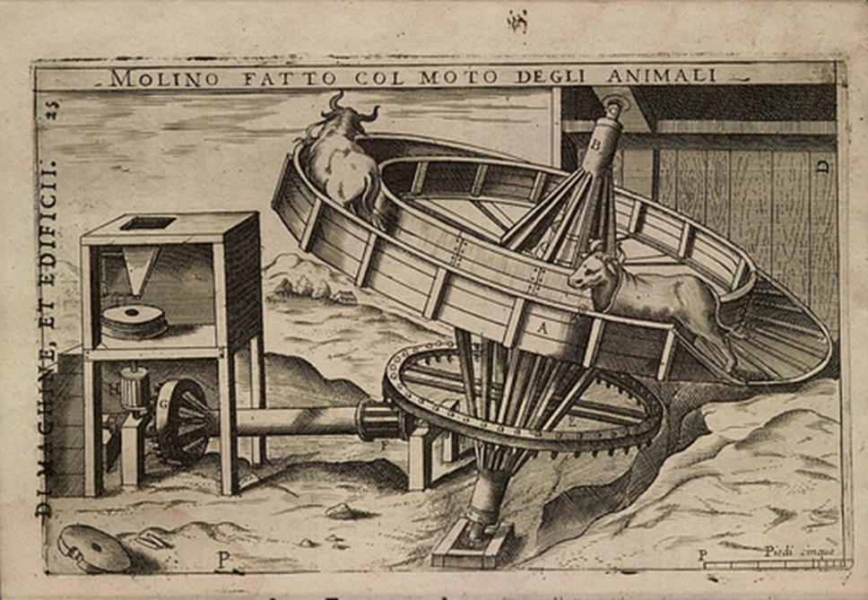

Slide 17
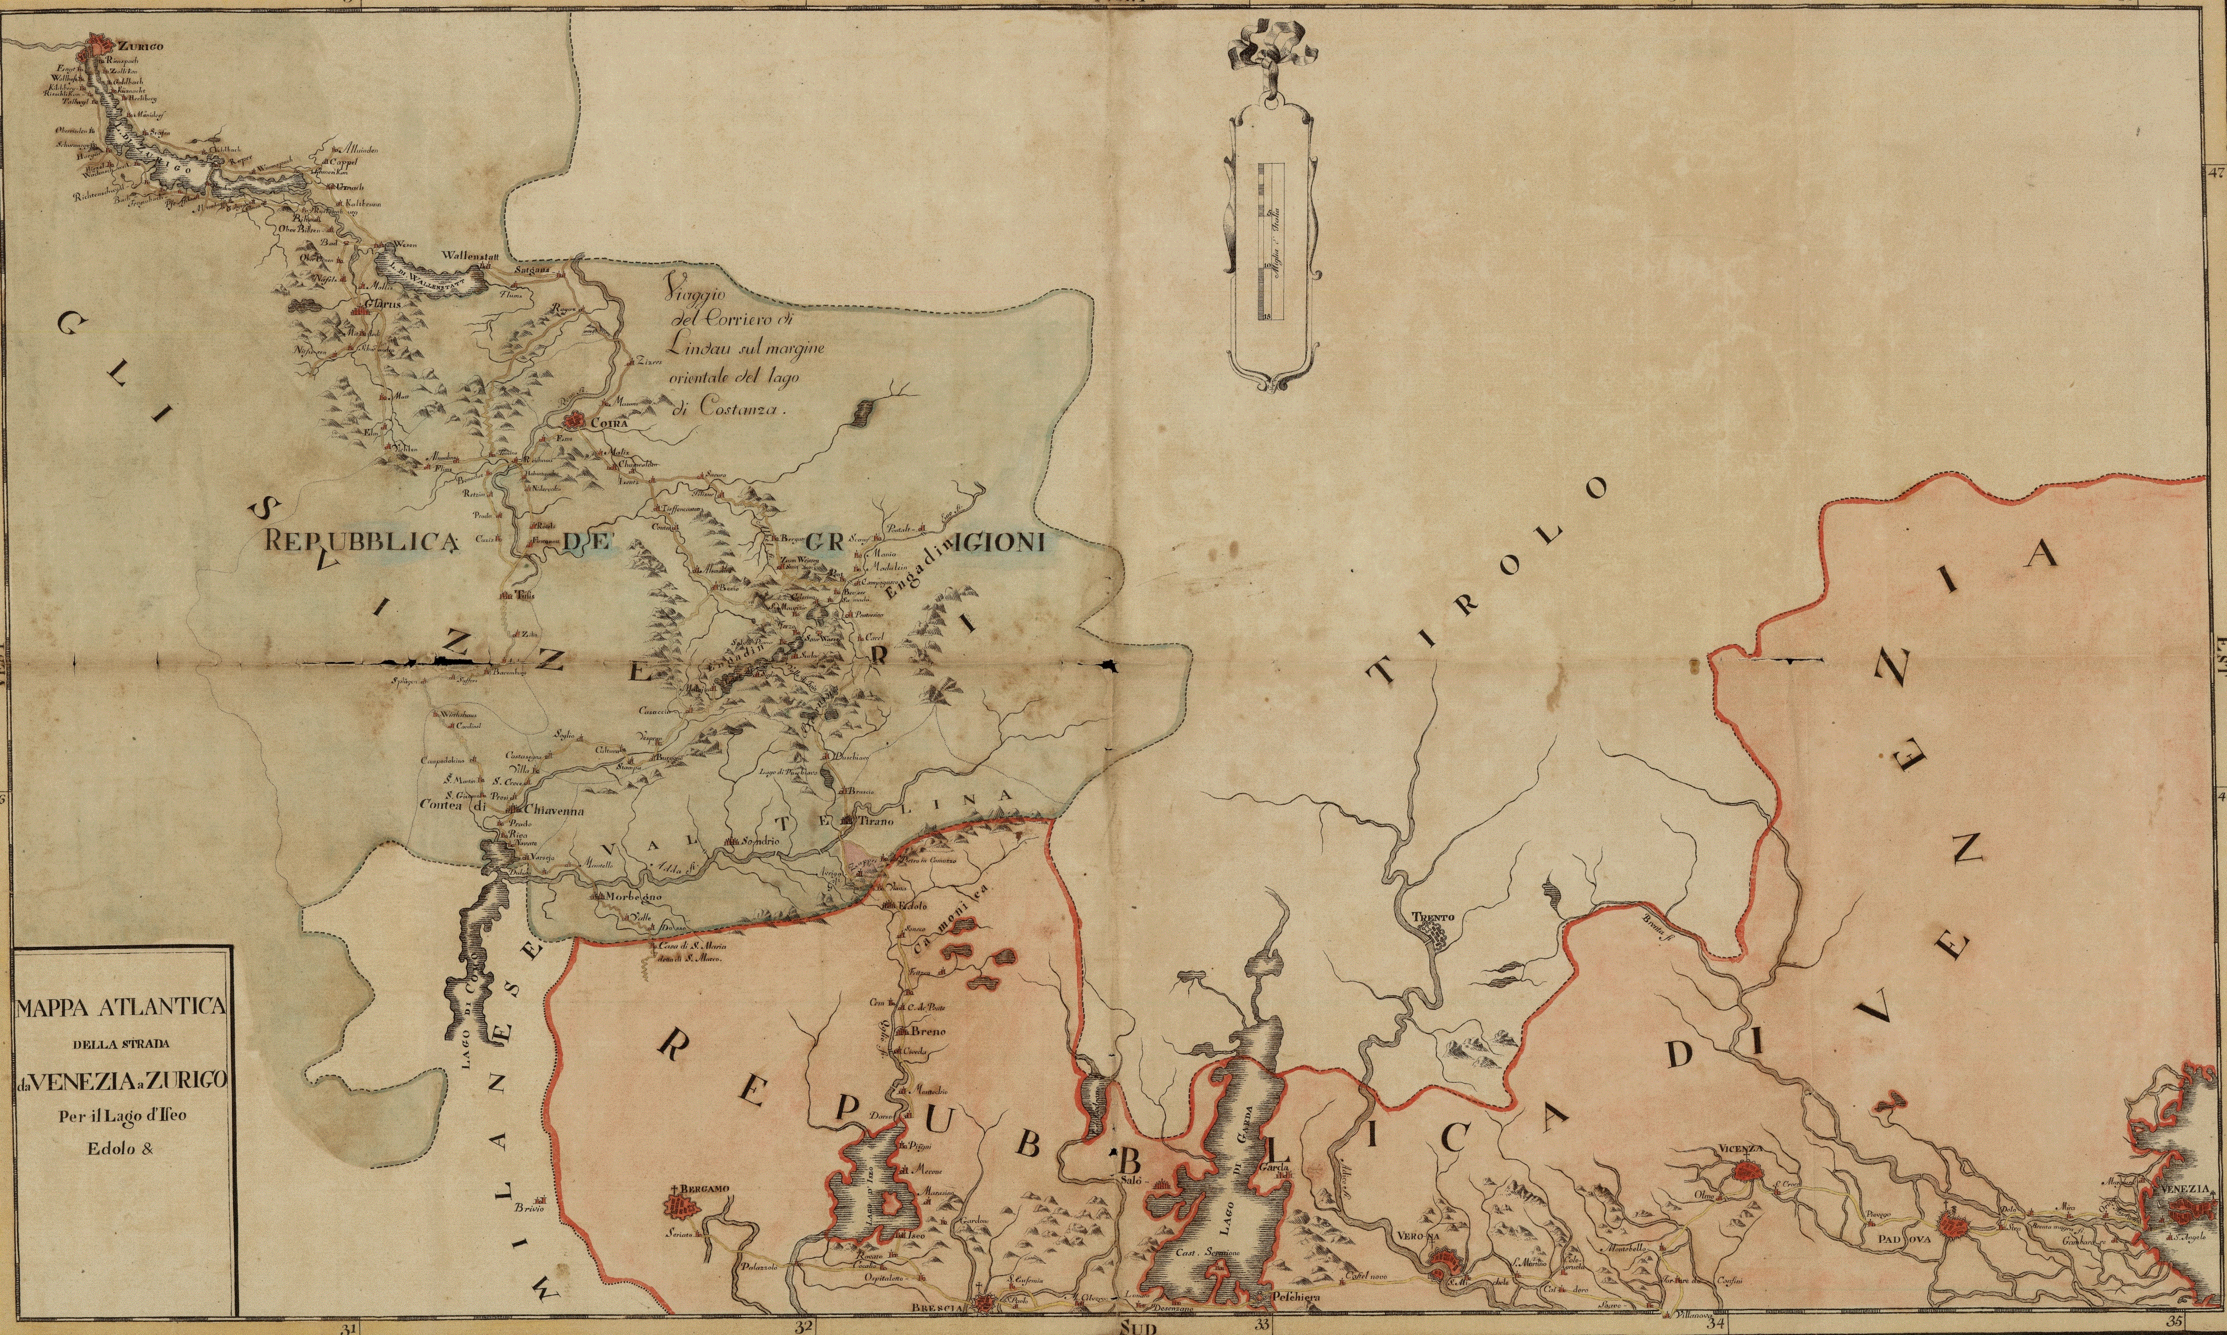
Distance from Venice
Distance in Kms between city of the guild and Venice
Constructed using a variety of maps of the period from State Archive of Venice and other sources
Also confirm results with:
- Ancient Roman road network (McCormick)
- Google maps modern road network (excluding highways)

Slide 18
Guild Internal Regulation and Patenting
Guild internal regulation and patenting – Poisson regressions
 | (1) | (2)
Dependent Variable | Patents | Patents
Strong internal regulation | -0.981*** | -1.133***
 | (0.101) | (0.439)
log(Distance) | 0.225***
 | (0.026)
Trade guild | -4.357*** | -4.355***
 | (0.708) | (0.848)
City Effects | No | Yes
Observations | 340 | 340
Two key findings:
- Strong negative association between patents and statutory strength (~65% reduction)
- Patenting more frequent in technology areas of guilds geographically distant from Venice

Slide 19
Extension/Robustness
A variety of additional robustness tests in the paper (statutory changes, patents up to 1600, alternative patent data, control for mills, population growth, drop Venice, industry controls…)
Placebo: no correlation if we pick 3 random statutory clauses not related to competition
Effect for locals stronger than for foreigners (consistent with model but less than 7% are foreign patents)

Slide 20
Endogeneity concerns and IV strategy
We document strong negative association between strength of guild statute and patenting
Robust correlation but there are concerns of endogeneity. For example, technology shocks may induce guilds to change their statutes (permit entry) and to patent more
Good instrument is correlated with statutory norms restricting entry and competition, and uncorrelated with patenting in the technology area. To do so we exploit the history of guilds in Northeast Italy

Slide 21
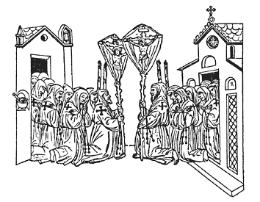
Religious confraternities in XIII century
Spread of flagellant movement in Europe in the 13th century lead to confraternities (‘scola’ or ‘fratalea’)
Associations of lay people, driven by Christian devotion follow rules and bylaws in exchange for help in time of hardship and security of good funeral (Monticolo, 1905). Mostly artisans and often from the same profession
In the 14th and 15th century craft guilds formed in Venetian Republic, fostered by government to collect tax revenue. When craftsmen belong to a confraternity, often guild was a ‘spin-off’ of the confraternity
30% of craft guilds in our sample are linked to religious confraternity (e.g. in Venice ironmongers linked to San Lorenzo, fishermen with San Nicolo’, etc..) (Gasparini, 1987)

Slide 22
Religious origin as IV
Key assumptions:
First Stage: Guilds with religious origin more likely to regulate competition and entry. Confraternities follow very detailed rules (Mariegola) and guild statutes inspired by rules of related confraternities (Mackenney, 1994)
Exclusionary Restriction: Religious origin driven by idiosyncratic reasons related to the local success of religious movements in the 13th century, not correlated with shocks driving patenting three centuries in the future
Many guilds with religious origin in Venice but not clear pattern in geographical variation and industry (barbers in Verona but not in other cities, blacksmiths in Udine but not in other cities, etc…)

Slide 23
Exogeneity of religious origin
 | (1) | (2) | (3) | (4)
Dependent Variable | Religious confraternity | Religious confraternity | Religious confraternity | Religious confraternity
Age | 0.001 |  |  | 0.001
 | (0.001) |  |  | (0.001)
Age² | -0.001 |  |  | -0.001
 | (0.001) |  |  | (0.001)
Apprentship |  | 0.046 |  | 0.055
 |  | (0.042) |  | (0.042)
Number of statutory changes 1474-1550 |  |  | 0.022 | 0.041
 |  |  | (0.044) | (0.045)
Textiles |  |  |  | -0.062
 |  |  |  | (0.045)
Construction |  |  |  | -0.096
 |  |  |  | (0.120)
Agriculture |  |  |  | 0.032
 |  |  |  | (0.055)
Correlation between religious linkages and guild characteristics small and insignificant suggesting that exclusion restriction holds
Statutory changes (proxy for propensity to change) not correlated

Slide 24
Ruling out Benabou’s theory
Benabou, Ticchi and Vindigni (2015) with modern data find negative association between religion and innovation
Not very plausible in our setting.
1. If anything, religious confraternities in Northern Italy are more modern and open minded than Church. They improved literacy rates liberating many from superstition and profound ignorance, and generated debate about religious beliefs which led to Catholic Reform (Black, 1989)
2. Risk taking and individual entrepreneurship not discouraged by confraternities. Cheap loans to their members and celebrated individual success of their members (donations) (Black, 1989)
3. Mariegolas do not report any restrictions to the adoption of new technologies, production processes or property rights. Instead, they stress the ability of confraternities to accommodate changes and adapt to innovation (Monticolo, 1892: Gasparini, 1987, Mackenney, 1994)

Slide 25
Religious confraternities and guild internal strength
 | (1) | (2)
Dependent Variable | Strong guild | Patents
Estimation | OLS | 2SLS
Religious confraternity | 0.150***
 | (0.045)
Strong internal regulation (instrumented) |  | -4.300**
 |  | (2.230)
City Effects | Yes | Yes
Observations | 340 | 340
First stage F-test |  | 12.58
First stage confirms that religious origin more likely to lead to strong internal rules
Main finding robust to instrumenting strength with religious origin (downward bias consistent with measurement error)

Slide 26
Distance from Venice and Patenting
Link between distance and benefit from formal institution is theoretically ambiguous (lower distance implies easier to enforce patents but also availability of informal or substitute protection mechanisms)
Data show a strong positive correlation between patenting and distance from Venice suggesting that being close to central government reduces benefits from patenting
We explore this issue combining geographical distance with measure of city power and political connections:
we digitize census of patrician families residing in Veneto from Schroeder (1830) includes data on high nobility and low nobility (conti, nobili palatini, etc…)
we combine this information with list of families members of the Great Council (Raines, 2004) and ‘Avogaria’ (marriages involving a noble husband)

Slide 27
Geographical and Political Distance
 | (1)
Dependent Variable | Patents
Strong internal regulation | -1.203***
 | (0.125)
log(Distance) | 0.340***
 | (0.022)
log(Noble Families) | 0.419***
 | (0.093)
log(Population₁₅₀₀) | 0.027
 | (0.072)
Politically Connected Families | -1.333***
 | (0.351)
City Effects | No
Drop Venice | No
Observations | 334
Robust to:
Dropping Venice
Controlling for books in the city as in Dittmar (2011) (data from British library)

Slide 28
Possible Mechanisms
Geographical and political distance render more costly:
Access to direct legislation: Historians (e.g. Caniato, 1996) provide evidence of legislation directly protecting some Venetian Guilds (Murano glass and arsenal) against copy and rewarding local and foreign innovators
Access to justice system: Giustizia Vecchia (main magistracy regulating guilds) was in Venice, face to face interaction may allow resolution of disputes without the need of patents
Our findings are consistent with Khan’s view of US patent system. Democratize innovation not to increase market power of elites as in British and French systems

Slide 29
Conclusions
Examine diffusion of very first patents from Venetian patent act of 1474. Patented technologies appear related to guilds: (i) with weaker statutes, (ii) located in cities geographically distant from Venice and with lower political connection
Implications:
Diffusion of new economic institutions may be strongly affected by features of the local economic and political environment
Two key insights from innovation economics:
- patenting strategies vary across fields and effectiveness of patent protection interact with other government policies (Schankerman, 1998)
- patenting less common when market power is very high (Aghion et al, 2005)
Do not appear to be specific to modern economy

Slide 30
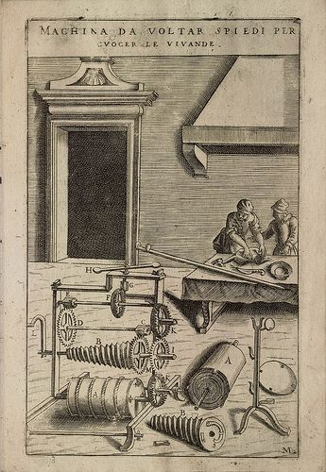
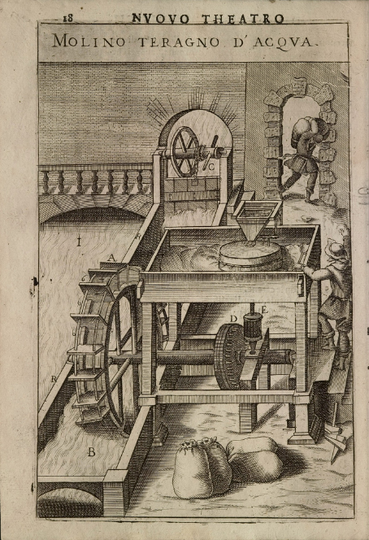
Thank you!

