Slide 1
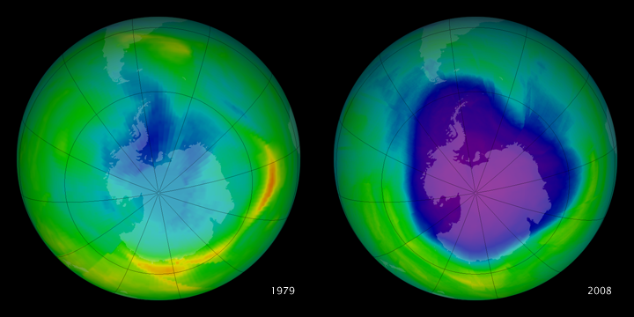
Annular Modes

Slide 2
Annular Modes
Hemispheric scale patterns of climate variability
Driven by internal atmospheric dynamics in mid-latitudes
NAM/SAM: Dominant modes of climate variability in Northern and Southern Hemisphere mid-latitudes
Explain ~20-30% of the total variance in geopotential height and wind
North-south oscillations in atmospheric mass and wind fields between poles and mid-latitudes
Positive index: lower than normal pressure over the polar region and anomalously strong westerly winds at ~55-60 degrees latitude

Slide 3
Southern Hemisphere
Southern Annular Mode
High-latitude mode
Antarctic Oscillation
All used to describe the leading mode of variability in the Southern Hemisphere!
leading empirical orthogonal function (EOF) in many atmospheric fields, including:
surface pressure
Geopotential height
surface temperature
zonal wind
Thompson and Wallace 2000

Slide 4
SAM index
Geopotential height
Annular or zonally symmetric structure with synchoronous anomalies of opposite sign btwn poles and midlatitudes
Variations btwn strong + polward shifted or weak and equatorward-shifted westerlies
High frequency to very low frequency timescales
SAT
IPCC AR4 report
Notes:
The dominant mode of variability associated
with the midlatitude westerlies is characterized
by swings between a stronger and poleward-shifted or
weaker and equatorward-shifted flow. In terms of
anomalies, this translates to vacillations in a zonally
symmetric, meridionally varying dipole pattern centered
about the climatological mean flow.
This mode of variability
exists in the high latitudes of both hemispheres. However
the zonal symmetry is particularly evident in the
Southern Hemisphere where the Southern Ocean provides
a longitudinally uninterrupted area with few land
masses breaking the symmetry.
The variability shows
significant strength spanning monthly to interannual
time scales
The SAT response
to the SAM (Fig. 5) shows a cooling over much
of Antarctica where rising air is associated with adiabatic
cooling. An anomalous warming, however, forms
over the Antarctic Peninsula region, forced by a conspiring
of both zonal advection (of a higher-thannormal
climatological zonal temperature gradient) and
poleward advection (of the strong meridional temperature
gradient in a region of unusually strong poleward
air flows).

Slide 5
Indices of SAM
First PC of a Southern Hemisphere extratropical climate variable (e.g. geopotential height (GpH), mean sea level pressure, wind, temperature) (e.g. Thompson and Wallace, 2000; Nan and Li, 2003);
Gong and Wang (1999) method: the difference between normalised zonal mean pressure between 40S and 65S:
Gong & Wang = P_{40S} − P_{65S}
where: P is the normalized zonal MSLP (at 40 S and 65 S) for every month.

Slide 6
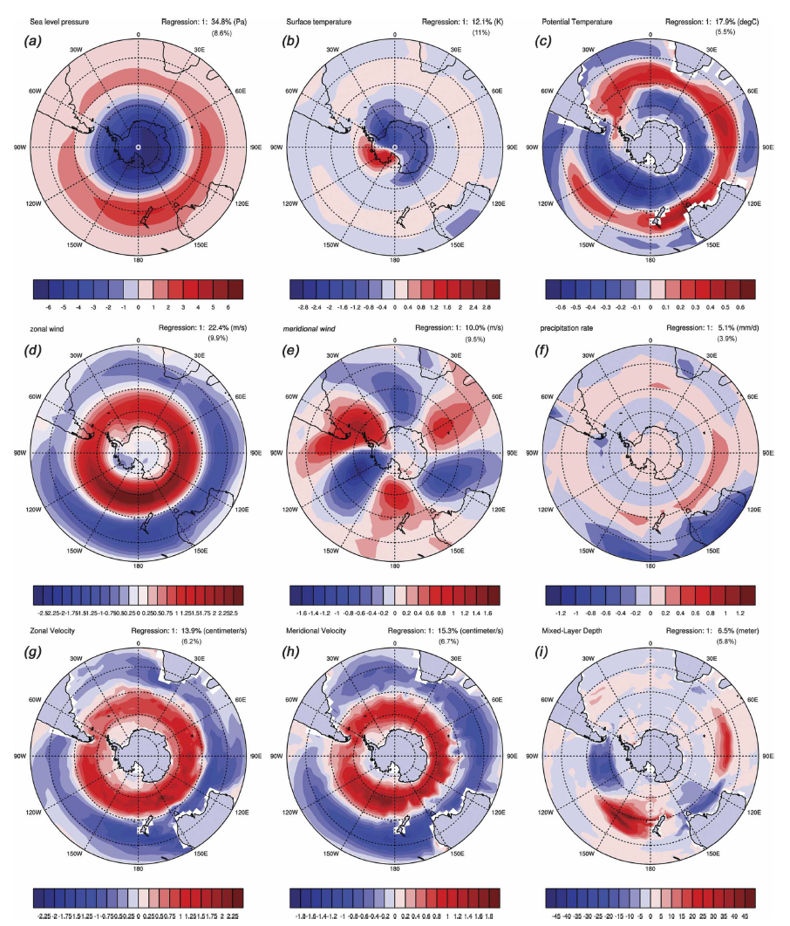
EOF1
Gupta and England 2006
Notes:
Clearly apparent are dominant annular
modes of variability in SLP, SST, zonal winds,
and zonal and meridional ocean currents. These modes
are well separated from subsequent modes in the EOF
analysis (Fig. 1). The annular mode accounts for between
15% and 35% of total variability with SLP the
most dominant annular property (34.8%). In contrast, a
distinct wavenumber-3 pattern is apparent in the meridional
wind. This mode is poorly separated from the
subsequent mode and is indicative of a propagating signal.
Similarly, the mixed layer depth mode does not
show an annular pattern and is poorly separated from
the subsequent EOF mode.

Slide 7
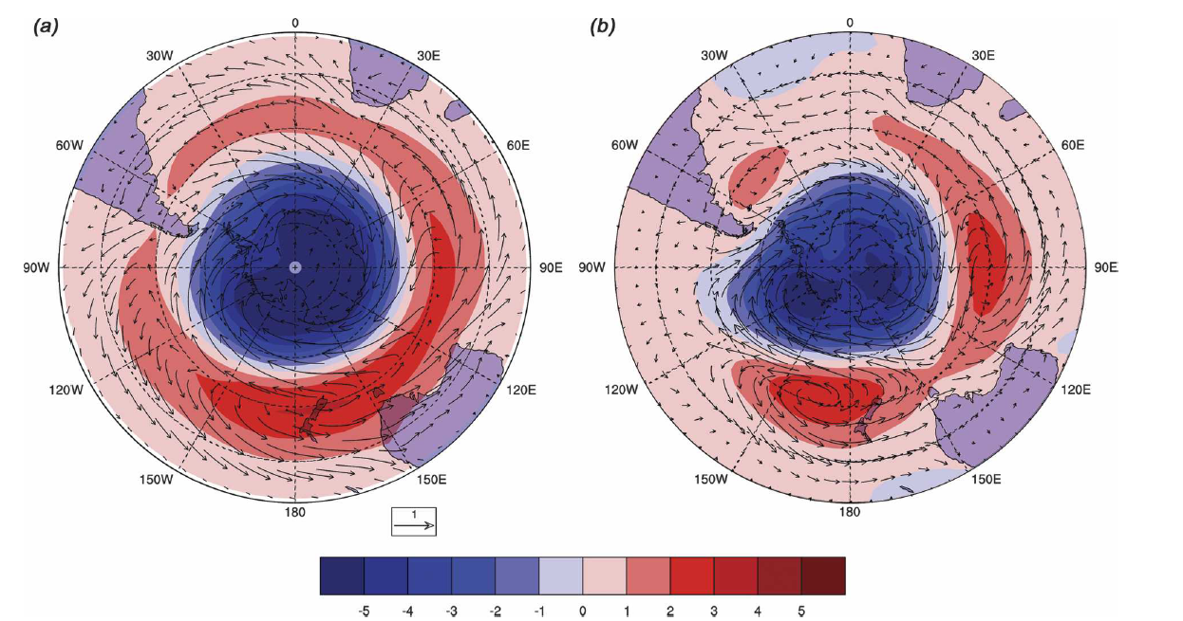
SAM SLP EOF index
This mode explains 24.5% (observed) and 34.5% (modeled) of the total variability and is well separated from subsequent modes
ECMWF
CCSM
Regression of SAM EOF index on:
Vectors: winds
Colors: SLP anom (hPa)
Gupta and England 2006
Can be reproduced by Atm only model simulations: internal atm physics maintains this mode
Some question whether they are truly dynamical structures and suggest that it may be an artifact of EOF itself

Slide 8
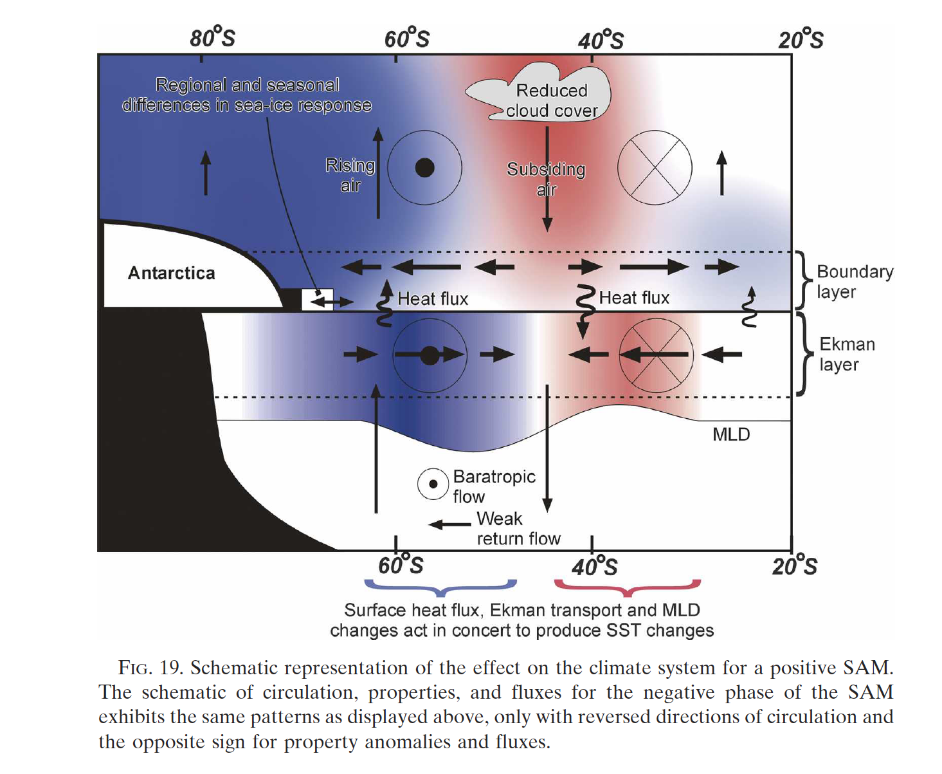
SAM schematic
Easterly
Westerly
Gupta and England 2006

Slide 9
Impacts of SAM
Antarctic temperatures
Southern Ocean sea surface temperatures
- Surface fluxes of latent and sensible heat
- Anomalous Ekman divergence & upwelling
Antarctic sea ice
Precipitation: decreased (increased) at middle (high) latitudes during positive SAM
…
Notes:
decreased (increased)
precipitation at middle (high) latitudes during
positive SAM phases

Slide 10
Cloud cover and precipitation
Gupta and England 2006
Notes:
Significant changes in atmospheric moisture, total
cloud cover, and total precipitation (Fig. 6) are also
associated with the SAM. The precipitation response,
in particular, shows good correspondence between observation
and simulation (Figs. 6c,d), with potentially
important consequences for regions with altered rainfall
over land. For example, a positive phase of SAM is
linked to decreased rainfall over southern Chile, southern
New Zealand, and Tasmania and increased rainfall
over eastern Australia and southern South Africa.

Slide 11
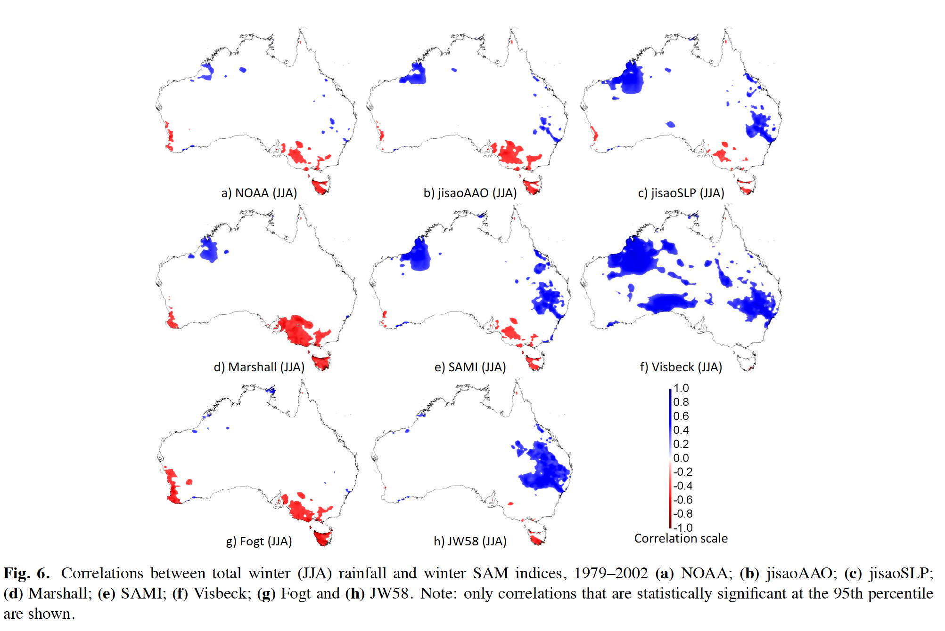
SAM indices & teleconnections
Ho et al. 2012

Slide 12
Ocean Impacts
The SAM wind anomalies inpact ocean thru
dynamic (e.g., via surface stress & Ekman transport)
thermodynamic (via air-sea heat and freshwater fluxes)
Ciasto and Thompson 2008
Notes:
The SAM wind anomalies have both a dynamic (e.g.,
via Ekman transport) and thermodynamic effect on the
ocean through surface stresses and by affecting heat
and freshwater fluxes, respectively.
A strong annular SST pattern also builds up in response
to the SAM. The large thermal capacity of the
mixed layer means that the greatest response lags the
atmospheric response by 1 month. The SST response
is primarily driven by two forcings. First, the meridional
currents advect cold water northward south of 45°S and warm water southward at midlatitudes north of
45°S (Fig. 13d). The zonal and vertical heat advection
components are significantly smaller than the meridional
term. More important, however, is the response of
the air–sea heat fluxes, which act to heat and cool the
mixed layer. All of the sensible, latent, and net radiative
fluxes work in unison to warm the DP region and,
in addition, a band centered near 45°S extending from
there eastward to Australia

Slide 13
SAM schematic
Easterly
Westerly
Gupta and England 2006

Slide 14
Sea ice
Equatorward advection (via north-eastward ocean and sea ice Ekman transport) tends to increase ice extent
orientation of the ice edge to the direction of zonal advection drives either increased (e.g., Greenwich meridian during summer) or decreased ice extent (e.g. DP region).
The ice concentration is also significantly affected in the DP region by the anomalous heating from the increased SAT.
Sea ice anomalies are maintained for considerable lengths of time as a result of a positive ice–albedo feedback.
CESM
HadISST
Gupta and England 2006
Notes:
Drag forces associated with the SAM anomalous surface
wind and ocean circulation, as well as the various
thermodynamic forcings, also affect the advection and
formation/melting of sea ice.
Equatorward advection (through the influence
of the predominantly north-eastward ocean and sea ice
Ekman transport response) tends to increase the ice
extent. Zonal advection due to the strengthened westerlies
causes both increased ice extent (for example at
the Greenwich meridian during summer) and decreased
ice extent (for example across the DP region)
depending on the orientation of the ice edge to the
direction of advection. The ice concentration is also
significantly affected in the DP region by the anomalous
heating from the increased SAT. Sea ice anomalies
are maintained for considerable lengths of time as a
result of a positive ice–albedo feedback.

Slide 15
SAM & ENSO
the structure of ENSO in 500-hPa height anomalies has a stronger wavelike component than the SAM (contours, middle panels):
Austral winter: La Nina (cold phase ENSO) → positive height anomalies to the east of New Zealand, negative height anomalies to the west of the Antarctic Peninsula, and positive height anomalies in the Atlantic sector of the Southern Ocean
Austral summer: negative geopotential height anomalies that extend across the pole, and thus the signature of ENSO in Z500 field bears resemblance to the structure of the SAM
Ciasto and Thompson 2008

Slide 16
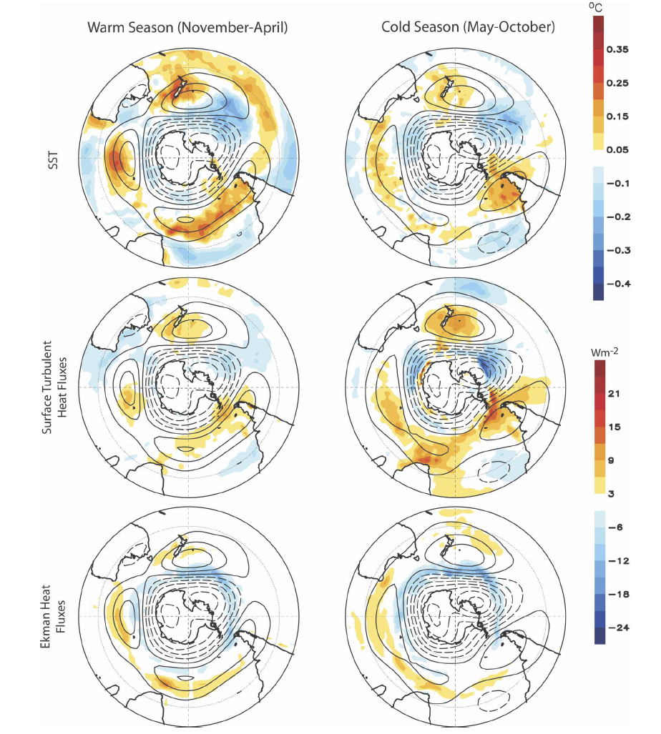
SAM ENSO
Correlation between monthly-mean indices of the SAM and ENSO is r 0.5 during the months November–April
Ciasto and Thompson 2008

Slide 17
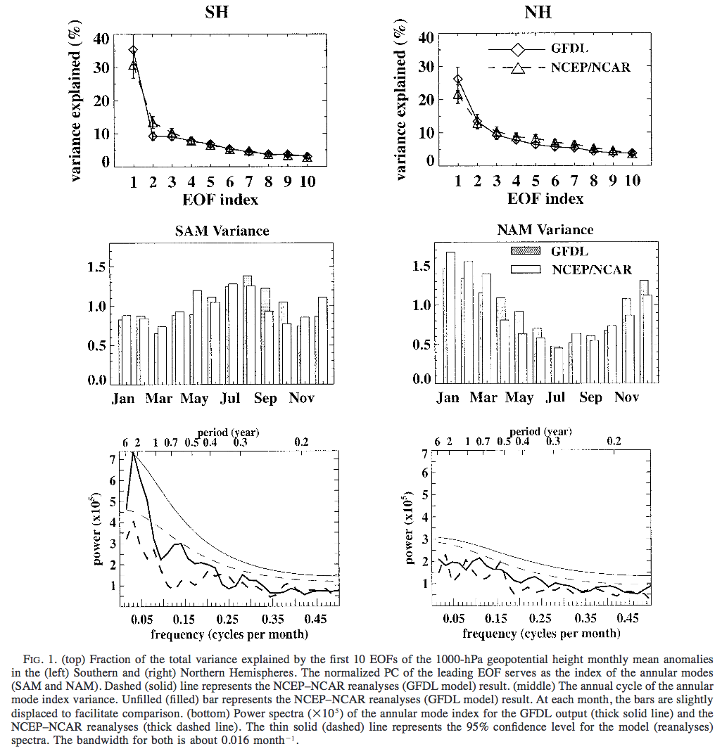
SAM spectra
generally red spectra with little evidence of dominant time scales
2-yr intensification, matching the model’s dominant ENSO time scale
SST shows the greatest “reddening” with little power at subseasonal time scales.

Slide 18
Obs vs modeled SAM
Top: NCEP reanalysis
Right: CMIP 5 models
Zhang et al. 2013

Slide 19
Forcing
there is evidence that the SAM, in particular its temporal evolution, is sensitive to external forcing.
Arblaster and Meehl 2006

Slide 20
Trends in SAM
Trend to high index polarity over past few decades
Largest in SH summer
Explains pattern of recent temperature trends over Antarctica
Climate models forced with increasing GHG simulate a trend towards high index polarity of SAM
Drivers of this trend:
Internal variability?
Observations and model results suggest the trend in the SAM is at least partially driven by Antarctic ozone depletion
But to what extent changes in other external forcings (e.g., mid-latitude SST anomalies, solar variability, etc.) impact the annular modes is less clear

Slide 21
Future SAM in CMIP5
SAM changes between 1861-1910 & 2050-2099 (or 1980-2029 and 2050-2099 in gray)
Gillett and Fyfe 2013

Slide 22
Future projections
Arblaster and Meehl 2006
Notes:
he radiative forcing
from those increasing GHGs produces large warming
over most of the Southern Hemisphere by the end of
the twenty-first century. Although the low-range (B1)
scenario still exhibits some weak, presumably SAM-
induced, cooling at higher latitudes, the surface warm-
ing amplifies as the radiative forcing increases, implying
that the recent local cooling over the Antarctic will
reverse at some point in the future

Slide 23
\What is driving the trend towards positive SAM?
Annular modes are coupled with annular variability in stratospheric flow during the winter (NH) and spring (SH) seasons

Slide 24
GHG impact on this? Ozone?
45S
SP

Slide 25
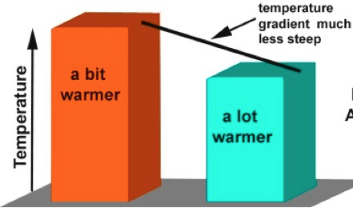
Troposphere temperature gradient

Slide 26
GHG impact on this? Ozone?
45S
SP

Slide 27
Stratospheric temperature trends

Slide 28
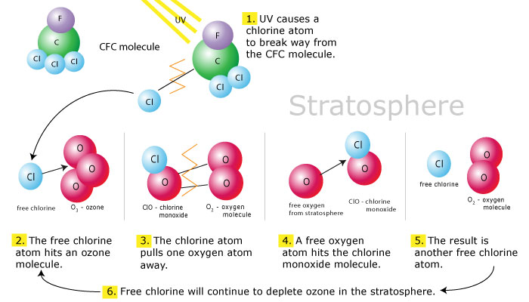
Ozone photochemistry review

Slide 29
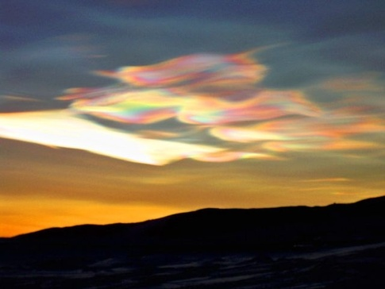
Why does ozone depletion occur in the spring?

Slide 30
Stratosphere temp & tropopause height
Son et al. 2009

Slide 31
GHG impact on this? Ozone?
45S
SP

Slide 32
Northern Annular Mode
The North Atlantic Oscillation
…And the Arctic Oscillation

Slide 33
Now to the Northern Hemisphere!
North Atlantic Oscillation
Arctic Oscillation/ Northern Annular Mode
Whether these are separate modes is debated!

Slide 34
History
Late 1990’s
North Atlantic Oscillation
Arctic Oscillation
Northern Annular Mode
Most of the 20th century, the NAM was referred to exclusively as the North Atlantic Oscillation. That's because both the data coverage and the amplitude of the NAM are largest over the Atlantic sector of the hemisphere.
late 1990s: Arctic Oscillation was introduced to highlight the fact that the pressure anomalies associated with the NAO span most of the Arctic.
Recent years: NAM increasingly used as 'oscillation' is something of a misnomer, as neither the northern or southern annular modes oscillate regularly in time. Annular denotes the longitudinal scale of the pattern.
Adapted from Thompson
Notes:
Through most of the 20th century, the NAM was referred to exclusively as the North Atlantic Oscillation. That's because both the data coverage and the amplitude of the NAM are largest over the Atlantic sector of the hemisphere. When the polar scale of the northern pressure center of the NAO was identified in the late 1990s, the name Arctic Oscillation was introduced to highlight the fact that the pressure anomalies associated with the NAO span most of the Arctic. But 'oscillation' is something of a misnomer, as neither the northern or southern annular modes oscillate regularly in time (see text on What are the annular modes?, above). For this reason, in recent years the NAO/AO nomenclature has been increasingly supplanted in the dynamical literature by the phrase Northern Annular Mode (NAM). Annular denotes the longitudinal scale of the pattern, and annular mode suggests the NAM reflects dynamical processes that transcend a particular hemisphere or, for that matter, planet.

Slide 35
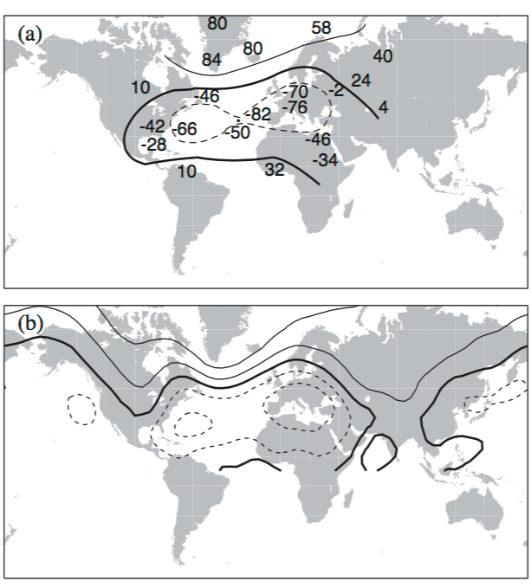
Historical perspective
Walker and Bliss 1932
Wallace 2000
Wallace 2000

Slide 36
Definitions
NAO: a pattern that is primarily confined to the North Atlantic, whereas the NAM is usually understood as being an annular or zonally symmetric pattern that is disrupted by zonal asymmetries in the lower boundary.
(Feldstein and Franzke 2006)

Slide 37
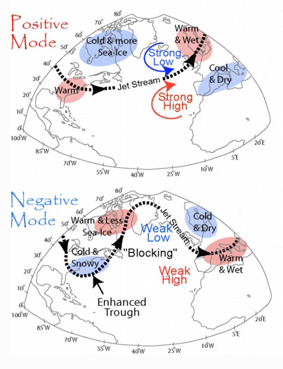
NAM/AO
High/Positive phase: the jet is shifted towards higher latitude, the polar vortex is intensified, and cold air is walled off in the polar vortex.
Low/Negative phase, the vortex is weaker, the jet is shifted southward, and cold air outbreaks are more common

Slide 38
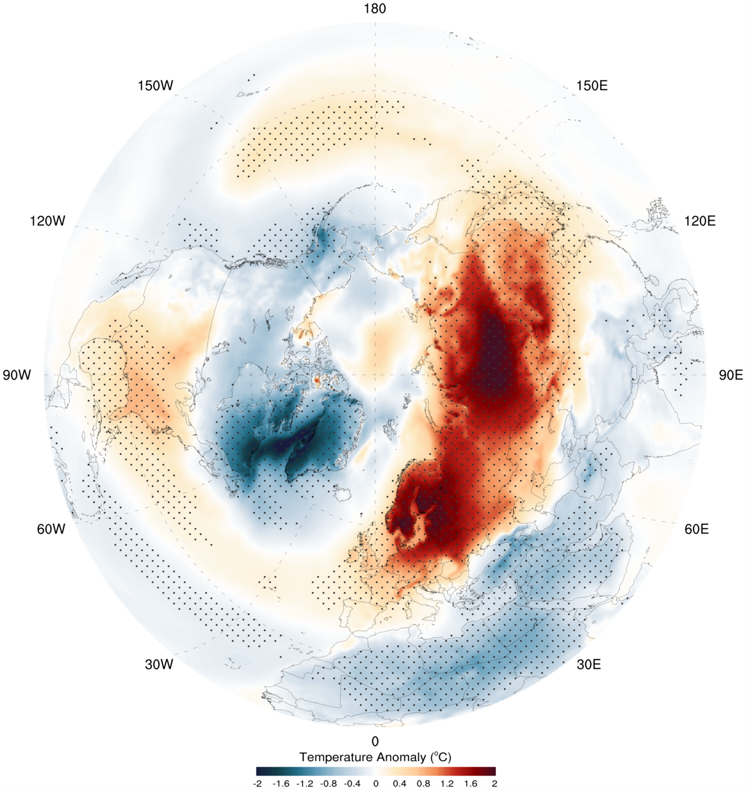
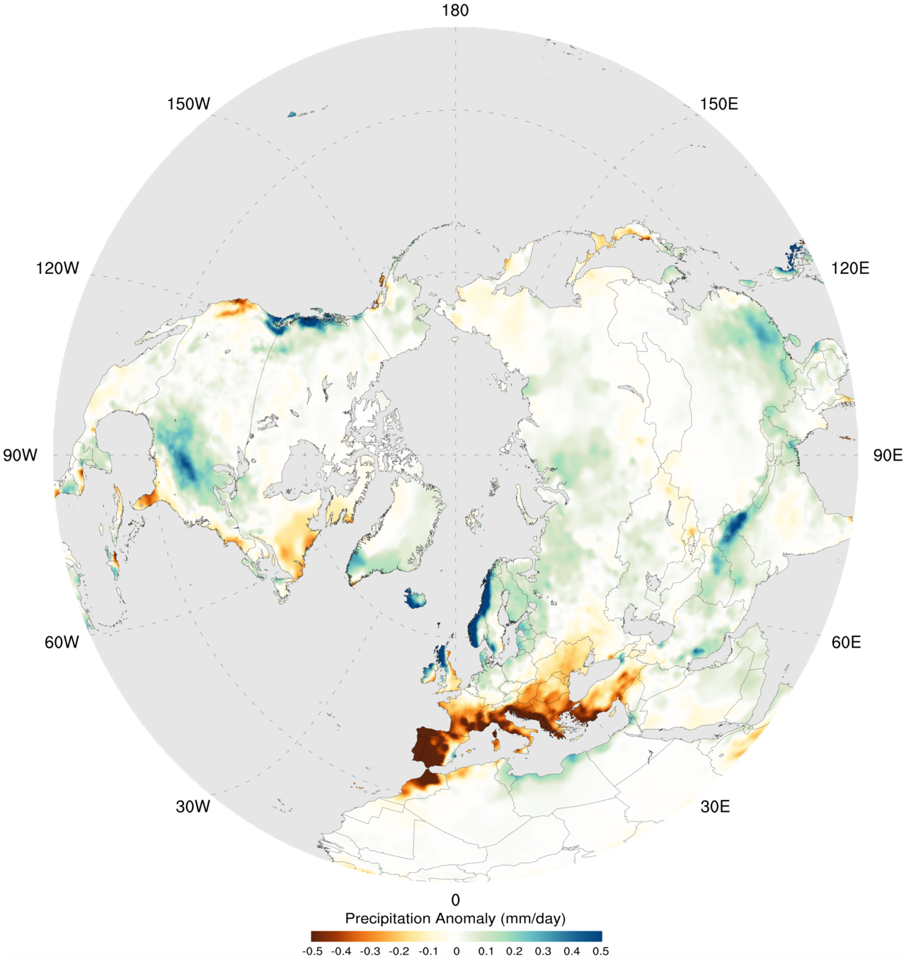
+NAM/AO

Slide 39
NAM & Extreme weather
Increased likelihood of record-breaking temperatures during negative NAM/AO
Wallace 2000

Slide 40
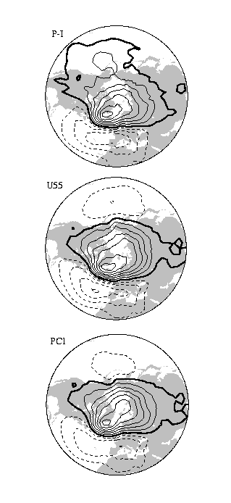
Indices
correlation between SLP at each grid point and:
1. the two-point Portugal - Iceland NAO index (i.e., SLP in Iceland minus SLP in Portugal)
2. Lorenz's U55 index: averaging [u] at 55N (U55)
3. leading EOF of SLP

Slide 41
How are these all related?
Wallace 2000

Slide 42
How are these all related?
NAM-centric perspective: the NAO is simply a regional manifestation of the larger scale NAM pattern (Thompson and Wallace 1998).
NAO-centric perspective: NAM is not even a robust pattern, since the Atlantic and Pacific centers of action for the NAM are not significantly correlated with each other (Ambaum et al. 2001; Deser 2000).
NAO and NAM may not be distinct patterns and that the ability to separate them depends upon their respective definitions (Wallace 2000). NAO may be regarded as distinct from the NAM only if the NAO is defined with a local station-based index
SLP field suggests that the NAO and NAM are separate patterns during the spring, summer, and autumn seasons, but not during the winter (Rogers and McHugh 2002)
Composites of NAO and NAM persistent events are indistinguishable (Feldstein and Franzke 2006)
(Feldstein and Franzke 2006)

Slide 43
NAO vs NAM
statistically indistinguishable, thus:
NAO is not simply a regional manifestation of the NAM
neither the NAO nor the NAM is a statistical artifact
either one of the two patterns should be regarded as redundant.
(Feldstein and Franzke 2006)

Slide 44
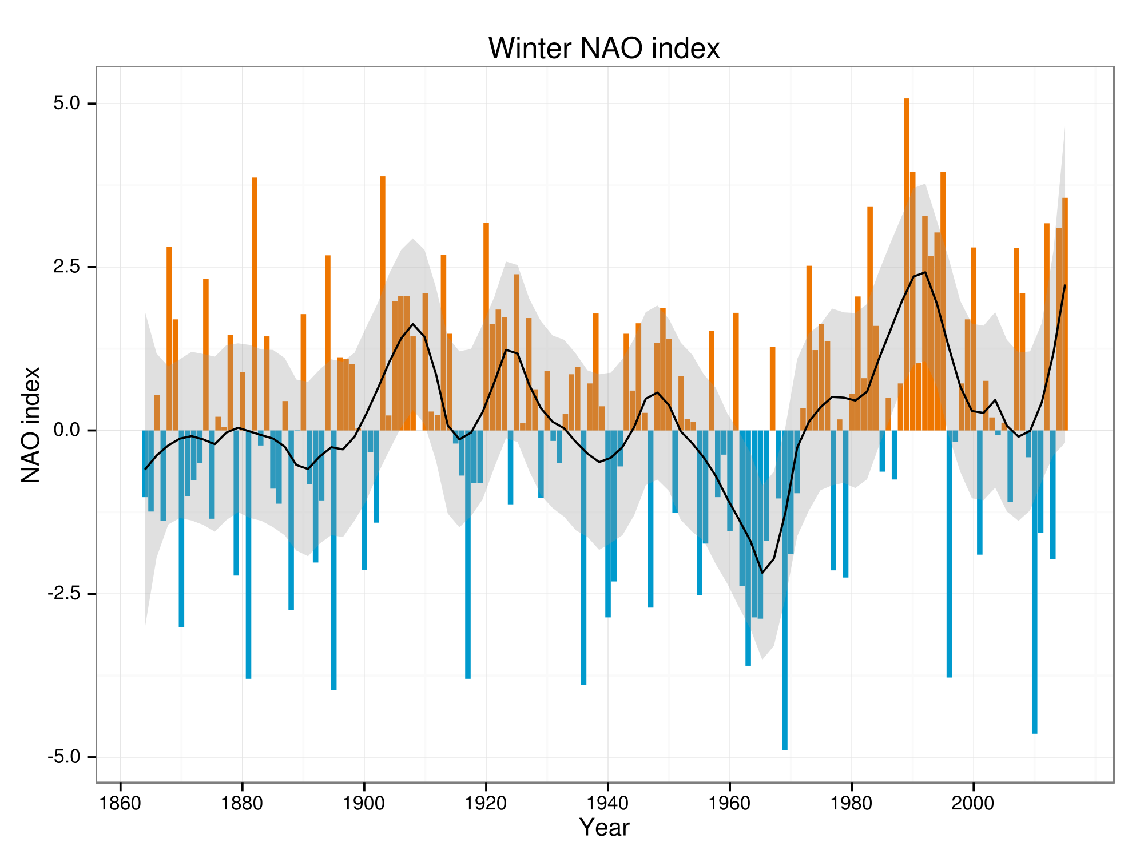
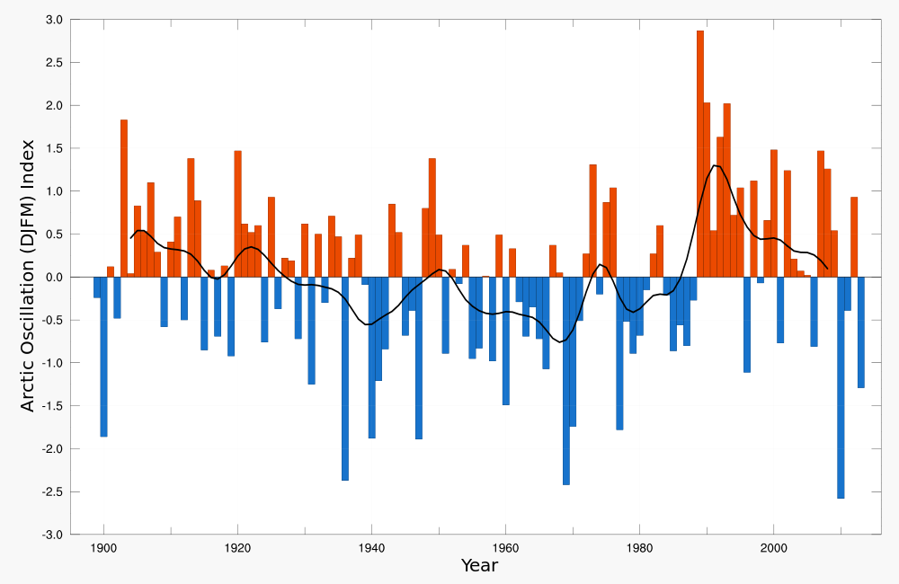
NAM vs NAO indices

Slide 45
OK, so NAO or NAM??
The small amplitude and lack of statistical significance at all lags for the North Pacific anomaly suggest that the NAO/NAM pattern should not be seen as annular
BUT NAO/NAM pattern is associated with a weak North Pacific anomaly, the NAO/NAM is not entirely confined to the North Atlantic.
suggest that perhaps neither the NAM or NAO picture is quite appropriate
“they are different names for the same variability, not different patterns of variability. The difference between the terms is in whether that variability is interpreted as a regional pattern controlled by Atlantic sector processes or as an annular mode whose strongest teleconnections lie in the Atlantic sector.” (Wallace 2000)
(Feldstein and Franzke 2006)

Slide 46
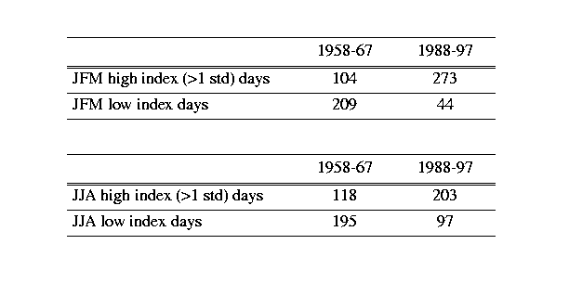
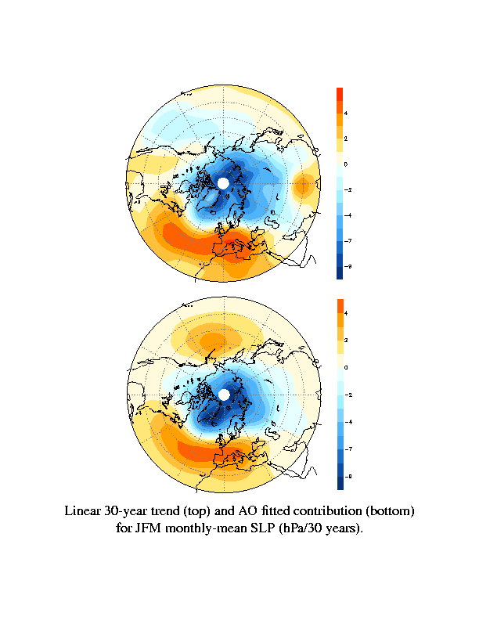
Trends in NAM?
Wallace 2000

Slide 47
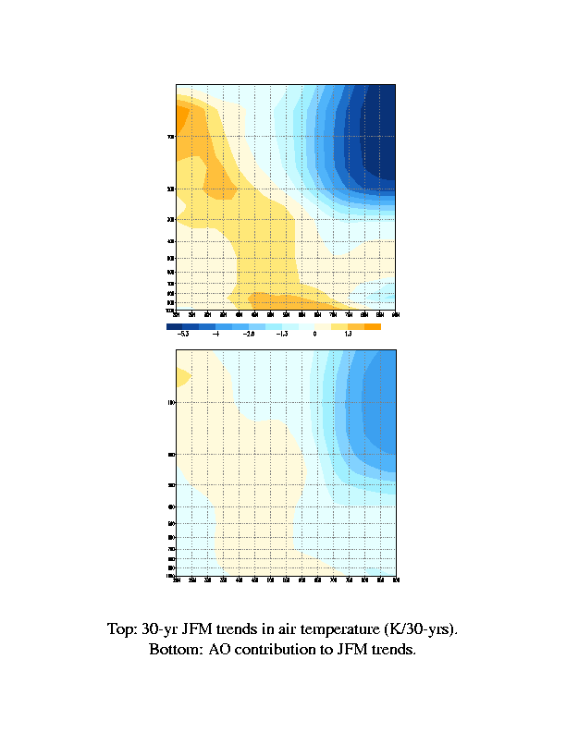
Vertical structure
Trend
AO contribution
Wallace 2000
Notes:
The AO also makes a substantial contribution to [T], as shown in figure 20. However, the polar stratospheric temperature has decreased dramatically, and the AO contribution to the trend does not account for all of this decrease. The radiative effect of ozone depletion must also be involved.

Slide 48
Ozone trends
The AO contribution bears a strong spatial resemblance to the total trend, and accounts for about half of its amplitude and much of its spatial structure.
Wallace 2000

Slide 49
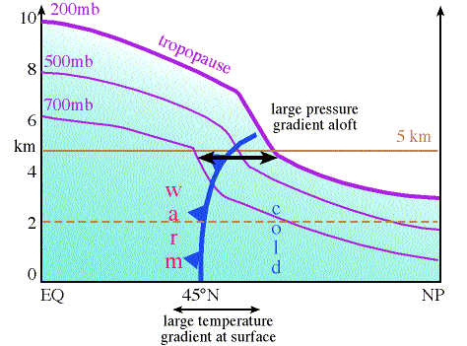
NAM, Ozone and GHG

