Slide 1
Infertility
Clinical Infertility
Definition: 1 year of attempting conception with regular unprotected intercourse
6 months if age 35 or higher
Incidence is approx 10% worldwide, but some geographic variation.
SART 2008
Bachu 1997, Mascarenhas 2012
Notes:
Infertility is a complex disorder defined as inability to conceive after 1 year of attempted conception, or a 6month effort in women aged 35 or greater. The incidence of infertility is approximately 10% worldwide, with some geographical variation.

Slide 2
Infertility
Diagnostic Evaluation
Hysterosalpingogram
Primary or Secondary
Female:
Ovarian Function Tests
Thyroid/Pituitary Tests
Uterine Cavity Assessment
Tubal Patency Assessment
Male:
Semen Analysis
Notes:
Infertility is a couples problem, and is comprised of female and male factors. Infertility can be primary, when the female partner has never before been pregnant, or can be secondary, where a woman who has previously conceived. A standard diagnostic evaluation for infertility includes testing the male and female partner.

Slide 3
Lab Testing
Female Testing
Endocrine System
Ovarian Reserve: FSH, E2
Uterus and Tubes: HSG
Endocrine Screening: TSH, PRL
Sexually Transmitted Disease Screening:
Hepatitis
HIV
Gonorrhea/Chlamydia
Syphillis
Prenatal Genetic Screening:
Cystic Fibrosis (CF)
Spinal Muscular Atrophy (SMA)
Prenatal Virology:
Chicken Pox (Varicella)
Rubella
Blood Type and Screen

Slide 4
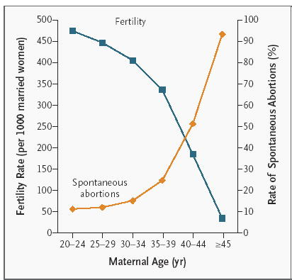
Facts about Infertility

Slide 5
Male Factor Infertility
Causes
Azoospermia: absence of motile sperm in the semen
Oligospermia: low sperm concentration in the semen
Abnormal morphology or motility
Erectile and ejaculatory dysfunction
Testing
Semen analysis
FSH, LH, total T
Prolactin
Thyroid
Rx
Urologic evaluation, GnRH or gonadotropins, intracytoplasmic sperm injection
Depends on cause and diagnosis
http://m.patient.media/images/i24_l1.jpg

Slide 6
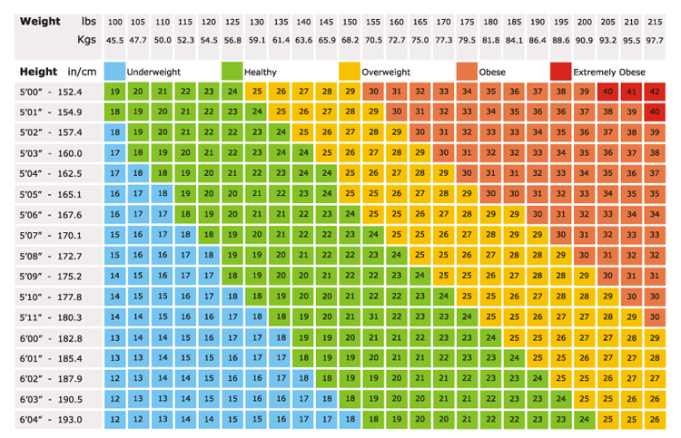
Body Mass Index

Slide 7
IVF Submit
All lab testing completed
Consents, Patient Registration form
→ Submit to Insurance Company
2-4 weeks for decision (Yes/No/More testing needed)
If Yes → meet with Waltham Nurses for a teaching session on medications and the plan
Start stimulation per the plan.

Slide 8
Causes of Recurrent Miscarriage
Chromosomal/Genetic
Hormonal Abnormalities
Metabolic Abnormalities
Uterine Abnormalities
Antiphospholipid Syndrome
Thrombophilia
Male Factor
Unexplained
Environmental Factors

Slide 9
Prognosis
Status | Intervention | Viable Births (%)
Genetic factors | Timed intercourse and supportive care | 20-90
Anatomic factors | Surgery and supportive care | 60-90
Luteal phase deficiency | Progesterone + ovulation induction and supportive care | 80-90
Hypothyroidism | Thyroid replacement and supportive care | 80-90
Hyperprolactinemia | Dopamine agonist | 80-90
Antiphospholipid syndrome | Aspirin, heparin, and supportive care | 70-90
Unknown factors | Timed intercourse and supportive care | 60-90

Slide 10
Facts about PRL
Recurrent pregnancy loss (RPL) is defined as 2 or more spontaneous losses before or at 20 weeks gestation
Prevalence of RPL is 1-4%
Pregnancy loss can trigger a wide range of emotions: anger, sadness, shock, denial, guilt, depression
Your risk of loss increases with each consecutive loss, and with advanced maternal age
Appropriate Testing
HSG, blood karyotype for both partners, fasting glucose, fasting insulin, antocardiolipin antibodies IgG and IgM, lupus anticoagulant, prothrombin mutation, Factor V Leiden mutation, homocysteine, aPTT, antithrombin III, protein C, protein S

Slide 11
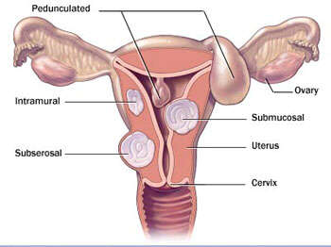

Slide 12
Facts about Uterine Fibroids
Hormonally dependent benign monoclonal tumors that grow on the uterus
Most common female pelvic tumor
Incidence is greater than 70% in women over 50
Incidence is 2-3 times higher in black women than in white women
Also referred to as leiomyomas and myomas

Slide 13
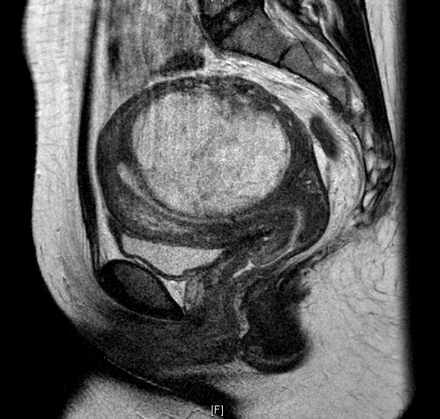
Diagnosis
Menorrhagia
Abnormally heavy bleeding during menstruation
Pelvic pressure and pain
Reproductive dysfunction
Diagnosis
Pelvic examination
Imaging – pelvic ultrasound, MRI
For submucosal fibroids – hysterosalpingogram (HSG) or sonohysterogram

Slide 14
Treatment Options
Surgery
Myomectomy – removal of fibroids and uterine reconstruction → abdominal, laparoscopic, hysteroscopic
Abdominal hysterectomy
Uterine artery embolization
Endometrial ablation
Myolysis
Medical therapies
GnRH agonists/analogs have limited long-term efficacy

Slide 15
Congenital Obstructive Müllerian Anomaly
http://www.acfs2000.com/assets/images/surgery_services/mullerian7.jpg

Slide 16
PCOS
Polycystic Ovary Syndrome is the most common hormonal disorder and cause of anovulatory infertility among reproductive aged women, affecting 5-10% of all premenopausal women
PCOS is diagnosed by Rotterdam Criteria; you must meet 2 of the following 3 characteristics:
Anovulation and/or oligoanovulation
Clinical and/or biochemical signs of hyperandrogenism
Polycystic ovaries upon ultrasound
Common symptoms are infertility, hirsutism, acne, and amenorrhea
Highly associated with insulin resistance and obesity
Increased risk of developing metabolic syndrome (MS)
Well managed through diet, exercise, and other integrative medicine options

Slide 17
Fertility
Appropriate testing
Cycle day 3 FSH and estradiol
HSG
Progesterone
HCG
Prolactin
LH, FSH
DHEAS, total testosterone, 17-OH-progesterone
Fasting glucose, fasting insulin
Cholesterol panel
Hemoglobin A1C
2 hour 75 g oral glucose tolerance test
Treatment options
Clomid: selecting estrogen receptor modulator (SERM) that stimulates ovulation
Can be paired with timed intercourse or IUI to attempt conception
Intrauterine insemination (IUI): partner or donor sperm is placed inside uterus near ovulation to attempt conception
Can be paired with clomid or gonadotropin injection
In vitro fertilization (IVF)
Egg and sperm are combined outside of body, embryo is placed inside uterus to attempt conception

Slide 18
Uterine Health
Risk of endometrial cancer
Without ovulation, uterus does not produce progesterone
Constant estrogen stimulates the endometrium → intermittent breakthrough bleeding and dysfunctional uterine bleeding
Increased with no period for 5-10 months or 4 or less periods a year
High BMI is linked with hyperinsulinemia, which contributes both directly and indirectly to androgen production
Decreasing insulin levels can decrease testosterone and DHEAS levels
Can be achieved with medication or weight loss
http://permanence.com.au/wp-content/uploads/2014/05/pcos_ultrasound.jpg
I recommended that the male partner obtain an MRN and schedule a semen analysis.

Slide 20
Future Health
PCOS puts you at an increased risk of developing:
Coronary heart disease
Hypercholestrolaemia
Type 2 Diabetes Mellitus and Gestational Diabetes
Hypertension
Maintaining a healthy diet and participating in moderate regular exercise possibly resulting in weight loss can lower these risks as well as improve other symptoms such as infertility, hyperandrogenism, and hirsutism

Slide 21
Endometriosis
Dr. mahalingaiah

Slide 22
What is Endometriosis?
Presence of endometrial tissue outside of the endometrial cavity (uterus)
Estimated prevalence 5-10%
Estrogen dependent
https://www.centerforhumanreprod.com/fertility/content/uploads/2012/12/endometrium.jpg
Notes:
http://www.fairviewebenezer.org/HealthLibrary/Article/85433

Slide 23
Treatment Options
Hormonal suppression of ovulation
Oral contraceptive pills (OCP)
Gonadotropin releasing hormone (GnRH) analogs
Progestins
Surgical removal or ablation
Electric
Laser

