Slide 1
Secondary Amenorrhea: Clinical Causes and Evaluation
Robert M. Weiss, MD
Division of Reproductive Endocrinology and Infertility
Boston University School of Medicine

Slide 2
Learning Objectives
To review and understand the endocrinology and physiology of the normal menstrual cycle.
To recognize the various disorders along the hypothalamic, pituitary, ovarian and uterine axis which lead to irregular menses and secondary amenorrhea.
To understand the pathophysiology and diagnostic criteria of Polycystic Ovarian Syndrome (PCOS).
To be able to evaluate women with secondary amenorrhea.

Slide 3
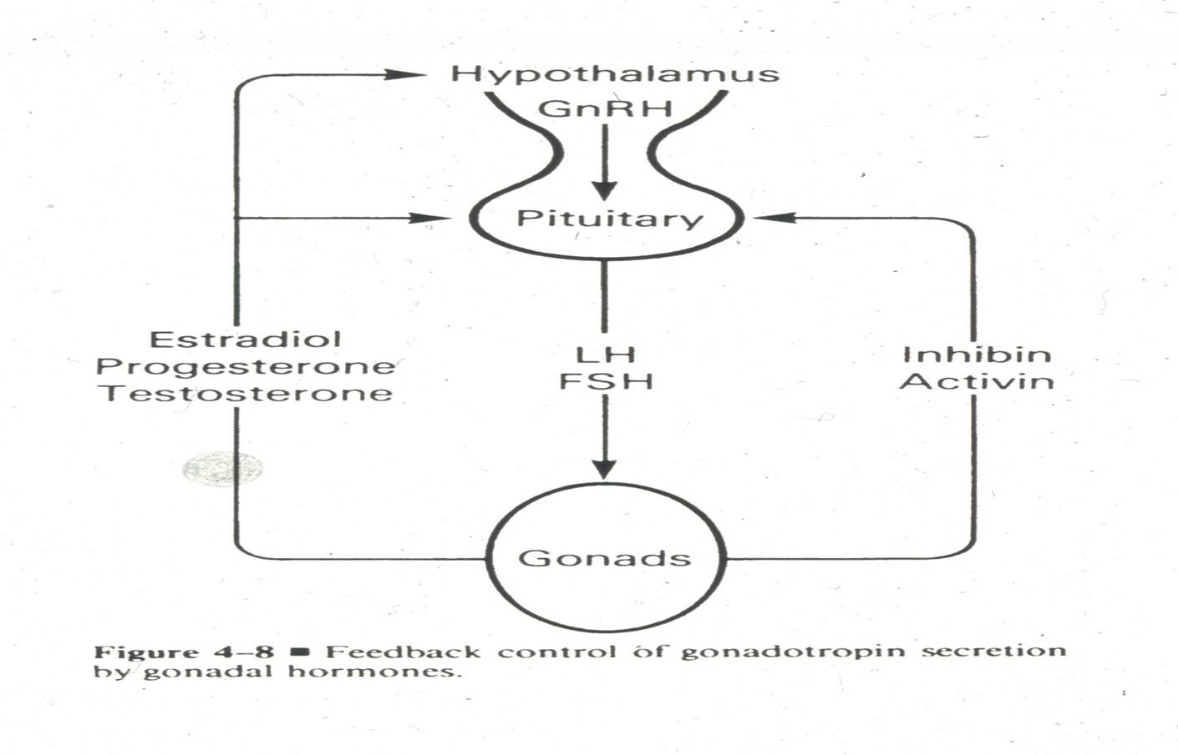

Slide 4
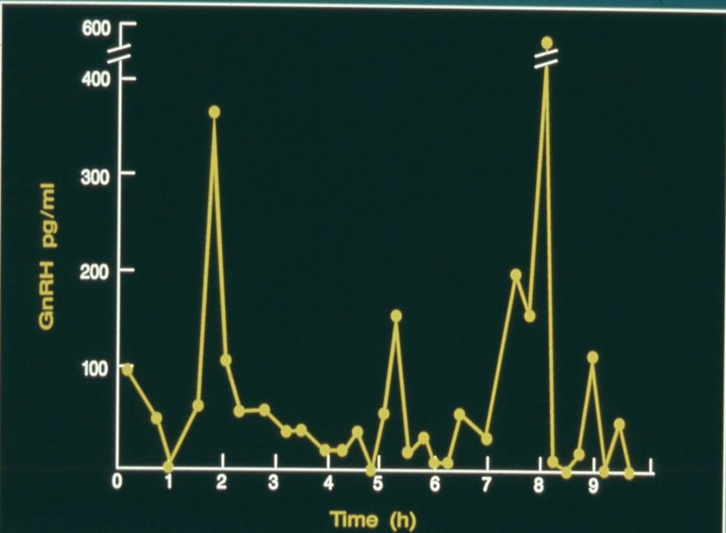
Pulsatile GnRH Release

Slide 5
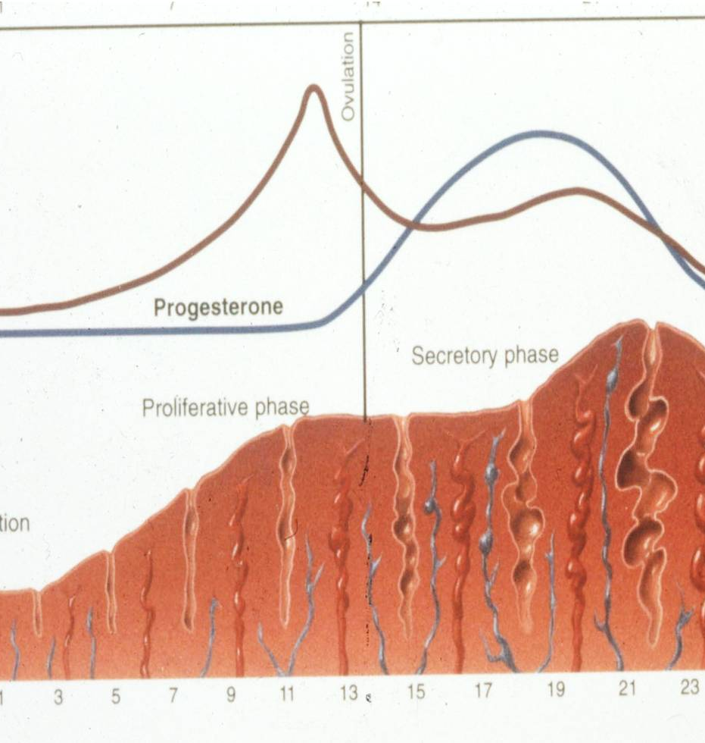
Changes in the uterine lining in response to Estrogen and Progesterone

Slide 6
Secondary Amenorrhea: Causes*
Chronic Anovulation | 30-35%
Hypothalamic amenorrhea Structural and functional disorders | 20-25%
Premature Ovarian Insufficiency Including Gonadal Dysgenesis | 10-12%
Hyperprolactinemia Prolactin tumors | 7-10%
Asherman’s Syndrome Uterine adhesions | 5-10%
Hypothyroidism | 1%
*After pregnancy is excluded

Slide 7
Structural Causes of Hypothalamic Amenorrhea
Compression or destruction of hypothalamus by tumors
Craniopharyngioma
Germinoma (ectopic pinealoma)
Glioma (optic chiasm or hypothalamus)
Hand-Schuller-Christian disease (hystiocytosis, eosinophilic granuloma)
Midline dermoid cyst and teratoma
Tuberculosis and sarcoidosis
Metastatic carcinoma
Head trauma
Post-irridation
Isolated GnRH deficiency (Kallman’s Syndrome)
Primary amenorrhea

Slide 8
Functional Causes of Hypothalamic Amenorrhea
Intense exercise routine
h/o Anorexia/Bulimia/Calorie counting
Athletic Female Triad

Slide 9
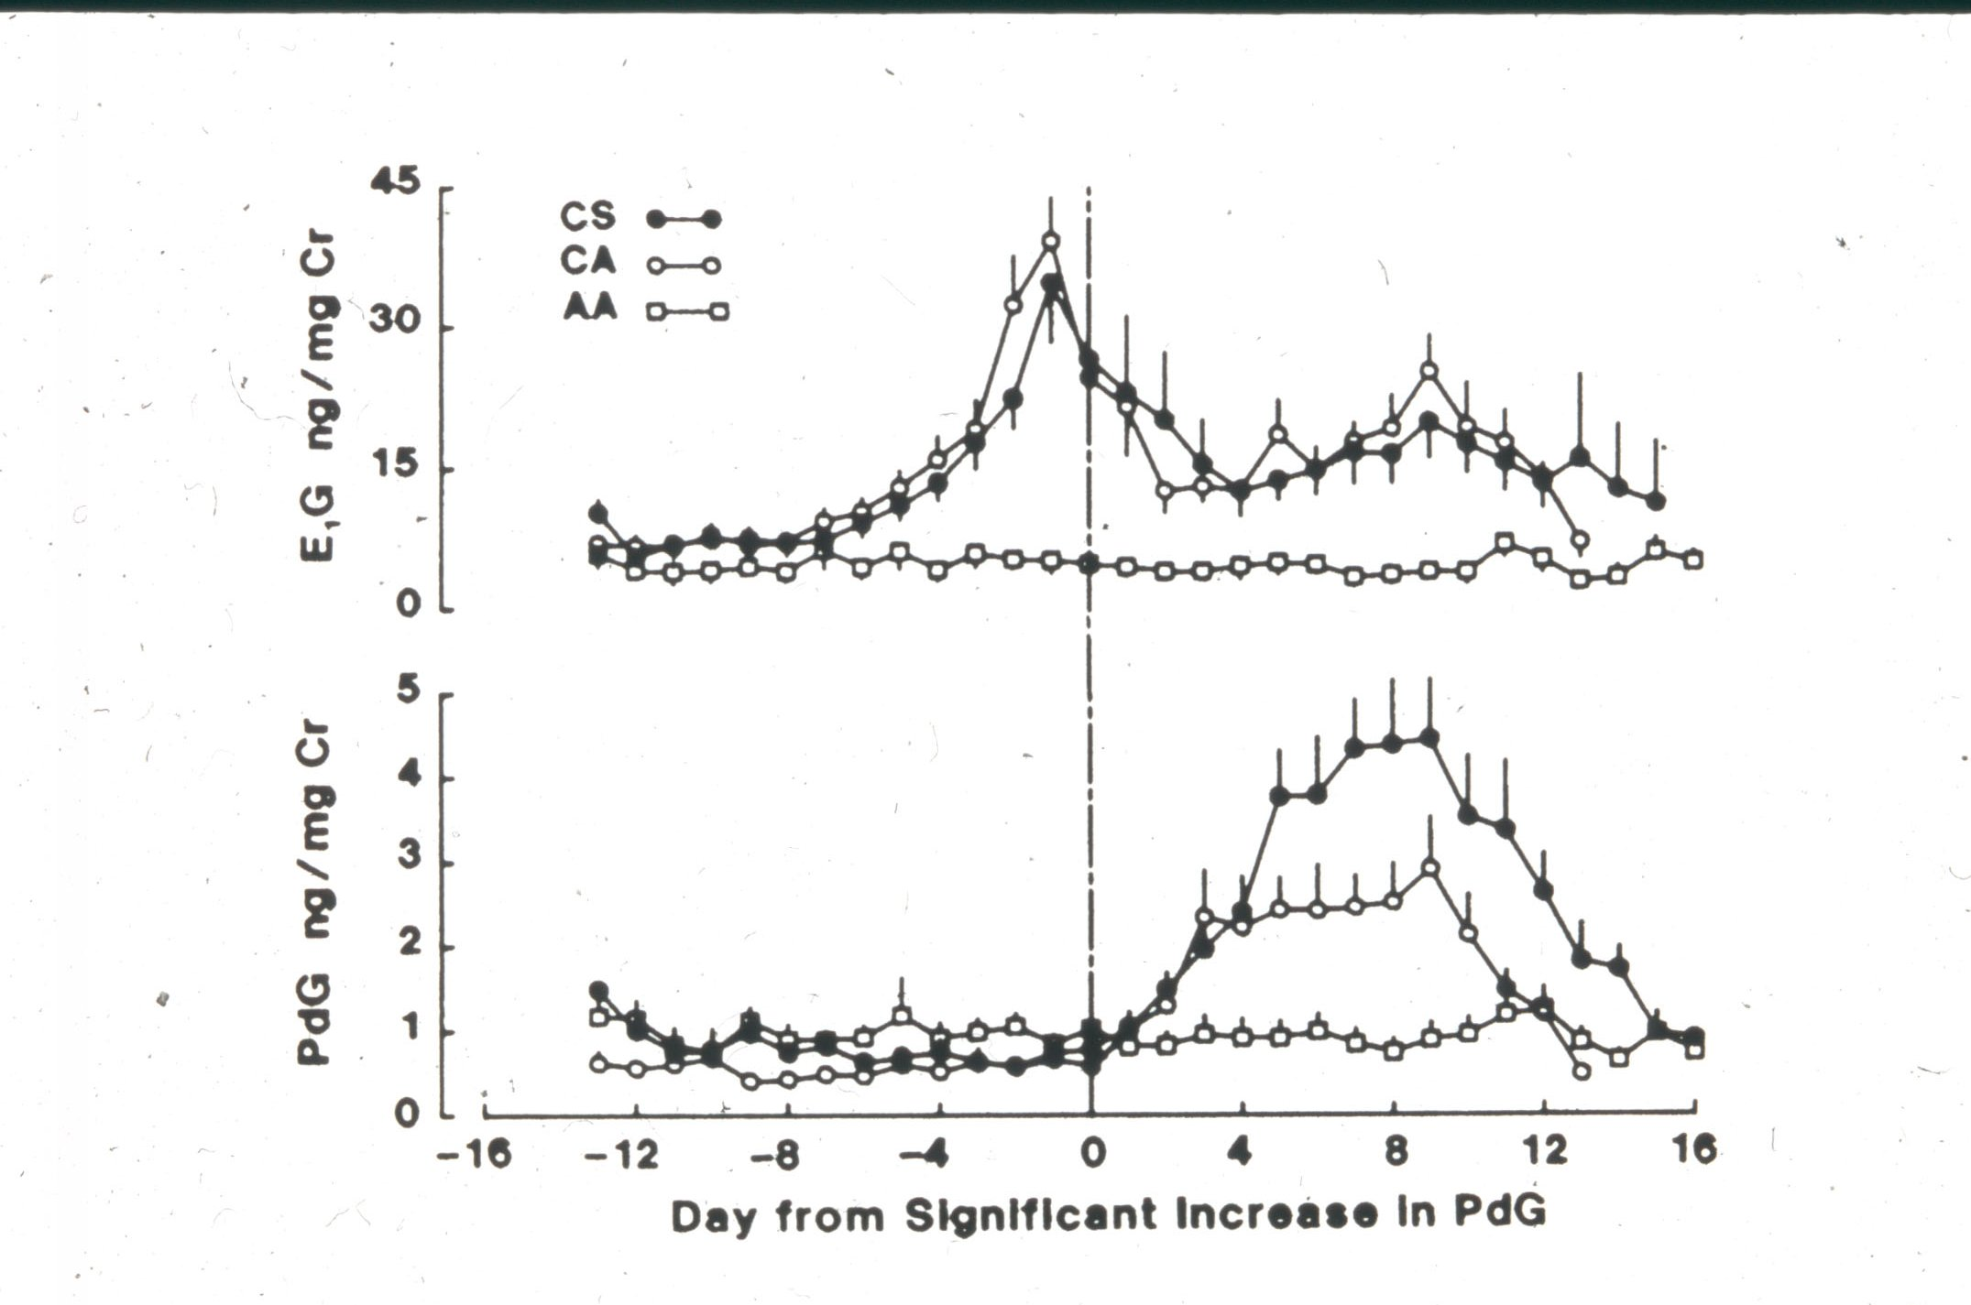

Slide 10
Diagnosis of Anorexia Nervosa
Onset between ages 10-30
Weight loss of 25%
Weight 15% below normal for age and height
Special attitudes: denial, distorted body image, unusual hoarding or handling of food
Amenorrhea

Slide 11
Pituitary Causes of Amenorrhea
Prolactin-producing Pituitary Adenoma
Non-prolactin-producing Pituitary Tumor
Empty Sella Syndrome
Sheehan’s Syndrome- Pituitary Necrosis
Autoimmune Disease
Lymphocytic Hypophysitis

Slide 12
Hyperprolactinemia as a Cause of Amenorrhea

Slide 13
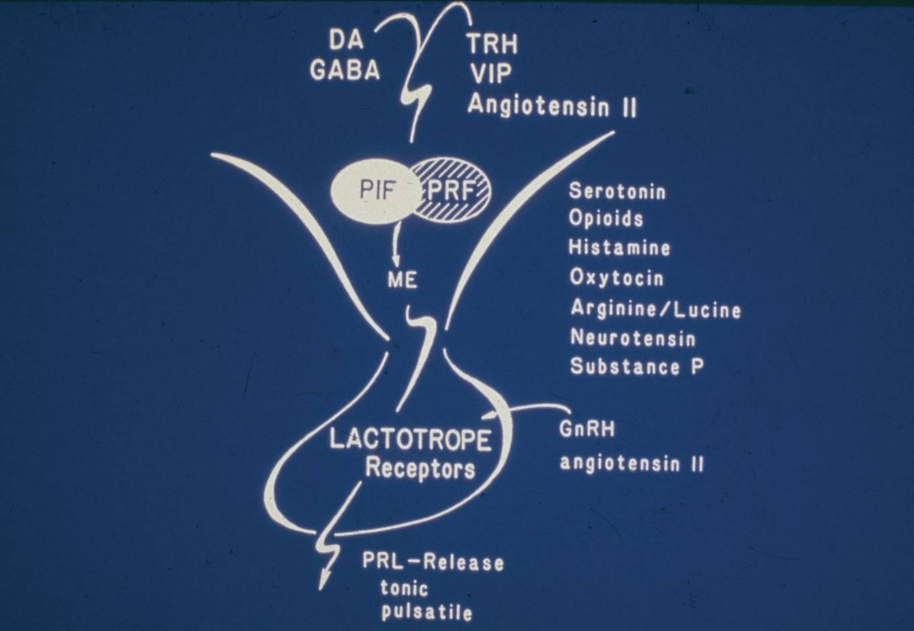
Figure 9-3. Diagrammatic illustration of the multi-factorial neuroendocrine control of tonic and pulsatile prolactin release; numerous prolactin-inhibiting and -releasing factors are involved.

Slide 14
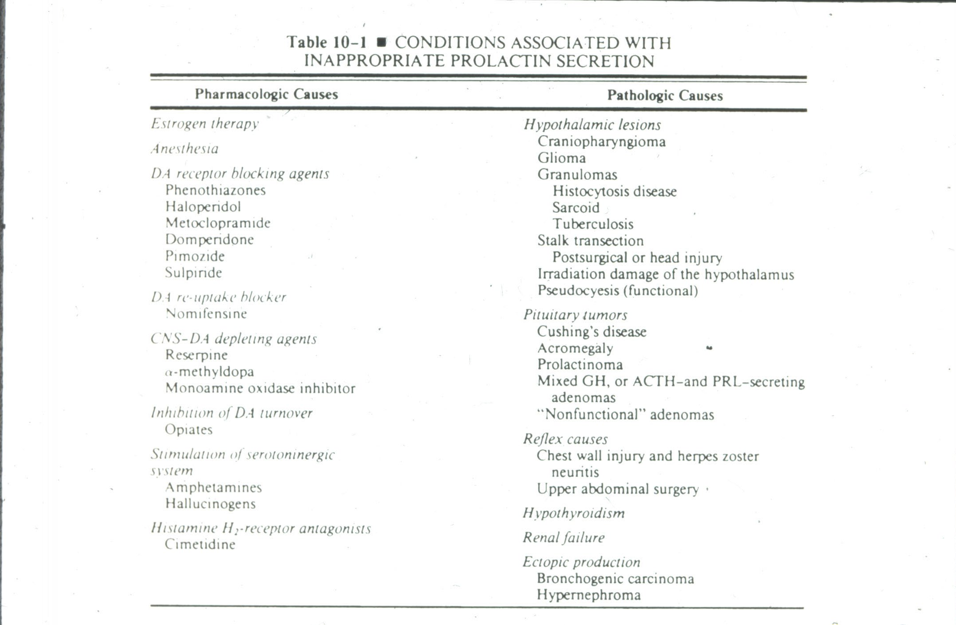

Slide 15
Gonadal Disorders as a Cause of Amenorrhea
Congenital
Gonadal dysgenesis (e.g. Turner’s syndrome 45,X)
Gonadal agenesis (46XY or 46XX)
Acquired
Premature ovarian insufficiency (POI)
Autoimmune disorder
Fragile X
Physical causes
Irradiation
Chemotherapy
Severe Endometriosis/multiple surgery/ovarian destruction
Idiopathic

Slide 16
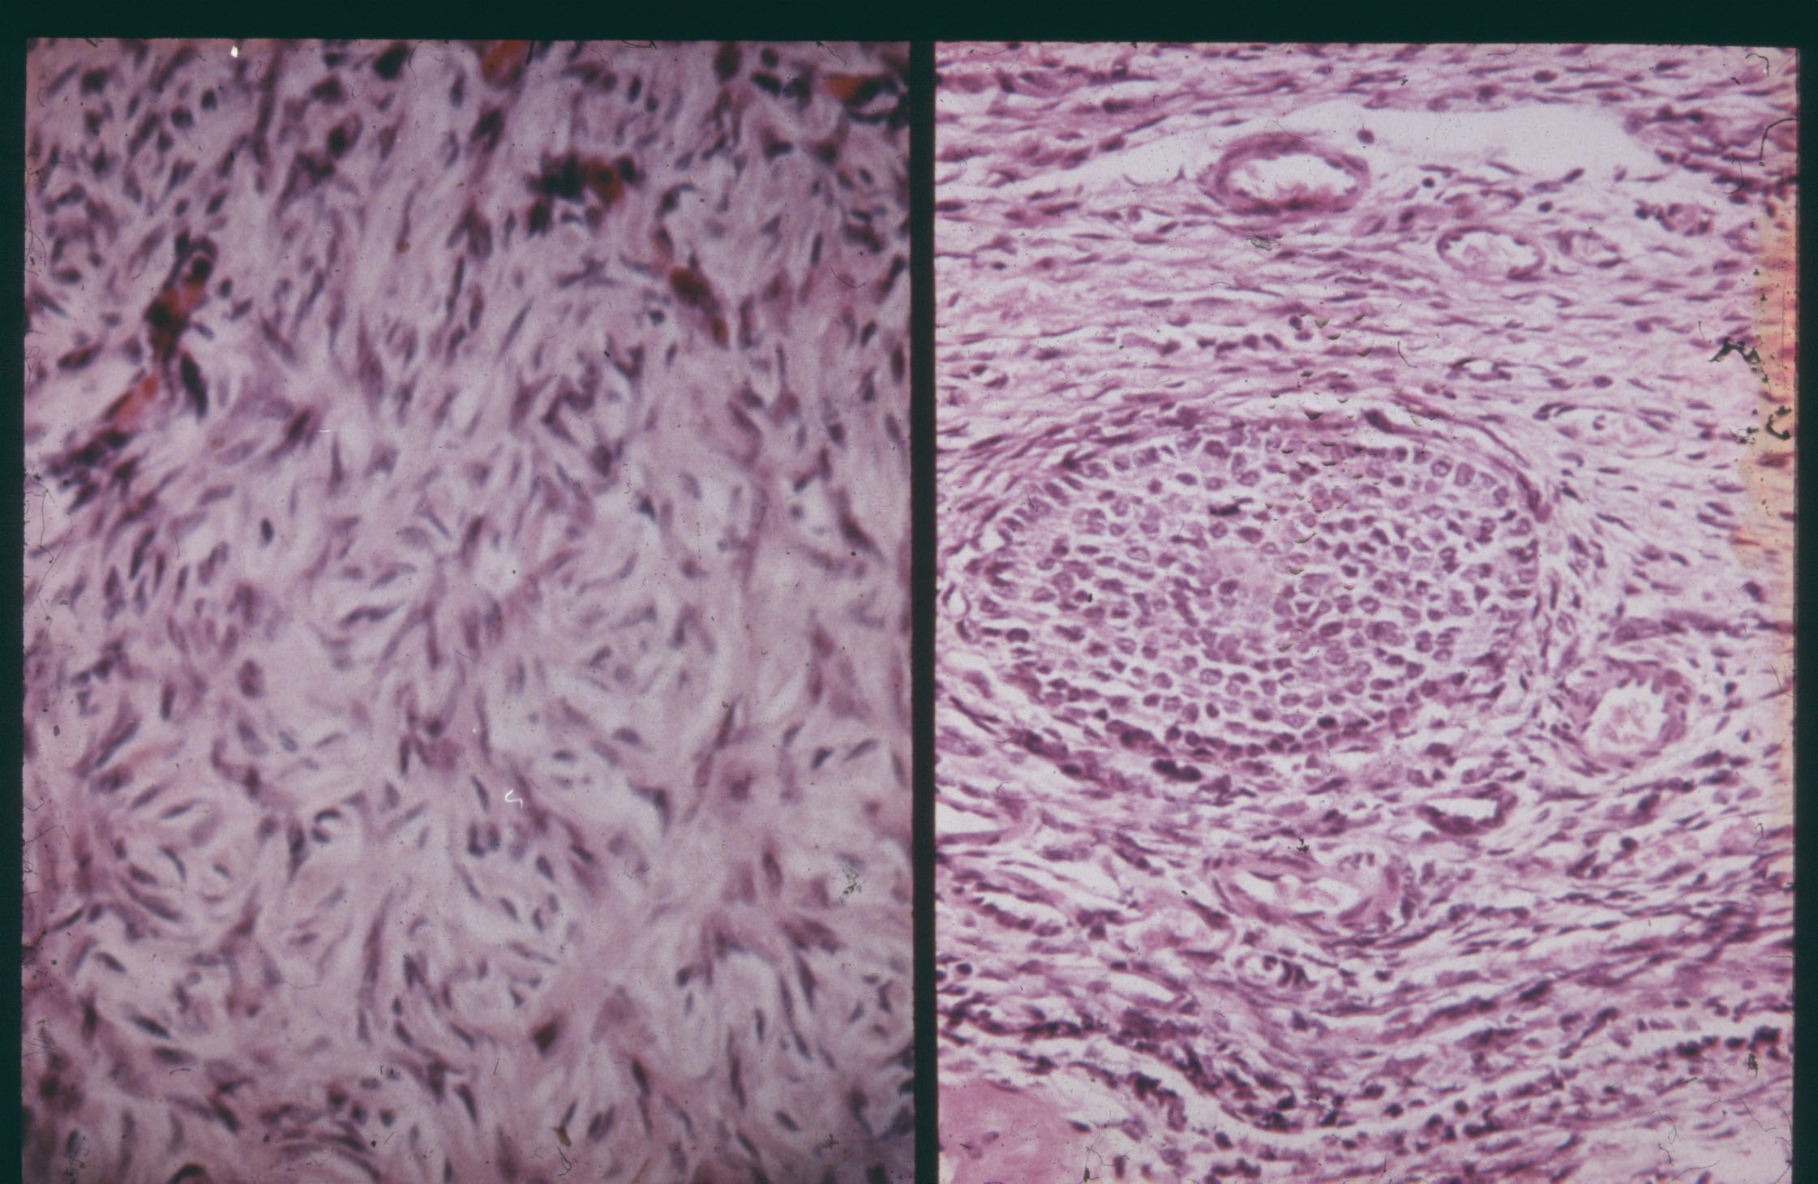

Slide 17
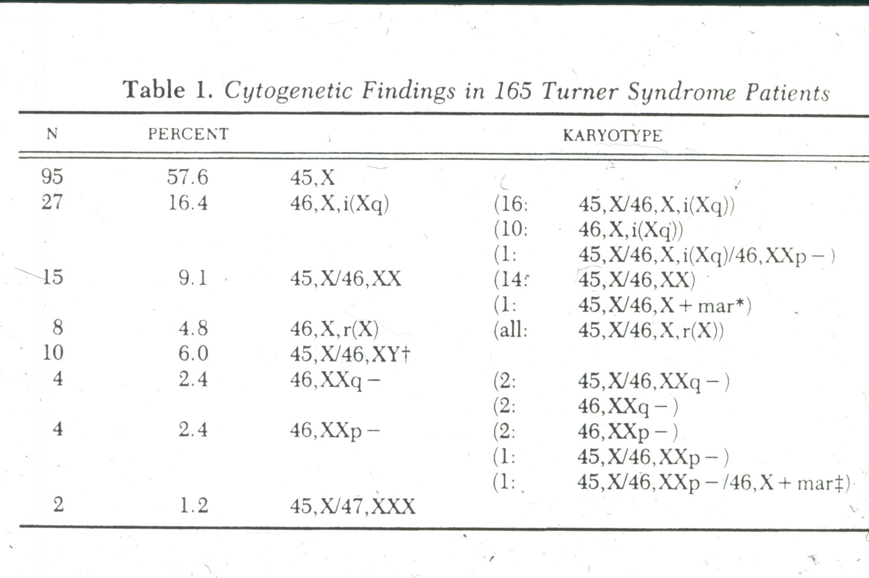

Slide 18
Nonovarian Endocrine Causes of Amenorrhea/Chronic Anovulation
Disorders of the thyroid gland
Hypothyroidism
Hyperthyroidism
Disorders of the adrenal gland
Hypocortisolism (Addison’s Disease)
Hypercortisolism (Cushing’s Syndrome)
Congenital Adrenal Hyperplasia

Slide 19
Outflow Tract Abnormalities as a Cause of Amenorrhea
Congenital
Mullerian abnormalities
Mullerian Agenesis
Transverse vaginal septum
Imperforate hymen
Acquired
Asherman’s Syndrome
Intrauterine adhesions
Caused by a peripartum D&C, infection, or surgery on the uterus (myomectomy)

Slide 20
Polycystic Ovarian Syndrome
Complex syndrome of ovarian dysfunction, with features of hyperandrogenism and polycystic ovaries
First described in 1935 by Stein and Leventhal
Affects 6% of female population

Slide 21
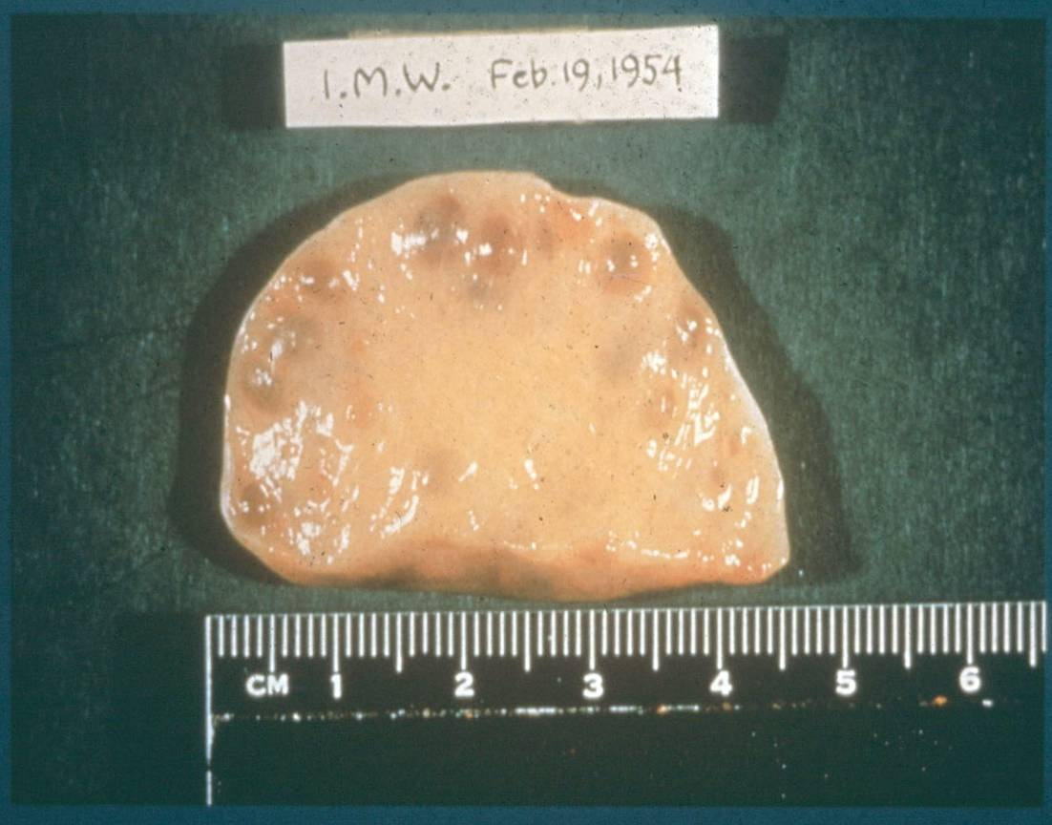
The Polycystic Ovary

Slide 22
Correlation of Symptoms with Incidence of PCO
Symptom | Percentage with PCO
Amenorrhea | 26%
Oligomenorrhea | 87%
Idiopathic hirsutism (normal cycles) | 92%
Endocrine abnormality (elevated LH:FSH ratio, elevated testosterone or androstenedione) | 93%
Anovulation | 57%
N = 173
From Adams et al: Br Med J 1986;293:355-359.

Slide 23
Insulin resistance
High Insulin
GnRH pulses
High LH
Binds IGF on theca cells
High Andronstenedione
Estrone (adipose)
Low SHBG
Elevated Testosterone
Low FSH
High LH
Low Aromatase
Impaired follicular maturation
Anovulation
Treatment options

Slide 24
Revised diagnostic criteria of PCOS
1999 Criteria (both)
Chronic anovulation
Clinical or biochemical signs of hyperandrogenism, and exclusion of other etiologies
Revised 2003 Criteria (two out of three)
Oligo- or anovulation
Clinical or biochemical hyperandrogenism
Polycystic ovaries and exclusion of other etiologies (congenital adrenal hyperplasia, androgen-secreting tumors, Cushing’s syndrome)
Revised 2003 consensus on diagnostic criteria and long-term health risks related to polycystic ovary syndrome (PCOS). Hum Reprod 2004; 19:41.

Slide 25
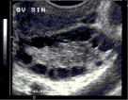
Polycystic Ovaries
Defined as the presence of 12 or more follicles in each overy measuring 2-9mm in diameter and/or ovarian volume > 10ml
Does not apply to women on OCPs
If dominant follicle/cyst, repeat scan at next cycle
Only one ovary needs to meet criteria

Slide 26
PCOS Laboratory Diagnosis
Not necessary for diagnosis since PCOS is mainly a clinical diagnosis, but labs can be useful to r/o other disorders
FSH, E2, TSH, PRL, or confirm hyperandrogenism
Testosterone, DHEA-S, 17-OH Progesterone

Slide 27
PCOS Insulin Resistance
Appears in up to 50-70% of obese and non-obese PCOS women
30% impaired GT
5-10% D.M.
Not necessary for diagnosis
Obese women are at greater risk for insulin resistance and other metabolic disorders: should be screened with fasting glucose, HgbA1c, lipid profile

Slide 28
Amenorrhea: Clinical Evaluation
Careful history
Physical exam
Basic lab tests: BHCG, FSH, PRL, TSH
Lab tests as indicated: androgen levels, LH, Hgba1c, estradiol, AMH
Other tests: pelvic ultrasound, progesterone withdrawal bleed, MRI, bone density

Slide 29
Secondary Amenorrhea: Causes
Anovulation/PCOS
Irregular menses
Elevated testosterone or hirsutism
US with PCOs
Normal PRL, TSH, FSH
Elevated AMH>3.5
Hypothalamic amenorrhea
Low-normal levels FSH, E2
Normal PRL/TSH
Premature Ovarian Insufficiency
FSH>2.0
Normal PRL, TSH
AMH<0.3
Hyperprolactinemia
Primarily pituitary adenomas
PRL>30
Normal FSH/TSH
Asherman’s Syndrome
Normal endocrine parameters
Hypothyroidism
Elevated TSH

