Slide 1
Experimental Economics and Behavioral Economics Kathy Zeiler Boston University School of Law June 2019 Thirty-Fourth Economics Institute for Law Professors Henry G. Manne Program in Law & Economics Studies LAW & ECONOMICS CENTER, GEORGE MASON UNIVERSITY SCHOOL OF LAW

Slide 2
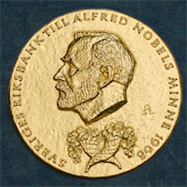
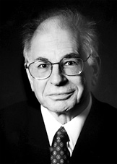
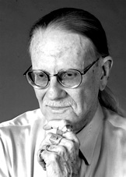
2002 Nobel Prize in Economic Sciences
Daniel Kahneman "for having integrated insights from psychological research into economic science, especially concerning human judgment and decision-making under uncertainty"
Vernon L. Smith "for having established laboratory experiments as a tool in empirical economic analysis, especially in the study of alternative market mechanisms"

Slide 3
The Science of Economics
BEHAVIORAL ECONOMICS
EXPERIMENTAL ECONOMICS
THEORY
EMPIRICAL TESTS
Set of assumptions and conclusions (or predictions) derived from those assumptions
(aka models)
Statistical tests using data from:
observational studies
simulations
laboratory and field experiments

Slide 4
Where are we going?
Experimental Economics
An experiment!
Features of experiments
From experiments to policy
Behavioral Law & Economics
The BE school of thought v. others
From BE theories to policy (i.e., BLE)
Examples of theories (preferences v. biases/errors)

Slide 5
Where are we going?
Experimental Economics
An experiment!
Features of experiments
From experiments to policy
Behavioral Law & Economics
The BE school of thought v. others
From BE theories to policy (i.e., BLE)
Examples of theories (preferences v. biases/errors)

Slide 6
An experiment!
Please refrain from talking to the other participants during the experiment and do not disclose your choice to others
Everyone in the room will choose a whole number between 0 and 100 (inclusive)
The winner of the game will be the person who picks the number that’s closest to 2/3 of the average of the all the numbers chosen
The winner will receive $20 cash! (ties split $20)
Write down
guess
name
Y if you’ve played this game before; N if not

Slide 7
Purpose??
To test the principle of iterated dominance from game theory
Applications in location strategies, investment decisions…
If individual decision-making incorporates this principle, all players in the game should guess ZERO!
Why???...

Slide 8
Iterated Dominance Prediction
If everyone chooses randomly, 2/3 of average is roughly 33, so 34-100 are dominated and no one will choose them
Everyone will surmise that no one will choose 34-100. If everyone chooses 33, 2/3 of the average will be roughly 22, so 23-33 are dominated and no one will choose them
Iterate until we end up with a predicted guess of zero for everyone

Slide 9
Data from experiments
Hahn, Lum and Mela (working paper, 2010)

Slide 10
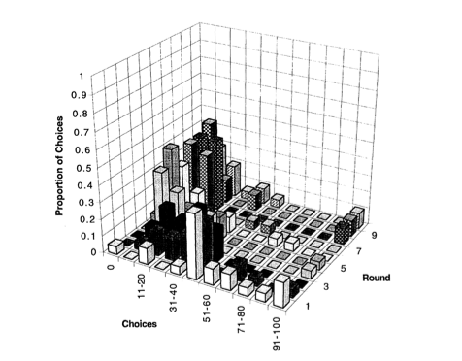
Data from experiments
Ho, Camerer and Weigelt (AER, 1998)

Slide 11
Cognitive Hierarchy Theory (Camerer, Ho and Chong, 2002)
Individuals think strategically
BUT, they make it through only one or two (or three..) steps of iterated reasoning
i.e., individual cognition is bounded
The winner will be the one who either:
Iterates (luckily) the “right” number of times
Correctly guesses the distribution of “abilities” of the group
With repeated play, individuals learn

Slide 12
Where are we going?
Experimental Economics
An experiment!
Features of experiments
From experiments to policy
Behavioral Law & Economics
The BE school of thought v. others
From BE theories to policy (i.e., BLE)
Examples of theories (preferences v. biases/errors)

Slide 13
Features of (economics) experiments
Sufficient sample sizes to allow for valid inferences about population of interest
(sometimes) Random assignment into treatment/control groups
Controls for selection effects (e.g., Oregon Medicaid lottery); major advantage of lab over field
Replicability—write up must include sufficient details (instructions/scripts)
No deception
(sometimes) One theory pitted against an alternative theory
Divergent predictions
Data are choices rather than subject-reported motivations

Slide 14
Features of experiments
The experiment design must build in all important features of the theory
The design should flow directly from the theory or theories being tested (“internal validity”)
E.g., Actual stakes (v. hypothetical choices)
It need NOT (and cannot) integrate all relevant features of environments to which the theory might eventually be applied through policy
Most economics experiments are completely context-free and do not ask subjects to pretend to take on particular roles (e.g., jury member, judge)

Slide 15
Features of experiments
The experiment design also attempts to rule out alternative explanations. E.g.,
test for understanding of instructions
ruling out wealth effects, demand effects, order effects, transaction costs, etc.

Slide 16
Economics experiments v. psychology experiments
Economists tend to rely on experiments in which subjects’ choices determine how much money they earn
Goal: to test basic principles / theories
Non-hypothetical (i.e., actual monetary payoffs) because the theories predict behavior assuming actual consequences
Psychologists often run experiments that are
hypothetical in nature
designed to detect changes in behavior given a change in the environment (i.e., testing for effects)
This led to list of effects, which troubled many economists given the purpose behind experiments in economics (to EXPLAIN behavior, not just observe it )

Slide 17
Experiments v. Field Studies
Field studies employ data generated in environments not manipulated by the researcher
Experiments allow more control than field studies
Lab allows random assignment to treatment and control and allows us to change just one feature of the environment and measure its impact
Lab allows for measure of parameters of interest that are difficult or impossible to observe in the field (e.g., willingness to pay)

Slide 18
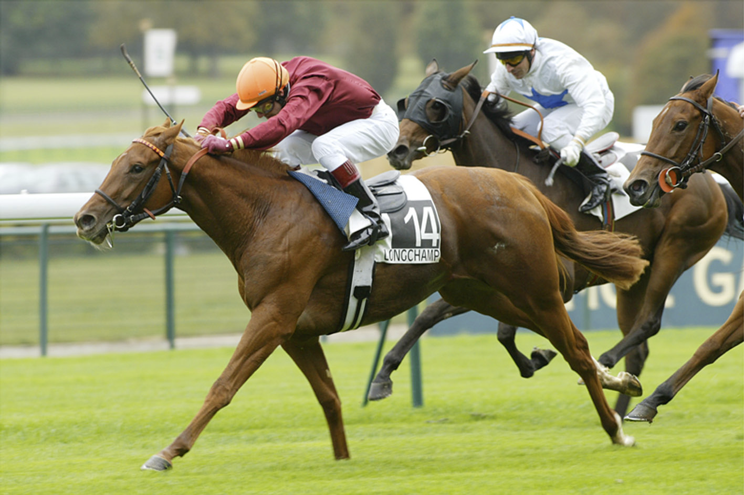
Frontier: field experiments
E.g. Camerer (JPE, 1998): placed (and then canceled at the last minute) actual bets at horse race track that were sufficiently large to change the odds
Objective: to test whether individuals react to new information in markets as theory predicts

Slide 19
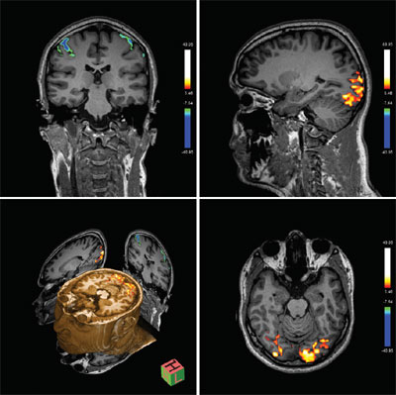
Frontier: neuroeconomics (McCabe, Camerer, Loewenstein, etc.)

Slide 20
Where are we going?
Experimental Economics
An experiment!
Features of experiments
From experiments to policy
Behavioral Law & Economics
The BE school of thought v. others
From BE theories to policy (i.e., BLE)
Examples of theories (preferences v. biases/errors)

Slide 21
Role of method in policymaking?
A central function of law is to influence behavior
To do this well, we need to be able to accurately predict how individuals will respond to changes in law (i.e., we need a theory we can apply with some level of confidence)
Law and economics researchers, in part, are working to develop theories that accurately predict how policy impacts behavior

Slide 22
Levels of Confidence
Results from one experiment that support a principle provide some confidence in applying theories built on that principle
Results from a number of experiments that support the same principle in a number of different contexts provide much more confidence
Demonstrates robustness
If the principle stands up in both laboratory and field tests in several different contexts, we can apply theories employing the principle with relatively high confidence
E.g., theory of supply and demand has held up well

Slide 23
Notes on Interpretation of Mixed Results
If it turns out that experiments testing the same theory produce mixed results, we turn our attention to constructing theories to explain the variation
More generally, we should place the most confidence in theories that are able to explain the variation in results

Slide 24
E.g., Plott and Zeiler (AER, 2005)
In mid-2000s, evidence from many (but not all) experiments supported endowment effect theory (e.g., WTA > WTP due to loss aversion)
PZ alternative explanation: observed gaps due to subject misconceptions related to valuation elicitation device (BDM)
We first successfully replicated KKT, 1990
We then constructed a second treatment that included controls for misconceptions: explain device (training) and let subjects practice THEN measure gap
Predictions
if EET is right → we should observe gap ;
if misconceptions → we should observe no gap
Result: no gap, so data support misconceptions conjecture
One step further: Misconceptions conjecture better organizes all existing experimental data

Slide 25
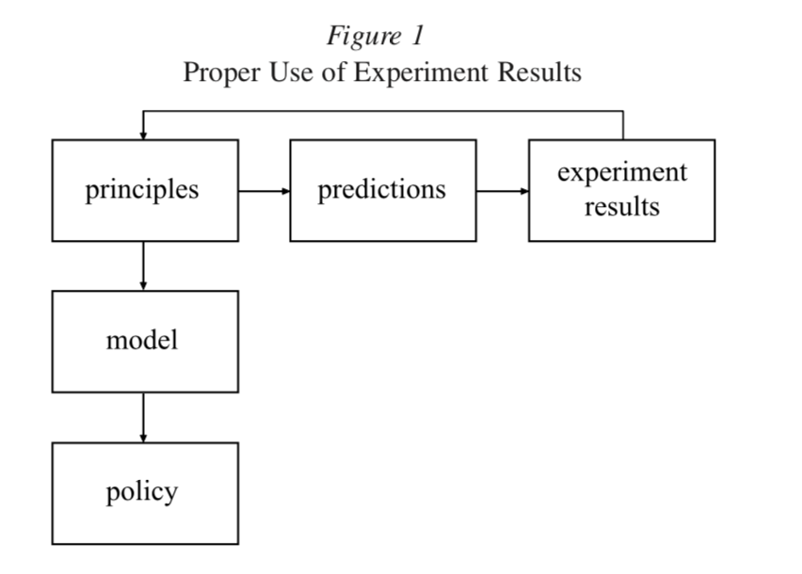
From experiments to policy

Slide 26
Example of Misuse
model
predictions
experiment
results
policy
Individuals rationally use new information to update prior beliefs

Slide 27
Example of Misuse
model
predictions
experiment
results
policy
Forecasts should be consistent with Bayes’ Rule

Slide 28
Example of Misuse
model
predictions
experiment
results
policy
Grether (1980!!): people fail to forecast using Bayes’ Rule

Slide 29
Example of Misuse
On a more scientific level, research by psychologists and economists over the past three decades has raised questions about the rationality of many judgments and decisions that individuals make. People fail to make forecasts that are consistent with Bayes’s rule [Grether, 1980], use heuristics that can lead them to make systematic blunders [cites] exhibit preference reversals (that is, they prefer A to B and B to A) [cites], suffer from problems of self-control [cites], and make different choices depending on the framing of the problem. (Sunstein and Thaler, 2003)
model
predictions
experiment
results
policy
Grether (1980!!): people fail to forecast using Bayes’ Rule

Slide 30
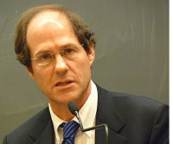
Example of Misuse
model
predictions
experiment
results
policy
Therefore, we should adopt regulations to “nudge” citizens to behave optimally

Slide 31
Missteps in Application
Grether (1980): “The psychologists' predictions [i.e., individuals do not Bayesian update] are confirmed for inexperienced or financially unmotivated subjects, but for others the evidence is less clear.”
Since 1980, hundreds of experiments (and field studies) have been conducted to study Bayesian updating
Results are mixed and the theory has progressed

Slide 32
Cautions
Review: notions of external and ecological validity as applied to experiment designs are misplaced
Apply theories not results
Be on the lookout for cherry-pickers
(and do not cherry pick)

Slide 33
Where are we going?
Experimental Economics
An experiment!
Features of experiments
From experiments to policy
Behavioral Law & Economics
The BE school of thought v. others
From BE theories to policy (i.e., BLE)
Examples of theories (preferences v. biases/errors)

Slide 34
School of Thought: Rational Choice Theory
Decisions optimize utility given rational preferences
Preferences treated as a given (exogenous)
Preferences are rational: complete, transitive and reflexive
Choices are independent of irrelevant alternatives
Extreme versions of RCT assume individuals are wholly self-interested; other versions are more general
Under conditions of uncertainty
Individuals operate under assumptions of expected utility theory
Individuals are Bayesian probability operators (any errors are random—rational expectations theory)
Individuals have consistent time preferences
Discounted utility model (typically exponential discounting assumed)
Revealed Preferences: choices reveal preferences

Slide 35
Schools of Thought: Behavioral Economics (weird name)
Goal: to import insights from the field of psychology to improve economic models (i.e., produce more accurate predictions)
Utility might depend on interpersonal comparisons
Utility might depend on where I started (or what I expected) before things changed (aka reference point dependence)
Decisions impacted by framing effects
Anchoring (writing down digits from SSN can impact willingness to pay for a keyboard)
Preference reversals (10% lost not same as 90% saved)
Individuals have time-inconsistent preferences (hyperbolic discounters)

Slide 36
Schools of Thought: Behavioral Economics (weird name)
Some models assume mistakes or cognitive limitations (e.g., bounded rationality, bounded cognition)
Some simply assume non-standard but rational preferences (e.g., bounded self-interest)
BE ≠ irrationality
No behavioral model has gained universal acceptance

Slide 37
Where are we going?
Experimental Economics
An experiment!
Features of experiments
From experiments to policy
Behavioral Law & Economics
The BE school of thought v. others
From BE theories to policy (i.e., BLE)
Examples of theories (preferences v. biases/errors)

Slide 38
Broad application to law: the early days
Libertarian Paternalism (Sunstein and Thaler, 2003)
Also see Camerer et al. (2003) on asymmetric paternalism
Key idea: we should design laws that NUDGE boundedly rational with scant willpower and unstable (nonexistent?) preferences toward better outcomes without limiting the choices of the rational with strong willpower and stable preferences
strong assumption: at least some irrationals fail to optimize (e.g., perhaps some smokers are behaving rationally, but certainly not all)
In any event, planners must decide on choice architecture
E.g., food placement in a cafeteria line in public schools; opt-out of savings plan rather than opt-in
Might as well make choices that preserve the rationals’ freedom and improve the irrationals’ lives

Slide 39
(some) Critiques of Nudging
Biases might not persist under market discipline
Application of one bias (or mistake type) at a time is unhelpful
Policy makers are also subject to biases
Policy makers do not necessarily have our best interests in mind
Policy makers can’t observe our preferences
Even if we can remedy all this, when we account for libertarian considerations, nudging might make us worse off (Wright and Ginsberg)

Slide 40
Where are we going?
Experimental Economics
An experiment!
Features of experiments
From experiments to policy
Behavioral Law & Economics
The BE school of thought v. others
From BE theories to policy (i.e., BLE)
Examples of theories (preferences v. biases/errors)

Slide 41
Major Categories [see Wilkinson & Klaes (2012)]
Decision-making under risk and uncertainty
Intertemporal choice models
Fairness / social preferences
Mental accounting / framing / choice bracketing
Behavioral game theory

Slide 42
Major Categories
Decision-making under risk and uncertainty
Intertemporal choice models
Fairness / social preferences
Mental accounting / framing / choice bracketing
Behavioral game theory

Slide 43
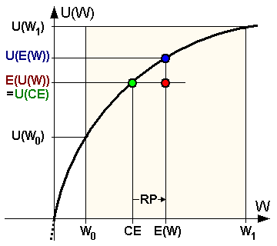
Rational Choice Theory: Choice under Uncertainty
Expected utility theory assuming risk aversion
Expected value of the gamble (e.g., W₀ = 5 and W₁ = 25 and probability of each is 50%, then E(W) = 15
I’m indifferent between the gamble and the “certainty equivalent” (say 10)
RISK PREMIUM
Utility is defined over outcomes (amount of wealth I end up with).

Slide 44
The Allias Paradox (1953)

Slide 45
The Allias Paradox (1953)

Slide 46
The Allias Paradox (1953)
EUT predicts either [1A and 2A] OR [1B and 2B]
BUT, most people chose 1A and 2B
Why 1A? I now own $1M!! Giving it up in exchange for the gamble would hurt
Why 2B? I’ll very likely end up with nothing, so I might as well go for the big win

Slide 47
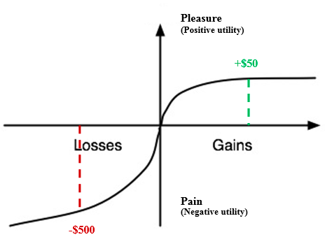
Choice under Uncertainty
BE: Prospect theory (Kahneman and Tversky, 1979)
Starting point matters (reference point)
Risk averse in gains/risk seeking in losses (loss aversion)
Overweight small probability events / underweight large probability events
- x
x
-$100

Slide 48
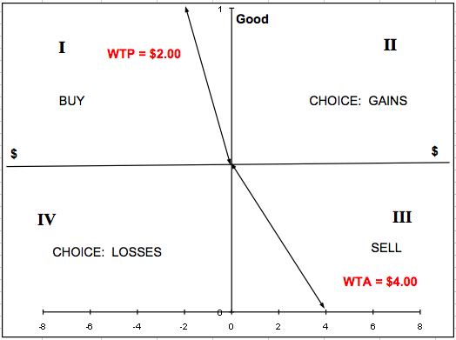
Applying Prospect Theory to Riskless Choice: The Endowment Effect Tversky and Kahneman (1991)
-1

Slide 49
Is Loss Aversion Irrational??
Some argue it is (e.g., Dan Ariely, Predictably Irrational)
But, Tversky and Kahneman are agnostic on this point
“A bias in favor of the status quo can be justified if the disadvantages of any change will be experienced more keenly than its advantages.”
In other words, if one is loss averse, it’s rational to prefer the status quo (all else equal)

Slide 50
Implications for Law (Kelman, 1979)
Coase Theorem (1960): If transaction costs are zero, then outcomes are independent of initial allocation
Parties will bargain to efficient outcome and good/right will end up in hands of the party with the highest value
allocation of legal rights is irrelevant to the outcome
BUT, if reservation values depend on entitlement status, then initial allocation will impact outcome
E.g.,
A reservation value = $10 if entitled, $5 otherwise
B reservation value = $15 if entitled, $7 otherwise
If A is entitled, then A will not trade; if B is entitled, B will not trade
Hard to know whether allocation is efficient; hard to know what efficiency means
Reservation values of those entitled might be thought of as functions of both consumption value and compensation required to suffer loss

Slide 51
Additional Implication
Loss aversion implies that contract default rules will be sticky (Korobkin, 1998)
[but note all sorts of problems with experiment
hypothetical negotiations in highly contextual setting
how does something like this get published??
It’s published in the Vanderbilt Law Review (not peer-reviewed; editors not experts in the field)
Main point: Don’t put equal weight on everything you read]

Slide 52
Back to Uncertainty Evidence of Misjudgments of Probabilities
Self-serving bias: information about uncertain events is interpreted in a way that serves one’s own interests
SJ: discovery might cause divergence of beliefs and lower likelihood of settlement
Hindsight bias: individuals attach excessively high ex ante probability to an outcome if the outcome occurs (SJ: might explain bus judgment rule)
Negligence determinations: juries asked to evaluate ex ante risk perceptions of a reasonable person
BUT, they necessarily evaluate after an injury has occurred
The negligence rule might lead to inefficient levels of care (or unfair punishment if injurers don’t anticipate)
SJ: Can we use law to “debias” individuals to avoid undesirable outcomes?

Slide 53
Major Categories
Decision-making under risk and uncertainty
Intertemporal choice models
Fairness / social preferences
Mental accounting / framing / choice bracketing
Behavioral game theory

Slide 54
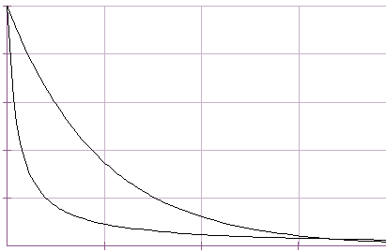
Intertemporal Choice
Decisions involving trade-offs between costs and benefits occurring in different time periods
Rational Choice Theory: discounted utility model (Samuelson, 1937)
constant discount rate over time
if I prefer $110 in one month to $100 today, I will prefer $110 in 1 year and 1 month to $100 in 1 year
Present value
today
Time →

Slide 55
Intertemporal Choice
Contradictory observation: preference reversal
I prefer $100 today over $110 in a month
However, I prefer $110 in a year and one month from now over $100 in one year
This observation and others have sparked the development of alternative models

Slide 56
Hyperbolic Discounting Model (time inconsistent preferences)
Present value
exponential
0
Time →
Are hyperbolic discounters irrational?
How to measure patience levels??
hyperbolic

Slide 57
Example of experiment (Mischel, 1972)
Over 600 kids of different ages took part in the experiment.
Small number ate immediately. 1/3 delayed long enough to get second marshmallow (told that they would get second marshmallow in 15 minutes)
Older kids able to resist longer than younger kids.
Ability to delay gratification has been correlated with higher SAT scores and other measures of success later in life.

Slide 58
Model Assumptions Vary
Individuals are aware that preferences change over time (“sophisticates”)
Able to take advantage of commitment devices (e.g., tying oneself to the mast)
NOTE: These models assume that giving in to temptation is suboptimal (“bounded willpower”) – but normative evaluation of individual preferences is not straightforward (see e.g., Mitchell)
or Individuals are unaware (“naïve”)
or Individuals are partially self-aware (O’Donoghue and Rabin, 2001)
Aware of self-control problems, but underestimate the magnitude of the problem
Many other models that employ different assumptions have been proposed (e.g., habit-formation models, myopia, models of multiple selves)

Slide 59
Legal Applications
Experiments often reveal heterogeneity across subjects
One-size-fits-all type policies might not be optimal
Room for asymmetric paternalism?
Policies that encourage saving
Opt-out v. out-in to employer retirement plans
Tax-free growth and penalty for early withdrawal
Sunstein/Jolls: maybe we should forbid renegotiation of contracts so they can be used as commitment devices?
Sunstein/Thaler: cooling off periods; opt-out for organ donation (“libertarian benevolence”)

Slide 60
Major Categories
Decision-making under risk and uncertainty
Intertemporal choice models
Fairness / social preferences
Mental accounting / framing / choice bracketing
Behavioral game theory

Slide 61
Preferences over fairness/equality (“bounded self-interest”)
Some claim that one of the basic tenants of RCT is absolute self-interest
Recall, though, that RCT takes preferences as given and assumes individuals make choices to maximize happiness given preferences over whatever makes them happy
In any case, many economists have been studying fairness/altruism/spite, what we might think of as non-standard preferences

Slide 62
Evidence
From the field
We tip waiters when we’re traveling
We give to charity
Some donate money to National Public Radio
Some of us fill out our tax returns honestly
Farmers leave produce for sale unattended (but attach the cash box to the table)
From the lab
Some make generous offers in ultimatum/dictator games
Some reject positive but ungenerous offers in ultimatum games (spite?)
Positive contributions in public goods games (at least in early rounds)

Slide 63
Trust Games in the Lab
Berg, Dickhaut, and McCabe (1995)
Design:
player X endowed with $10 and decides how much to give to player Y
Entire amount handed over to Y triples
Y decides how much to give back to X (embedded dictator game)
Theory: a strong version of RCT (pure self-interest) predicts?
X will give $0 b/c X expects Y to return $0

Slide 64
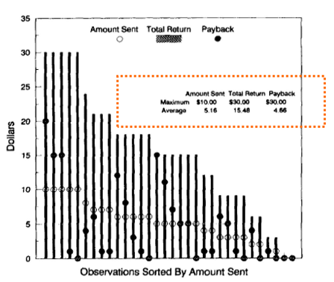
Berg, Dickhaut, and McCabe, 1995

Slide 65
Bohnet, Frey & Huck (2001)
Inquiry: Do contract breach remedies crowd out trust?
Design
similar trust game but X has opportunity to sue Y for breach if she does not return agreed upon amount
treatments varied with respect to likelihood that X will recover
repeated play (one treatment with random matching each round; aggregate behavior reported to subjects between rounds)
Predictions
Low likelihood of enforcement → trustworthiness crowded in (except in last round where we expect end game effects)
Medium (entering contract always better than outside option even with contract breach) → trustworthiness crowded out
High → crowding neutral (parties rely on enforcement)

Slide 66
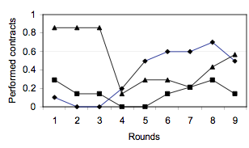
Bohnet, Frey & Huck (2001)
Inquiry: Do breach remedies crowd out trust?
Design
same trust game but X has opportunity to sue Y for breach
repeated play (one treatment with random matching each round; aggregate behavior reported to subjects between rounds
Results
Possible implication: utility derived not from good feelings about being fair but from reputation gained from behaving fairly
STRONG
ALL WEAK
INTERMEDIATE
WEAK

Slide 67
Variation on Trust Game
Fehr, Klein and Schmidt (2007) on principle/agent relationships
First treatment: One-shot game, principle chooses between
Costly investment in verification procedure
Trust contract—high wage ex ante
Like previous study, but person facing risk decides whether to use enforcement mechanism prior to contracting stage
Result: Ps strongly preferred costly verification
Conclusion: no trust if risk is high

Slide 68
Variation on Trust Game
Fehr, Klein and Schmidt (2007), cont.
Second treatment: principle chooses between
Costly investment in verification procedure
Unconditional bonus payment
I’m paying you a bonus to work hard, but you get the bonus whether you work hard or not
the efficient choice if sufficient trust/trustworthiness
Result: even with anonymity and one-shot game, bonus payment earned P more than verification

Slide 69
Impact of Conflict Disclosure on Trust
Cain, Lowenstein and Moore (2005)
Theory tested: law crowds out other-regarding behavior by removing guilt
Design: advisor and investor incentives conflicted; requirement to disclose conflicting incentives manipulated across treatments
Result: forced disclosure led to more distorted advice; investors fared worse in disclosure regime

Slide 70
Fairness/equality: relevance for law?
Arlen/Tally: if “policy-makers wish to auger at least certain types of (efficient) altruistic behavior though their choice of legal institutions….[and] expressed altruism is endogenous to its contextual environment, then lawmakers would want to know which institutions tend to be substitutes for such altruistic behavior, and which appear to be complements.”
Kaplow/Shavell (2001): “[P]olicy evaluation that gives any weight to principles independently of their effect on individuals’ utilities will sometimes lead to choices under which everyone is worse off.”
Ex. Price gouging laws maximize social welfare only if the aggregate utility we get from fairness of the rule outweighs the expected cost of failing to get the good into the hands of the person who values it the most

Slide 71
Major Categories
Decision-making under risk and uncertainty
Intertemporal choice models
Fairness / social preferences
Mental accounting / framing / choice bracketing
Behavioral game theory

Slide 72
Thaler, 1985
Mental accounting: “the set of cognitive operations used by individuals and households to code, categorize and evaluate financial activities”
Framing examples
an individual is more likely to buy a shirt marked down to $30 from $50 than he is if it was originally priced at $30 (“silver lining effect”)
Violates the assumption that utilities depend only on outcomes
Christmas club savings accounts that earn no interest
Violates the fungibility assumption
Expected utility maximizers don’t suffer from lack of self-control
Choice bracketing
Individuals segregate or aggregate choices over time periods
E.g., sunk costs
period 1: I purchase a ski lift ticket
Period 2: decide whether to ski in blizzard
EUT predicts choice in period 2 does not depend on choice in period 1
Data: individuals are much more likely to ski in period 2 if they bought a lift ticket in period 1

Slide 73
Evidence from the field
Camerer et. al (1997)
EUT predicts upward sloping supply curve
EUT predicts that cab drivers will work longer hours as hourly rate increases (i.e., longer hours on busy days)
Observation: Cab drivers work less on busy days!
Alternative theory: cab drivers aim for daily income target (once they earn the target income, they go home)
Narrow time bracket (one day)
Daily income target serves as useful heuristic (don’t have to compare marginal utility of work time with marginal utility of leisure over long period)
Daily income target as useful self-control device
More experienced drivers closer to EUT prediction!
Learn to optimize through experience
Non-optimizing target earners are weeded out by market competition

Slide 74
Major Categories
Decision-making under risk and uncertainty
Intertemporal choice models
Fairness / social preferences
Mental accounting / framing / choice bracketing
Behavioral game theory

Slide 75
Game Theory Assumptions
Game theory: model of interdependent decision-making. Decision makers
consider actions/reactions of others
assume others will act rationally
Herbert Simon (1956) introduced the term “bounded rationality”
Individuals have limited cognitive abilities when it comes to acquiring and processing information
Recall our experiment results
Is it that most people are not capable of iterating beyond a couple steps,
OR do they believe that other people are incapable of doing so??

Slide 76
Cognitive Hierarchy Theory (Camerer, Ho and Chong, 2002)
Individuals think strategically
BUT, they make it through only one or two (or three..) steps of iterated reasoning
The winner will be the one who either:
Iterates (luckily) the “right” number of times
Correctly guesses the distribution of abilities of the group
With repeated play, individuals learn

Slide 77
Important take-aways
BE has made important contributions that have the potential to increase accuracy of economic models
BUT, much more work to be done
Experiments should be carefully evaluated
Do they incorporate all necessary features of the theory? (e.g., non-hypothetical)
Do they control for alternative explanations?
Do subjects understand tasks?
Do results suggest heterogeneity despite conclusions based on aggregate behavior?
Do the results replicate?
Some have suggested a need for more general theories (e.g., Fudenberg, 2006; Schwartz, 2015)

Slide 78
Additional Reading List
Experimental Economics
Camerer, C. "Neuroeconomics: opening the gray box,” Neuron 60 (2008): 416–9.
Camerer, C. “Taxi Drivers and Beauty Contests,” Engineering & Science (1997): 10-19 (http://www.hss.caltech.edu/~camerer/Camerer%20Feature.pdf).
Chorvat, Terrance, Kevin McCabe & Vernon Smith. “Lessons from Neuroeconomics for the Law,” The Law and Economics of Irrationality, Francesco Parisi and Vernon Smith (eds.), Stanford University Press, 2005.
Croson, Rachel, “The Method of Experimental Economics,” International Negotiation 10 (2005): 131-148.
Croson, Rachel, “Why and How To Experiment: Methodologies from Experimental Economics,” University of Illinois Law Review 2002 (2002): 921-945.
Harrison, Glenn W. & John A. List, “Field Experiments,” Journal of Economic Literature 42 (2004): 1009-1055.
Klass, Gregory & Kathryn Zeiler, “Against Endowment Theory: Experimental Economics and Legal Scholarship,” UCLA Law Review 61(2013):2.
Roth, A.E. "Introduction to Experimental Economics," Handbook of Experimental Economics, John Kagel & Alvin E. Roth (eds.), Princeton: Princeton University Press, 1995, 3-109.

Slide 79
Additional Reading List
Behavioral Economics
Allais, M. "Le comportement de l’homme rationnel devant le risque: critique des postulats et axiomes de l’école Américaine,” Econometrica 21:4 (1953): 503–546.
Coase, “The Problem of Social Cost,” (1960).
Fudenberg, Drew, “Advancing Beyond ‘Advances in Behavioral Economics,’” Journal of Economic Literature 44:3 (2006):694-711.
Kahneman, Daniel & Amos Tversky, “Prospect Theory: An Analysis of Decision Under Risk,” Econometrica (1979): 263-292.
Kelman, Mark, “Consumption Theory, Production Theory, and Ideology in the Coase Theorem,” 52 Southern California Law Review 669 (1979): 669-698.
Mischel, Walter, Ebbe B. Ebbesen & Antonette Raskoff Zeiss, "Cognitive and Attentional Mechanisms in Delay of Gratification.” Journal of Personality and Social Psychology 21:2 (1972): 204–218.
Schwartz. Alan, “Regulating for Rationality.” Stanford Law Review 67 (2015) :1373.
Simon, Herbert, “Rational Choice and the Structure of the Environment,” Psychological Review 63 (1956): 129-38.
Thaler, Richard, “Mental Accounting and Consumer Choice,” Marketing Science 4:3 (1985): 199-214.
Thaler, Richard, “Mental Accounting Matters,” Journal of Behavioral Decision Making 12:3 (1999): 183-206.
Thaler, Richard, “Toward a Positive Theory of Consumer Choice,” Journal of Economic Behavior &Organization 1:39 (1980): 39-60.
Tversky, Amos & Daniel Kahneman, “Loss Aversion in Riskless Choice: A Reference-Dependent Model,” The Quarterly Journal of Economics 106 (1991): 1039-1061.
Wilkinson, Nick & Matthias Klaes, An Introduction to Behavioral Economics. (Palgrave MacMillan, 2nd ed., 2012).
White, Mark, The Manipulation of Choice: Ethics and Libertarian Paternalism (Palgrave MacMillian, 2013)
Zeiler, Kathryn, “Mistaken About Mistakes,” European Journal of Law & Economics (forthcoming).

