Slide 1
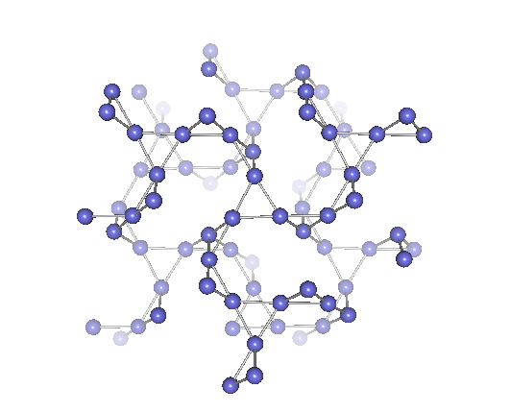
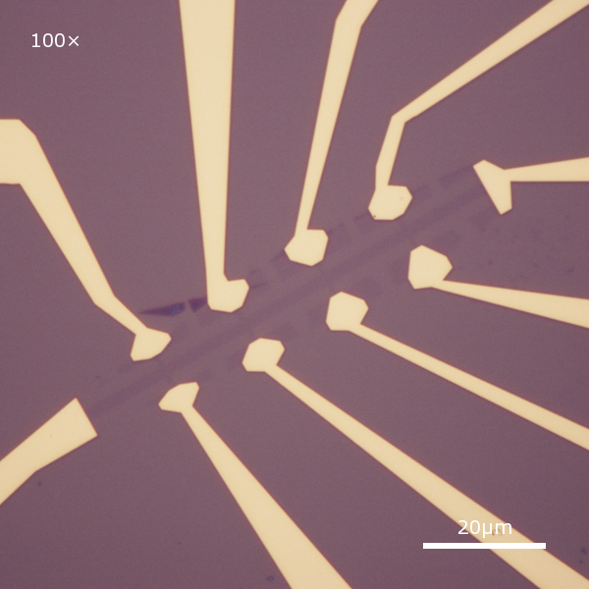
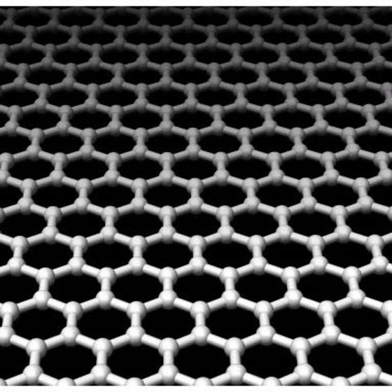
ICAM Boston, Sep. 27, 2013
Phase Change Functions in Correlated Transition Metal Oxides
Hide Takagi
Department of Physics, University of Tokyo
Max Planck Institute for Solid State Research
Notes:
First of all, let me thank the committee members for giving me such exciting opportunity.
Let me talk briefly about my research interest and future plan in the next half an hour.

Slide 2
Design of phase change functions
Struggle to be useful…..
Introduction: Concept of electronic phase
& phase change functions for electronics
electronic phase change can do more…
2. Electronic ice pack using large entropy of correlated electrons
with S.Niitaka (RIKEN)
3. Negative thermal expansion
utilizing magneto-volume effect at phase change
with K.Takenaka(Nagoya & RIKEN)
Digital design
Notes:
To appeal my keyword, let me first talk about the concept of electronic phase and why electronic matter interesting.
Then to help you capturing the concept,
I would like to talk about three recent works on the discovery of exotic electron matter.
Electron super-solid like phase in high-Tc cuprates
qunatum spin liquid
spin orbital electron soild
Based on those, I would like to propose department of quantum materials in Stuttgart.

Slide 3
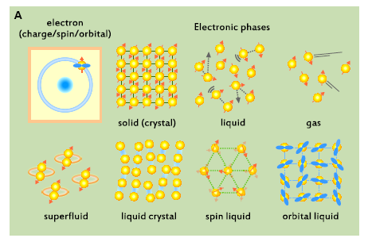
concept of electronic phase
“Electronic matters” in TMO: a rich variety of phases associated with multiple degrees of freedom
H.Takagi & H.Y.Hwang Science 327 (2010) 1601
charge/spin/orital almost independent
charge:solid/spin:liquid
coupling of spin-charge-orbital
even more complicated
self organized pattern of charge/spin/orital
Notes:
Not only solid, liquid and gas state of electrons, in transition metal oxides, we have superfluid state, which is nothing but superconductivity and very likeky liquid crystal state. In addition, each electron has charge and spin degrees of freedom plus choice of orbitals. This multiple degrees of freedom gives rise to even richer variety of exotic phases, for example,
we can have situation where charge forms a solid, namely insulator, but spin remains liquid as we discuss lator. Analogously, we can have an orbital liquid.

Slide 4
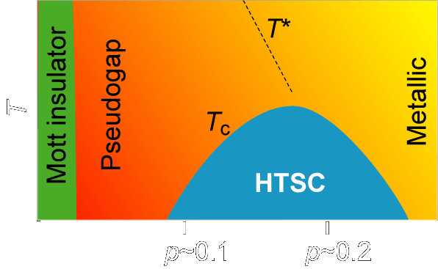
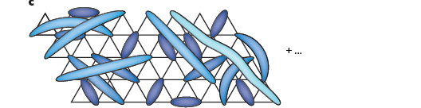
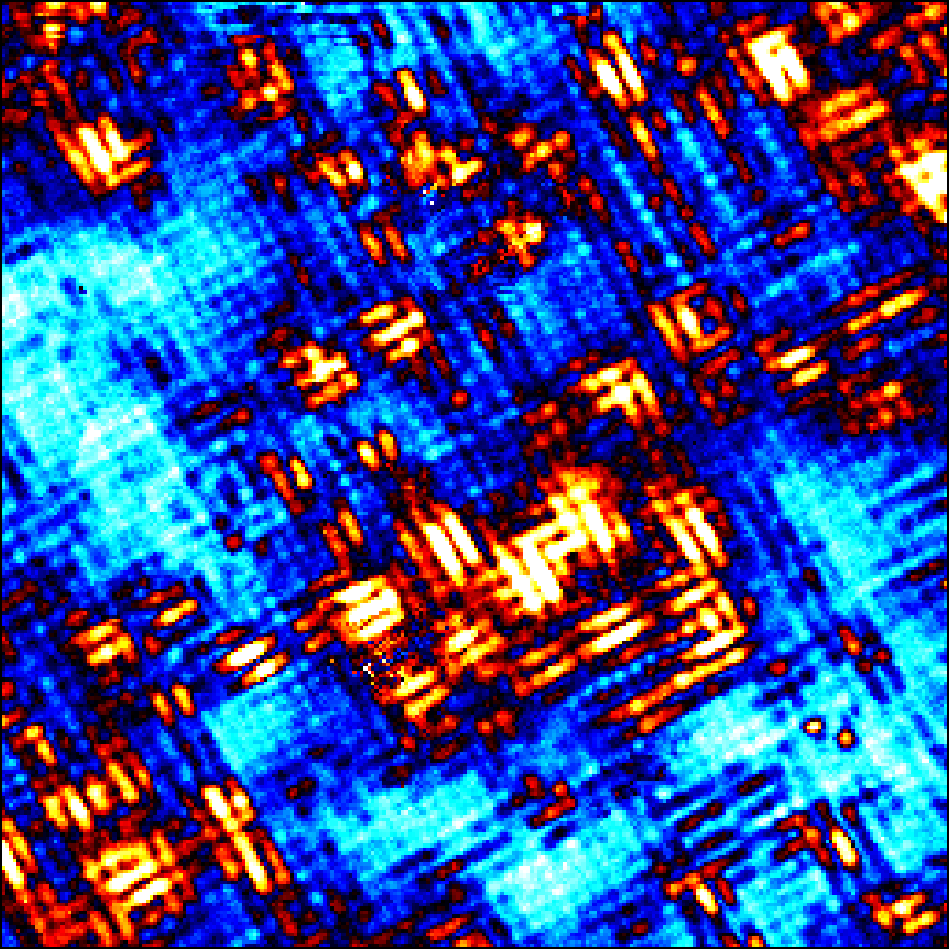
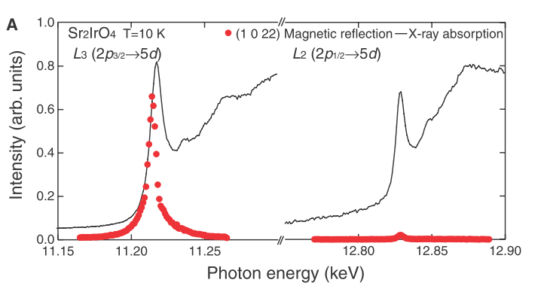
Exploration of novel electronic matter
– goal as a basic science
concept of electronic phase
Quantum spin liquid state in Na₄Ir₃O₈
^{Okamoto, Takagi PRL (07)}
20 nm
Spin-orbital Mott state in Sr₂IrO₄
Nano-stripe formation + nano phase separation
In Ca_{2-x}Na_{x}CuO₂Cl₂
Y.Kohsaka & Takagi, Nature Phys (2012)
J_{1/2}
xy,yz,zx
J_{3/2}
Kim, Ohsumi, Arima & Takagi, Science 323, 1329 (09)
Fujiyama, Ohsumi, Arima & Takagi, PRL (12)
Notes:
Very recently, we found nano-scale phase separation between the parent Mott insulator and the nano-stripe.
This is STM imagefor a non superconducting sample, closer to the parent insulator than the sample in the previous viewgraph..
We clearly see two fold symmetric nano stripe domains are floating on top of four fold symmetric insulating background.
Surprisingly, in nano stripe region, we still see signature of superconducting gap.
When those domains are connected, bulk superconductivity very likely emerges.
In this sense, this is a real space observation of insulator to superconductor transition.
The fact that we are able to see clear phase separation like oil and Vinegar suggests that the nano stripe is a well defined phase.

Slide 5
Phase change function
Functions produced by electronic phase concept
Rich electronic phases solid1 solid 2 , liquid 1 liquid 2 …….
competing with each other
cuprates
ruthenates
cobaltates
Critical phase competition between more than two phases
Phase change may occur with small change of control parameters (E, B, P, T)
-> at the heart of phase change functions
- Gigantic response to external field associated with phase change: sensor
- Phase change : memory

Slide 6
Phase change electronics
Phase change sensor & memory: controlling solid-liquid transition
Pr_{0.55}(Ca_{1-y}Sr_{y})_{0.45}MnO₃
B indeced M-I
-> sensor
Tomioka-Tokura
PRB(02)
0 ≤ y ≤ 0.2, CO/OOI
“electron crystal”
0.25 ≤ y, Feromagnetic Metal
“electron liquid”
E indeced M-I coupled with REDOX
-> memory
Inoue
PRB(08)
Non-volatile resistance switching memory (ReRAM)
-phase change meet with chemistry

Slide 7
entropic electronic phase change
Entropic functions out of electronic phases
in transition metal oxides
Phase change can do more…
Complex, multiple degrees of freedom, highly entropic liquid
H.Takagi & H.Y.Hwang Science 327 (2010) 1601

Slide 8
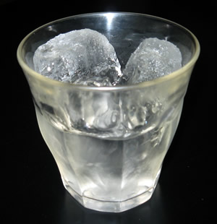
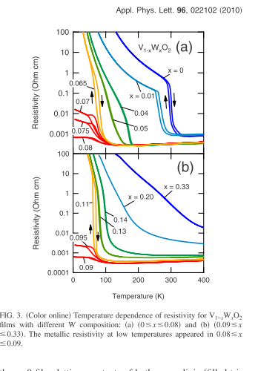

entropic electronic phase change
“10 ℃” electronic ice
El Sol,
Ins
El Liq
Met
shibuya et al. APL
Entropy change associated with ice-water trans.
Electron solid-liquid transition
in VO₂ (rutile)
el. melting temperature controllable
Picnic with Wine?
ice too cold 10 ℃ ice?
enthalpy change/unit volume (DSC)
H₂O 306J/cm³
medical surgery,
raw fish…….
60 ℃ for IC chip protection
VO₂:W (T_{melting}=10 ℃)
146 J/cm³

Slide 9
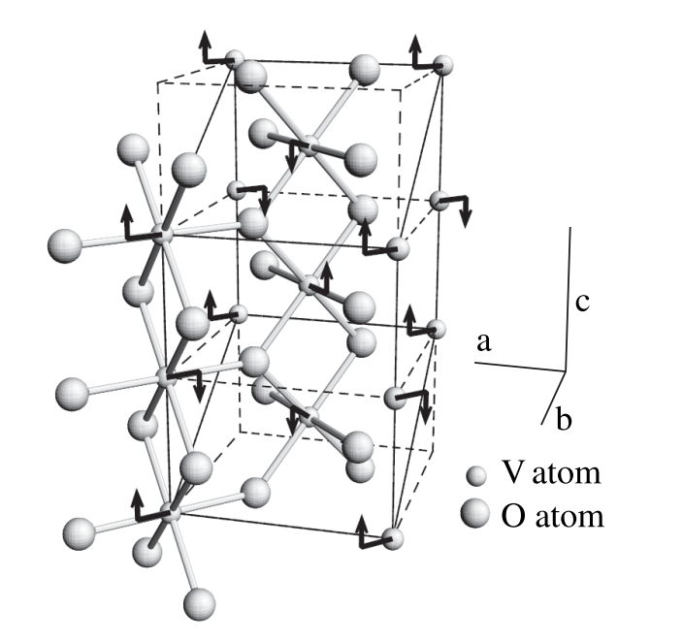
entropic electronic phase change
Why big entropy change comparable to ice/water?
VO₂ V⁴⁺ t_{2g}¹
in the insulating state : V⁴⁺-V⁴⁺ dimer formation
spin singlet & orbital ordering
spin/orbital entropy quenched!
Contrast of entropy between high- and low- T phases
high-T: highly entropic liquid with spin & orbital degrees of freedom
low-T: low entropy solid without spin & orbital entropy
Spin entropy=Rln2 -> ΔH=92 J/cc << 145 J/cc @285K
all spin entropy quenched + some orbital entropy
Notes:
9

Slide 10
entropic electronic phase change
Design(?) of Electronic Ice
Contrast of entropy between high- and low- T phases
low-T: insulator, low entropy solid without spin & orbital entropy
Materials with spin singlet & orbital ordering
 | ΔH (J/g) | Density (g/cc) | ΔH (J/cc) | T_{c} (℃)
H₂O | 334 | 0.917 | 306 | 0
VO₂_W | 31.3 | 4.65 | 146 | 11
LiMn₂O₄ | 8.7 | 4.28 | 37.2 | 21
LiVS₂ | 17.5 | 3.33 | 58.3 | 40
LiVO₂ | 75 | 4.35 | 326 | 206
NaNiO₂ | 22.5 | 4.77 | 107 | 213
200℃ ice
Optimization: How to realize high-T, large entropy liquid?
using spin/orbital

Slide 11
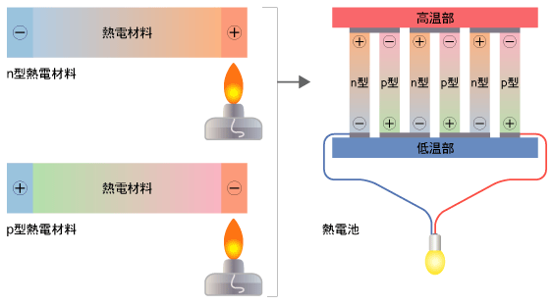
entropic electronic phase change
Entropic electrons for thermoelectrics
NaCo₂O₄:SCES thermoelectrics
Thermoelectric power
S = ΔV/ΔT = entropy / charge e
How to realize high-T, large entropy liquid?
I. Terasaki, Phys. Rev. B 56, R12685 (1997).
Entropic electron liquid NaCo₂O₄
spin/orbital entropy important
Similar situation in LiRh₂O₄ Okamoto, Takagi PRL(09)
Notes:
I have been emphasizing complexity of electronic matter.
Because of multiple degrees of freedom, electronic matter is often highly entropic.
In fact, here is a comparison of enthalpy change associated with liquid-solid transition of water and correlated electrons. As you can see, electronic matters are equally enthropic to water.
In fact, if we can demosntarte to maitain white at 11 deg, using electronic ice pack.
If we carry those electronic entropy by passing current, we can do thermoelectric conversion.
Indeed, thermoelectric power, seebeck coefficient, is nothing but entropy per electron.
based on this concept, we would like to develop novel thermoelectrics.

Slide 12
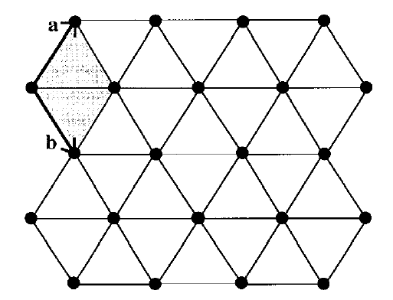
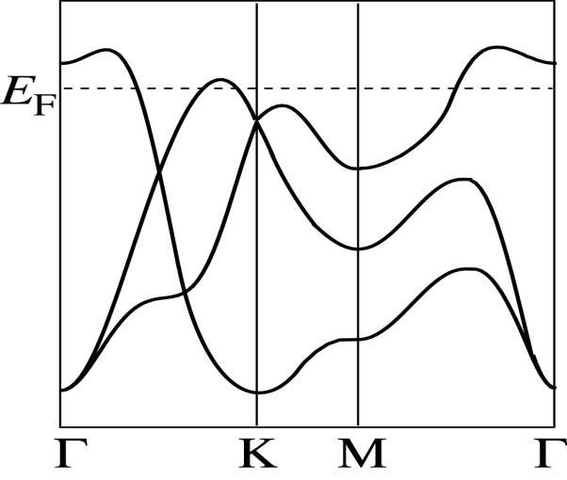
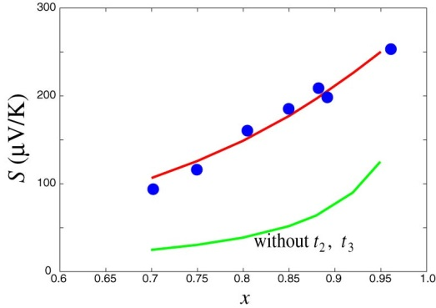
Finding highly entropic electron liquid
Chemist friendly approach
Configuration entropy
S=k_{B}/e ln x/(1-x) Heikes fomula
Enhancement due to orbital/spin
Orbital 3 x spin 2 = 6 +ΔS=K_{B}/e ln 6 ~ 150 μV/K
Co4+ t_{2g}
Koshibae, Phys. Rev. Lett. 87 (2001) 236603.
Localized picture OK for metal?
It works when a large S is realized.
the other way around not always true….
Digital approach
Agreement with exp.
even though SCES
Flat band (localized)
important
How the band picture is connected to high-T limit picture?
Should perform 100 calcs
while we make 1 compound!
Which compound to calculate?
Arita & Kuroki,
NaCo2O4

Slide 13
electronic phase change coupled with lattice
Strain functions out of electronic phase change
α(T ) = [ dL / dT ] /L
T
(ex. 0℃)
L₀
T+ΔT
L(T)=L₀+ΔL
Some materials contract on heating
Negative Thermal Expansion (NTE)
quite useful to control or reduce “positive thermal” expansion.
mirror, stepper, resonator ,,,,,,
Phase change couples with lattice!
large magneto volume effect

Slide 14
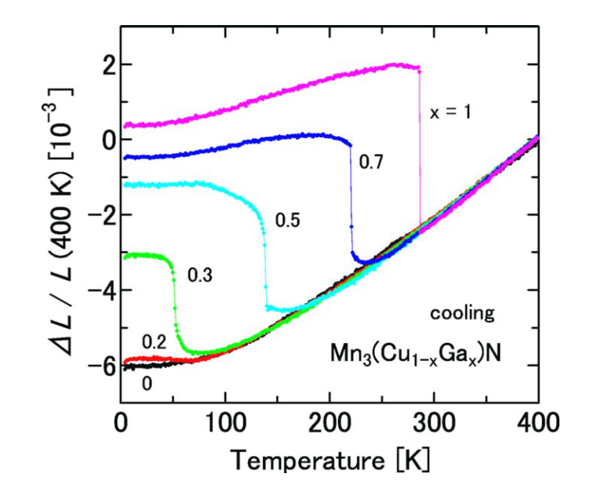
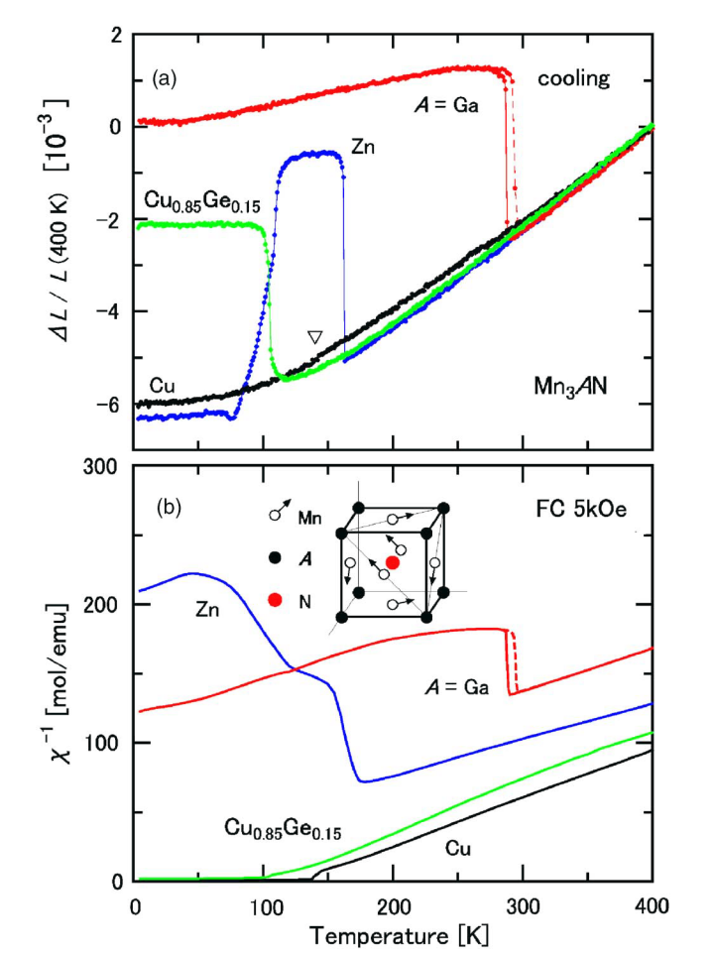
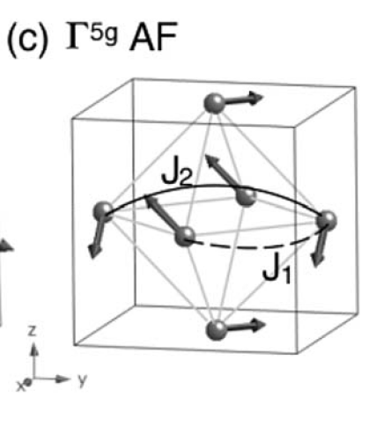
electronic phase change coupled with lattice
Large “negative” Magneto-volume Effect in Mn₃XN
Magnetically frustrated anti-perovskite
J. P. Bouchaud, Anm. Chim. 3 (1968) 81.
In most cases, however,
no broadoning due to doping
Mn₃XN (X: Zn, Ga, Ag, etc)
“only” wit non-collinear magnetic order
“frustration” matters
Magnet-volume relaxer
nano-disorder
ΔL/L ～ 4×10 ⁻³ at T_{mag}
Discontinuous expansion on cooling
to help spins to order
300 K

Slide 15
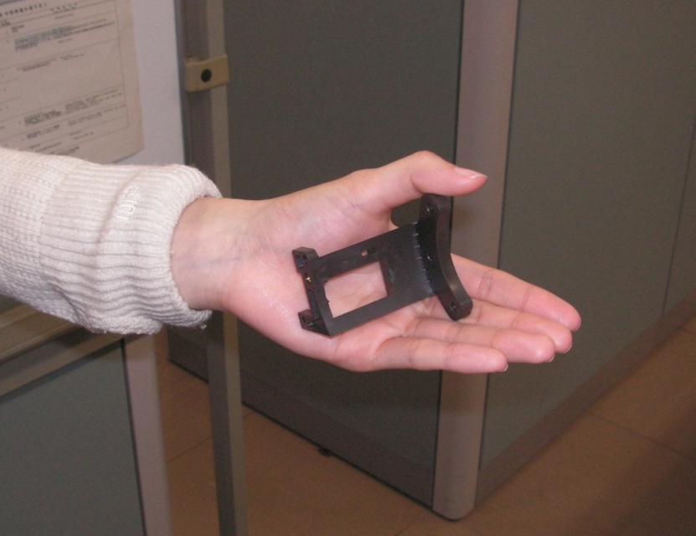
electronic phase change coupled with lattice – after the strggle with periodic table
Negative Thermal Expansion with Ge-Doped Mn₃XN
K. Takenaka and H. Takagi, Appl. Phys. Lett. 87 (2005) 261902
Appl. Phys. 109 (2011) 07309. Adv. Mater. 13 (2012) 01300
Test manufacture made from polyamideimide / NTE MnN composite
Only Ge & Sn promote volume relaxer
【Patents】
WO2006/011590 A1
US Patent No. 7632480
CN Patent No. 200580030788.X
WO2008/081647 A1
WO2008/111285 A1
NTE α= - 20μ/K over a wide T
Isotropic and non-hysteretic

Slide 16
Need for digital design
Magneto-elastic coupling predictable?
Why large magneto-volume effect for non-colinear spins?
Can we do mining using first principle calculations?
thousands of magnets known but strain functions not known
Calculation must be much faster than synthesis!
Dopant effect?
Evidences for significant local disorder induced by Ge & Sn Why?
Can we screen the effective dopant by calculation?
We spent months to find Ge and Sn
local environment by super cell approach?
Generally, dopant plays critical role in functional materials

Slide 17
Summary
Phase change concept in correlated electron systems
brings a variety of functions
not only memory & sensor
but also
ice pack, thermoelectric, negative thermal expansion
-Digital design works better (?)

