Slide 1

Progress in the study of high T_{c} electron doped Ca₁₀(Pt₃As₈)(Fe₂As₂)₅
and Ca₁₀(Pt₄As₈)(Fe₂As₂)₅ superconductors
Ni Ni
University of California, Los Angeles
ICAM-BU workshop: Digital Design of Material, 09/27/2013

Slide 2
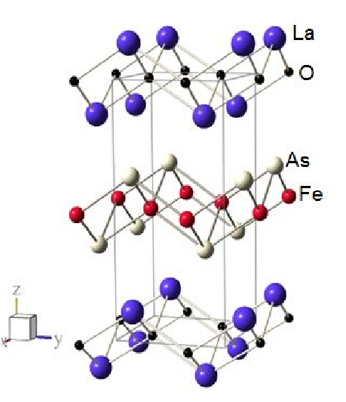
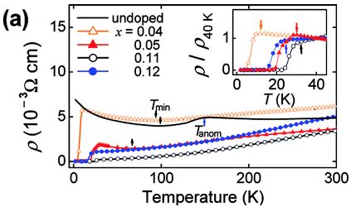
Back to 2008: the first Fe-Based High T_{c} superconductor: LaFeAsO_{1-x}F_{x}
FeAs layer made of the edge-sharing FeAs4 tetrahedral is the conducting layer
key structural ingredient
Reinvestigate known compounds with
FeAs layer and search for new compounds with this layer
Y. Kamihara, H. Hosono, et. al. JACS, 130, 3296 (2008)

Slide 3
History after 2008: Fe based superconductor families
compound identified SC discovered derivatives after 2008
RE³⁺O²⁻FeAs (RE: La-Ce) 2000 2008 AE²⁺F¹⁻FeAs (AE=Ca, Sr, Ba)
AE²⁺Fe₂As₂(AE: Ba, Sr) 1980 2008 CaFe₂As₂
Li¹⁺FeAs 1968 2008 NaFeAs
KFe₂As₂ 1981 2008 AFe₂As₂ (A: Na, Rb, Cs)
(Sr_{n+1}Sc_{n}O_{3n-1})(Fe₂As₂)
Ca₁₀(Pt_{n}As₈)(Fe₂As₂)₅ (n=3,4) 2011 (new structure type) 2011 Pd version
Fe_{1.01}Se 1933 2008
K_{x}Fe_{2-y}Se₂ 2010 (KCo₂Se₂ known in 1989) 2010
2009 ((Sr_{n+1}TM_{n}O_{3n-1})(Cu₂S₂) know in 1999 ) many
Li_{x}(NH₂)_{y}(NH₃)_{1-y}, intercalation
FeSe, LiFeAs, BaFe₂As₂, KFe₂As₂ were all identified well before the Cuprate were found superconducting, but pnictide’s superconductivity were uncovered recently.
Maybe more high Tc superconductors are sleeping in our data base, waiting for theorists & experimentalists to wake up

Slide 4
History after 2008: Fe based superconductor families
compound identified SC discovered derivatives after 2008
RE³⁺O²⁻FeAs (RE: La-Ce) 2000 2008 AE²⁺F¹⁻FeAs (AE=Ca, Sr, Ba)
AE²⁺Fe₂As₂(AE: Ba, Sr) 1980 2008 CaFe₂As₂
Li¹⁺FeAs 1968 2008 NaFeAs
KFe₂As₂ 1981 2008 AFe₂As₂ (A: Na, Rb, Cs)
(Sr_{n+1}Sc_{n}O_{3n-1})(Fe₂As₂)
Ca₁₀(Pt_{n}As₈)(Fe₂As₂)₅ (n=3,4) 2011 (new structure type) 2011 Pd version
Fe_{1.01}Se 1933 2008
K_{x}Fe_{2-y}Se₂ 2010 (KCo₂Se₂ known in 1989) 2010
2009 ((Sr_{n+1}TM_{n}O_{3n-1})(Cu₂S₂) know in 1999 ) many
Li_{x}(NH₂)_{y}(NH₃)_{1-y}, intercalation
FeSe, LiFeAs, BaFe₂As₂, KFe₂As₂ were all identified well before the Cuprate were found superconducting, but pnictide’s superconductivity were uncovered recently.
Maybe more high Tc superconductors are sleeping in our data base, waiting for theorists & experimentalists to wake up

Slide 5
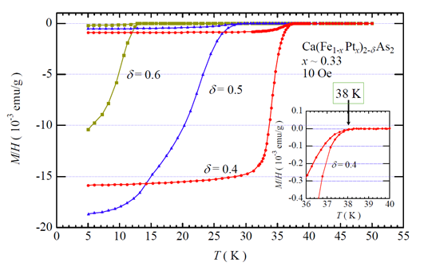
New superconductors in the Ca-Fe-Pt-As quaternaries
Nohara group:
Idea: superconductivity may occur in AEFe₂As₂ systems by creating deficiencies on Fe sites.
Try Ca:(Fe+Pt):As ~1 : 2-x : 2 rather than 1 : 2 : 2
What they got are not what they hope for, but two brand new superconductors :
One is a low temperature phase, T_{c}~13K;
the other phase has T_{c} up to 38K
Notes:
This March, in Japan, Nohara group reported two new superconductors in the Ca-Pt-Fe-As system. One is low temperature phase; the other phase has Tc up to 38K.The bulk superconductivity is
Indicated by the large diamagnetic signal. This is exciting. However, the crystal structures were not successfully characterized although
An alternating Ca, FeAs, Ca, and an unknown layer stacking is suggested.
What’s more the sample is a mixture of new phases and a considerable amount of impurity phases, which hindered the physical characterization and further investigation.
We intended to answer what are they and how they work.

Slide 6
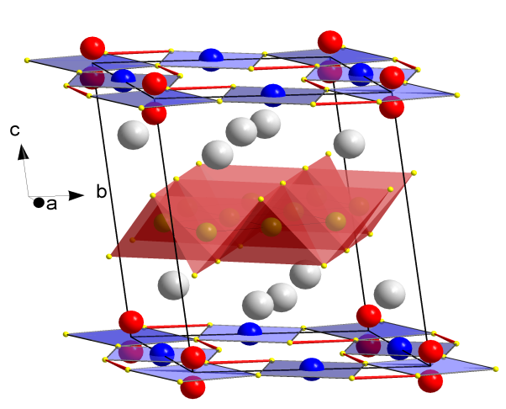
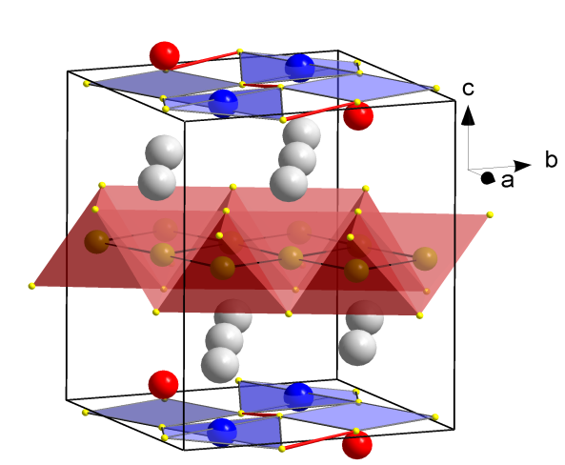
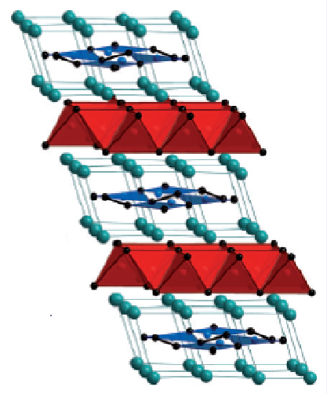
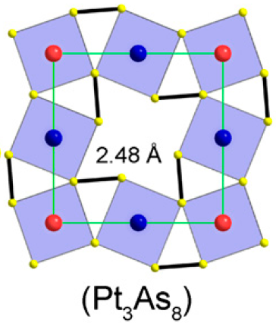
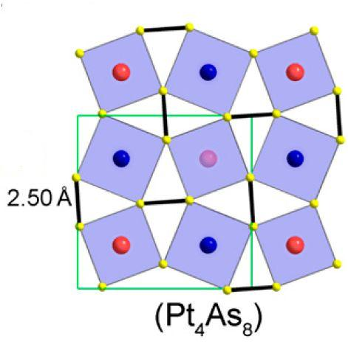
New structure type with -Ca-(Pt_{n}As₈)-Ca-(Fe₂As₂)- stacking
triclinic Ca₁₀(Pt₃As₈)(Fe₂As₂)₅ Ca₁₀(Pt_{4-λ}As₈)(Fe₂As₂)₅
tetragonal triclinic----Pt rich
Three different phases crystalized in new structural types
These structurally and chemically similar compounds
make direct comparison plausible
new insight in achieving high T_{c}?
Notes:
The PtnAs8
layer is a square lattice of corner-sharing PtAs4 squares
with a rotation of approximately 25° about an axis perpendicular
to the plane, governed by the formation of intraplanar As-As
dimers.
The PtnAs8 layer is made of the leads to their complicated formulas, each unit cell contains 10 Ca, 3 or 4 Pt, 10 Fe and 18 AS.
to make it simple, we will call the low Tc phase the “10-3-8” phase, and the high Tc phase the “10-4-8” phase

Slide 7
The ground state of the parent 10-3-8 phase
Sizable single crystals
Normal state:
Anomalies around 100 K
Two kinks in derivative of resistivity
Related to structural/magnetic phase transitions
Structural phase transition:
Revealed by polarized-light optical imaging and Powder X-ray diffraction
Magnetic phase transition:
Revealed by NMR and μSR
Ni Ni, et. al., PRB rapid communications, 87, 060507 (2013)
K. Cho, et al., PRB rapid, 85, 020504 (2012)
T. Zhou, et al., J. Phys.: Condensed Matter 25 122201(2013)
T. Sturzer, et al.,
J. Phys.: Condensed Matter 25 122203(2013)
Notes:
The normal state of the 10-3-8 phase has resistivity around 0.5 to 1 mr cm, indicating their poor metal nature.
It has low carrier concentration. The magnetization is in the range of 10-4 emu/mole, which are all comparable to the other Fe based supercoductors.
both the Hall coeeficient and the seebeck coeefiecient are negative, indicating the dominant role of electrons intransport.

Slide 8
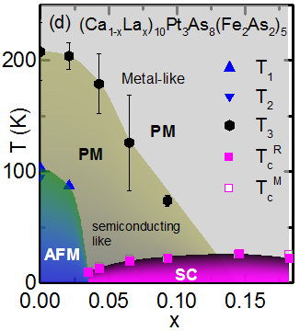
10-3-8 phase: La substitution on Ca sites
SC occurs with La doping
Maximum Tc is 26 K in this study
Highest Tc record in La doped
10-3-8 is 30 K
Bulk SC
Ni Ni, et. al., PRB rapid communications, 87, 060507 (2013)
Notes:
For the x=0.4% doping, when temperature is decreased from 95 K to 5K, domains due to the structural phase transition are observed.
No magnetic anomalies in the susceptibility measurement are observed even for the lowest doping level.
With more Pt doping, the resistivity anomaly is suppressed and
Superconductivity occurs. Tc increases with doping, and reaches 11 K at the highest doping level we got. The bulk superconductivity is confirmed by
the magnetization measurement. A T-x phase diagram based on these data is mapped out for the 10—3-8 phase. We suspect the structure here is the
Triclinic structure wih a!=b
the anisotropy of the optical properties in the lower symmetry phase
different rotation of the polarization plane upon reflection different contrast in the image

Slide 9
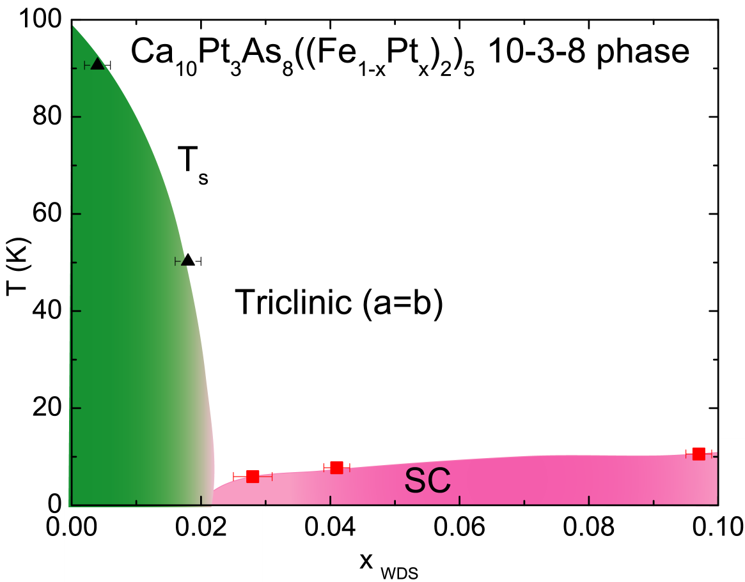
10-3-8 phase: Pt substitution on Fe sites
Superconductivity can be induced by Pt substitution on Fe sites
The only superconductor known in a triclinic lattice
The most anisotropic Fe based superconductor
10-3-8
Ni Ni, R.J.Cava et. al., PNAS, 108, E1019-E1026 (2011)
K. Cho, R. Prozorov, PRB, 85, 020504 (2012)
Notes:
For the x=0.4% doping, when temperature is decreased from 95 K to 5K, domains due to the structural phase transition are observed.
No magnetic anomalies in the susceptibility measurement are observed even for the lowest doping level.
With more Pt doping, the resistivity anomaly is suppressed and
Superconductivity occurs. Tc increases with doping, and reaches 11 K at the highest doping level we got. The bulk superconductivity is confirmed by
the magnetization measurement. A T-x phase diagram based on these data is mapped out for the 10—3-8 phase. We suspect the structure here is the
Triclinic structure wih a!=b
the anisotropy of the optical properties in the lower symmetry phase
different rotation of the polarization plane upon reflection different contrast in the image

Slide 10
10-4-8 phase: Pt substitution on Fe sites
Normal state is a poor metal. Bulk SC is confirmed.
Unlike the 10-3-8 phase, due to the difficulty in growing pure homogeneous samples, the relation between the chemical composition and the superconducting properties were not reported consistently in different groups.
Ca₁₀(Pt_{4-λ}As₈)((Fe_{1-x}Pt_{x})₂As₂)₅
K. Kudo, M. Nohara et. al., JPSJ, 80 (2011)
C. Lohnert, D. Johrendt, Angew. Chem. Int. Ed. 50, 9195 (2011)
Q.P. Ding, T. Tamegai, et. Al.,
PRB, 85, 104512 (2012)
Ni Ni, R.J.Cava, et. al., PNAS, 108, E1019-E1026 (2011)
T_{c}=38K
λ = 0, x=0.18
Triclinic structure
obtained by Rietveld refinement of
synchrotron power X-ray diffraction pattern of
well characterized pieces.
T_{c}=35K
λ = 0.42, x=0
Tetragonal structure
obtained by Rietveld refinement of
power X-ray diffraction pattern
T_{c}=33K
λ = 0.49, x=0.02
Tetragonal structure
obtained by EDX measurement
T_{c}=26K
λ = 0.246, x=0.03
Tetragonal structure
obtained by single crystal
X-ray measurement and EDX
From the reports from different groups, no unified trend of the relation of Tc and concentration can be extracted Investigation in this system is needed to reliably
build up this λ, x and Tc phase diagram
Notes:
OK, now we move to the high Tc 10-4-8 phase. Since only 100 micronmeter single crystals were grown and the doping level can not be tuned, we only
Have limited information about this phase. The single crystal xray diffraction shows
The normal state resistivity shows no anomalies and decreases with decreasing temperature, although its value
Is smaller than the 10-3-8 phase, it is still poor metal. Bulk superconductivity is detected below 25 K, which is much lower than the reported 38 K.
This could be due to the different level of Pt vacancy or doping between these samples.

Slide 11
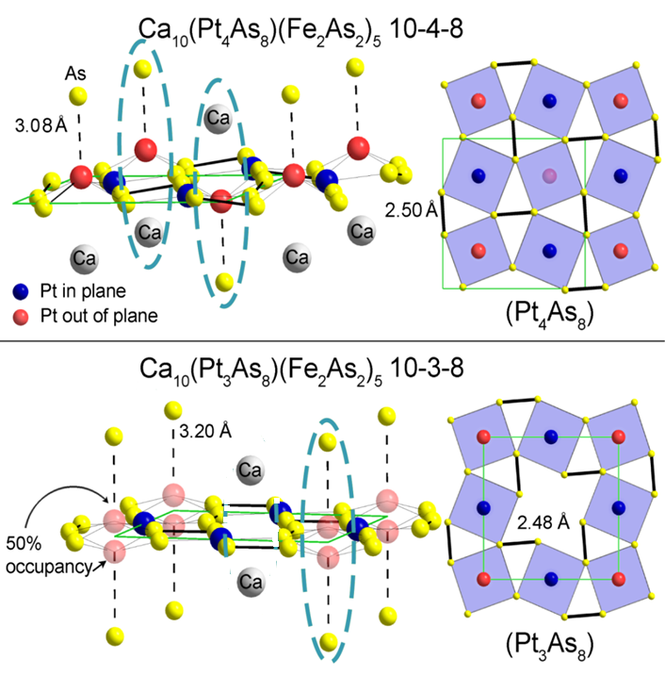
Comparison between these two phases
Extra electron count? As-Fe-As bond angle? Not enough.
One hypothesis: the nature of the spacer layer
Chemical point of view:
[Ca₁₀ ]²⁰⁺ (Pt₃As₈)¹⁰⁻[(Fe₂As₂)₅]¹⁰⁻
is valence satisfied
Zintl compound
semiconducting nature of Pt₃As₈ layer
weak interlayer FeAs coupling in 10-3-8 phase.
Ni Ni, et. Al., PNAS, 108, E1019-E1026 (2011)
Notes:
They are structurally and chemically similar compounds with the biggest differencce lying on the PtnAs8 layer,
both of them have the magic As, why is Tc so different, one has the highest Tc
At 11 K and the other one has the highest Tc abround 38 K?
The extra electron count or the empirical rule of the As-Fe-As bond angle are not enough to count it.
We believe these two systems provide New insight in increasing Tc in fe pnicetide.

Slide 12
Comparison between these two phases
Structural point of view:
One interlayer Pt-As interaction
channel per unit cell in 10-3-8; two in 10-4-8
weaker interlayer coupling in 10-3-8 and better isolated Pt₃As₈ layers
Pt₃As₈ layer is more electronically blocking and its semiconducting nature is reinforced
weak interlayer FeAs coupling in 10-3-8 phase.
The importance of the interlayer coupling and metallicity of the spacer layer
Ni Ni, et. Al., PNAS, 108, E1019-E1026 (2011)
Notes:
They are structurally and chemically similar compounds with the biggest differencce lying on the PtnAs8 layer,
both of them have the magic As, why is Tc so different, one has the highest Tc
At 11 K and the other one has the highest Tc abround 38 K?
The extra electron count or the empirical rule of the As-Fe-As bond angle are not enough to count it.
We believe these two systems provide New insight in increasing Tc in fe pnicetide.

Slide 13
Comparison between two phases
The other hypothesis:
10-3-8 can be taken as the parent compound for 10-4-8.
The reason 10-4-8 shows higher Tc is because the extra Pt indirectly doped the FeAs layer----- rigid band approximation
Recently ARPES measurements have provided some clue.
C. Lohnert, D. Johrendt, Angew. Chem. Int. Ed. 50, 9195 (2011)
Notes:
They are structurally and chemically similar compounds with the biggest differencce lying on the PtnAs8 layer,
both of them have the magic As, why is Tc so different, one has the highest Tc
At 11 K and the other one has the highest Tc abround 38 K?
The extra electron count or the empirical rule of the As-Fe-As bond angle are not enough to count it.
We believe these two systems provide New insight in increasing Tc in fe pnicetide.

Slide 14
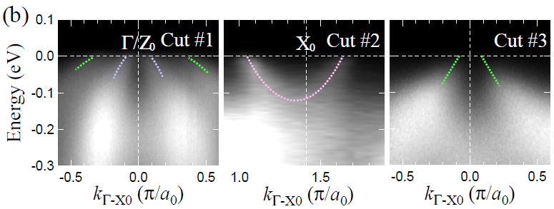
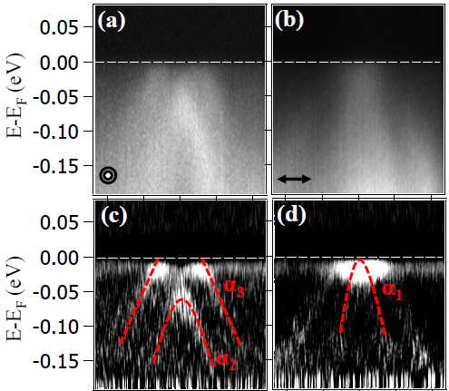
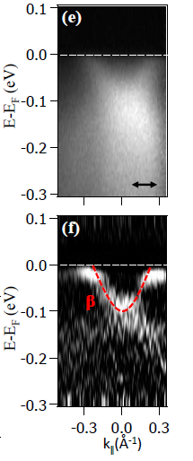
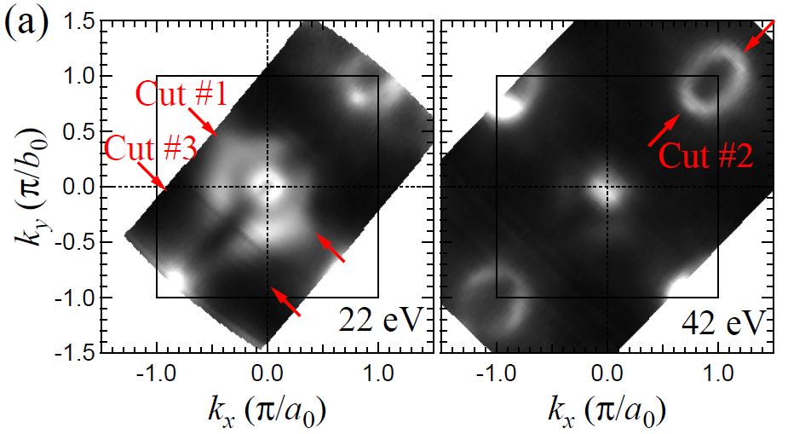

ARPES: electronic structures of 10-3-8 and 10-4-8 phase
Sample: underdoped 10-3-8: Tc=8K optimal doped 10-3-8: Tc=15 K
M. Z. Hasan, et. al, Phys. Rev. B 85, 094510 (2012)
S. V. Borisenko, et. al., arxiv: 1307.1608v1 (2013)
1. One hole pockets at zone center,
one electron pocket at zone corner
2. No Fermi pocket from Pt₃As₈ layer
1. Two hole pockets at zone center, one electron
pocket at zone corner
2. No Fermi pocket from Pt₃As₈ layer, indicating
they are weakly coupled to the FeAs layers

Slide 15
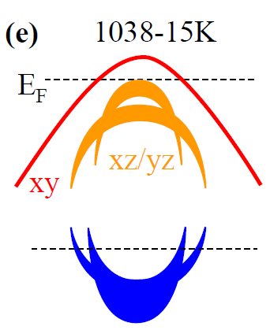
ARPES: electronic structures of 10-3-8 and 10-4-8 phase
Sample: underdoped 10-3-8: Tc=8K optimal doped 10-3-8: Tc=15 K
M. Z. Hasan, et. al, Phys. Rev. B 85, 094510 (2012)
S. V. Borisenko, et. al., arxiv: 1307.1608v1 (2013)
1. One hole pockets at zone center,
one electron pocket at zone corner
2. No Fermi pocket from Pt₃As₈ layer
1. Two hole pockets at zone center, one electron
pocket at zone corner
2. No Fermi pocket from Pt₃As₈ layer, indicating
they are weakly coupled to the FeAs layers

Slide 16
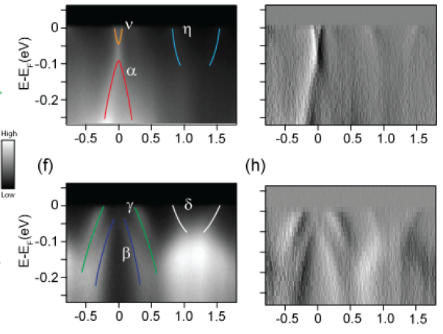
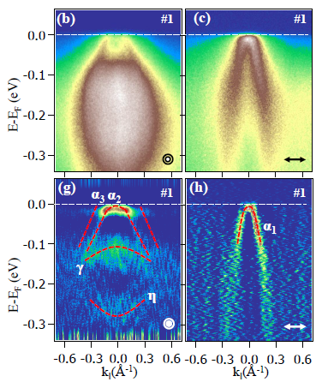
ARPES: electronic structures and Fermi surface
Ca₁₀(Pt_{4-λ}As₈)((Fe_{1-x}Pt_{x})₂As₂)₅,
near optimal 10-4-8: T_{c}=35 K; overdoped 10-4-8: T_{c}=22 K
S. V. Borisenko, et. al., arxiv: 1307.1608v1 (2013)
D. L. Feng, et. al, arxiv: 1308.3105v1 (2013)
from Pt₄As₈ layer
No pocket observed from Pt₄As₈ layer
2. only one dxy-originated hole pocket around
the zone corner, but the top of dxz and dyz band coincide and lie at the Ef
Electron pocket from Pt₄As₈ layer-----the first Fe based superconductor with a metallic spacer layer.
2. only one d_{xy}-originated hole pocket in zone
center
3. negligible kz dependence

Slide 17
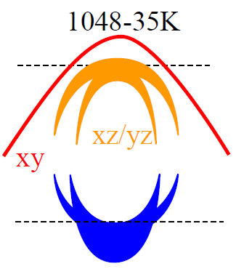
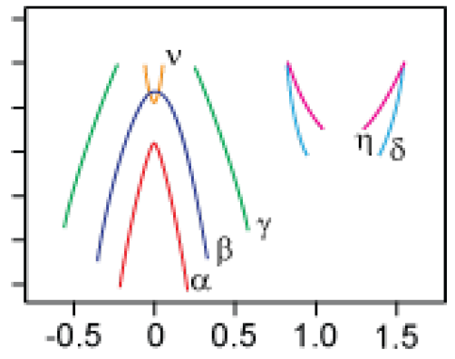
ARPES: electronic structures and Fermi surface
Ca₁₀(Pt_{4-λ}As₈)((Fe_{1-x}Pt_{x})₂As₂)₅,
near optimal 10-4-8: Tc=35 K; overdoped 10-4-8: Tc=22 K
S. V. Borisenko, et. al., arxiv: 1307.1608v1 (2013)
D. L. Feng, et. al, arxiv: 1308.3105v1 (2013)
Not rigid band

Slide 18
ARPES: electronic structures and Fermi surface
Ca₁₀(Pt_{4-λ}As₈)((Fe_{1-x}Pt_{x})₂As₂)₅,
near optimal 10-4-8: Tc=35 K; overdoped 10-4-8: Tc=22 K
S. V. Borisenko, et. al., arxiv: 1307.1608v1 (2013)
D. L. Feng, et. al, arxiv: 1308.3105v1 (2013)
Not rigid band
Ca₁₀(Pt₃As₈)((Fe_{1-x}Pt_{x})₂As₂)₅,
optimal 10-3-8
underdoped 10-3-8

Slide 19
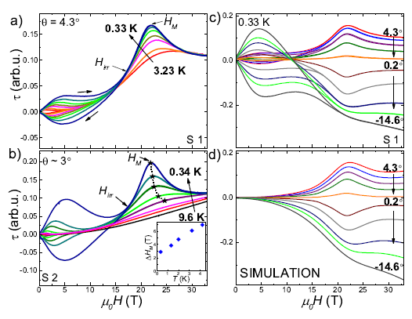
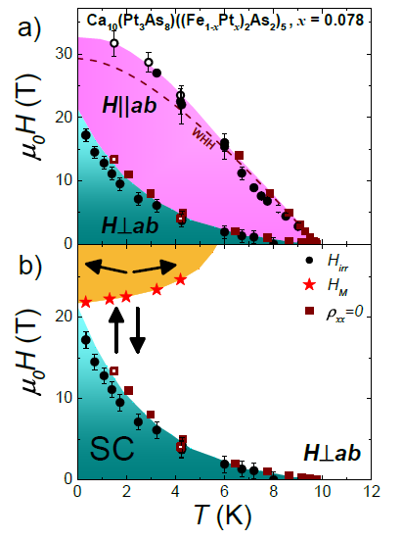
Field-induced spin-flop of AFM fluctuation in Pt doped 10-3-8
Watson, Coldea, et. al., to be submitted (2013)
a clear anomaly in the magnetic torque data when H is perpendicular to ab plane.
It is symmetric to the normal to the ab plane. This is unique in Fe pnictides.
Spin-flop of antiferromagnetic fluctuation

Slide 20
Summary of this review
Structural/magnetic phase transitions occur in 10-3-8 parent compound
Bulk SC up to 38 K has been induced in 10-3-8 and 10-4-8
Optimal doped 10-4-8 shows two band-edge singularities at Ef, possibly
giving rise to higher Tc; overdoped 10-4-8 has an electron pocket at zone
center coming from Pt4As8 layer, indicating the first Fe pnictide
superconductor with a metallic spacer layer; rigid band approximation can not
be assumed from 10-3-8 phase to optimal 10-4-8 phase to overdoped 10-4-8
phase.
Field induced spin-flop transition of AFM fluctuation is observed in nearly optimal doped 10-3-8.

Slide 21
The effects of applied external pressure
Superconductivity up to 10 K can be induced by applied pressures
Ni Ni, et. Al., PNAS, 108, E1019-E1026 (2011)
Peiwen Gao, Liling Sun, et. al., Arxiv: 1301.2863 (2013)
Notes:
For the x=0.4% doping, when temperature is decreased from 95 K to 5K, domains due to the structural phase transition are observed.
No magnetic anomalies in the susceptibility measurement are observed even for the lowest doping level.
With more Pt doping, the resistivity anomaly is suppressed and
Superconductivity occurs. Tc increases with doping, and reaches 11 K at the highest doping level we got. The bulk superconductivity is confirmed by
the magnetization measurement. A T-x phase diagram based on these data is mapped out for the 10—3-8 phase. We suspect the structure here is the
Triclinic structure wih a!=b
the anisotropy of the optical properties in the lower symmetry phase
different rotation of the polarization plane upon reflection different contrast in the image

Slide 22
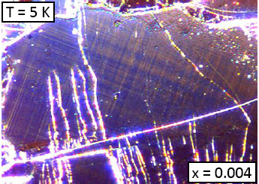
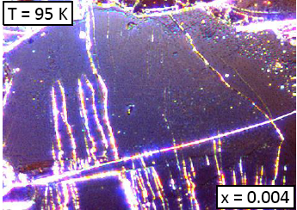
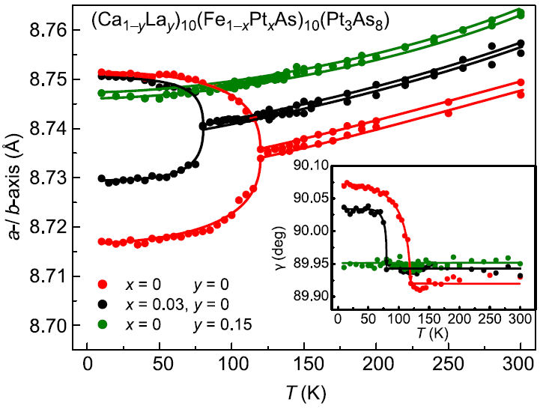
The ground state of the parent 10-3-8 phase
Structural phase transition exists :
polarized-light optical imaging
K. Cho, et al., PRB rapid, 85, 020504 (2012)
X-ray diffraction
T. Sturzer, et al.,
J. Phys.: Condensed Matter 25 122203(2013)
Notes:
We can see from the powder xray data that no impurities exist in the sample and the pattern was fitted well with our structure model.
The bulk superconductivity is conformed by the zero resitivity, 100% of shielding fraction and a subtle jump in heat capacity.
Althogu The FC messnner fraction is small, it is comparable to other fe pnicetides and it is due lto the flux pinning. The anisotropic Hc2 measuremnet
Shows the 10-3-8 phase is the most anisotropic one in the Fe based superconductor.

Slide 23
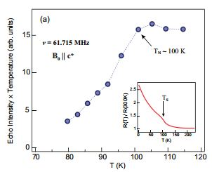
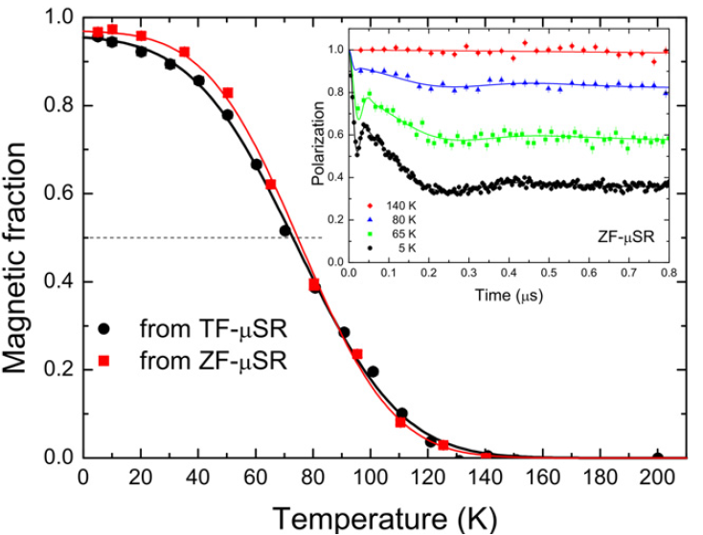
The ground state of the parent 10-3-8 phase
NMR shows long range AFM
T. Zhou, et al., J. Phys.: Condensed Matter 25 122201(2013)
μSR shows long range AFM
T. Sturzer, et al.,
J. Phys.: Condensed Matter 25 122203(2013)
CaFe₂As₂: T_{s}/T_{SDW}=170K
The insertion of the intermediary Pt₃As₈ layer leads to longer FeAs distance, which may lead to the lower structural and magnetic phase transitions.
Notes:
We can see from the powder xray data that no impurities exist in the sample and the pattern was fitted well with our structure model.
The bulk superconductivity is conformed by the zero resitivity, 100% of shielding fraction and a subtle jump in heat capacity.
Althogu The FC messnner fraction is small, it is comparable to other fe pnicetides and it is due lto the flux pinning. The anisotropic Hc2 measuremnet
Shows the 10-3-8 phase is the most anisotropic one in the Fe based superconductor.

