Slide 1
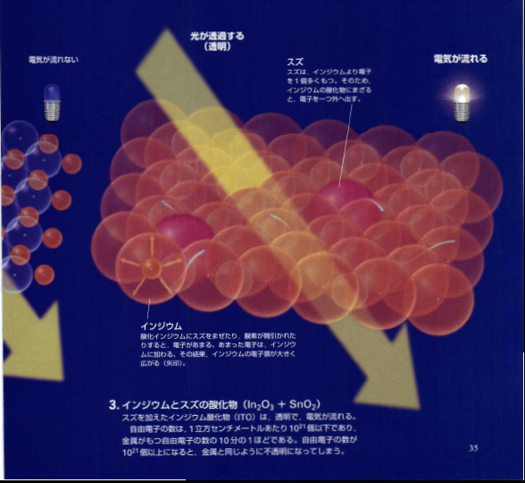
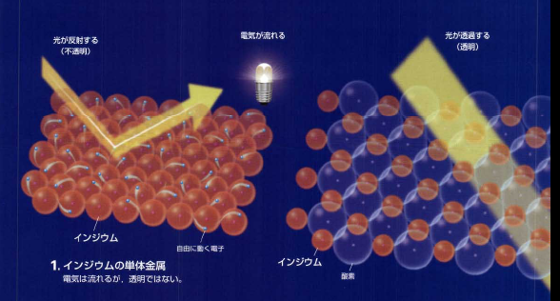
Materials Design of Transparent Oxide Semiconductor
In₂O₃
In
In³⁺ 5s
STO radius
Hideo HOSONO
Frontier Research Center
Tokyo Institute of Technology, JAPAN

Slide 2
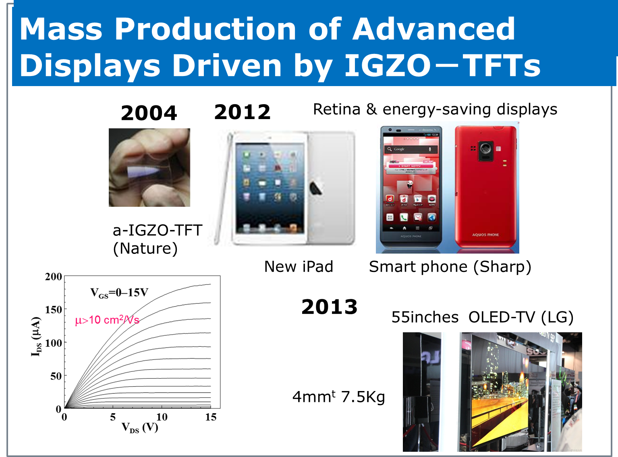

Slide 3
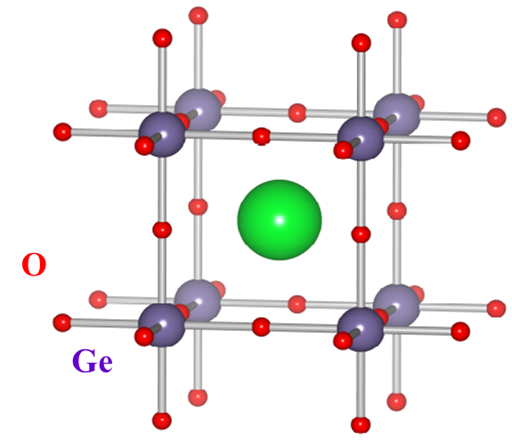
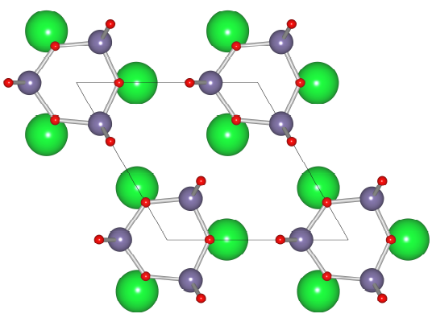
TCO Frontier
Outermost
STO radius
pm
Edge-sharing MO₆ chain
e
-
2-
Metal vacant ns⁰
Sr
M⁺ p-block metal
Ge
O
Ex. In³⁺, Sn⁴⁺, Cd²⁺
High pressure phase
( degenerate semicond.)
Ambient phase
(insulator)
Nature Commun.(2011)

Slide 4
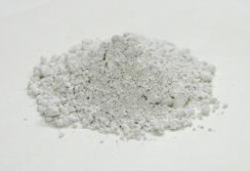
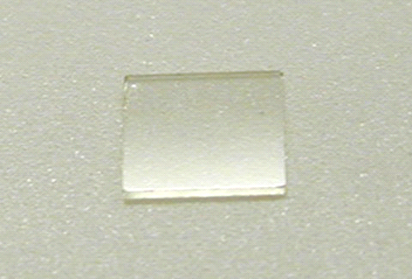
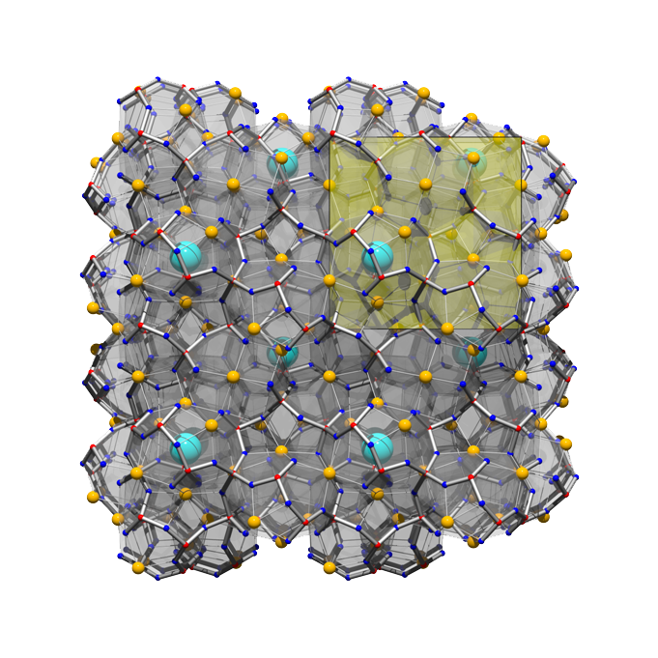
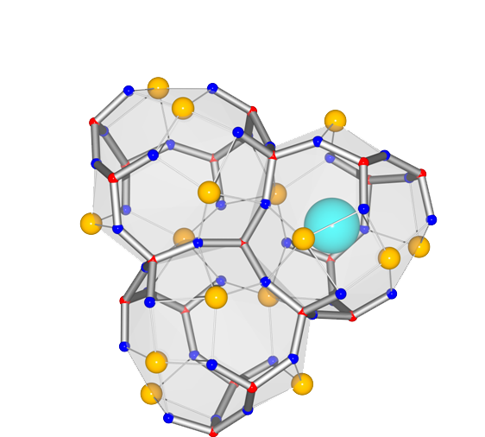
12CaO∙7Al₂O₃ (C12A7)
powder
single crystal
A constituent of alumina cements
Large band gap ~7 eV
Cubic (a = 1.199 nm, I43d)
Unit cell: Ca₂₄Al₂₈O₆₆ = [Ca₂₄Al₂₈O₆₄]⁺⁴+ 2O^{2–}
Mp. 1415 ºC
12 Cages
6×10²¹ cm^{–3}
Free Oxygen Ions
1×10²¹ cm^{–3}
Unit cell
Al
O
1.199 nm
Ca
Densely Packed Sub-nano-sized Cages
Fast Oxygen Ion Conductor
Notes:
In 2003 we reported first RT stable electride using C12A7 crystal with nanoporous crstal stricture in place of organic ligands.

Slide 5
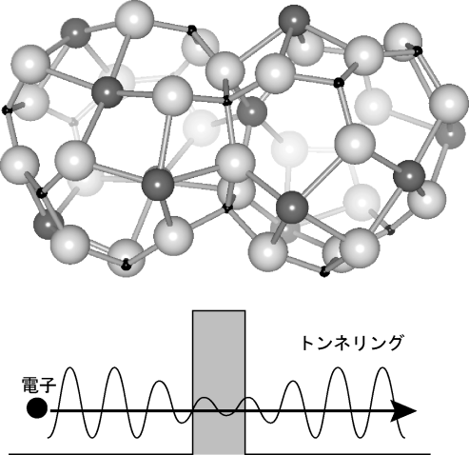
Electronic Structure of C12A7
6
Conduction Band (Framework)
Wave functions confined in cages
Evac
WF=2.4eV
4
Cage Conduction Band
2
0
tunneling
Energy (eV)
O_{2p} (Free Oxygen)
-2
Valence Band (Framework)
-4
Ζ
Α
Μ
Γ
Ζ
Ρ
Ξ
Γ
_{k}
PRL(2003), PRB(2005), Nanolett(2007), Adv.Mat (2007)
Notes:
The small open mouse structure suppresses the invasion of O2 and H2 molecule from oitside.
Invasion
This is a energy band struture of C12A7..

Slide 6
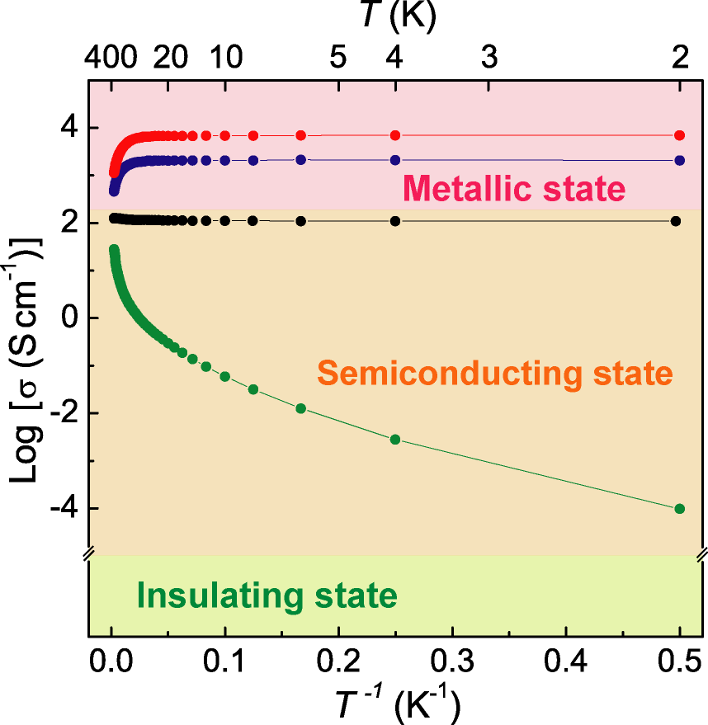
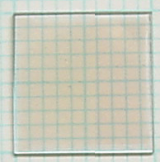
Metal – Insulator Transition
Metal composed of typical insulators, lime and alumina !
1.5x10³Scm⁻¹@RT
2x10²¹cm⁻³
Band Conduction
Nc = ~1 × 10²¹ cm^{–3}
Metal – Insulator Transition
electron
concentration
In cages
Hopping Conduction
3x10¹⁹cm⁻³
Polaron : electron localized by lattice distortion
Nano Lett. 2007
σ = ∼10⁻¹⁰Scm⁻¹

Slide 7
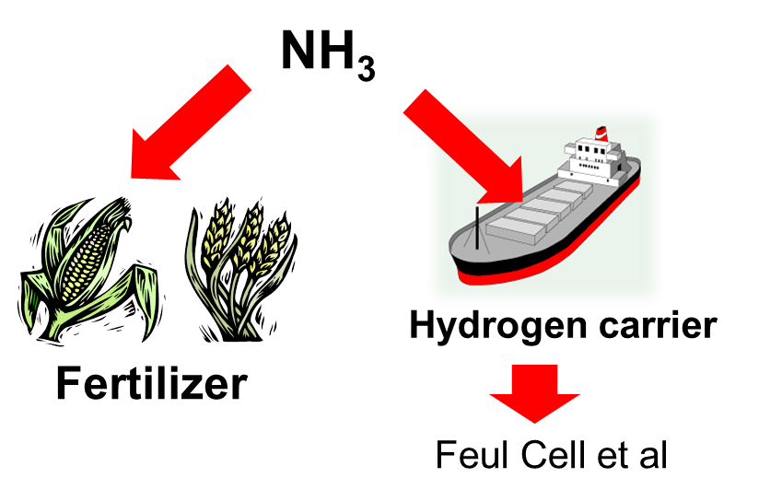
Ammonia Synthesis
Harber-Bosch Process
Mass production
started in 1912
Fe₃O₄
N₂ + 3H₂
2NH₃
200-400 atm
400-600ºC
Issue： Huge Energy Consumption
（1% of total energy consumed by Human Being）

Slide 8
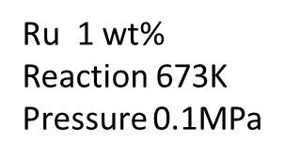
Performance
Activation Energy of reaction
Activation Energy
C12A7 electride
N₂
H₂
C12A7:O²⁻
NH₃
Cs-loaded MgO
Reported
Ba-loaded carbon
black：reported
blue：C12A7:e-
Catalytic activity /site
Catalytic activity : ten times higher
Activation Energy : ~Half
Nat.Chem.(2012)

Slide 9
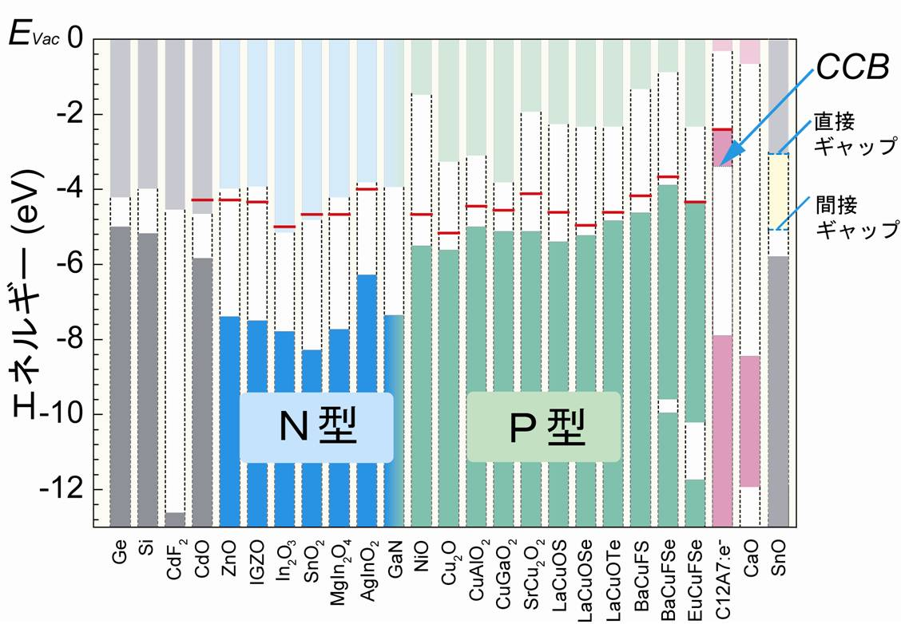
Band Lineup
Direct
Gap
Indirect
Gap
E
Energy
N-type
P-type
JJAP (comprehensive review) Sep 2013
Notes:
The band gap of C12A7 is ~7eV. Why can we dope electron to this material ?
The bandline up provides the reason.

Slide 10
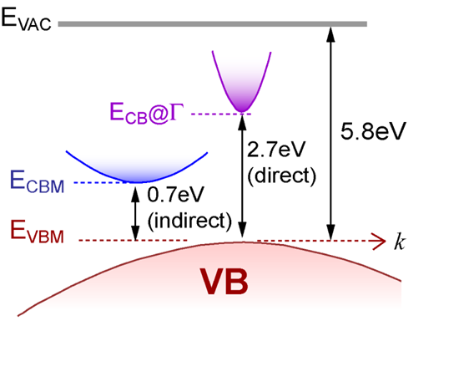
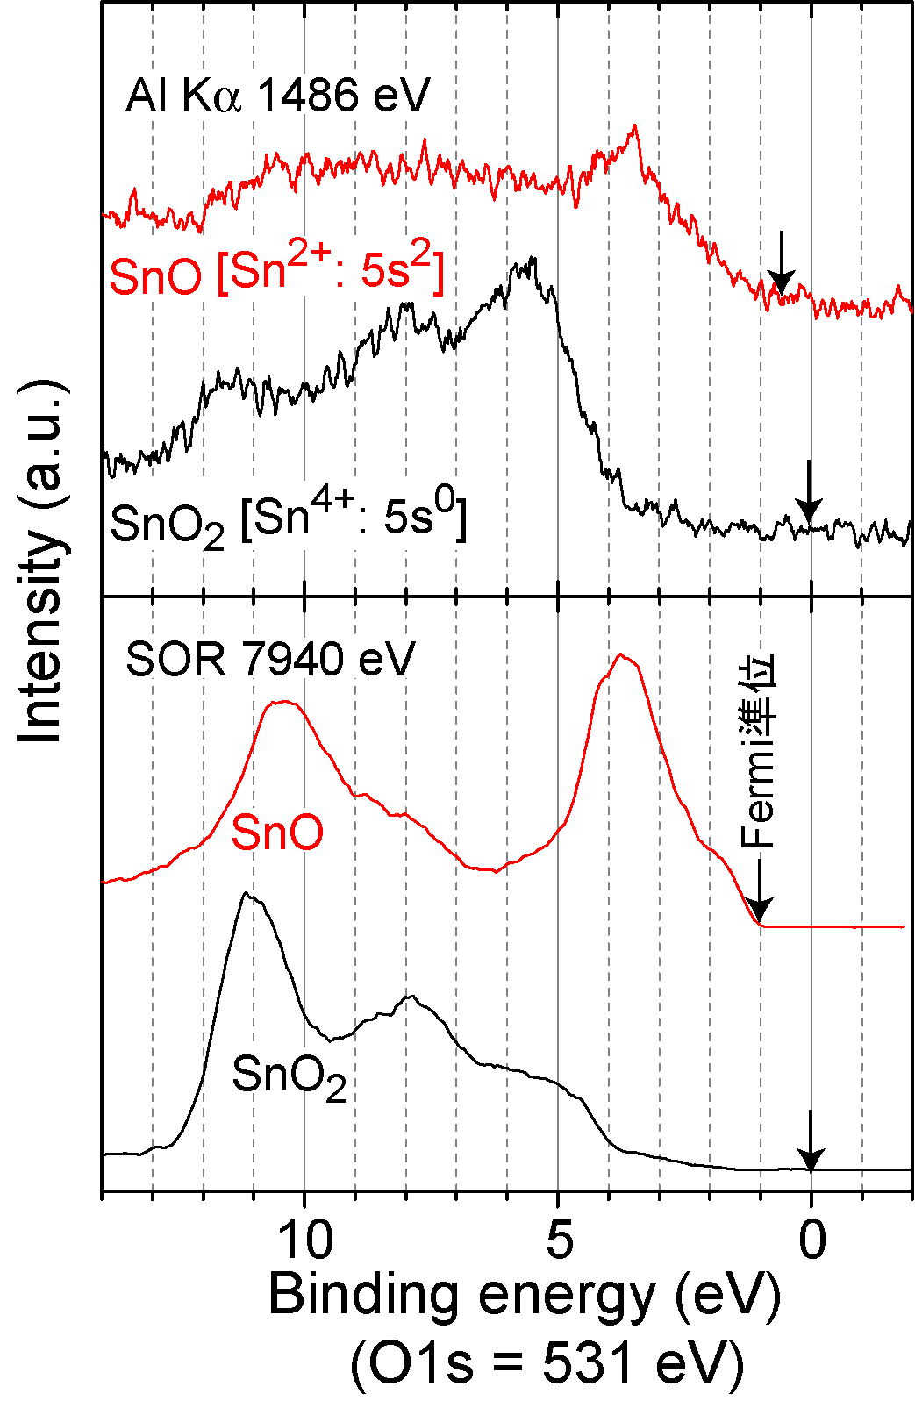
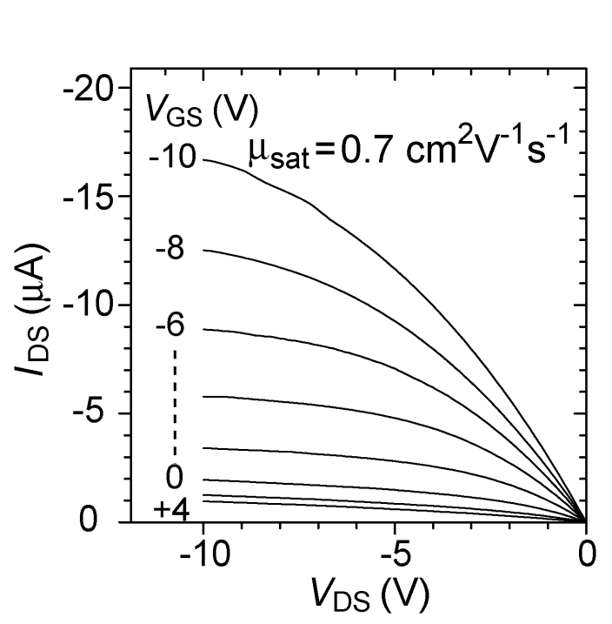
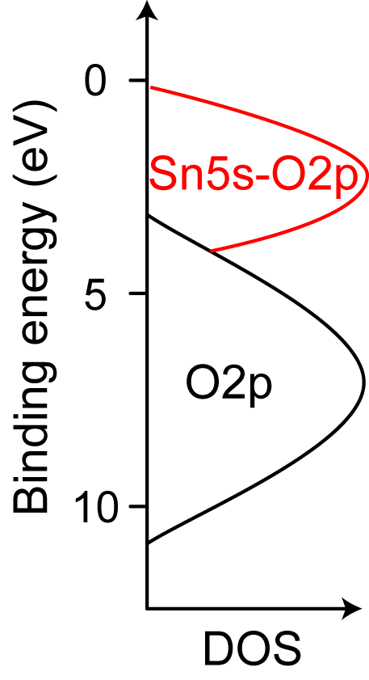
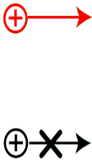
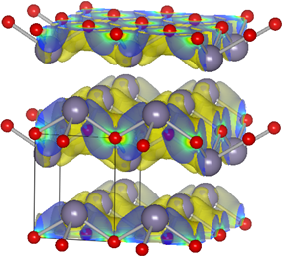
SnO: p-channel oxide
O2p
Sn5s - O2p
P-channel TFT
SR
APL(2008)
Phys.Stat.Sol (a) (2008)
Notes:
Electronic structure of SnO.
Moderately dispersed VBM and IP is 5.8eV, rather small. The valence band top is primarily composed of Sn 5s oritals which is largely spread.
This situation is similar to n-type s-band semiconductors.
In addition, bottom of CBM is is 5eV from Evac. So, We may expect bipolarity for this material
.

Slide 11
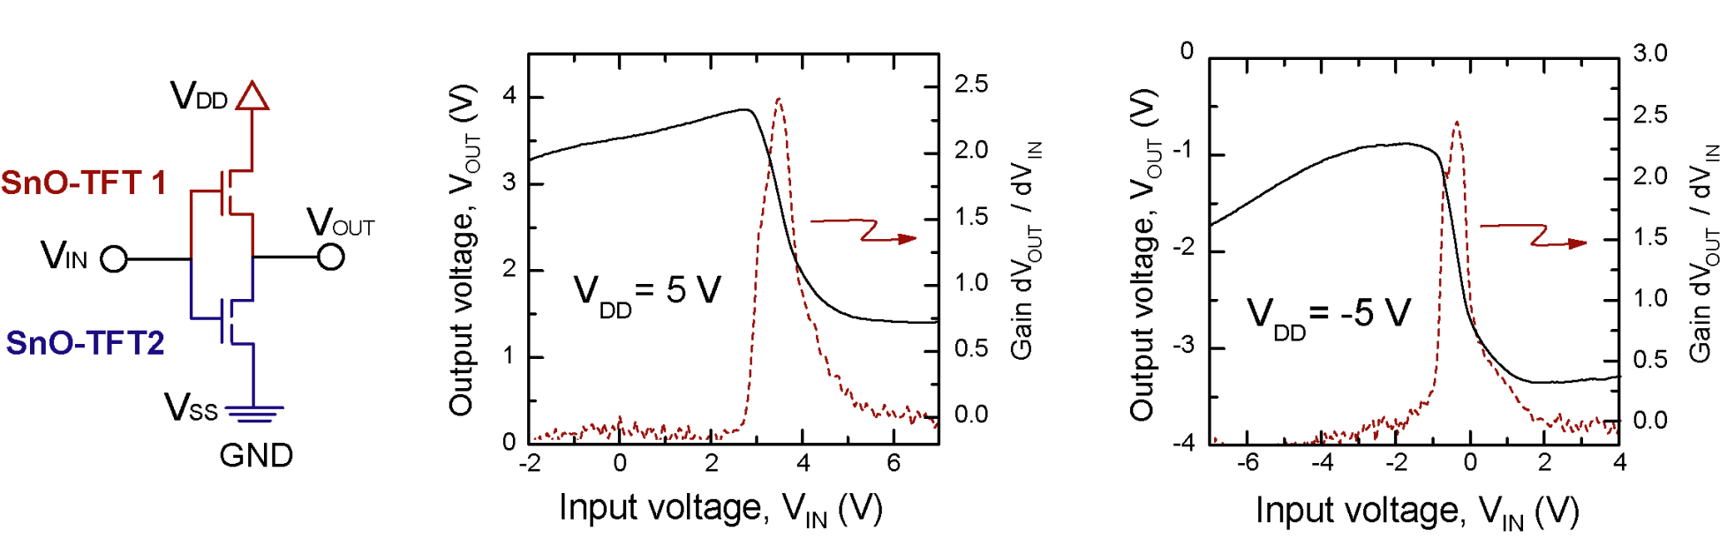
C-MOS inverter using two bipolar TFTs
First demonstration of C-MOS inverter
using bipolar oxide
Adv.Mater.(2011)
Notes:
第1&3象限で動差 Vthが重なっているのでVgaにならない 単極のｐ－TFTとn-TFT の組み合わせでは第一象限のみ

Slide 12
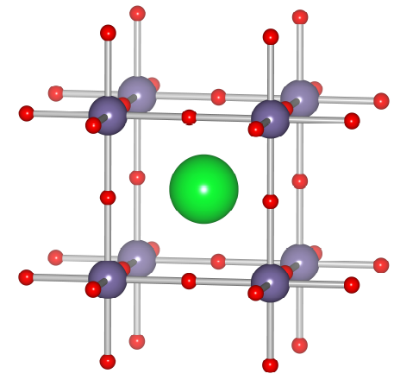
SrGeO₃
Ambient Phase
High P Phase (>5GPa)
Sr
Ge
O
O
Ge
Cubic Perovskite
Tetrahedral Ge
Octahedral Ge

Slide 13
Electronic Structure:
covalency &
cubic symmetry
Eg, ind
M :
O 2p_{y}
Bond angle
180°in c-perovskite
Energy (eV)
X :
O 2p_{x}
Ge 4s
Γ :
R Γ X M Γ
exact
n-bonding
GeO₂
SrGeO₃
AP
HP
AP
HP
CB
Energy (eV)
Energy (eV)
Eg
VB
×5
×5
Ge Sr O total
DOS (a.u.)
Nat.Commun （２０１１）

Slide 14

Conductivity and Thermopower
in HP-Sr_{1-x}La_{x}GeO₃
x = 0.05
σ (S cm ⁻¹)
x = 0
x = 0.05
α (μV K⁻¹)
x = 0
x = 0
T (K)
Nat. Commun （２０１１）

Slide 15
Optical Properties
Drude –Tauc-Lorentz model
E_{g} (HP-phase) < E_{g} (AP-phase)
ω_{p} = 1.0 eV
τ = 2.0 fsec
E_{g} (Tauc) = 3.35 eV
Assumption (m*=0.3m₀)
N_{opt} ＝2.2E20 cm⁻³
μ_{opt} = 12 cm² V⁻¹ sec⁻¹
σ_{opt}(0) = 410 Scm⁻¹ (bulk DC conductivity)

Slide 16
Challenges
● New type of transparent metal
using abundant element
●P-type transparent semiconductors
with mobility comparable to N-type.

Slide 18

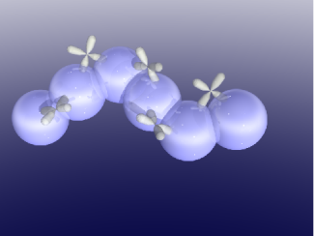


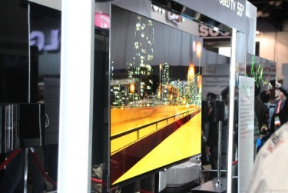
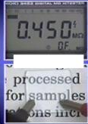
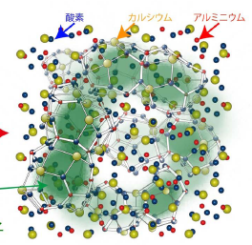
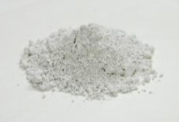

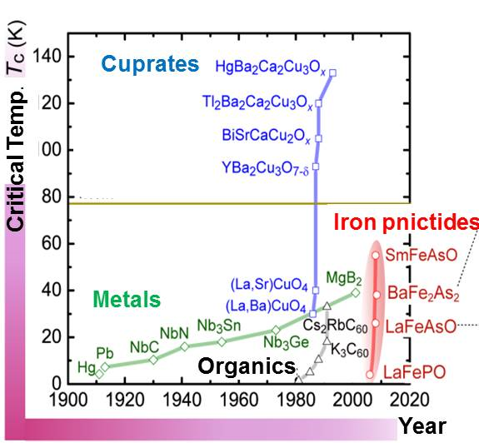
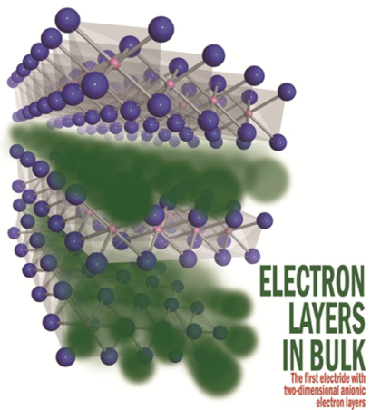
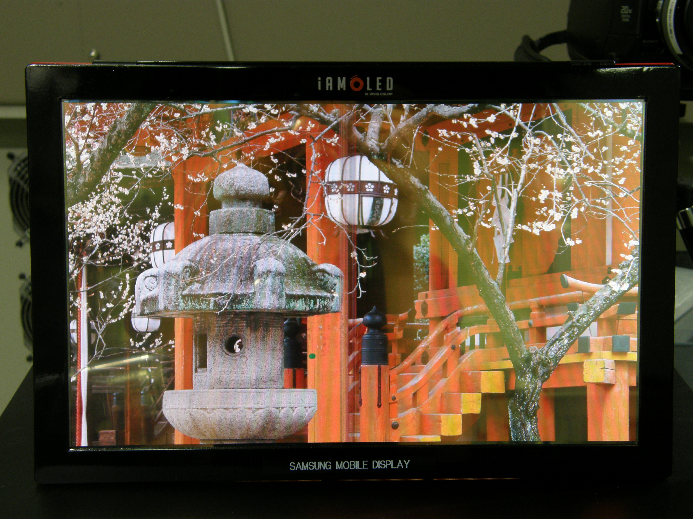
Ｈｉｇｈｌｉｇｈｔｓ
High Performance Transistor
design concept(1995)
IGZO-TFT, Science(2003)
Nature (2004)
Transparent Conductor
Mass Production starts(2012)
Catalyst for NH3 synthesis
Transparent
P-type oxide
Semiconductor
(CuAlO2, LaCuOCh)
Ru
(Nature 2002, Science 2003)
molten metallic electride
( Science) 2011
Iron Pnictide
Superconductor
(Nat.Chem.2012)
Nature(1997)
2D electride
JACS 2008, Nature 2008
Nature(2013)

Slide 19
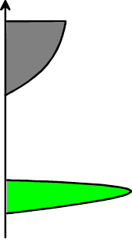
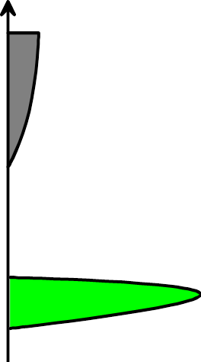
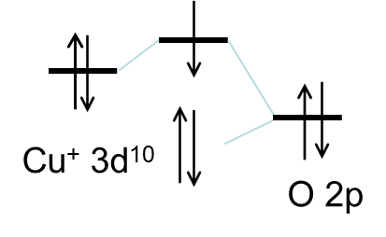


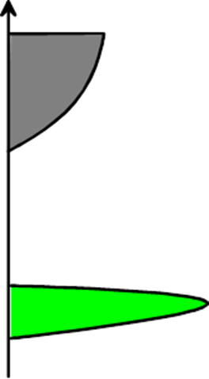

P/N Orientation and Band Structure
(a)
(b)
P-type
N-type
Sn 5s
CB
CB
Sn⁴⁺ 5s⁰
VB
O 2p
VB
Cu 3d
O2p
O 2p
(nature 1997)
(c)
P-type
CB
VB
Sn 5s
Sn²⁺ 5s²
O 2p
O2p
(APL 2008)

Slide 20
Ammonia Synthesis
Harber-Bosch Process
Mass production
started in 1912
Fe₃O₄
N₂ + 3H₂
2NH₃
200-400 atm
400-600ºC
Issue： Huge Energy Consumption
（1% of total energy consumed by Human Being）

Slide 21
Performance
Activation Energy of reaction
Activation Energy
C12A7 electride
N₂
H₂
C12A7:O²⁻
NH₃
Cs-loaded MgO
Reported
Ba-loaded carbon
black：reported
blue：C12A7:e-
Catalytic activity /site
Catalytic activity : ten times higher
Activation Energy : ~Half
Nat.Chem.(2012)

Slide 22
Glass formation
Notes:
This is the phase diagram in the system of CaO and Al2O3. A classical ceramic system.
There are 5 compounds with different CaO to Al2O3 ratio. Of course, each of them is known as insulator.

Slide 23
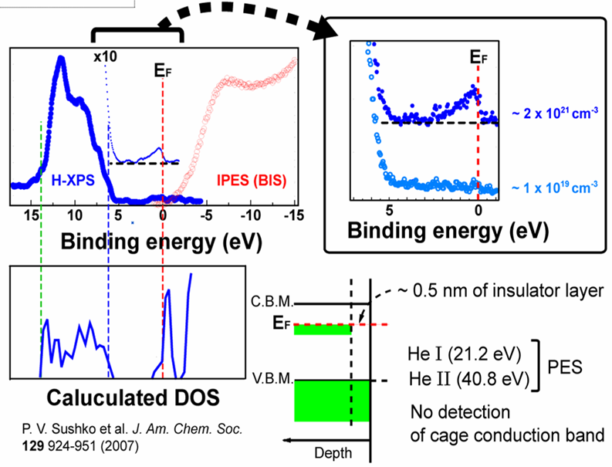
HAXPES spectra
Observation of CCB :Hard XPS
Sensitive to s electron
Adv.Mat.(2007), JACS(2007)
Notes:
The presence of CCB can be verified by photoemission measurement. This figure shows PES of C12A7 electride usng hard X-ray from synchroron radiation.
Valence band and conduction band. You can see a distinct Fermi edge near the below the CBM.
Since the optical transition from VBM to CCB is forbidden, we cannot observed the presence of CCB by optical absorption.
So we applied HX-PES . HX PES ihas two feaatures compared with conventional XPS or UPS. First is bulk sensitive and second is s-electron sensitive.
This is an observed spectrum, We can see a clear Fermi edge between VBM and CBM and the intensity is increased with carrier concentrations.

Slide 25
Schematic orbital Drawing
In₂O_{3-x}
Stoichimetric
In₂O₃
In metal
In³⁺ 5s
STO radius
metal
radius
In³⁺
ionic radius
In 5s STO raduis

Slide 26
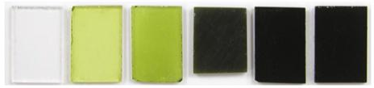
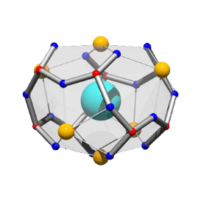
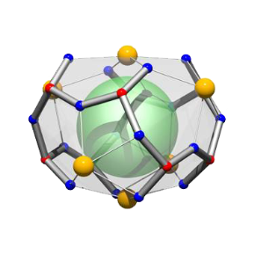
E-doping to C12A7
Chemical reduction
[Ca₂₄Al₂₈O₆₄]⁴⁺ (2O^{2–}) + Ti → [Ca₂₄Al₂₈O₆₄]⁴⁺ (4e–) + TiO_{X}
(Max 2.3x10²¹cm⁻³)
Free O²⁻
cage
Ti
TiO_{X}
(insulating)
(metallic)
Out-diffusion of free O²⁻
e–
Science(2003), Nanolett(2007)
Notes:
This figure shows the most efficient process to replace the free O2- ion with electrons.
That is, C12A7 crystals are sealed with metal Ti in a silica glass tube and heats it up to 1000C. The surface of C12A7 is coated with metal Ti.
When free O2- ions diffuse to the surface to react with Ti, strong Ti-O bonds are formed. As a consequence, electrons are injected to the cages to maintain electroneutrality. If this reaction proceeds 100%, the maximum concentration of 2.3x10²¹cm⁻³ should be created in the cages.

