Slide 1




Understanding and Controlling the Electronic Properties of Materials with Strong Correlations
Antoine Georges
http://www.cpht.polytechnique.fr/cpht/correl/mainpage.htm
Boston University – ICAM - Sep 2013

Slide 2
Why is the theoretically-aided design of correlated electron materials a relevant question to ask NOW ?

Slide 3
Because a theoretical and practical framework has been emerging, which :
Takes a radically different point of view on the electronic structure of solids than the “standard model” of solid-state physics
Is not faced with the limitations of the standard model when dealing with strongly correlated systems/localized orbitals
Uses a language much closer to that of the chemist: ATOMS - atomic orbitals, bonding and hybridization (rather than Bloch bands)

Slide 4
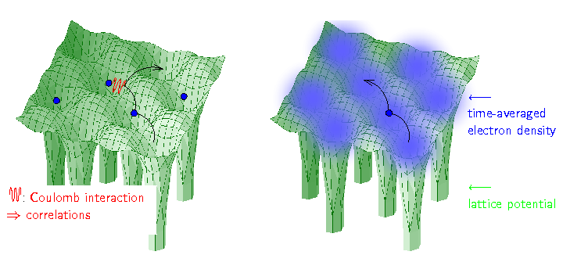
The standard model (most solid-state physics textbooks):
a solid is a kind of electron gas
subject to the periodic potential of ions
→ Bloch wavefunctions, energy bands
Interactions complicate the matter in a somewhat annoying way
Image: K.Held
Modern (and most useful) incarnation: DFT-LDA/GGA

Slide 5
In materials with strong correlations
LOCAL ATOMIC PHYSICS is crucial

Slide 6
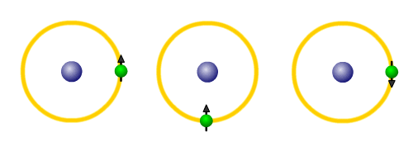
The Mott Phenomenon
Clear failure of the textbook picture
Note: It has NOTHING to do with magnetism. The key
is Coulomb repulsion blocking of charge motion
Electrons “hesitate: between being localized on short-time
scales and (in metals) itinerant on long time-scales

Slide 7
Electrons “hesitate” between being localized on short-time-scales and itinerant on long time-scales
We see this from spectroscopy…

Slide 8
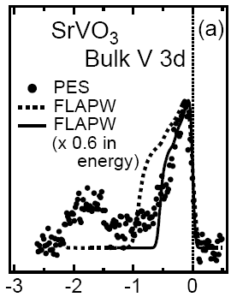
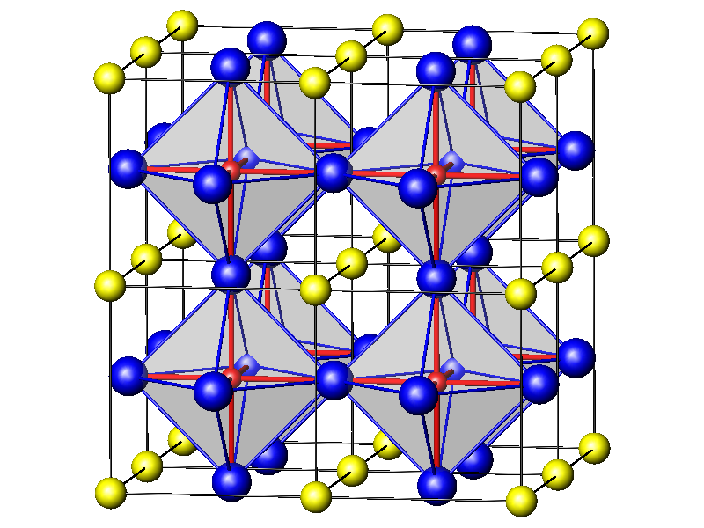
Correlated metals: atomic-like excitations at
high energy, quasiparticles at low energy
- Narrowing of quasiparticle bands due to correlations (the Brinkman-Rice phenomenon)
- Hubbard satellites (i.e extension to the solid of atomic-like transitions)
Dashed line:
Spectrum obtained from
Conventional
band-structure methods (DFT-LDA)
SrVO₃
Sekiyama et al., PRL 2004

Slide 9
This is also clear from phase changes between localised and delocalised behaviour of electrons…

Slide 10
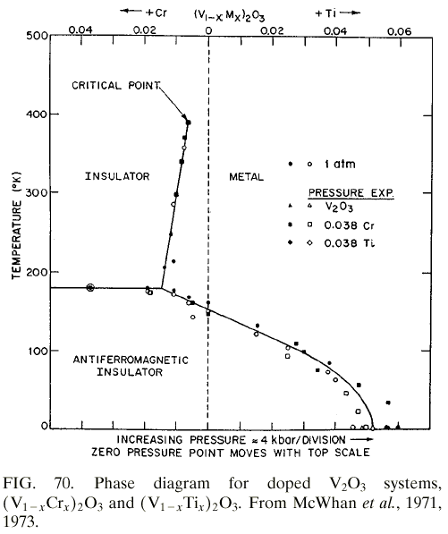
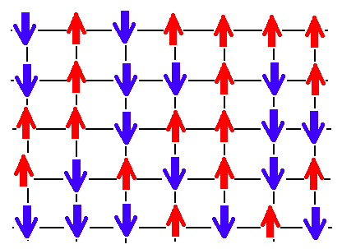
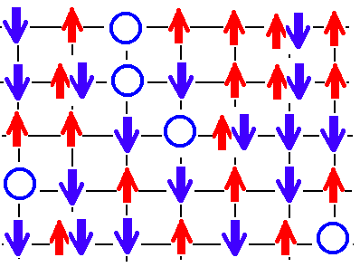
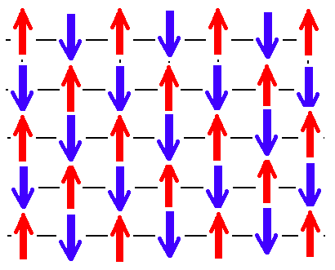
Metal-Insulator →
Transition in V2O3
Paramagnetic metal
Paramagnetic
insulator
The Cerium phase
Diagram:
Antiferromagnetic
insulator

Slide 11
We need to change our theoretical description and computational tools in order to deal with these
« strongly-correlated electron materials »
Think in terms of atoms, not in terms of an electron gas ! [closer to a chemist point of view]
Each atom is an interacting (many-body) problem
Atomic orbitals overlap but motion of electrons is opposed by energy cost for changing the valence of each atom

Slide 12
A theoretical description of the solid-state based on ATOMS rather than on an electron-gas picture:
« Dynamical Mean-Field Theory »
Dynamical Mean-Field Theory:
A.G. & G.Kotliar, 1992
Correlated electrons in large dimensions:
W.Metzner & D.Vollhardt, 1989

Slide 13
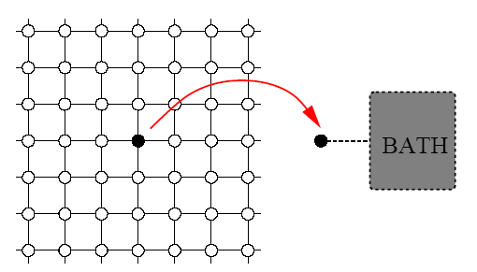
Dynamical Mean-Field Theory: viewing a material as an (ensemble of) atoms coupled to a self-consistent medium
Solid: crystal lattice of atoms
Effective
Medium
Atom

Slide 14
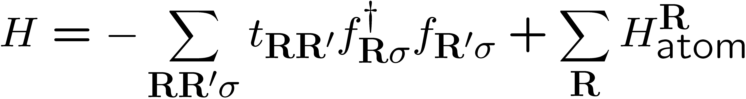
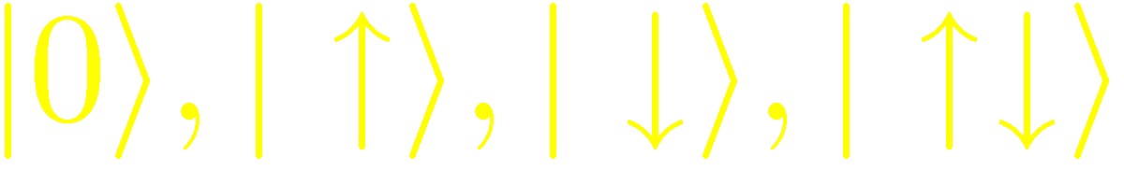
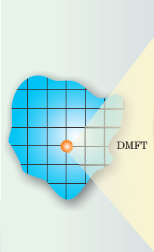
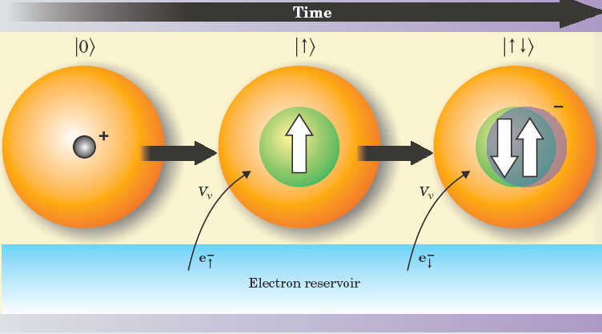
A simple example: the Hubbard model
Focus on a given lattice site:
Atom can be in 4 possible configurations:
Describe ``history’’ of fluctuations between those configurations

Slide 15
The happy marriage of DMFT with electronic structure (DFT)
- an interdisciplinary effort started in 1996 and still continuing today
Anisimov, Kotliar et al.
J.Phys Cond Mat 9, 7359 (1997)
(Review: Kotliar et al Rev Mod Phys 78 865, 2006)

Slide 16
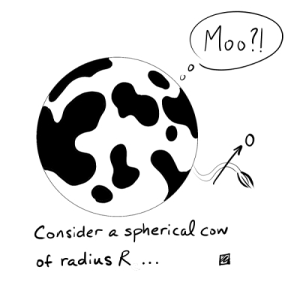
From spherical cow models…
… to real materials
SrVO₃
Rich interplay between: structural aspects, orbital degrees
of freedom, various intra- and inter-orbital interactions,
spin degrees of freedom, etc…

Slide 17
Puzzle # 1:
Why are 113 Vanadates Metallic while 113 Titanates are insulating ?
Interplay:
Structural distortion
Energetics of orbitals
Mott transition
Pavarini et al. PRL 92, 176403 (2004); NJP 7, 188 (2005)
See also recent work by Dang et al. arXiv:1309. 2995

Slide 18
Vanadates and Titanates commonalities:
- 1 electron in the 3d shell
- Very similar values of the Hubbard U
- Similar electronic structure …
SrVO₃ [V⁴⁺, d¹]: A metal with signatures of sizeable but moderate e-e correlations (m*/m~2.5)
CaVO₃ [V⁴⁺, d¹]: A metal with stronger electronic correlations (m*/m ~ 3.5)
LaTiO₃ [Ti³⁺, d¹]: A small-gap insulator (~0.2 eV)
YTiO₃ [Ti³⁺, d¹]: A larger gap insulator (~ 1eV)
WHY ?

Slide 19
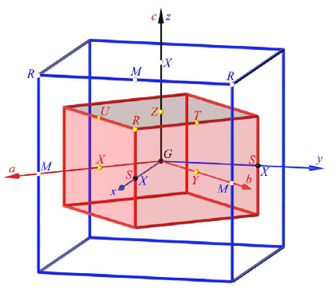
From a band-structure (DFT-LDA) point of view, they are all metals with a single electrons in t_{2g}-like bands…
Sr 5s and 4d
SrVO₃
2 V-eg bands
Pavarini et al.
PRL 92 (2004) 176403
New J.Phys 7 (2005) 188
Amadon et al.
PRB 77 (2008) 205112
Fermi level
3 V-t2g bands
9=3*3
Oxygen
bands

Slide 20
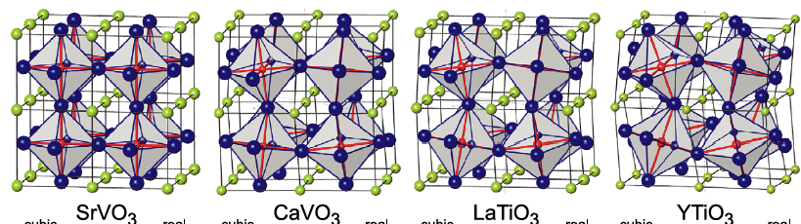
The answer…
``It’s the bandwidth reduction,
stupid…’’
Important effect
but insufficient to
explain MIT
(U ~ 3-4 eV)

Slide 21
Key to solving the puzzle: lifting of t_{2g} degeneracy due to structural distortion
→ lowers considerably critical U
Splitting: up to 200 meV for LaTiO3, up to 330 meV for YTiO3
1 electron in:
3 degenerate orbitals, J/U=0.15 → U_{c}/W ~ 3.5
1 single orbital → U_{c}/W ~ 1.5
Pavarini et al. PRL 92, 176403 (2004); NJP 7, 188 (2005)

Slide 22
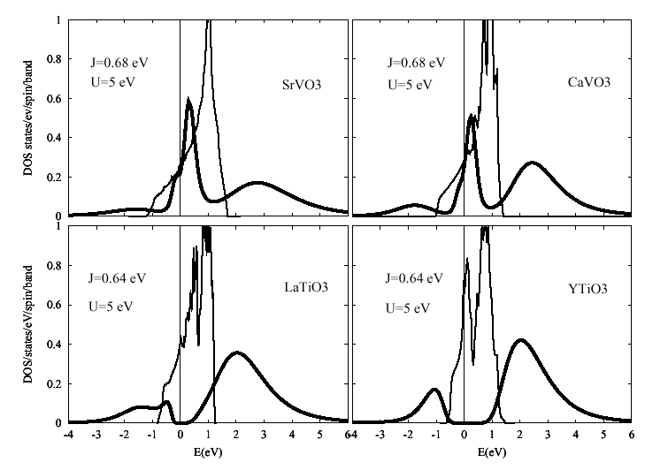
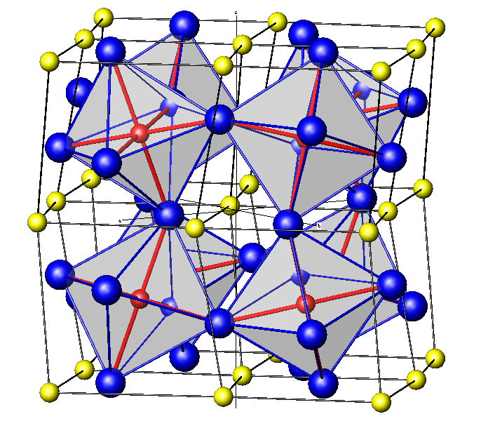
Electronic structure + Many-Body (DMFT) calculations: accouting for metallic/insulating nature of vanadates/titanates
- Narrowing of quasiparticle bands due to correlations (the Brinkman-Rice phenomenon)
- Hubbard satellites (i.e extension to the solid of atomic-like transitions)
E.Pavarini et al., PRL 2004
cf. also Sekiyama et al. (Ca/SrVO3)
PRL 2004

Slide 23
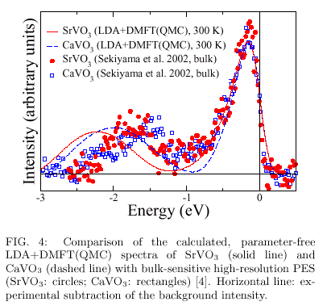
Quantitative comparison with experiments quasiparticles + lower Hubbard band clearly resolved in bulk-sensitive photoemission experiments
Sekiyama et al,
Ca/SrVO3

Slide 24
Strong orbital polarization predicted in the insulating materials :
(88% of d1 electron population)
(96% of d1 electron population)
LDA+DMFT calculations

Slide 25
Puzzle # 2
Why are transition-metal oxides
of the 4d series (such as ruthenates)
strongly correlated metals, while not
being close to a Mott insulating state ?
Example: Sr₂RuO₄ has t_{2g} bandwidth ~ 4eV,
And estimated U for t_{2g} shell about 2.5 eV at most.
Nevertheless effective mass enhancement (over LDA)
of xy-band is ~ 5 !!

Slide 26

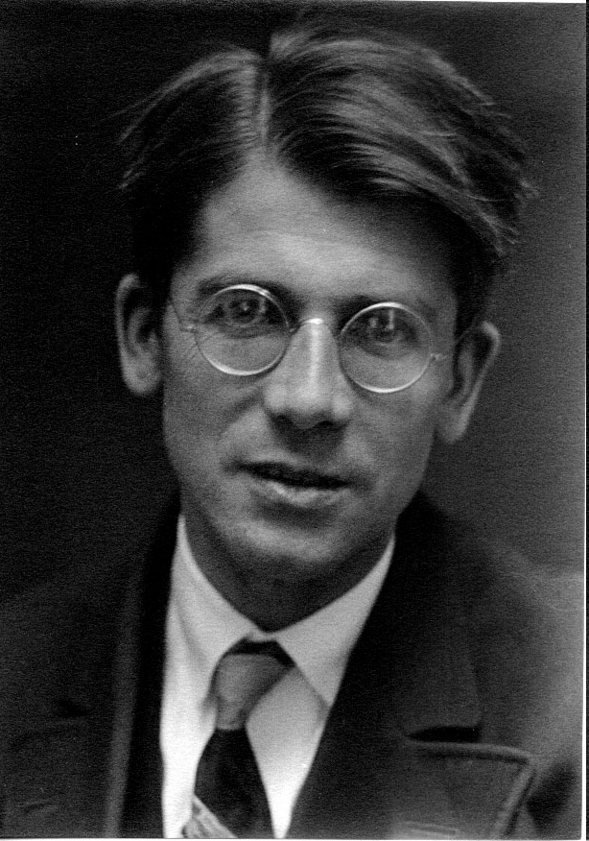
The Platters said:
« Only U can do
make all this world
seem right… »
… Take-home message here:
« Not only U, also J_{H} matters » !
Friedrich Hund
1896-1997

Slide 27
Some articles of the `Hund’s metals’ saga…
Haule and Kotliar New J. Phys. 11, 025021 (2009)
Werner, Gull Troyer and Millis, PRL 101, 166405 (2008)
Mravlje et al.PRL 106, 096401 (2011)
de’Medici et al. PRL 107, 256401 (2011)
Recent review article:
AG, de’Medici and Mravlje
Annual Reviews Cond. Mat. Phys Vol 4 (2013)
arXiv:1207.3033

Slide 28
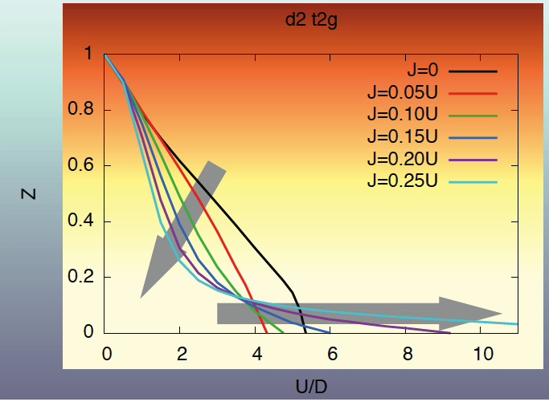
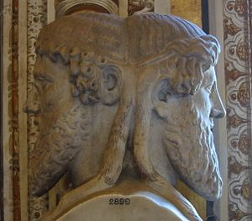
For all filling except ½-filling and a single electron and hole:
1. Hund’s coupling suppresses coherence scale →
reduces quasiparticle coherence scale, smaller Z
The two faces
of Hund’s coupling
2. But also increases U_{c} → Enhances range of metallic state !

Slide 29

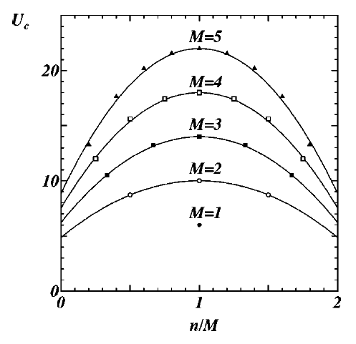
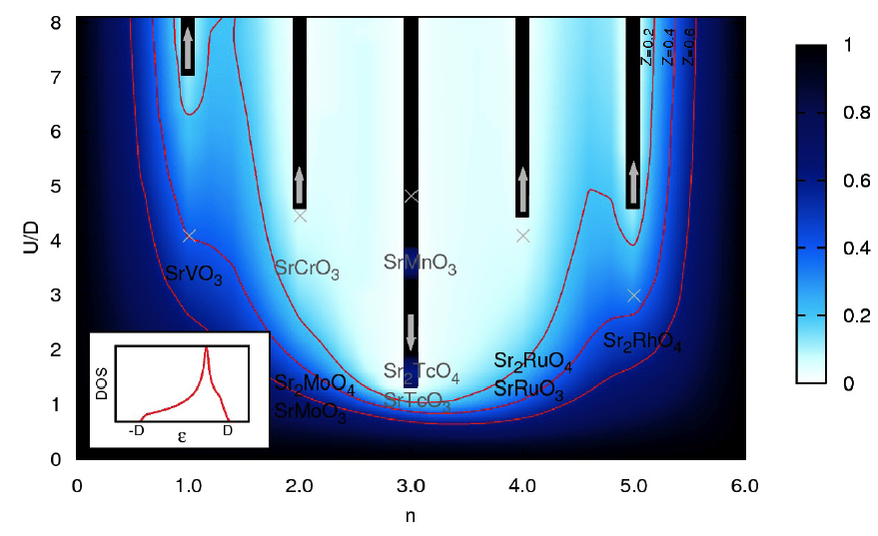
J=0
J≠0

Slide 30
→ Drawing a map of early transition-metal oxides
(both 3d and 4d) with Hund’s rule coupling as guidance and based on dynamical mean-field theory electronic-structure calculations

Slide 31
Color-intensity map of quasiparticle weight Z (~ m/m*)
3d oxides: U/D ~ 4 ; 4d oxides: U/D ~ 2

Slide 32
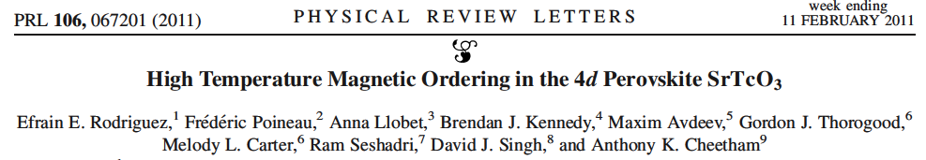
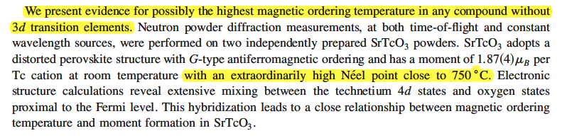
Puzzle # 3: record-high Néel temperature of SrTcO₃ (ca. 1000K) and prediction for pressure-dependence

Slide 33
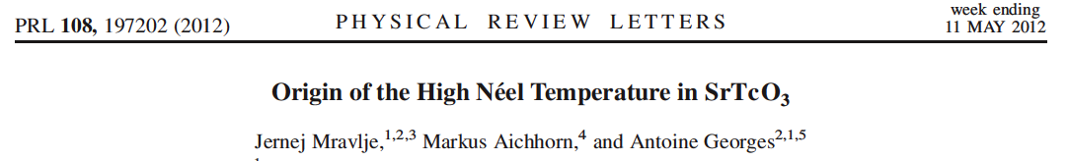
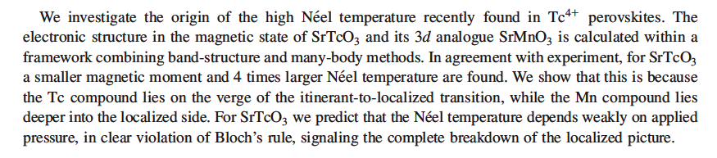
SrTcO₃ poised close to Mott transition
In contrast: SrMnO₃ on localized side
→ Prediction: distinct pressure-dep of T_{N}

Slide 34
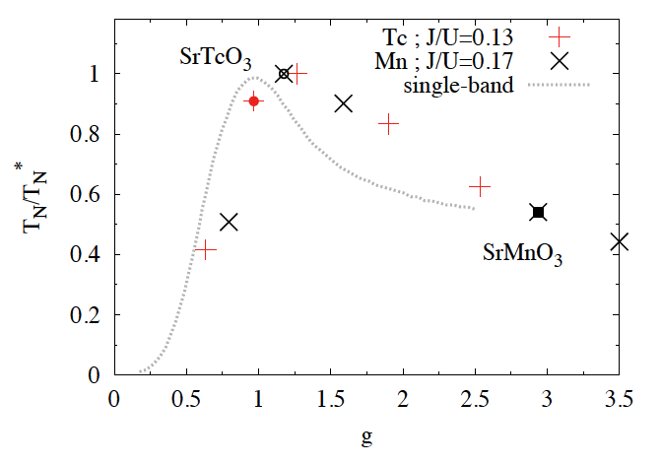
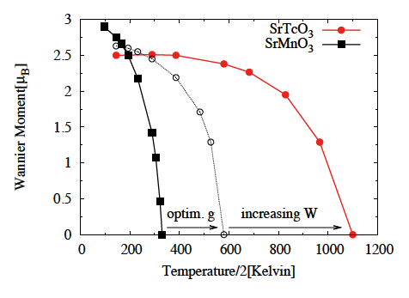
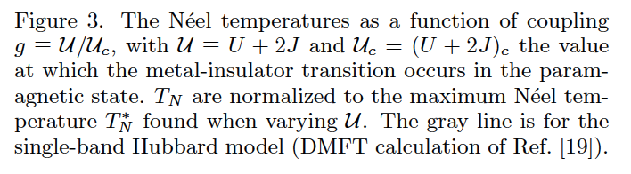
Mechanism: SrTcO₃ (T_{N}~1000K) very close to Mott transition (Hund lowers U_{c})
(In contrast SrMnO₃ is a more localized insulator, T_{N} ~ 260 K)
Mravlje,
Aichhorn, A.G.
PRL 108, 197202
(2012)

Slide 35
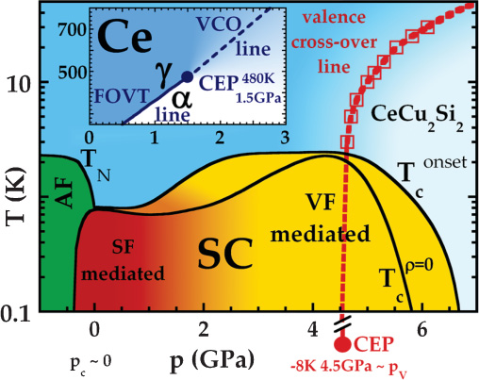
Puzzle # 4:
What is the underlying critical phenomenon responsible for the “second superconducting dome” in CeCu₂Si₂
[not related to magnetism] ?

Slide 36
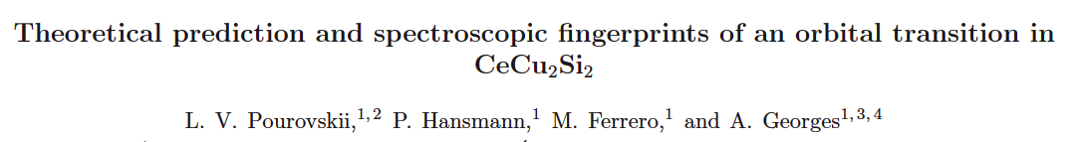
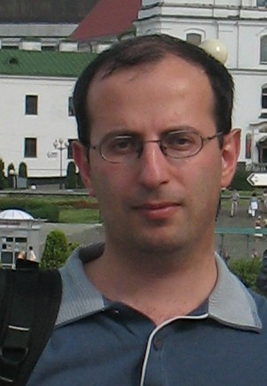
arXiv:1305.5204 (currently in limbo at PRL…)
LDA+DMFT → Transition between two regimes dominated by different Xtal field states
``Orbital switch’’
Low-P: Xtal field energy wins, Hi-P: Hybridization wins

Slide 37
In tetragonal environment, lowest 6-states with J=5/2 split into three doublets:
In the absence of hybridization to other electrons
(``atomic limit’’), |0> has the lowest energy.
BUT |2> has a larger hybridization to conduction electrons

Slide 38
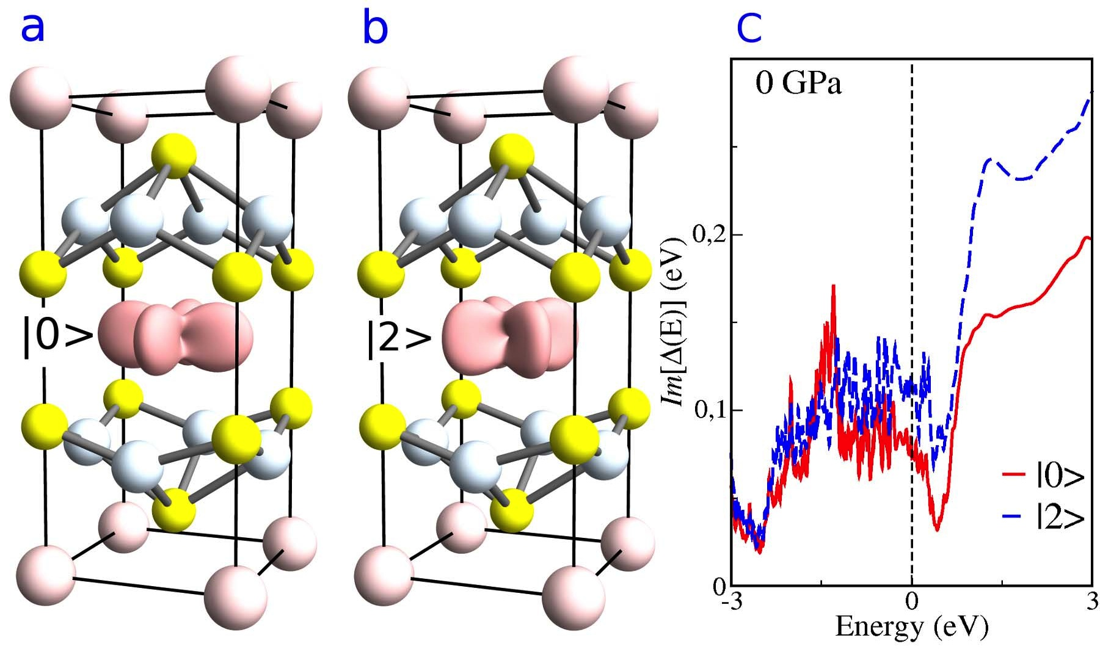
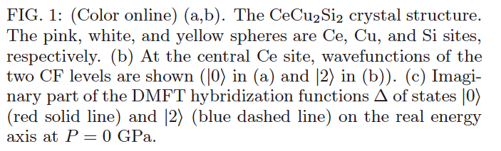
Level |2> has larger hybridization than |0> because it points to Si atoms

Slide 39
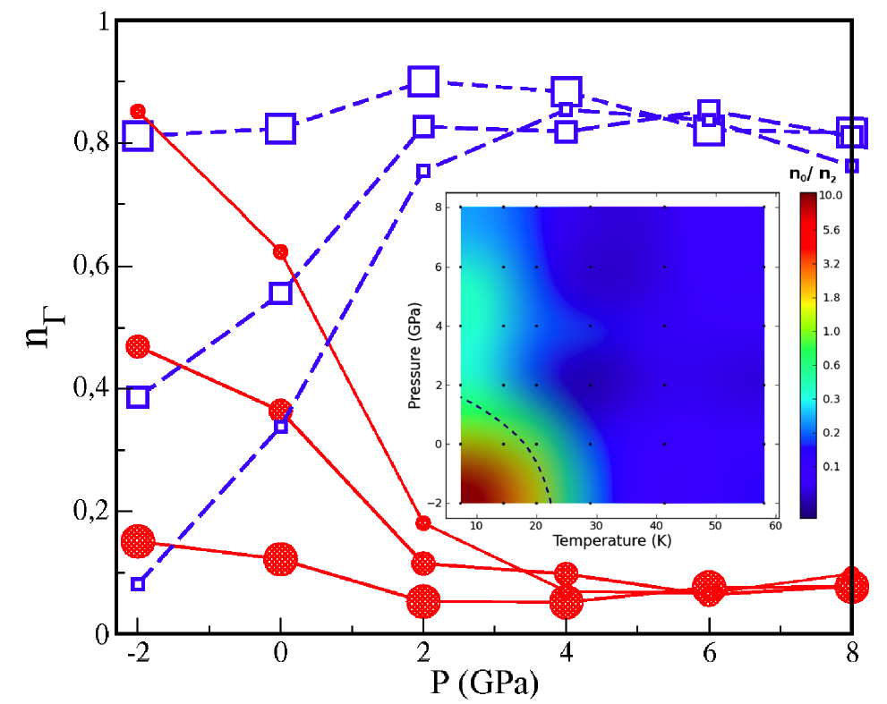
As P (or T) increases, orbital switching from
0-dominated to 2-dominated
Red: 0 Blue: 2
Note:
NOT a
crossover
such that
all Xtal field
levels are
relevant at hi-P
recovering
6-fold deg.
Small/Medium/Large symbols: 7K, 14K, 58K,

Slide 40
Take-home message
We’ve come a long way in 2 decades…
Tremendous progress on materials and on experimental/instrumental techniques
Theory is coming of age: quantitative calculations become possible, with material-specific realism, and predictive capabilities
Bridging to chemistry by putting the focus on ATOMS and bonding

Slide 41
Applied
challenges
Condensed Matter Physics:
BOTH fundamental
AND applied
Fundamental
Issues
cf: Donald E. Stokes
« Pasteur’s Quadrant »
Brookings Inst. Press
Fundamental vs. Applied Science: a false debate

Slide 42
Let’s dream a little…
CONTROLING electronic properties ?
MATERIALS by design ?

Slide 43
1. Exploiting the sensitivity to structural degrees of freedom by strain-engineering and heterostructuring
→ cf. D.Schlom’s talk

Slide 44
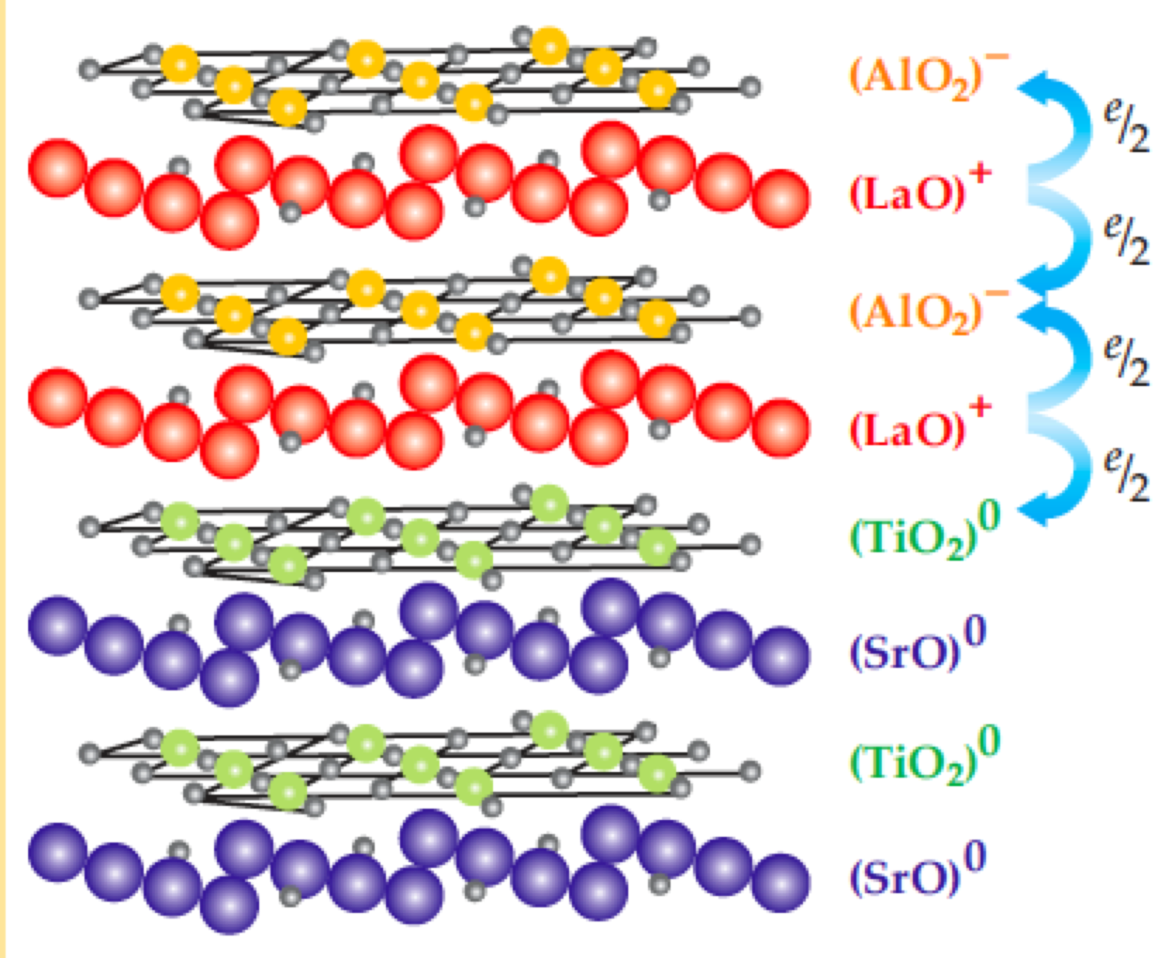
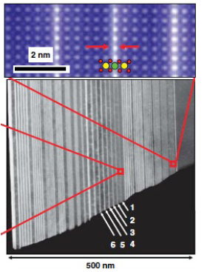
Oxide heterostructures: combining and controlling electronic functionalities of oxides
Hwang et al, 2002
LaTiO3/SrTiO3
Interfaces between insulators
can be conducting,
even superconducting (LAO/STO)
cf. talks on Monday: JM Triscone,…

Slide 45
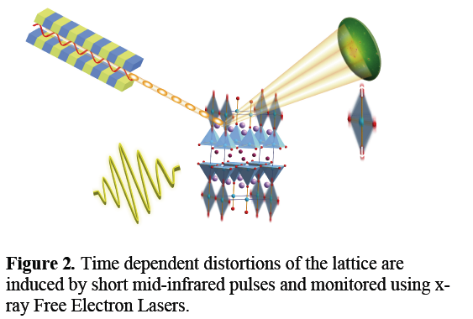
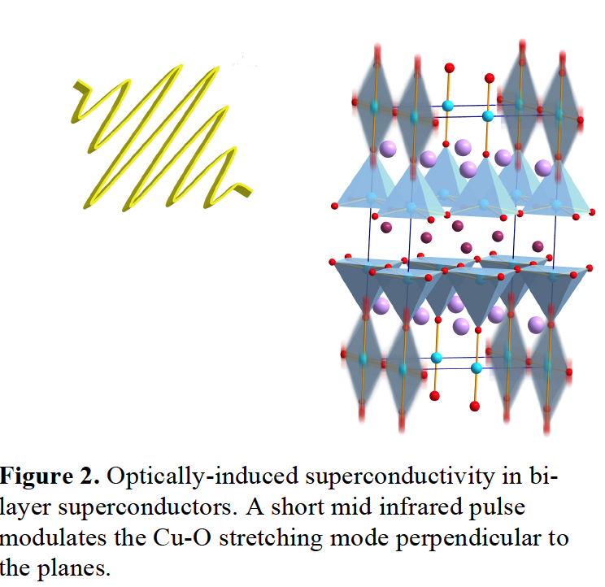
2. Controlling these materials with LIGHT ?
cf. Andrea Cavalleri’s work

Slide 46
A creative proposal: turning a nickelate into a superconducting cuprate-like material by strain-engineering ?
Chaloupka and Khaliullin, PRL 2008
Hansmann et al., PRL 2010
cf. Andy Millis’ talk on monday

Slide 47
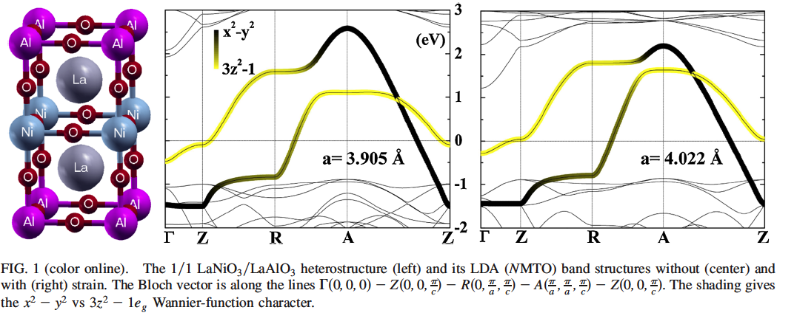
Stabilisation of the x²-y² orbital under tensile strain
Destabilisation of the 3z²-r² orbital
Effect enhanced by strong interactions
→ Engineering a single-band material, like in cuprates or
kappa-BEDT organic materials ?

Slide 48
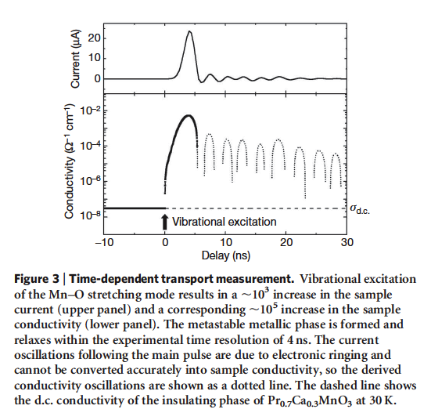
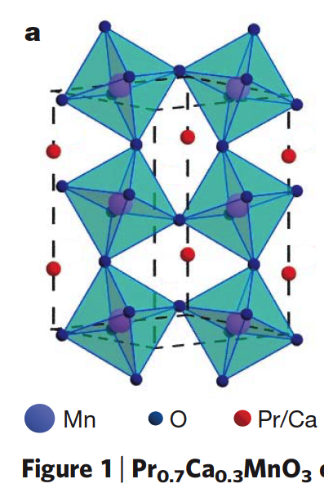
Some spectacular effects have already been demonstrated…
Exciting an IR-active phonon
(up and down shaking of octahedra 71 meV ~ 17 THz)
in a manganite induces
an insulator-to-metal
Transition [Rini et al. Nature 2007]

Slide 49
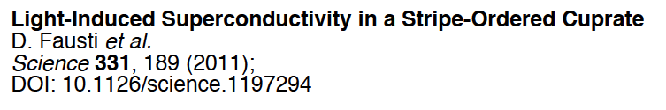
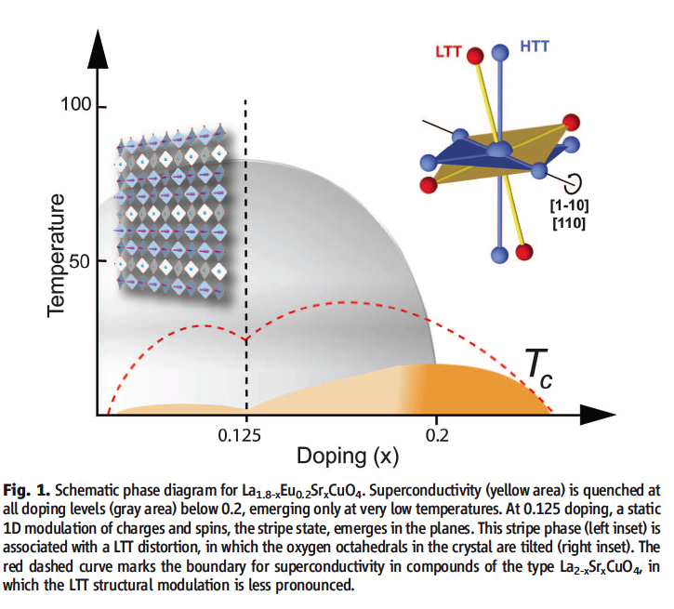
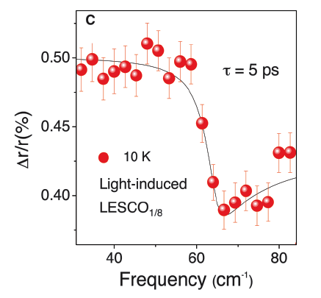
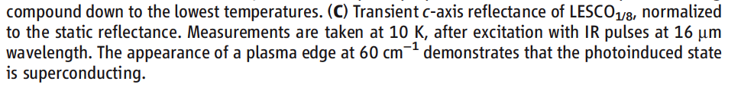

Slide 50
Shameless advertisement to the younger folks:
Postdoc applications welcome at any time !

Slide 51
The suspects are the localized orbitals !
* d- or f- orbitals are quite close to ions nuclei
(particularly 3d and 4f, for orthogonality reasons)
They do not behave as regular band-forming orbitals
(e.g sp-bonding) and retain atomic-like aspects
Electrons “hesitate” between
localized and itinerant behaviour !
Materials: transition-metals and their oxides, rare-earth/actinides and their compounds, but also some organic materials

Slide 52
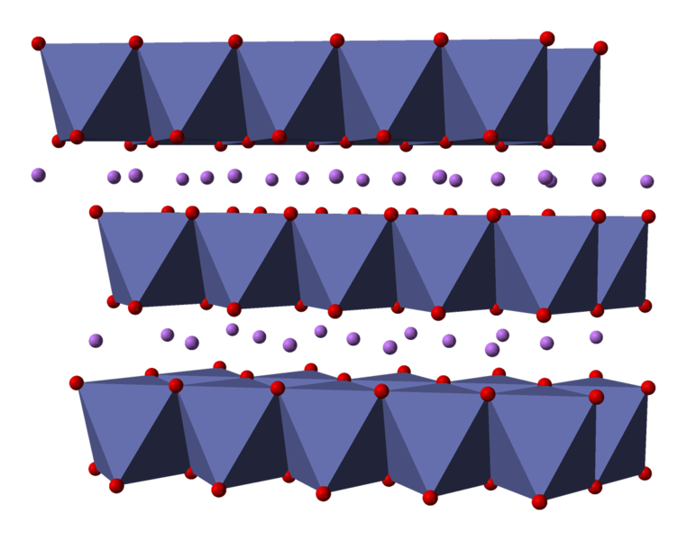
Layered cobaltates: cf. Lithium intercalated compounds (key materials in current batteries)
Li
LiCoO₂

Slide 53
And the saga goes on…
In his search for… transparent metals (touch-screens),
Hideo Hosono discovers in 2008 Fe-based superconductors
with quite high T_{c} !

Slide 54
This description in terms of quasi-independent electrons filling up individual (Bloch) energy levels works well for many materials… but not when interactions between electrons are too strong !
(as in transition-metal oxides…)
In technical terms: Slater determinant of Bloch waves is
NOT an adequate representation of the wave-function

Slide 55
Structural distortions: acting on both bandwidth and crystal-field splitting
Depending on the ionic radii of the 3 ions, the material often
adopts a structure which breaks perfect cubic symmetry and
can be viewed as a distorted perovskite.
Example:
`GdFeO₃’ distortion
Octahedra remain perfect
(no or very small Jahn-Teller)
Rotation of octahedra along
[010] and [001]
- Orthorombic symmetry
4 M-atoms per unit cell, all
equivalent by symmetry
- M-O-M angle becomes π-θ
Other possible distortions
e.g rhomboedric, rotation [111]

Slide 56
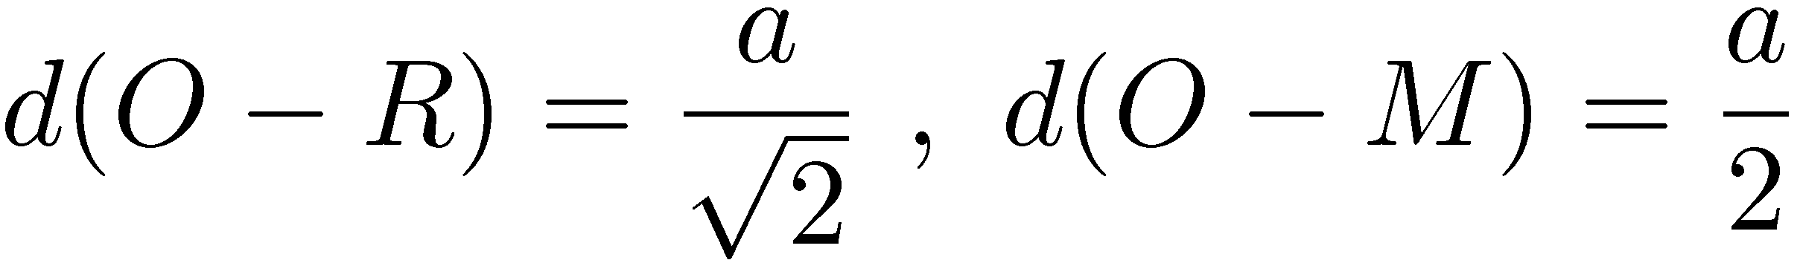

RMO₃ : ``tolerance factor’’
- Consider close packing by hard spheres
of radii r_{R}, r_{M}, r_{O} (ionic radii)
- Call a length of cubic cell
a
- Ideal packing will have:
* t=1: ideal cubic perovskite
* t<1: deforms to rhomboedral,
then orthorombic
* t too small (<0.86): unstable

Slide 57
Effects of the orthorombic distortion on electronic structure: SrVO₃, CaVO₃,LaTiO₃,YTiO₃
Left panels: hypothetical cubic; Right panel: real structure

Slide 58
The two effects of distortion:
1) Reduction of total t2g bandwidth:
This is because the O-M-O bond is no longer straight
→ pi-bonding less efficient
2) Splitting between t2g orbitals (lifting of
orbital degeneracy)
(140,200) meV for LaTiO3 ; (200,330) meV for YTiO3
Both effects are responsible for the Mott insulating state
of LaTiO3 and YTiO3

Slide 59

Splitting of orbital degeneracy
FAVORS the transition into the Mott insulating state
Model example: 1 electron in 2 orbitals, split by Δ, J=0
(Manini et al., PRB 2002; Poteryaev et al. PRB 2008)
Lifting of orbital
Degeneracy:
Favors insulating state
Triggers orbital
polarization
Fully orbital-polarized insulator
1-band metal
2-band metal

Slide 60


A big effort (1998-2013…): the happy marriage of DMFT with electronic structure calculations
Realistic calculations with predictive power
Photoemis-sion
V₂O₃
Prediction of the phonon spectrum of
Plutonium in δ-phase
Theory: Dai et al, Science (2003);
Experiments: Wong et al
Pannacionne et al. Phys Rev Lett 2006
Poteryaev et al. Phys Rev B 2007

Slide 61

Many-body Hamiltonian of a multi-orbital shell
Simple case :
well-isolated degenerate t_{2g} triplet
in a cubic oxide
with octahedral environment of the TM atom
Kanamori hamiltonian (exact for t_{2g}) :
See e.g.: Sugano, Tanabe & Kamimura,
Multiplets of transition-metal ions in crystals
Academic Press, 1970

Slide 62
Another key structural degree of freedom controlling superconductivity: distance of apical oxygen from CuO₂ plane

Slide 63

T_{c}~ 35K
T_{c}~ 90K
Not entirely clear why… perhaps because of reduction
of charge-transfer energy to Ligand (Weber et al, 2011)

Slide 64

Strain-control of apical oxygen height ?

Slide 65

Control of screening
(→ electrostatic energy scales) through a tunable dielectrics (STO)

Slide 66
Disclaimer :
Broad-brush picture
Not a technical talk
Just a very limited set of examples
Not necessarily the most recent results (rather, selected for illustrative purpose)
A somewhat idiosyncratic viewpoint (especially: emphasis on Dynamical Mean-Field Theory)

Slide 67

Last, but not least…copper-oxide « high-T_{c} » superconductors
Liquid Nitrogen
Year
Bednorz, J.G. et K.A. Muller,
Possible high-Tc superconductivity in the Ba-La-Cu-O system.
Zeitschrift fur Physik B-Condensed. Matter, 1986
→ Nobel prize, 1987
La_{2-x}Sr_{x}CuO₄

Slide 68
Copper-oxide superconductors:
A headache for theorists - Rich phase diagram with mysterious electronic phases
Temperature (Kelvin)
« Strange » Metal
(not a conventional Fermi liquid)
Metal with
« pseudogap »
Magnetic
State (AF)
Superconducting state
Electron injection
Hole injection
Mott Insulator

Slide 69

The Mott phenomenon: a « toy model »
Two key energy scales: t and U
t: hopping amplitude of electron between atoms
U: on-site repulsive interaction → cost of a double occupancy
Animation: permission H.Fukuyama
Notes:
Mott insulators violate this rule ! [Sir Nevil Mott, NiO]. Nobel prize. Simple explanation: this is the result of strong Coulomb interactions. Continue with cartoon picture… The packed subway Competing energy scales: t,U.

Slide 70

U << t : A metal (itinerant state)
Band picture OK
1 electron/site → ½-filled band
Fermi level
U >> t An insulator
(motion blocked by repulsive interaction)

Slide 71
The Mott phenomenon at strong coupling (U >> t)
HAS NOTHING TO DO with magnetism
It is due to blocking of density/charge
Energy scale for magnetism: superexchange J ~ t²/U
Insulating gap: ~ U > t >> J
The system is basically an insulator
even well above T_{Neel}
Ex: MANY oxides, e.g. NiO, YTiO3, cuprates etc…
e.g. YTiO3 has a gap ~ 1eV, orders (ferro)magnetically at 30 K

Slide 72

Beautifully illustrated by experiments on cold atoms in optical lattices with spinless bosons !
(Greiner et al. Nature, 2002)
Real-space picture: the simplest kind of insulator in nature !
[“Any 5-year old kid can understand it…Bring me a 5-year old kid ! ”
as Marx (Groucho) said]

Slide 73


High-energy excitations of Mott insulators : atomic-like excitations reveal Coulomb energy cost
Hubbard satellite
LDA
A Hubbard “band”
is nothing else than
an atomic transition
broadened in the
solid-state
Photoemission: Fujimori et al., PRL 1992

Slide 74
From « spherical-cow » models…
Once upon a time, in dark ages
where MaNEP did not exist,
milk production at a dairy farm was low. So the farmer asked
a condensed-matter theorist from
a nearby university for help.
After many days of intensive
calculations and scenario-building, the theorist
came back and said :
“I have the solution, but it only
works in the case of spherical
cows in vacuum…”
Exercise: in the text on the
right, replace:
`milk production → T_{c}’
`spherical cow→
your favorite model’ …

Slide 75


The Mott phenomenon is ubiquitous for transition-metal oxides
… but what controls it in real life ?
YTiO₃
LaTiO₃
CaVO₃
SrVO₃
Atsushi Fujimori’s map of RMO₃ perovskites
J.Phys Chem Sol. 53 (1992) 1595

Slide 76

Hund’s metals: very low scale for Fermi-Liquid behaviour and extended non-Fermi liquid crossover regime
(``spin-freezing’’)
Relevant e.g. to anomalous
optics of 113 ruthenates ?
Pioneering papers:
Werner et al PRL 2008
Haule&Kotliar NJP 2009

Slide 77
- Goal(s) of this talk –
Convey enthusiasm about :
Remarkable properties of materials with strong electronic correlations
Progress in our ability to understand them theoretically over ~ 20 years, on a semi-quantitative level (while acknowledging that this is an experimentally-driven field…)
Prospects for controlling their properties and possibly for materials design

Slide 78

The suspects: materials with electrons that ``hesitate’’ between being itinerant and being localized…
Transition Metals
Rare earths and Actinides

Slide 79


Cobalt oxides: large Seebeck coefficient
(thermopower)
Layered structure
of cobalt oxides
(after Terasaki, 2009)
Thermopower of
« misfit » cobalt oxides
(cf. Hebert, Maignan et al. CRISMAT, Caen)

Slide 80

→ Oxides for thermoelectric applications ?
Terasaki, 2009
Figure of merit ZT: need large Seebeck,
high conductivity, low thermal conductivity

Slide 81
Some fascinating electronic properties of materials with strong electron correlations, e.g. transition-metal oxides :
- Metal-Insulator Transitions (many materials: e.g. vanadates, titanates)
High-Tc superconductivity (cuprates)
Colossal magnetoresistance (manganites)
Strong thermopower (cobaltates)
And so on…
→ May be useful for something (applications)
→ Fundamental questions
SOME EXAMPLES…
Notes:
1) Introduce to you some remarkable materials with remarkable electronic properties transition metal oxides - old and new ones… They do big things ! Such as: - Hi Tc superconductivity > cuprates (mention also Fe-based SC) - Hi thermopower (recall what that is…) Cobaltates - `Colossal' magnetoresistance Manganites Many more examples

Slide 82
Fundamental question facing the theoretical description of such materials :
- Electrons `hesitate’ between itinerant and localized behaviour
→ Descriptions in terms of electron gas and band-theory have severe limitations
Notes:
3) This mixed itinerant/localized character raises fundamental questions regarding established theoretical descriptions of the solid-state and important challenges. Indeed, conventional view of a solid: electrons form a gas ridden over the periodic potential created by ions. Almost independent electrons because strong screening of Coulomb interactions. Cartoon: a 1D chain of simplistic atoms ! Bloch waves (illustrate), Slater determinant, etc… Metals vs. insulators. e.g. one electron in one orbital > metal (more generally odd number of electrons in a shell).

Slide 83
Back to the map of RMO₃ perovskites’’…
Hund’s J is crucial to make contact with real-life !
YTiO₃
LaTiO₃
CaVO₃
SrVO₃

Slide 84




Putting these instabilities to good use: the room-temperature MIT of Vanadium Dioxide VO₂ and ``Intelligent windows’’
Hi-T rutile
structure:
~ Metal
→Reflects
infra-red
T_{MIT} ~ room temperature
Cf. Tomczak & Biermann
Phys. Stat. Sol B246 (2009)
Low-T
monoclinic
structure:
Insulator
→Transparent
in infra-red

Slide 85

Hund’s rules
(1925 – Z.Phys on atomic spectra of transition metals)
N electrons in a M=2l+1-fold degenerate shell
Maximize S [= N/2 N<M ; = M-N/2 N>M]
Given S, maximize L
Given (S,L) lowest J=|L-S| if N<M (less than ½ filling) , highest J=L+S if N>M
The « bus seat rule »: better
occupy another orbital
than share one…

Slide 86


1. The correlating effect of the Hund’s coupling: strongly suppresses quasiparticle coherence scale known since the ~ 70’s for Kondo impurities
M.Daybell, in ‘Magnetism’ (1970); Daybell and Stayert RMP 1968; Alloul 1974

Slide 87

2. The decorrelating effect of the Hund’s coupling: increasing Mott critical U
cf. van der Marel&Sawatzky PRB 37 (1988) 10674 ;
L. de’ Medici PRB 83 (2011) 205112
Hund’s rule ground-state E₀ not affected by spin-flip and pair-hopping terms.
N<M (N>M) :
Max spin state only U’-J = U-3J matters
→ Atomic gap and U_{eff} REDUCED by J for N<M, N>M
N = M (half-filled shell) :
Excited state with M+1 electrons has higher energy:
→ Atomic gap gap and U_{eff} INCREASED by J for N<M, N>M

Slide 88



Modern formulation of electronic structure/band theory:
Density-Functional Theory (DFT) and the local-density approximation (LDA)
[Kohn , Hohenberg, Sham]
* Focus on local electronic density ρ(x) and
construct an energy functional:
* Exchange-correlation functional:
Exact form unknown. Approximation:
* An exact representation of E_{kin} can be obtained from a one-particle
problem in an effective potential: the Kohn-Sham system
The Kohn-Sham orbitals form a reference system representing the local density
– often interpreted (at one’s own risk…) as one-electron excitation energies

