Slide 1
Universal electric-field-driven resistive transition in Mott insulators and
A digitally inspired prediction of novel emergent behavior in correlated materials
Marcelo Rozenberg
LPS, CNRS – Université Paris-Sud, Orsay, France
IMN (Nantes, France)
L. Cario
E. Janod
B. Corraze
P. Stoliar
V. Guiot
V. Ta Phuoc
C. Guillot-Deudon
S. Salmon-Bourmand
J. Tranchant
INSP (Paris, France)
T. Cren
D. Roditchev
UBA (Buenos Aires, Argentina)
C. Acha
A. Camjayi
CNEA (Buenos Aires, Argentina)
R. Weht
Refs:
V. Guiot et al, Nat Comm (2013)
P. Stoliar et al., Adv. Mat. (2013)

Slide 2
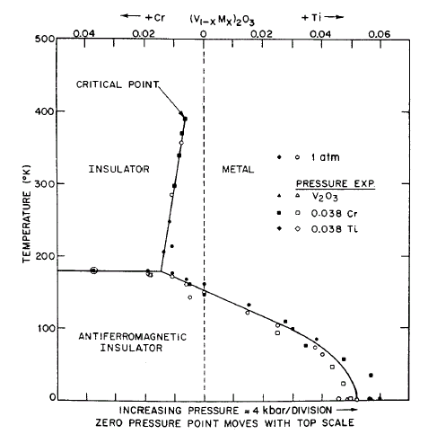
The classic example: Mott transition in V₂O₃
Equilibrium
Phase diagram
T
pressure or chemical substitution
McWhan et al PRB ’71 ‘73

Slide 3
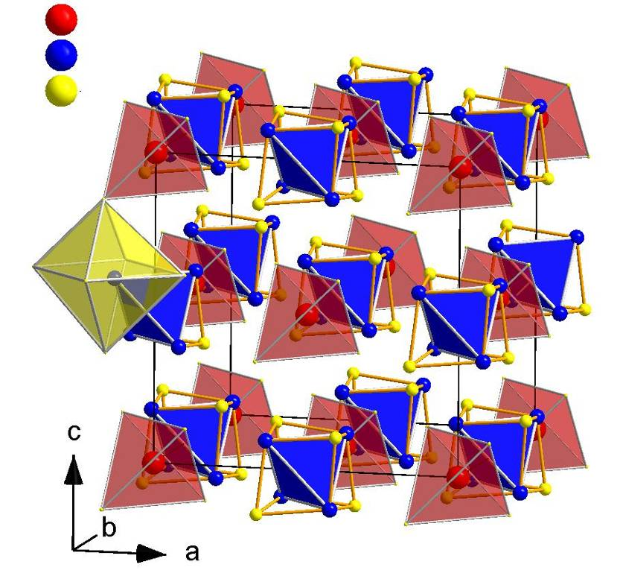
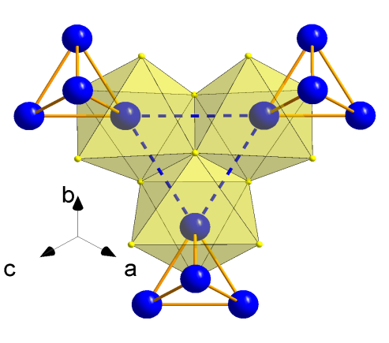
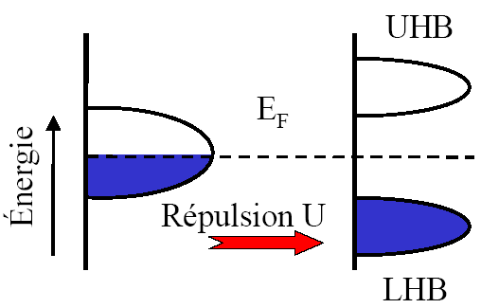

AM₄X₈ family: « tailor-made » 3D Mott systems
FCC lattice of Tetrahedral Clusters
A = Ga, Ge
3.002 Å
M = V, Nb, Ta
X = S, Se
4.322 Å
GaTa₄Se₈ (GTS)
Molecular
orbitals
Energy
U_{eff}
Gap ~ 0.20 eV
Pocha, R. et al., J. Am. Chem. Soc. 127, 8732 (2005)

Slide 4
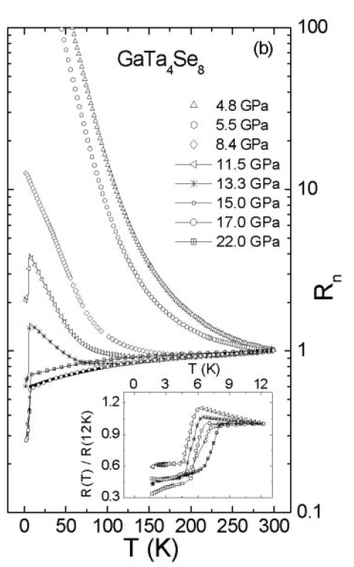
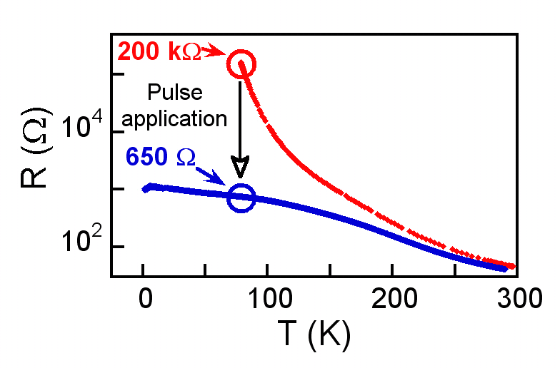
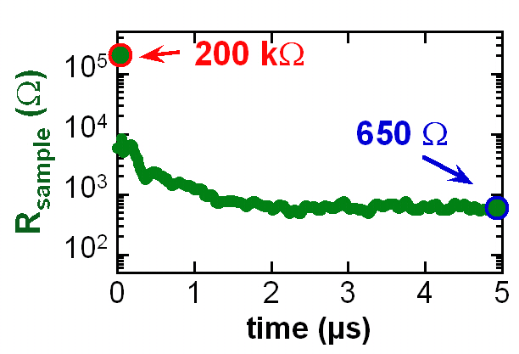
Metal – Insulator transition
Pressure driven Mott transition
E-field driven Mott transition
Non Volatile Resistive Switching, t <100 ns
Abd-Elmeguid et al., PRL ’04
C. Vaju et al., Adv. Mater. ‘08
Notes:
In fact reported to have an insulator to metal transition driven by pressure

Slide 5
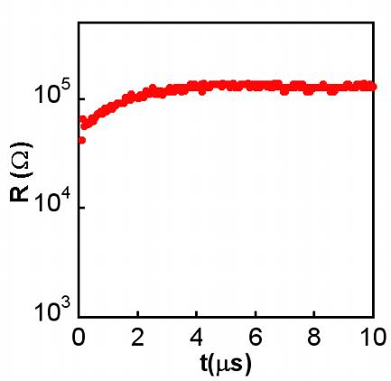
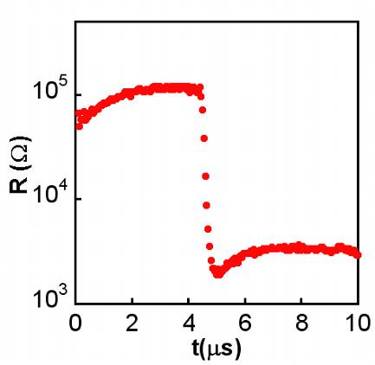
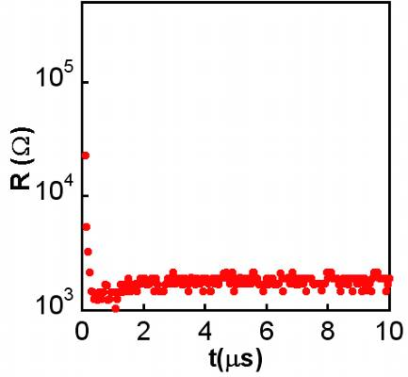
Electric pulsing: Three different regimes
GaTa₄Se₈ 77 K
L. Cario et al. Adv. Mater. ‘10
small
medium
large
V
V
V
t
t
t
R_{BEFORE}
R_{AFTER}
t_{delay}
no change
volatile RS
non-volatile RS
« elastic »
« plastic »
Notes:
Systematic investigation of the pulsing effect

Slide 6
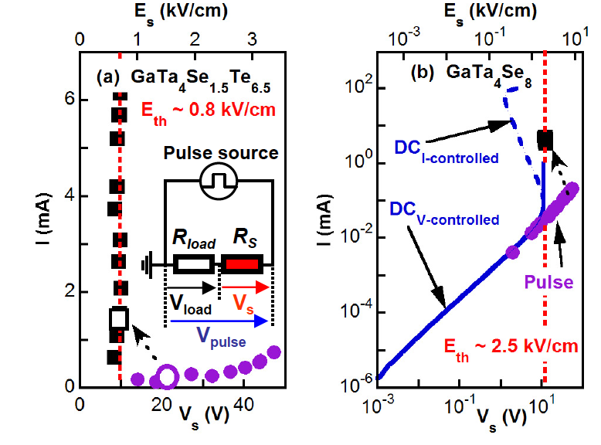
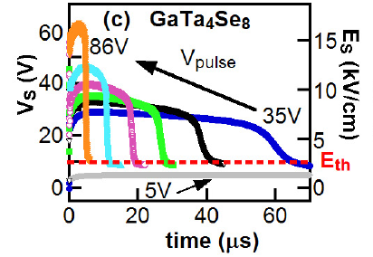
Electric-field driven breakdown in GTS
V. Guiot, MR, et al. Nat Comm (2013)
Notes:
Similar to electric breakdown in semiconductors

Slide 7
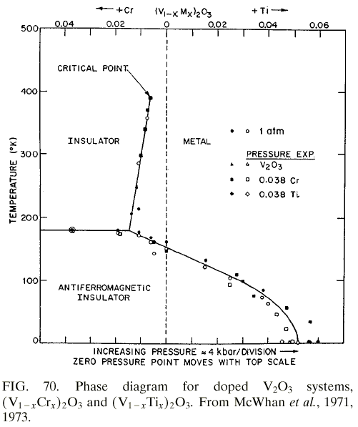
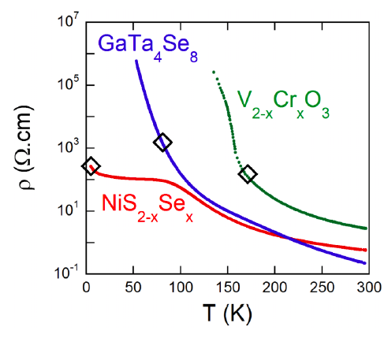
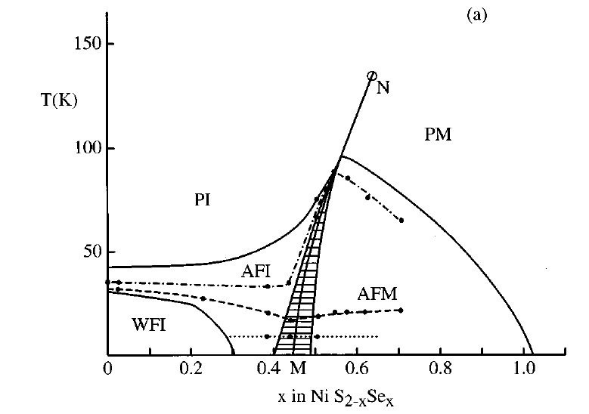
Is the Mott electric-breakdown universal?
Three different 3D Mott-insulators: GaTa₄Se₈ – V_{2-x}Cr_{x}O₃ – NiS_{2-x}Se_{x}
Mott
Corr Met
Mott
Corr Met
Czjzek et al JMMM ‘76

Slide 8
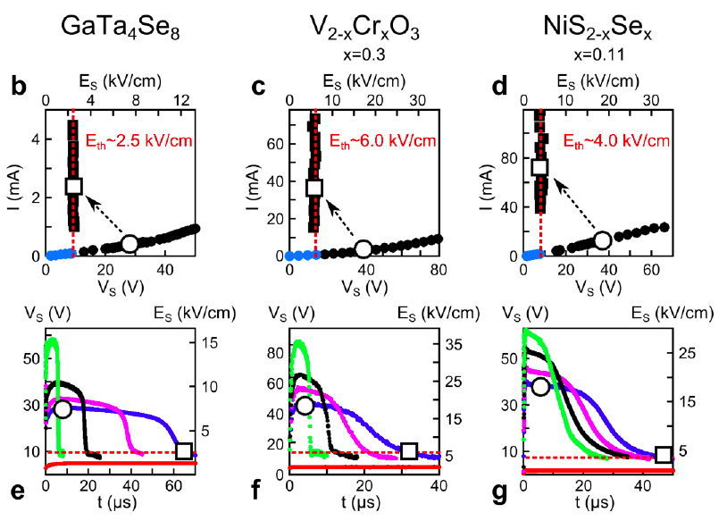
Universal behavior!!
P. Stoliar, et al Adv. Mater. (2013)
Notes:
Consistent with the scaling law
E_Th is much smaller than expected fro simple Hubbard model consideration

Slide 9
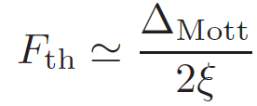
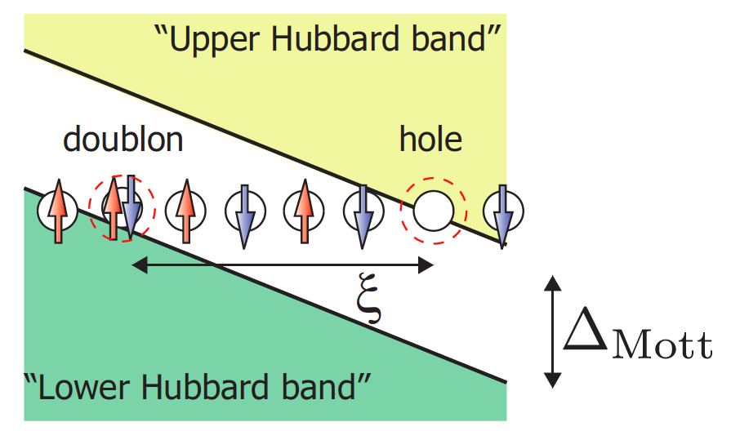
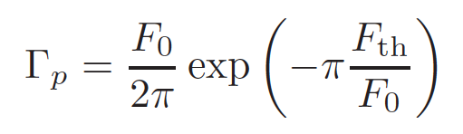

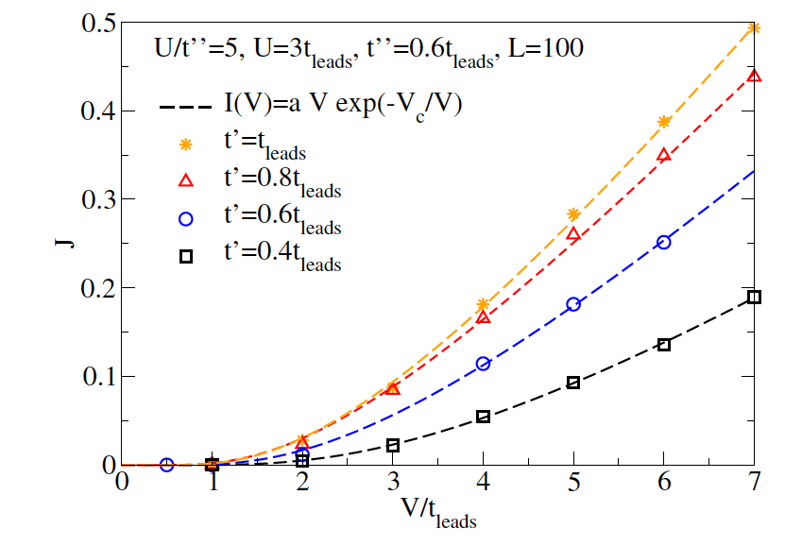

What is the origin of the Mott electric-breakdown?
Hubbard model 1D
Δ ~ 10⁻¹ eV
ξ ~ 1 nm = 10⁻⁷ cm
F_{Th} ~ 1 MV/cm
E_{Th} ~ 1 KV/cm !!!!
T. Oka et al. ‘03 ‘05 ‘10 ‘12
F. Heidrich-Meisner et al ’10
Notes:
In fact lets consider recent work on electronic breakdown transition in Hubbard model
X No SHARP threshold effect !!!
V The threshold parameter scales like the gap^2, similar as the experiment, but not exact.
? Correlation length of doublons in 3D???

Slide 10
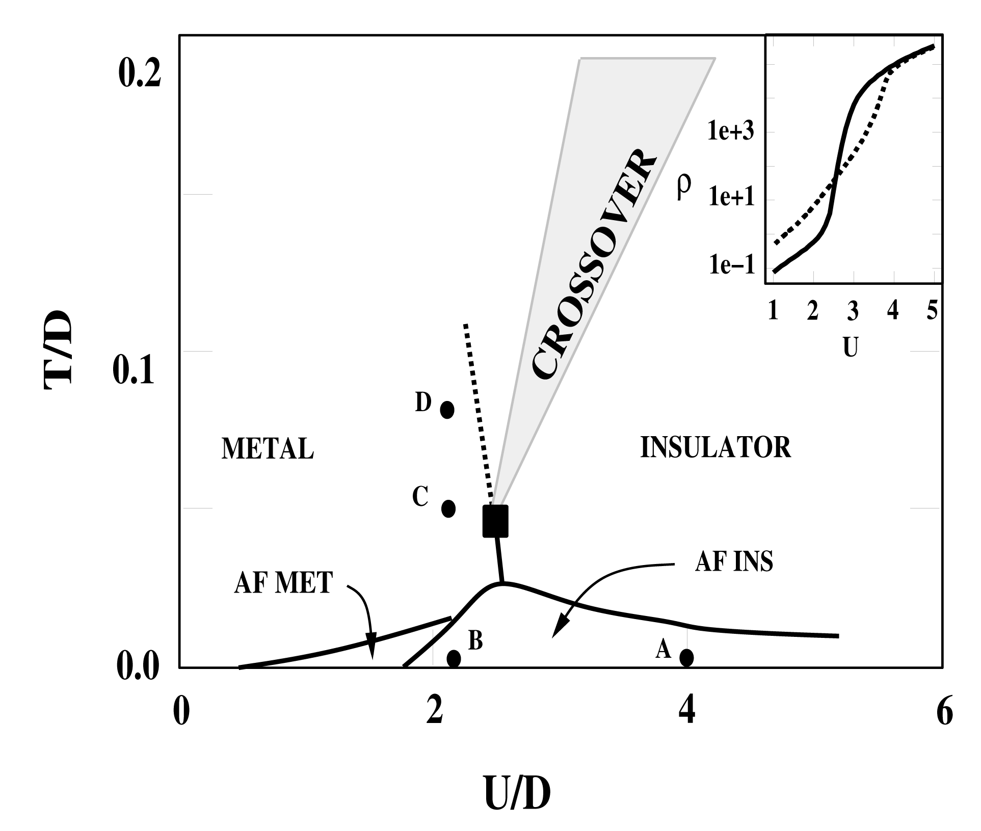
3D Mott- metal-insulator transition is well captured by the
Dynamical Mean Field Theory (DMFT) of the Hubbard model
A. Georges, G. Kotliar, MR, W. Krauth, RMP ‘96
V_{2-x}Cr_{x}O₃ NiS_{2-x}Se_{x} DMFT
Mott
Corr Met
Mott
Corr Met
Corr Met
Mott
Czjzek et al JMMM ‘76
M. Eckstein et al. ‘10 ’11 (DMFT)
A. Amaricci et al. ‘12 (DMFT)
Notes:
1D is always insulator for all U. Only doping can show a MIT
Lets focus on 3D Hubbard Mott transition

Slide 11
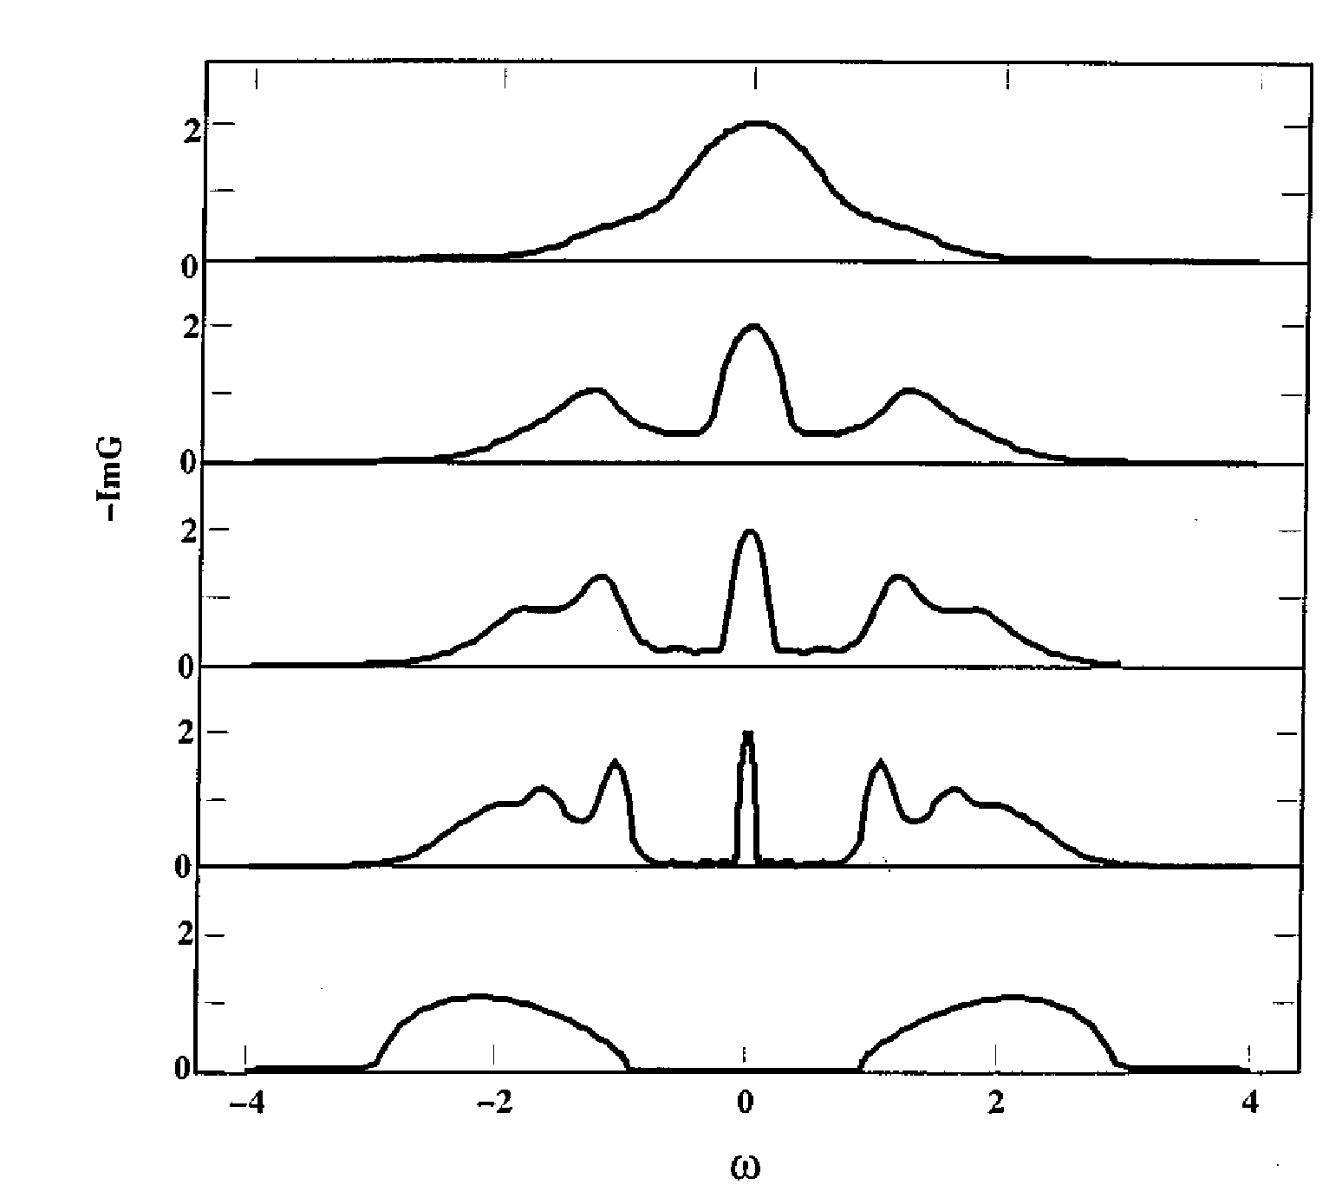
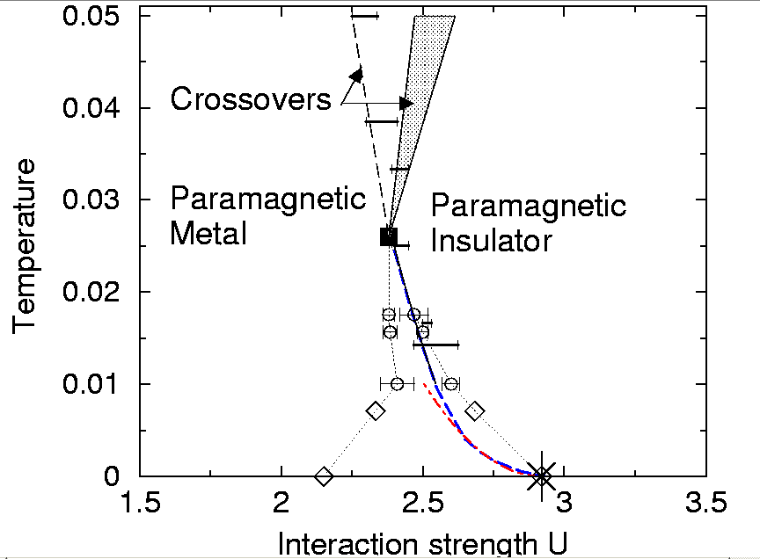
DMFT of the Mott – Hubbard transition
MR et al, PRL ‘95
XY Zhang, MR, G. Kotliar, PRL ‘92
Metal
U = 1
U = 2
Corr Met
Mott
U = 2.5
Corr Met
U = 3
Mott Insulator
U = 4
T_{coex}
Coexistance region: 2 solutions
Notes:
Experiments are on the Ins side, well beneath the 2nd order point at low T
GTS = 77K
V2O3 = 164K
NiSeS = 4K

Slide 12
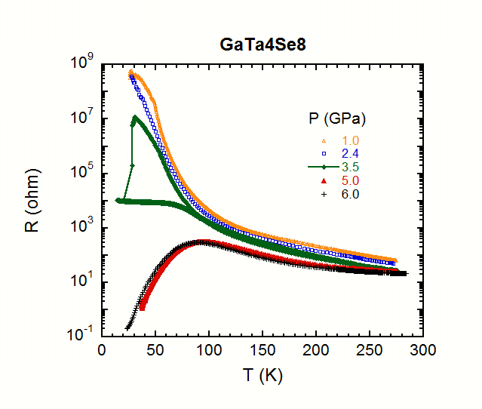
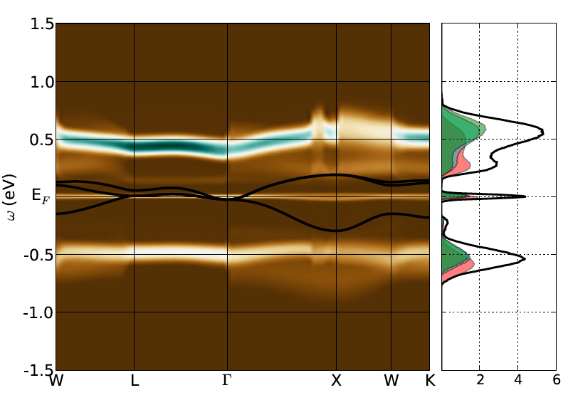
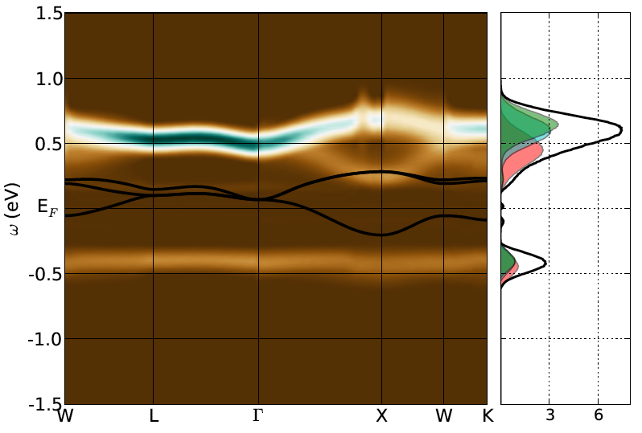
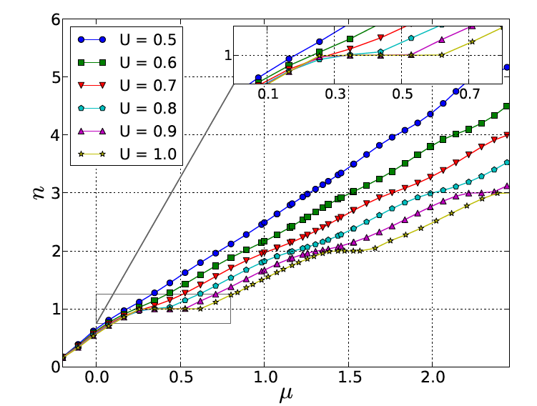
GTS is a Mott-Hubbard insulator (exp & theory)
LDA + DMFT
coexistence
C. Acha et al (in preparation)
T_{COEX} = 0.025*0.25 eV
~ 70 K
A. Camjayi et el. EPJB ’12 & in preparation
Notes:
GTS is physically near the coexistence region
77 K
DMFT scenario validated by LDA+DMFT calculations
Quantitatively predict the 2nd order point at about 100K
W = 0.5eV, U_MIT = 1eV, T_MIT = W/80 = 5500K/80 = 70K

Slide 13
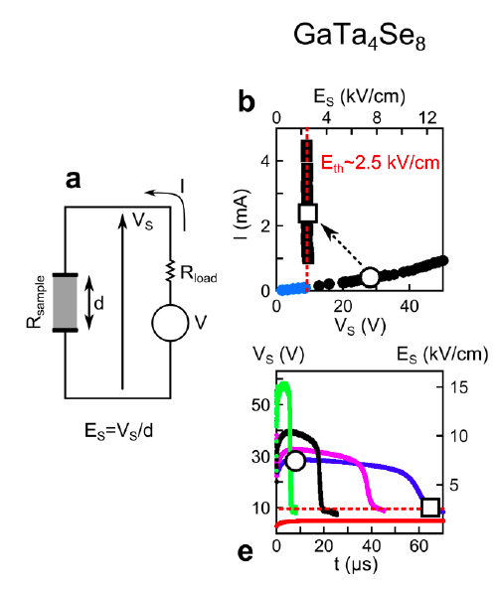
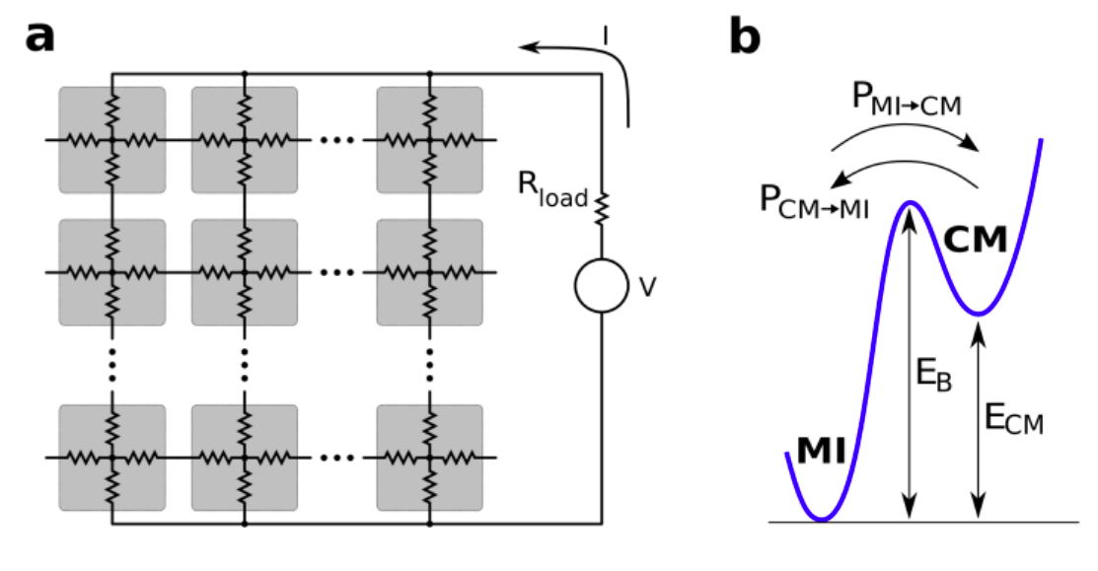
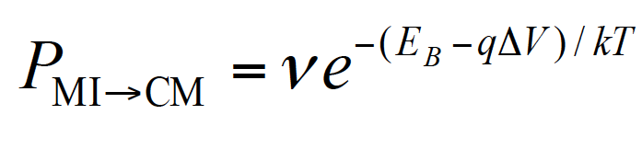
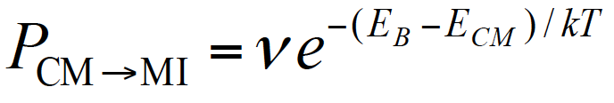
Model of the Mott resistive transition
P. Stoliar et al Adv. Mater. (2013)
Two states: MI – Mott insulator
CM – Correlated metal
R_{MI} >> R_{CM}
P_{MI->CM} and P_{CM->MI} are transition probabilities
Notes:
Motivated by the Hubbard model results, we model the transition as a resistor network
E_CM = 20 kT
E_B = 10 kT
E_B ~ 0.01 eV
R_MI = 16
R_CM = 0.3

Slide 14
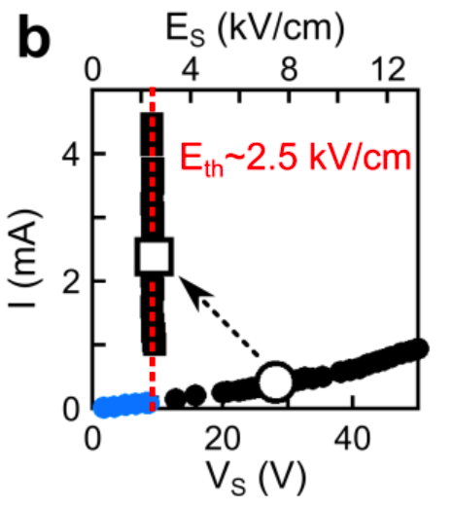
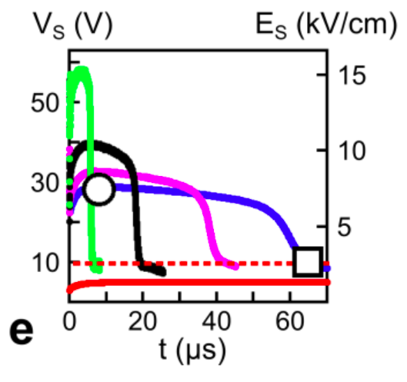
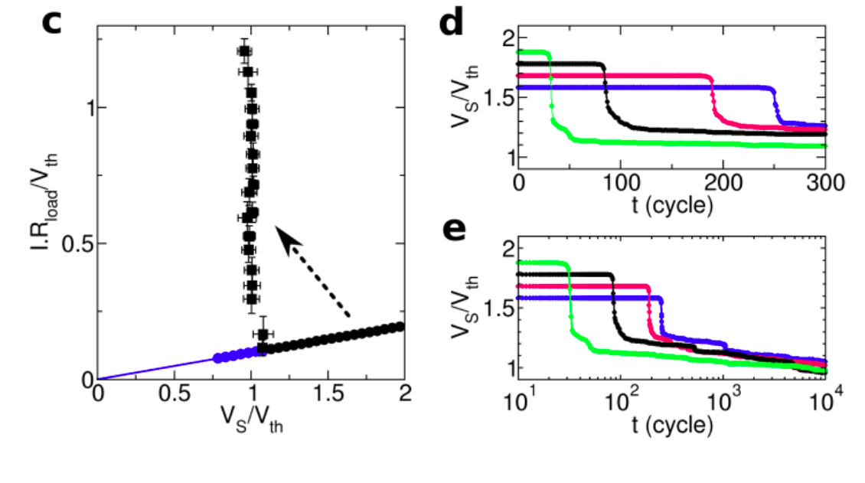
Model results: Threshold-field Mott transition
Experiment
V_{S}/V_{Th} = 1.74, 1.84 1.95, 2.06
Theory

Slide 15
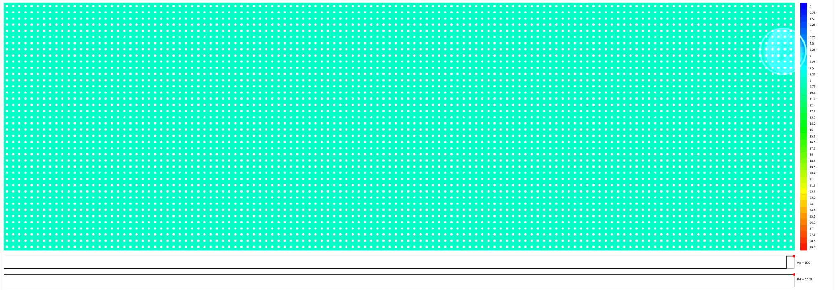
How the transition evolves in time?
Each pixel is a cell of the resistor network model
Color intensity indicates the local ΔV drops (ie local E)

Slide 16
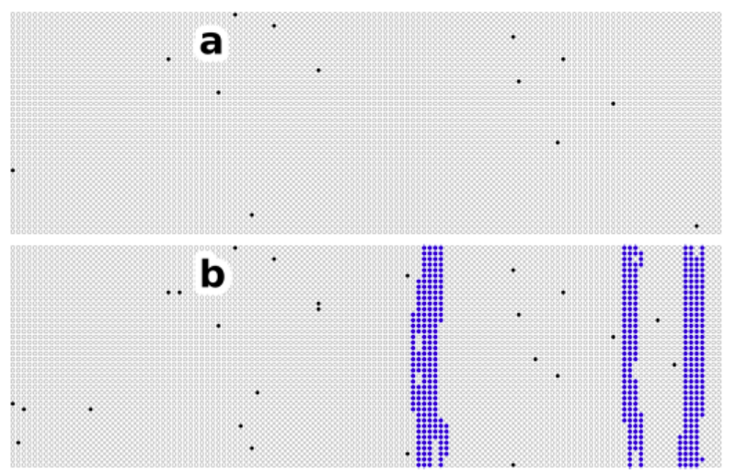
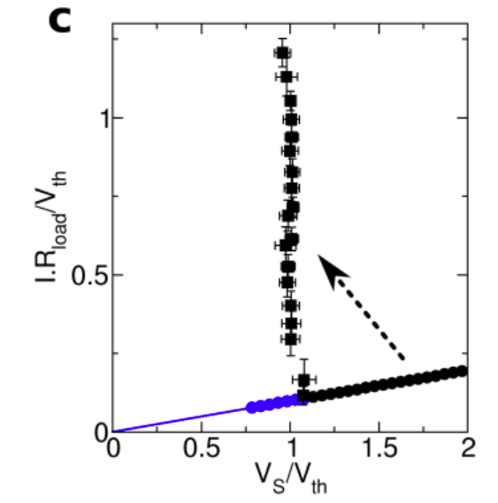
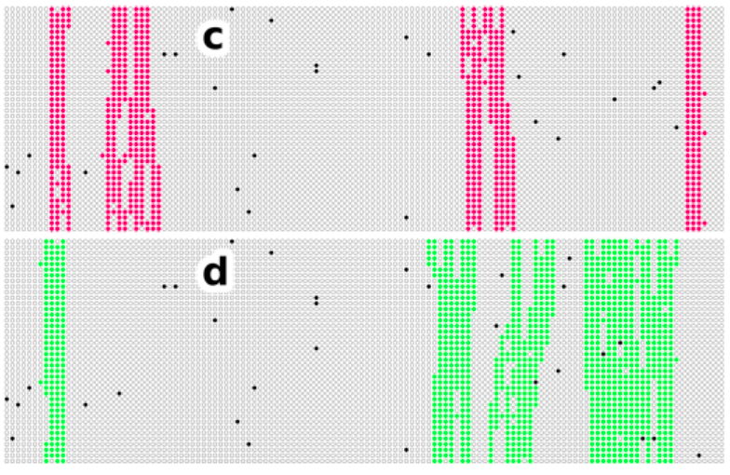
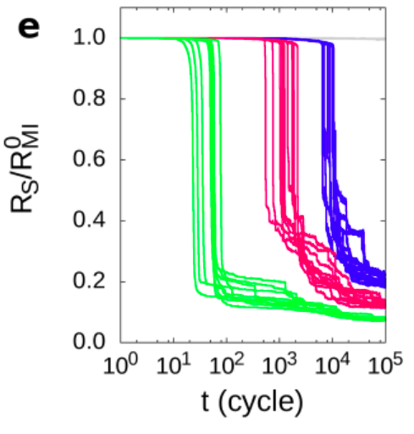
Threshold effect
V_{S}/V_{Th} = 0.7, 1.1, 1.4, 1.8

Slide 17
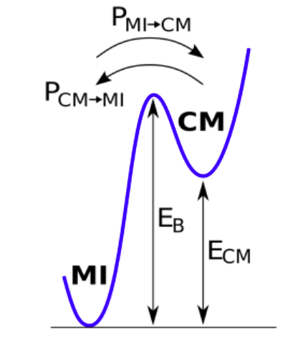
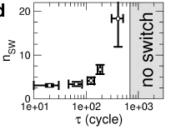
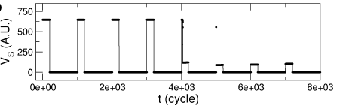
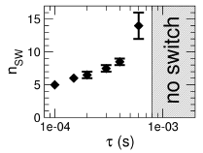
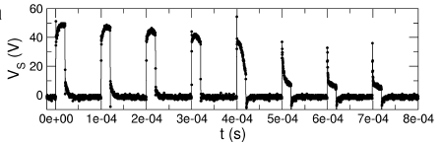
Model prediction
Transition rates imply the existence
of a relaxation time scale t_{relax}
Short pulses (< t_{delay}) are sent at intervals τ < t_{relax}
τ
Model
prediction
Transition after 5 pulses
Experiment

Slide 18
Summary
E-field driven Mott insulators show a universal resistive transition with threshold behavior
A model based on DMFT Mott-Hubbard physics captures the qualitative behavior of the Mott resistive transition
Model predictions for « synaptic » behavior are validated
Refs:
V. Guiot et al, Nat Comm (2013)
P. Stoliar et al., Adv. Mat. (2013)

Slide 19
Bulk effect => conductive path
Gold
Silver
Carbon

Slide 20
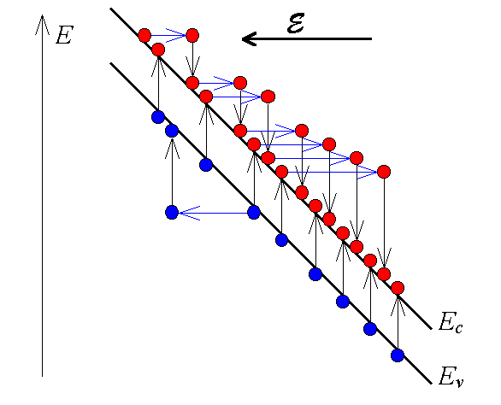
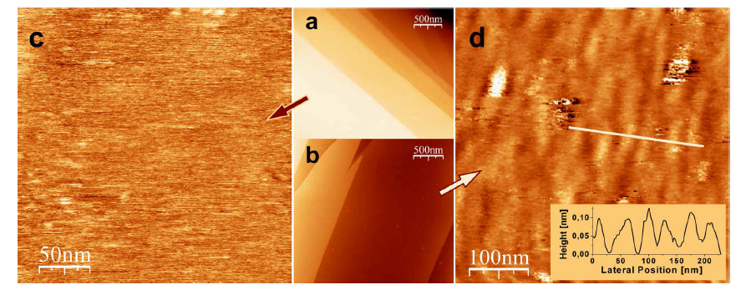
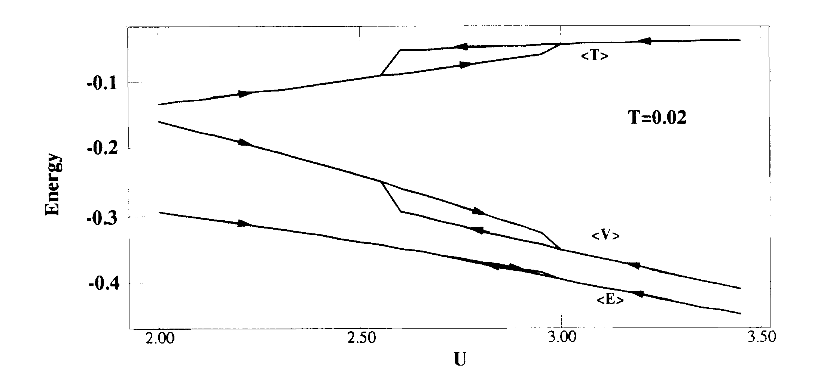
Impact ionization, Gigantic electro-mechanical effect or small energy scale?
STM
after
before
V. Dubost et al. Adv. Func. Mater. ’09

Slide 21
What is the Mott transition?
a correlation driven metal-insulator transition
Mott ’49
σ
a
n ~ 1/a³ ~ t
n
cannot be obtained in band theory:
t
not due to AF (weak coupling effect):
2a

Slide 22
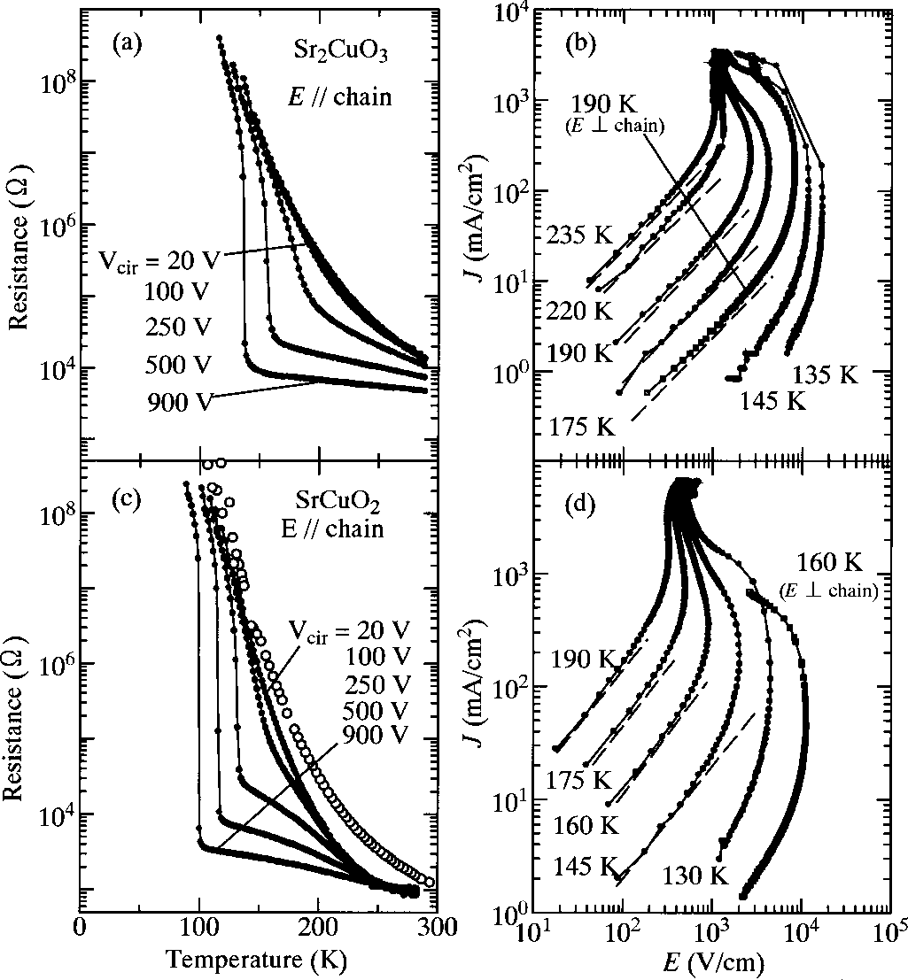
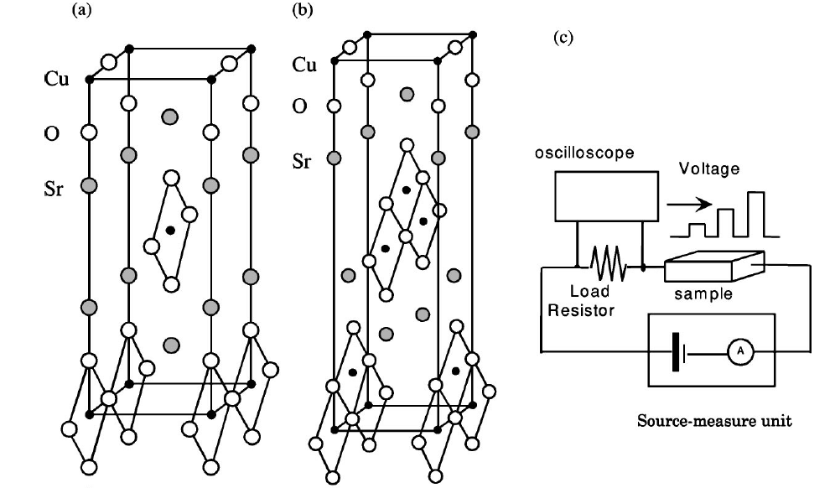
E-field driven dielectric breakdown
1D Mott chains (CuO) in Sr₂CuO₃ and SrCuO₂
Taguchi et al PRB ‘00
Notes:
1D chains
Mott-ronics and oxide electronics is now a very hot topic
Among precursors works we find Tokura’s group
At small V full gap – insulating behavior
At large V, the gap collapses as T is increased

Slide 23
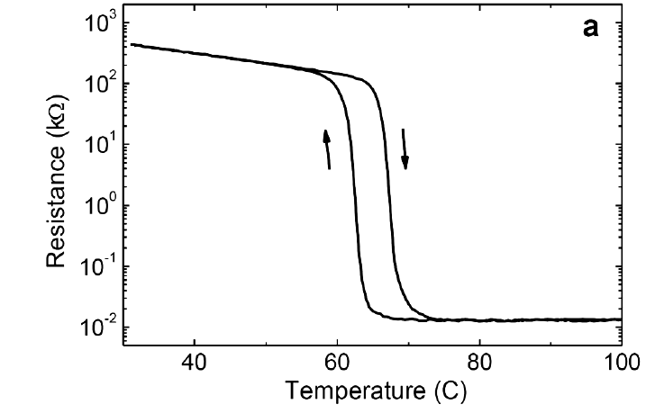



Do not mix up with the Mott transition in VO₂
1st order transition driven by T
T
T
insulator
metal
ins
met
P
Joule heating effect
E-field effect
Zimmers et al PRL ‘13
Driscoll PRB ‘12
Notes:
Large current activity
E field –driven Mott–transition is also mentioned in VO2
Ongoing debate by members of UC San Diego!

Slide 24





Phenomena is generic across the AMX family
E-field driven resistive transition
GaV₄S₈
GaV₄Se₈
GeV₄S₈
GaNb₄Se₈
GaTa₄Se₈
Notes:
Robust effect

Slide 25



Bandwidth (or gap) control by Se – Te substitution
GaTa₄Se_{8-x}Te_{x}
V. Guiot et al. Nat Comm (in press)
Notes:
Systematic understanding of the E-field driven Mott transition

Slide 26


Electric-field breakdown vs Gap
V. Guiot et al. Nat Comm (in press)
Semicond
avalanche
Time delay vs Excess field
E_{th} ~ Δ^{2.5}
Mott
Notes:
Similar to electric breakdown in semiconductors

Slide 27


Model results: Threshold-field Mott transition
V_{S}/V_{Th} = 1.74, 1.84 1.95, 2.06
Time delay
vs
Excess field
Theory
Experiment

Slide 28

What is the origin of the Mott electric-breakdown?
Hubbard model 1D
1/ξ ∼ Δ_{Mott} (1D)
Δ ~ 10⁻¹ eV
ξ ~ 1 nm = 10⁻⁷ cm
F_{Th} ~ 1 MV/cm
E_{Th} ~ 1 KV/cm !!!!
T. Oka et al. ‘03 ‘05 ‘10 ‘12
F. Heidrich-Meisner et al ’10
M. Eckstein et al. ‘10 ’11 (DMFT)
A. Amaricci et al. ‘12 (DMFT)
??? 1/ξ ∼ Δ_{Mott} (3D)
??? ξ ∼ μm (3D)
Notes:
In fact lets consider recent work on electronic breakdown transition in Hubbard model
X No SHARP threshold effect !!!
V The threshold parameter scales like the gap^2, similar as the experiment, but not exact.
? Correlation length of doublons in 3D???

Slide 29
What is a Mott transition?
It is a metal-insulator transition due
to electron correlation effects.
Competition between kinetic and
potential energy
Notes:
Better start with recalling the basic features of the Mott transition

Slide 30

The Hubbard model at ½ filling is a minimal model for the metal – insulator transition
ρ
U = 0
metal
~ t
ω
ρ
t = 0
insulator
~ U
ω
Notes:
Of course out-of-equilibrium many-body problem is very difficult

Slide 31


How the transition evolves in time?
(snapshots)
time

Slide 32


Threshold effect
Below threshold
Above threshold

