Slide 1
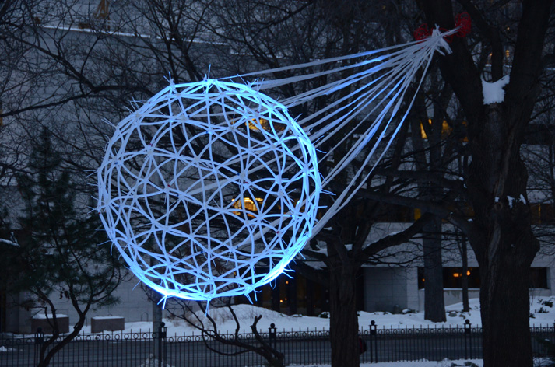
Massimo Capone
WHEN MOTT MEETS BCS: MOLECULAR CONDUCTORS AND THE SEARCH FOR HIGH Tc SUPERCONDUCTIVITY
Massimo Capone
ICAM BU Workshop – Digital Design 27-29/09/13

Slide 2
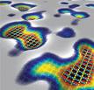
Massimo Capone
COWORKERS AND FUNDING
Amaricci
G. Giovannetti
A. Privitera
E. Tosatti (SISSA)
M. Fabrizio (SISSA)
C. Castellani
Toschi
G. Sangiovanni
L. de’ Medici
SUPERBAD
http://www.lemsuper.eu
http://superbadproject.wordpress.com
ICAM BU Workshop – Digital Design 27-29/09/13
SUPERBAD
SUPERBAD
SUPERBAD
SUPERBAD

Slide 3
Massimo Capone
OUTLINE
Cs3C60 is a Mott insulator, and it turns into a
phonon-mediated superconductor with pressure
Mott physics favours electron-phonon superconductivity
in the fullerides
Molecular phonons do not “fight” with Coulomb repulsion
Other phonons fight. Other organics?
ICAM BU Workshop – Digital Design 27-29/09/13

Slide 4
Massimo Capone
FRAMEWORK
SUPERCONDUCTIVITY after the cuprate revolution
Phonon-mediated “BCS”
Weak correlations
s-wave
low T_{c}
“Electronic Mechanism”
Strong Correlations
d-wave (nodes)
high T_{c}
Unconventional
Conventional
Standard, conventional, boring…
Exotic, unconventional, interesting, beautiful…
New pieces in the puzzle (organics, iron-based, MgB₂, aromatics)
[Where do the iron-based SC belong ?]
Electron-phonon superconductors which benefit from correlations
“the other high-T_{c}s”
Cs₃C₆₀, K₃C₆₀, .. : M.C., M. Fabrizio, C. Castellani and E. Tosatti
Ba_{1−x}K_{x}BiO₃ β-HfNCl Z. P. Yin, A. Kutepov, G. Kotliar
Aromatics?
ICAM BU Workshop – Digital Design 27-29/09/13

Slide 5
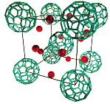
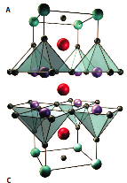
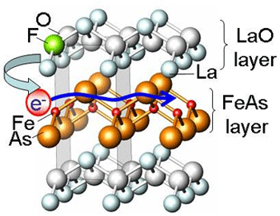
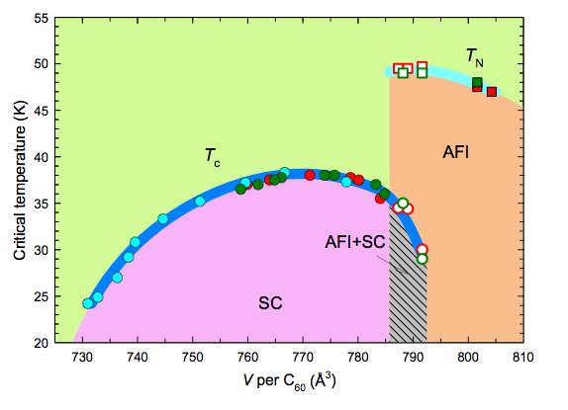
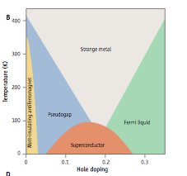
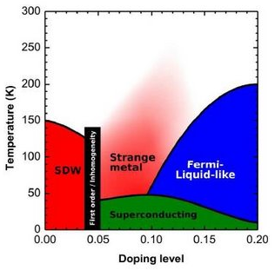
SUPERCONDUCTIVITY AND MOTT PHYSICS
Main Underlying Idea
SUPERBAD
Three different families share a similar behaviour regardless of the glue:
Superconductivity is Best Realized in “Optimally Bad” Metals
ICAM BU Workshop – Digital Design 27-29/09/13

Slide 6
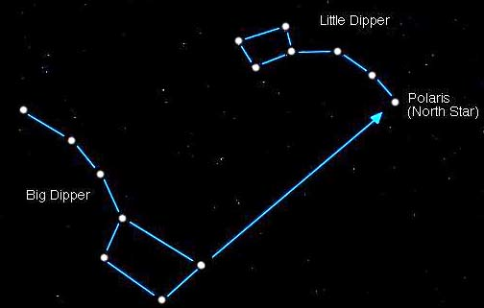
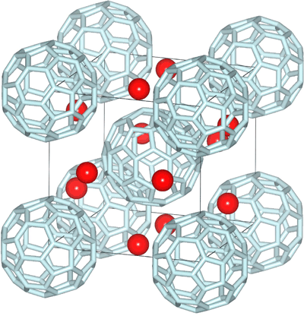
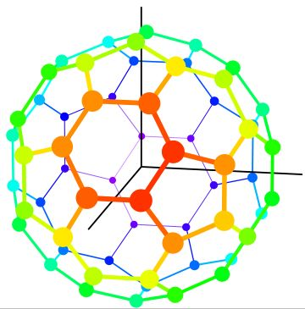
Massimo Capone
OUR NORTH START: THE FULLERIDES
Solid C₆₀ forms a molecular crystal
Undoped Band insulator with a 3-fold degenerate (t_{1u}, like p) LUMO
A₃C₆₀: alkali-metal atoms
donate electrons to C₆₀ bands
A=K, Rb s-wave superconductor
A=Cs AFM insulator
SC with T_{c}=38K at 5 kbar
A = K, Rb, Cs
ICAM BU Workshop – Digital Design 27-29/09/13

Slide 7
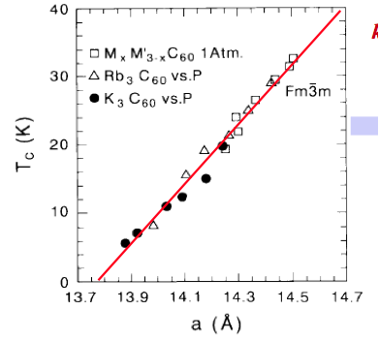
THE FIRST ANSWER: ELECTRON-PHONON
Massimo Capone
“old” (90s) compounds (K₃C₆₀, Rb₃C₆₀)
Ordinary “BCS” Superconductors with “moderate” effective mass enhancement
Carbon Isotope effect on T_{c}
Regular Specific heat jump at T_{c}
Increase of T_{c} and DOS with lattice spacing
O. Gunnarsson, Rev. Mod. Phys. 69, 575 (1997)
ICAM BU Workshop – Digital Design 27-29/09/13

Slide 8
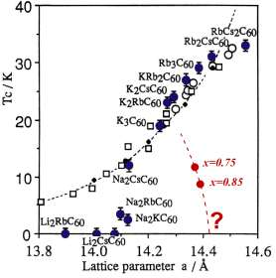
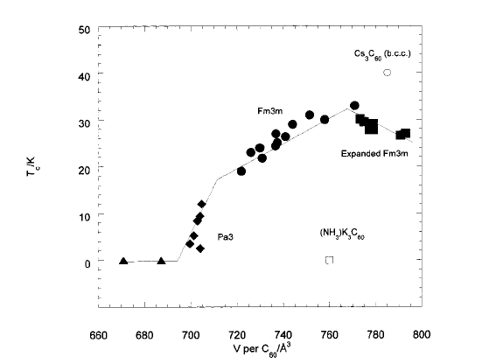
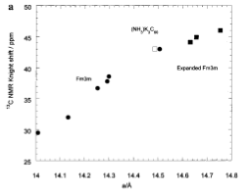
THE STORY BECOMES MORE “INTERESTING”
Massimo Capone
Early 00s: Expanded (large interball distance) compounds:
T_{c} decreases with lattice parameter
While DOS
increases
(NH₃)_{x}NaK₂C₆₀
Cs_{3-x}Rb_{x}C₆₀
M. Riccò et al.
Phys. Rev. B, 68, 035102 (2003)
Dahlke, Denning, Henry, Rosseinsky,
J. Am. Chem. Soc. 122, 12352 (2000)
ICAM BU Workshop – Digital Design 27-29/09/13

Slide 9
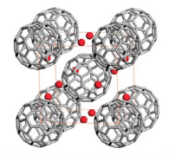
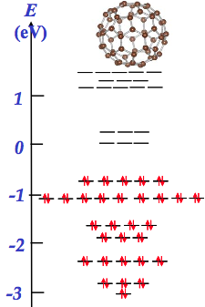
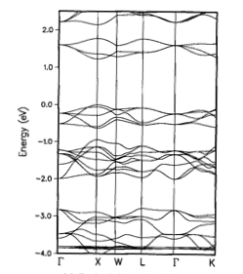
Massimo Capone
BACK TO THE QUESTION:
ELECTRON-PHONON OR NOT ?
C₆₀ molecule MOs
Solid C₆₀ bands
3 degenerate
LUMO bands
LUMO t_{1u}
Molecular Crystal: the bands are formed by molecular orbitals
ICAM BU Workshop – Digital Design 27-29/09/13

Slide 10
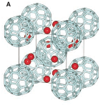
MODELING A_{n}C₆₀ - A “DIGITAL” PREDICTION
Massimo Capone
One C60 per lattice site
Alkali only donate their s electrons
hopping Term
3 bands
W ~ 0.5-0.6 eV
Coulomb Repulsion U ~ 1/1.5 eV
Numbers suggest we have a correlated system
(not just Cs-doped)
ICAM BU Workshop – Digital Design 27-29/09/13

Slide 11
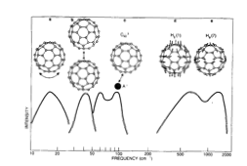
Massimo Capone
MODELING A_{n}C₆₀ Chap. 2 - ELECTRON-PHONON
Electron-phonon interaction
t_{1u} coupled to H_{1g} phonons
(deformations of the ball)
The interaction lives
on a single molecule
Hund’s rule for t_{1u}
J > 0 favors minimum S e L (inverted Hund’s rule)
ICAM BU Workshop – Digital Design 27-29/09/13

Slide 12
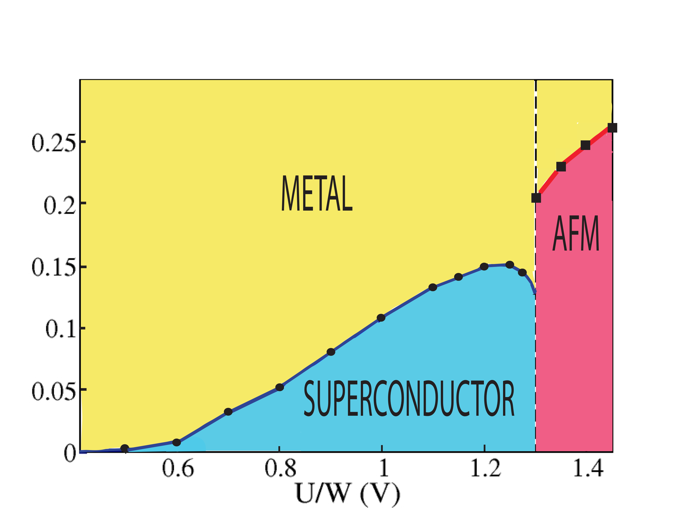
Massimo Capone
THE DMFT PHASE DIAGRAM
Orbital Degeneracy (3 t1u orbitals)
Jahn-Teller coupling
Strong Correlation
s-wave superconductors
S=1/2 AFM Mott
First-order transition
Superconductivity close to a Mott state is enhanced by correlations
M. C., M. Fabrizio, C. Castellani, and E. Tosatti, Rev. Mod. Phys. 81, 943 (2009)
[before the experiment in Cs₃C₆₀]
M. C. and G. Giovannetti, Phys. Rev. Lett. 109, 166104 (2012) [HSE]
ICAM BU Workshop – Digital Design 27-29/09/13

Slide 13
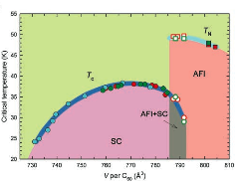
Massimo Capone
ENTER Cs₃C₆₀
Cs is bigger than K, Rb
Larger lattice spacing implies a smaller W
S=1/2 “low spin”
A=Cs S=1/2 AFM insulator
SC with T_{c}=38K at 5 kbar
V per C₆₀ or U/W
The “correlated” DMFT phase diagram!
A. Y. Ganin et al. Nature Materials 7, 367 (2008)
Y. Takabayashi et al., Science 323, 1585 (2009)
ICAM BU Workshop – Digital Design 27-29/09/13

Slide 14
Massimo Capone
WHY?
Active Phonons are coupled with Spin/Orbital Degrees of Freedom
still active when charge fluctuations are frozen by correlations
even in the Mott state the singlet energy gain is J
U
ZU
Coulomb Repulsion
W
ZW
Z << 1
J
J
Electron-phonon
Enhanced Superconductivity
Molecular phonons: deformations of the molecule which couple to
“internal” degrees of freedom.
M.C., M. Fabrizio, C. Castellani, and E. Tosatti, Science 296, 2364 (2002)
ICAM BU Workshop – Digital Design 27-29/09/13

Slide 15
WHAT DOESN’T KILL YOU MAKES YOU STRONGER
Attractive
Potential
λ = ρV
Density of States
Quasiparticles with
Reduced bandwidth
W
ZW
Correlations
Z << 1
ρ
ρ/ Z
Repulsion enhances T_{c}!
“Typically”
V is also renormalized
λ
λ Ζ << λ
V
VZ²
Correlation can enhance Tc when the attraction is not renormalized
ICAM BU Workshop – Digital Design 27-29/09/13

Slide 16
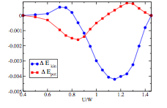
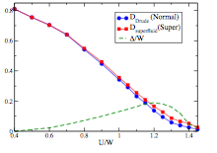
WHATEVER DOES NOT KILL YOU SIMPLY
MAKES YOU STRANGER
Massimo Capone
SUPERCONDUCTIVITY “HEALS”
THE ANOMALOUS METAL CLOSE
TO THE CRITICAL POINT
Superfluid delta-function
in optical conductivity
larger than the Drude
Weight of the metal
a kinetic energy gain
stabilizes the SC
Anti-BCS
(as it happens in u.d. cuprates)
ICAM BU Workshop – Digital Design 27-29/09/13

Slide 17
Massimo Capone
WE MUST CONSIDER “REAL” PHONON SYMMETRY
Hubbard-Holstein model
E-ph coupling directly “fights” with Hubbard U
(needs charge fluctuations)
Minor phonons effects, completely frozen by U
(no hope for phonon-driven superconductivity)
ICAM BU Workshop – Digital Design 27-29/09/13

Slide 18
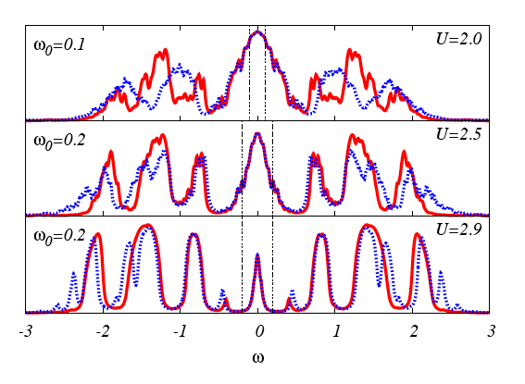
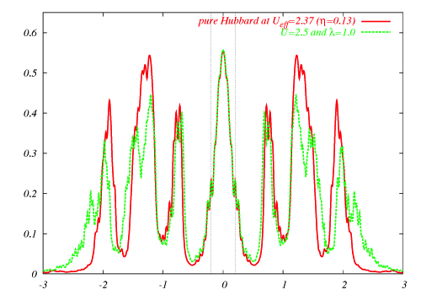
Massimo Capone
STILL SOME PHONON EFFECTS
Effective Hubbard model (no phonons) vs Hubbard-Holstein
Low energy Identical
Hubbard bands are in the same place
Phonon effects in the Hubbard bands
ICAM BU Workshop – Digital Design 27-29/09/13

Slide 19
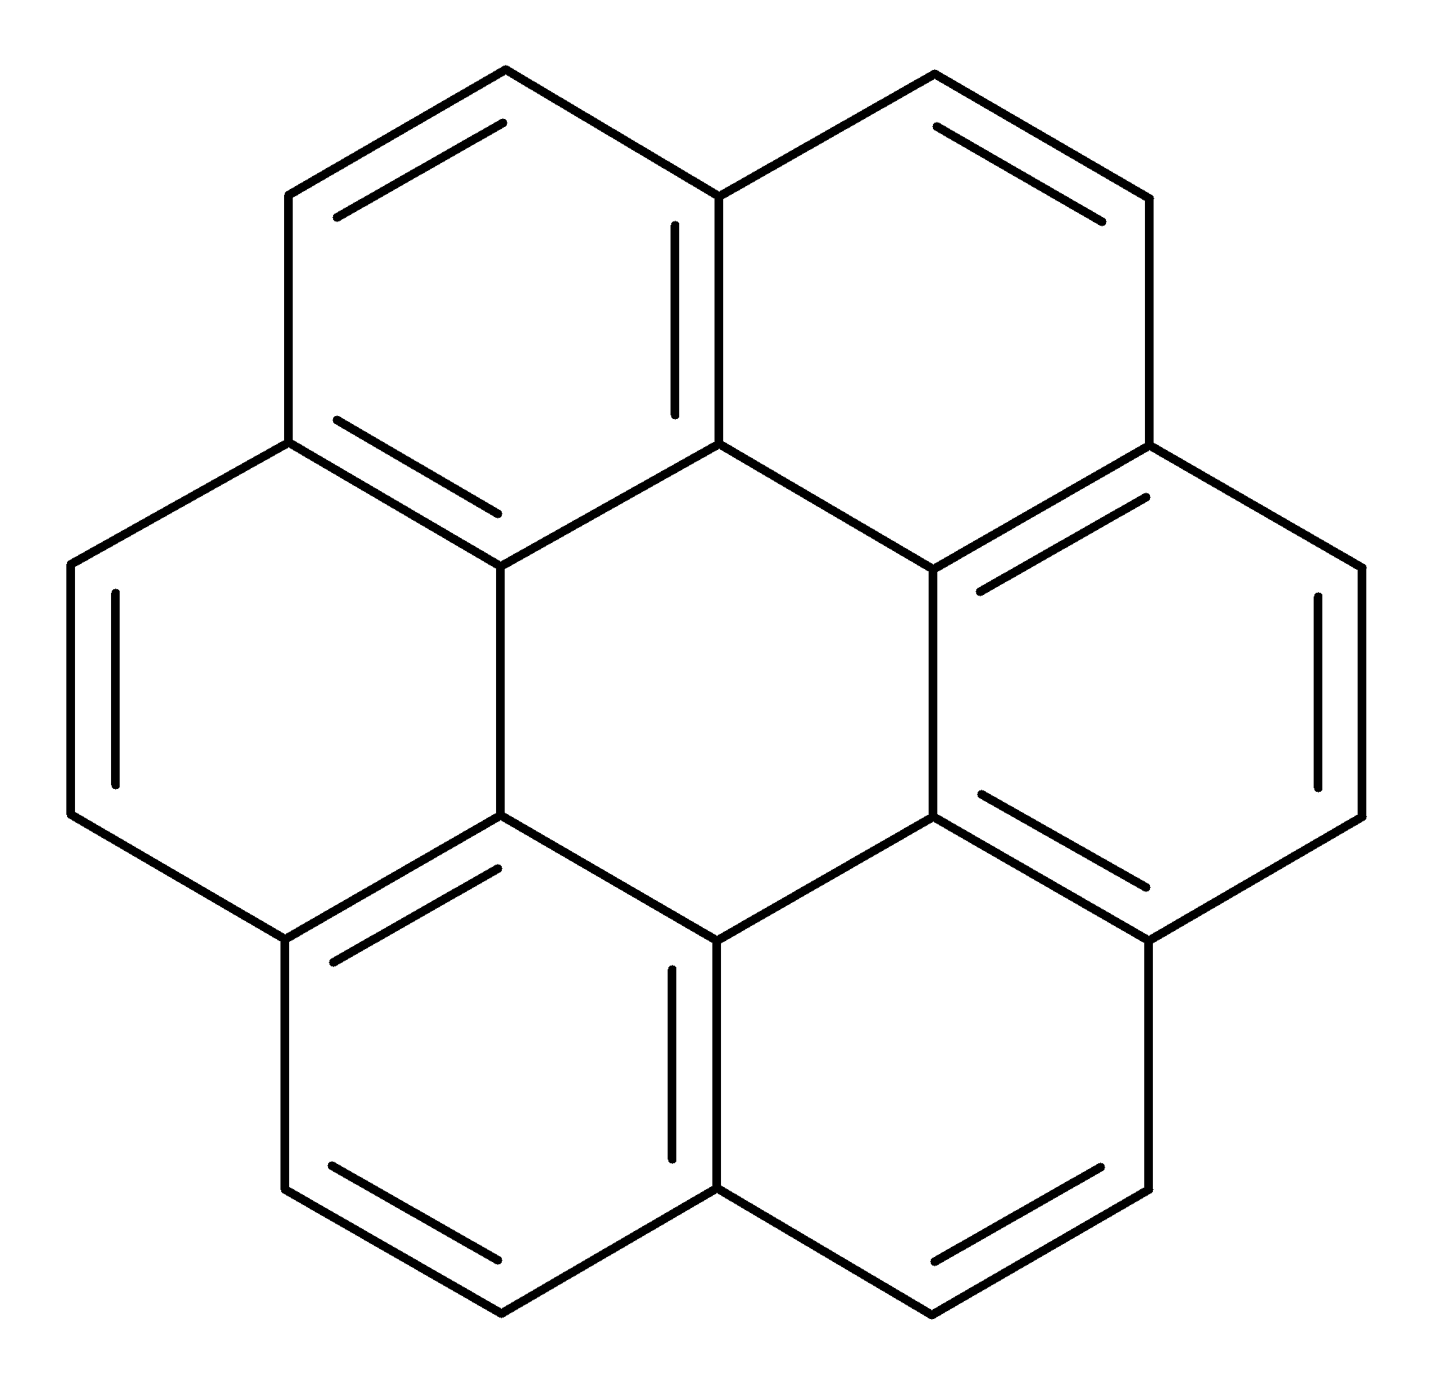
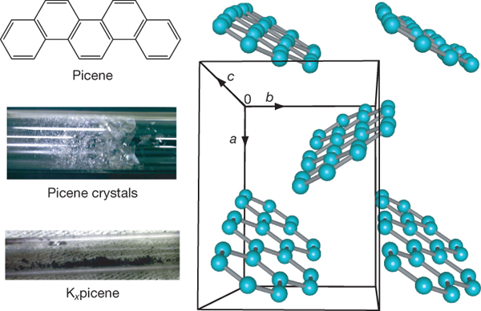
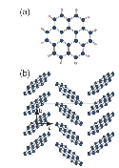
AROMATIC SUPERCONDUCTORS (?)
K_{x}-picene
2.7 < x <3.3
T_{c} = 18K
R. Mitsuhashi et al. Nature 464, 76 (2010)
K_{x}-coronene
T_{c} = 15K
Y. Kubuzono et al.
Phenanthrene
T_{c} = 5K
X.F. Wang et al. Nat. Comm.
and 1,2:8,9-dibenzopentacene with T_{c}=33K
M. Xue et al. Scientific Report
ICAM BU Workshop – Digital Design 27-29/09/13

Slide 20
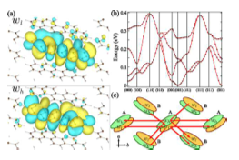
PICENE MOLECULAR ORBITALS
C₂₂H₁₄
Conduction bands from
LUMO and LUMO+1
nearly degenerate
T. Kosugi et al.JPSJ 79, 044705 (2010)
U is around 0.7 eV
W < 0.6 eV
Y. Nomura, K. Nakamura and R. Arita, Phys. Rev. B 85, 155452 (2012)
ICAM BU Workshop – Digital Design 27-29/09/13

Slide 21
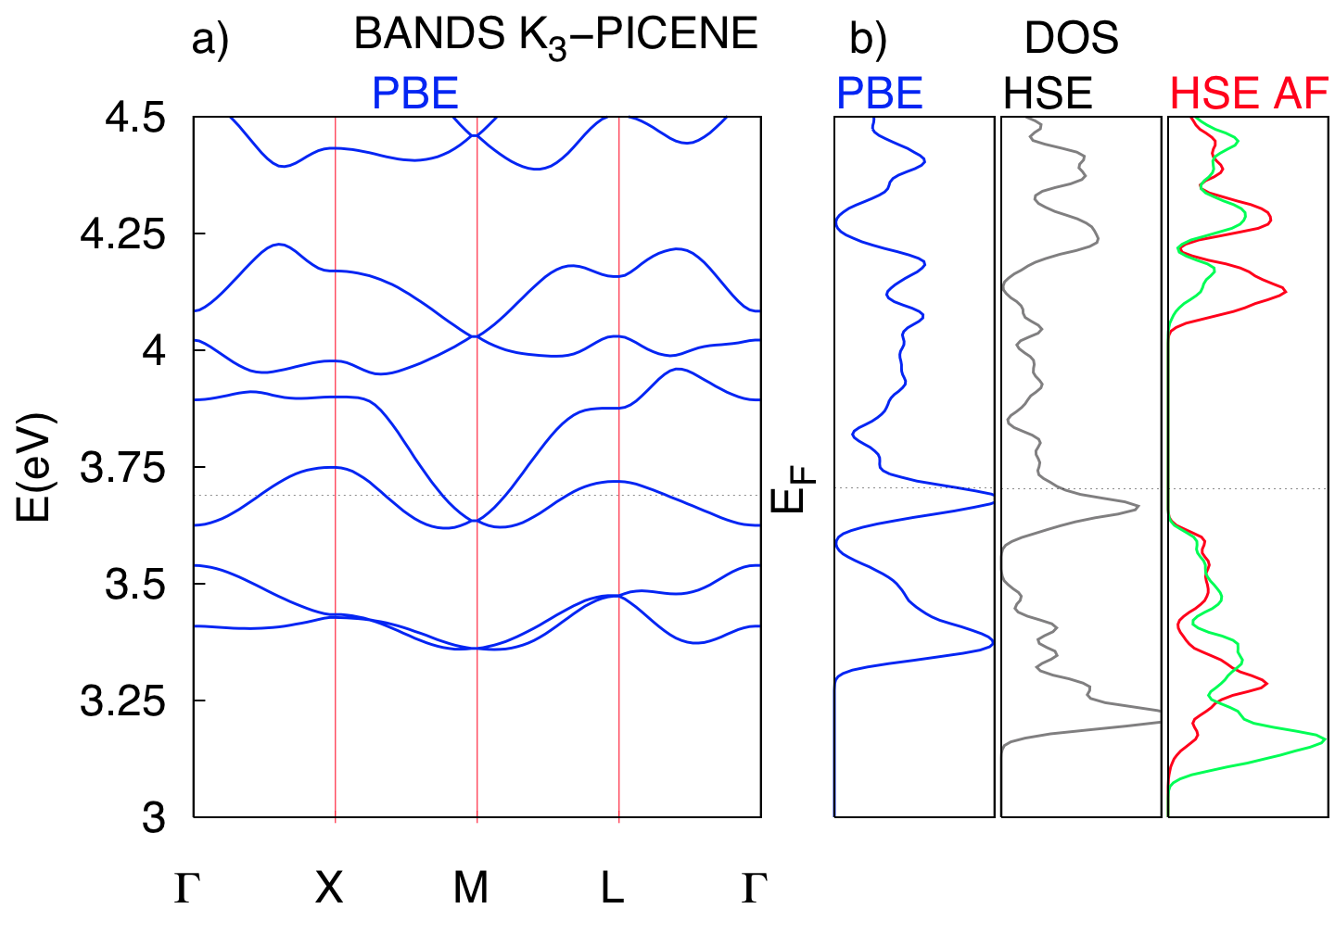
CORRELATION EFFECTS IN K-PICENE
G. Giovannetti and M.C. Phys. Rev. B 83, 134508 (2011); M. Kim et al.
C₂₂H₁₄
Conduction bands from
LUMO and LUMO+1
nearly degenerate
T. Kosugi et al.JPSJ 79, 044705 (2010)
AFM
Gap
Using HSE functional within DFT we find a low-spin AFM state
No AFM using LDA, GGA – We need correlations
HSE also necessary to make Cs₃C₆₀ insulating in DFT [G. Giovannetti and M.C. PRL 2012]
Correlation effects are important
ICAM BU Workshop – Digital Design 27-29/09/13

Slide 22
ELECTRON-PHONON AND CORRELATIONS
Cs₃C₆₀ | K₃picene
Threefold degenerate orbitals | Nearly degenerate
U/W ~ 1.5 | U/W ~ 1.2
Molecular Phonons | all sort of phonons
Casula et al. PRL 2011
Off-plane C
In-plane C
40% of the e-ph coupling comes from dopant+intermolecular modes
The intramolecular phonons can behave like in fullerene
The intermolecular and intercalant are expected to be depressed
ICAM BU Workshop – Digital Design 27-29/09/13

Slide 23
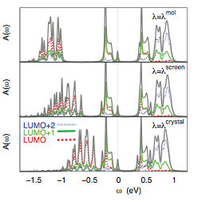
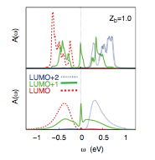
ELECTRON-PHONON AND CORRELATIONS
Plug everything into a single phonon mode
DMFT without phonons
DMFT with phonons
METAL due to off-diagonal phonons
G. Giovannetti, M. Casula, P. Werner, M. Calandra, F. Mauri, and M.C. submitted
ICAM BU Workshop – Digital Design 27-29/09/13

Slide 24
Massimo Capone
CONCLUSIONS
Electron-phonon interaction and Mott physics can live happily everafter
Phononic Superconductivity favored by strong correlation if it involves internal degrees of freedom
(deformations of the molecule)
Cs₃C₆₀ is the cleanest example
The symmetry of the phonon is crucial. Need for realistic
calculations
G. Giovannetti and M.C. Phys. Rev. B 83, 134508 (2011)
M. C., M. Fabrizio, C. Castellani, and E. Tosatti, Rev. Mod. Phys. 81, 943 (2009)
ICAM BU Workshop – Digital Design 27-29/09/13

