Slide 1



Electronic Delocalization in the Hunds Insulator LaMnPO: Implementing Theory Assisted Synthesis
J. W. Simonson, H. He, J. Misuraca, W. Miiller, D. McNally, A. Puri, J. Kistner-Morris, J. Hassinger, T. Orvis, S. Zellman, and M. C. Aronson
Stony Brook University and Brookhaven National Laboratory
D. Basov and K. Post Z. Yin, M. Pezzoli, and G. Kotliar
UC San Diego Rutgers University
A.Efimenko,N. Hollmann, J. Guo and L. L. Sun J. W. Allen
Z. Hu, and L. H. Tjeng CAS/IOP Beijing University of Michigan
MPI-CFS Dresden
Research supported by a DOD National Security Science
and Engineering Fellowship via the AFOSR

Slide 2
The Materials Development Pyramid
Tier 4: Materials for real technologies and societal benefit
Material incorporated into devices and systems
<10 SCs in
Current applications
Tier 3: Materials for Technology and Science
Improved synthesis for optimized properties
~2,000 known
superconductors
Tier 2: Materials of Interest
Material has special property (i.e. superconductivity)
~350,000 inorganic compounds in
ICSD/Pearsons
Tier 1: New Materials
Generally, only structure is known
Can the combination of electronic structure calculations in synthesis speed the advancement of Tier 1 materials towards the top of the pyramid?

Slide 3
Can Theory Speed Convergence of the Synthesis of New Materials with Specific Functionalities?
Wish to find a new family of superconductors with high SC onset temperatures: requires a new methodology
1. Need a guiding principle: (Unconventional) SC is found near the breakdown of magnetic order. High SC onset temperatures require proximity to an electronic delocalization (Mott) transition.
2. Need a structural motif: layered compounds, square net transition metals (Fe,Mn)
3. Need to verify that electronic structure calculations adequately reproduce basic quantities like charge gap, magnetic moment, etc in a prototype materials from the desired class.
Need to extrapolate electronic structure calculations to increase proximity to
desired electronic phases (electronic delocalization, collapse of moments) via doping or chemical pressure. Results must be expressed in terms of (key) atomic spacings and angles.
Need to identify Tier 1 materials from data bases that may exemplify these new properties for synthesis.

Slide 4
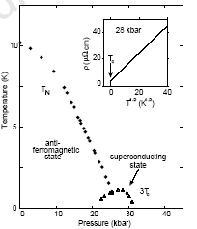
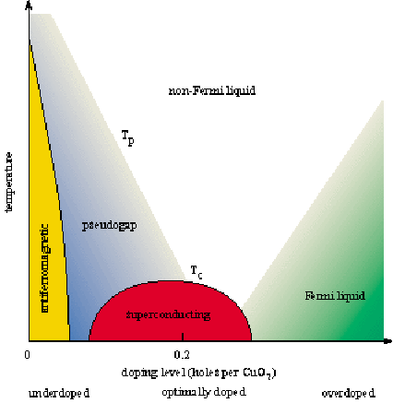
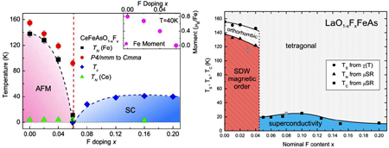
Quantum Critical Points: A Universal Relationship for Superconductivity and Magnetism in Strongly Correlated Metals?
Heavy Electron Intermetallics
Cuprates
CePd₂Si₂
Mathur 1998
AF
SC
Organic Conductors
Iron pnictides
(Jaccard 2001)

Slide 5
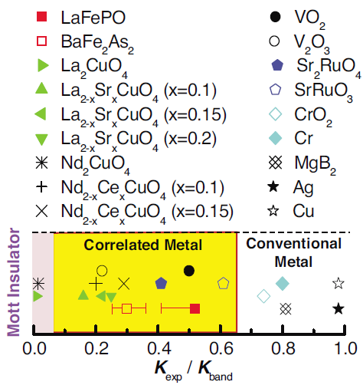
Conditions for Highest Superconducting T_{C} ?
Kotliar and Vollhardt 2004
Qazilbash 2009
Hypothesis:
High superconducting transition temperatures T_{C} are to be found on the metallic side, but close to the Mott-Hubbard (or other type of) electronic delocalization phase transition
Proximity to electronic delocalization:
enhanced Pauli susceptibility, electrical resistivity
Reduced ordered moments, kinetic energy K_{meas}/K_{band}
Band narrowing reduces kinetic energy cost of BCS gap formation.

Slide 6
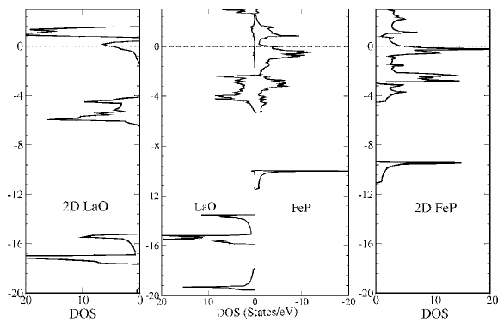
Lamellar Superconductors
(LaO)(FeP) Structure
LaFePO Electronic Structure
Lebegue 2007
Functional Layers (FeP): dominate electronic states near Fermi level
Charge Reservoir Layers (LaO_{1-x}F_{x}): determine bandfilling.
Can we find a functional layer that is initially insulating, but can be driven metallic?

Slide 7
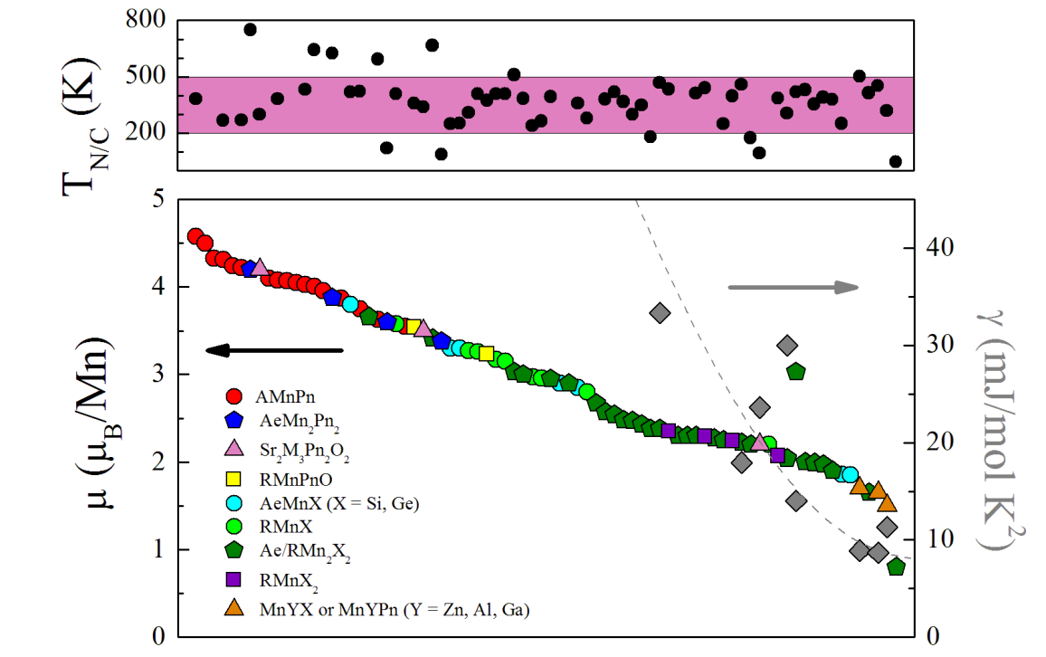
Moments and Metallization: Mn Square Net Compounds
LaMnPO
Insulating with
Magnetic Order
Metallic with
Magnetic Order

Slide 8
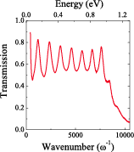
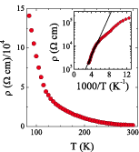
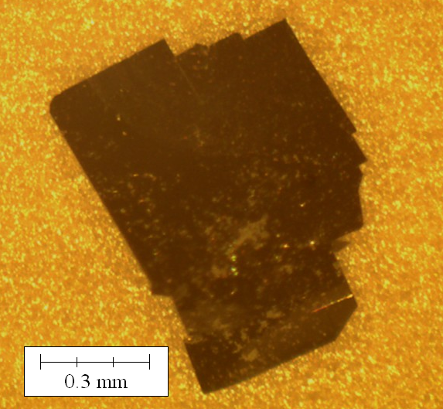
LaMnPO: Correlation Gap Insulator
Single crystals grown from NaCl-KCl flux: ZrCuSiAs structure
Previous measurements on polycrystalline samples (Yanagi 2009)
Optical gap: ~1 eV Resistivity: activation gap ~0.1 eV
Intrinsic insulator, localized states in gap

Slide 9
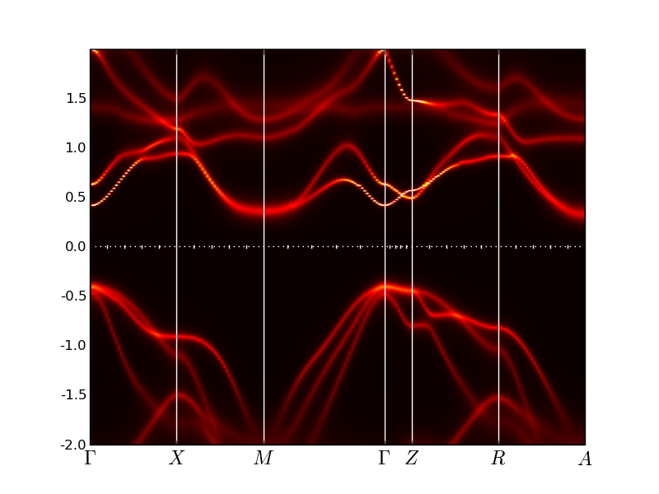
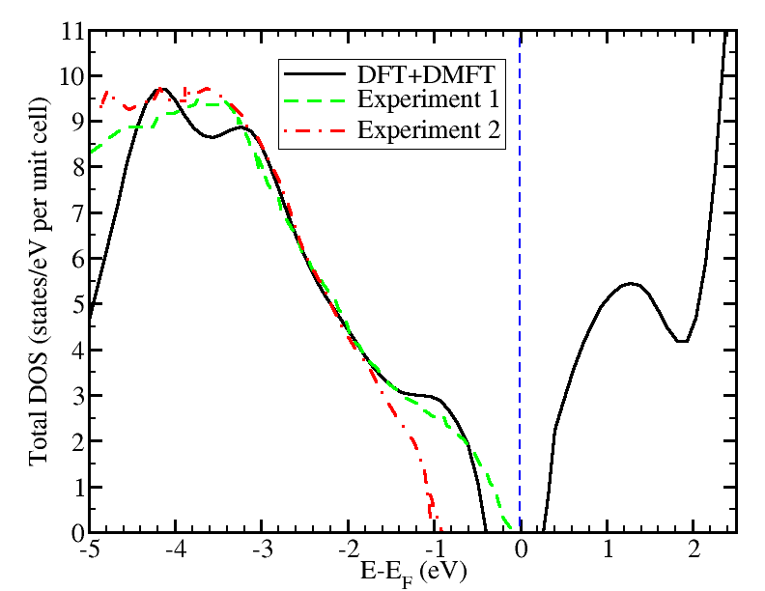
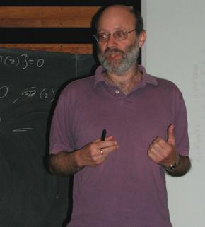







LaMnPO: Correlation gap insulator
DFT+DMFT
Yanagi 2009
Hu+Tjeng 2011
Electronic structure calculations via DFT+DMFT
-Indirect gap (Γ-M, Γ-A) : 0.65 eV
-Direct gap (Γ): 0.8 eV
Total density of states in good agreement with angle integrated photoemission
experiments (Yanagi 2009, Hu and Tjeng 2011).
Gabi Kotliar, Maria Pezzoli, Zhiping Yin
Rutgers University
Liu Hao Tjeng, Zhiwei Hu, Nils Hollman, Anna Efimenko
(MPI-CFKS, Dresden), Jim Allen (U. Michigan)

Slide 10
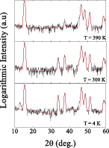
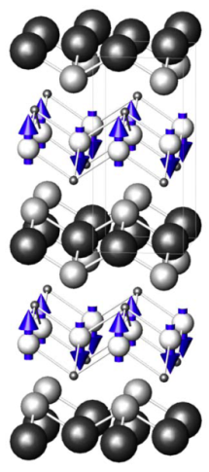
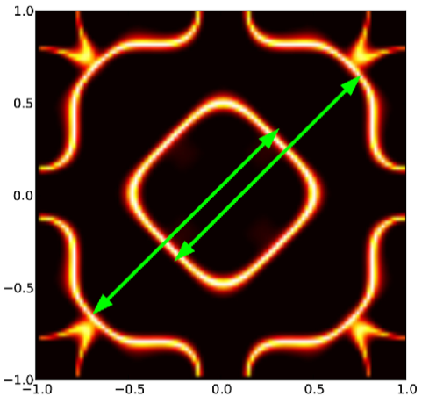
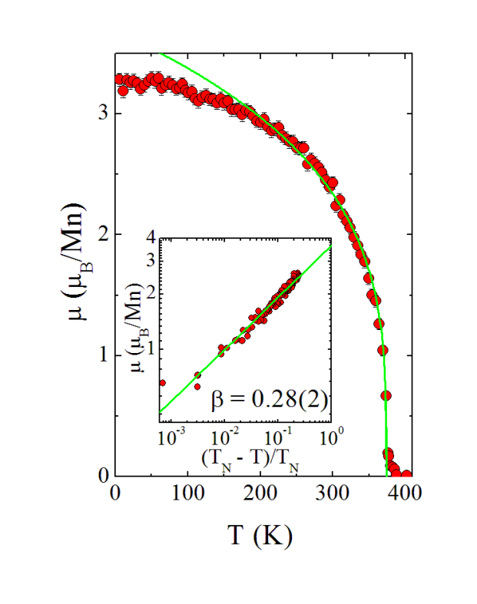
Antiferromagnetic Order in LaMnPO
Neutron diffraction experiments: polycrystalline material (BT-9, NIST-NCNR)
390 K
300 K
4 K
(Yanagi 2009)
Confirm checkerboard-type magnetic structure (Yanagi 2009):
LSDA Fermi surface nestable.
Spin canting along c-axis: T*=110 K
T_{N}=375 K, μ_{AF}(T→0) =3.2+/-0.1 μ_{B}/Mn DMFT: μ_{AF}=3.05 μ_{B}/Mn

Slide 11
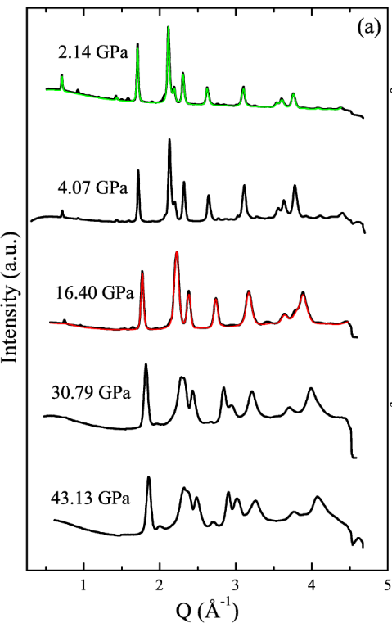


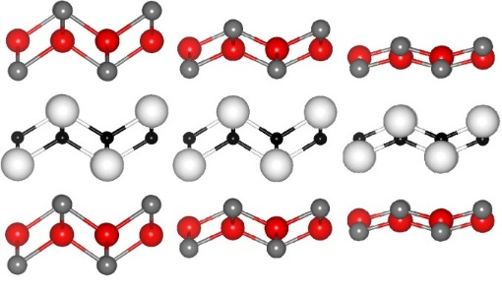

Structural Evolution with Pressure in LaMnPO
Liling Sun
Institute of Physics
Beijing
0
10
20
30
40
Pressure (GPa)
1 bar
c/a=2.179
Mn-P=0.1541 Ǻ
16 GPa
c/a= 1.442
Mn-P= 0.112 Ǻ
30 GPa
c/a=1.381
Mn-P= 0.0676 Ǻ
Experiments carried out in diamond anvil pressure cell on Beijing Synchrotron Radiation
Facility (Beamline4W2) (L.L. Sun, J. Guo, J. Liu).
-16 GPa: transition from tetragonal ZrCuSiAs to new orthorhombic phase (c/a collapse).
-30 GPa: transition to collapsed orthorhombic phase (ΔV/V~ 10%).
Information needed to enforce realism of DMFT and LSDA calculations.

Slide 12

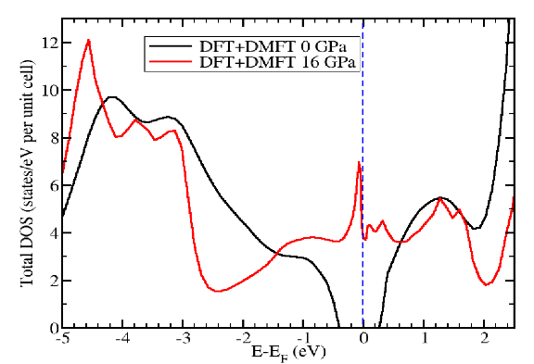
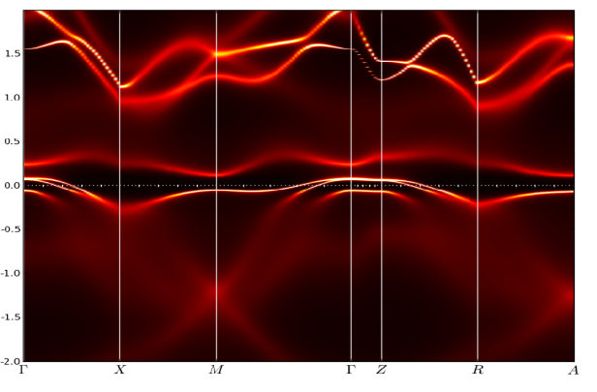
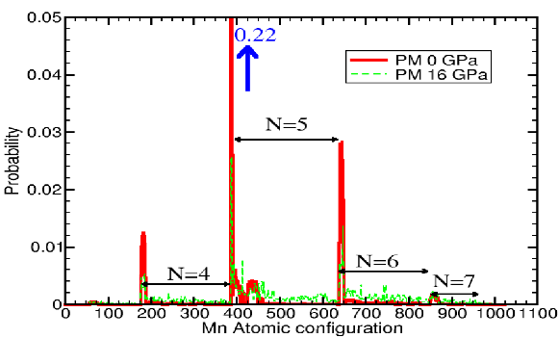
Insulator-Metal Transition in LaMnPO (P_{C}< 16 GPa)
1 bar
16 GPa
DFT+DMFT calculations using high pressure structures: (Z. P. Yin, G. Kotliar)
Increasing valence fluctuations with increasing pressure: precursor to insulator – metal transition.
Charge gap completely suppressed for P ≤16 GPa.

Slide 13
Electronic Delocalization in Pressurized LaMnPO
LSDA Calculations
Guo 2013
4 GPa
6 GPa
12 GPa
9 GPa
10 GPa
17 GPa
DMFT
19 GPa
Simonson 2012
Resistance measurements (hydrostatic pressure): T=0 insulator-metal transition P_{C}=12 GPa.
LSDA: collapse of insulating gap Δ at 10 GPa (DMFT: Δ=0 for 16 GPa).
10 GPa<P<30 GPa: AF metal (Fermi liquid) with localized Mn moments (LSDA).
30 GPa: discontinuous collapse of AF Mn moment (LSDA).

Slide 14
Pressure Dependence of Optical Gap in LaMnPO
Post 2013
Transmission experiments carried out under hydrostatic pressures on single crystals of LaMnPO and LaMnP(O_{1-x}F_{x}) x=0.04 at Geophysical Laboratory of the Carnegie Institute.
Linear suppression of gap E_{g} with pressure: E_{g}→0 for P=28 GPa.
Charge gap E_{g} persists above insulator-metal transition: MIT from delocalization of in-gap
states.
Closure of charge gap E_{g} little affected by doping. P_{C}=28 GPa (LaMnPO)
P_{C}=26 GPa (4%F)

Slide 15
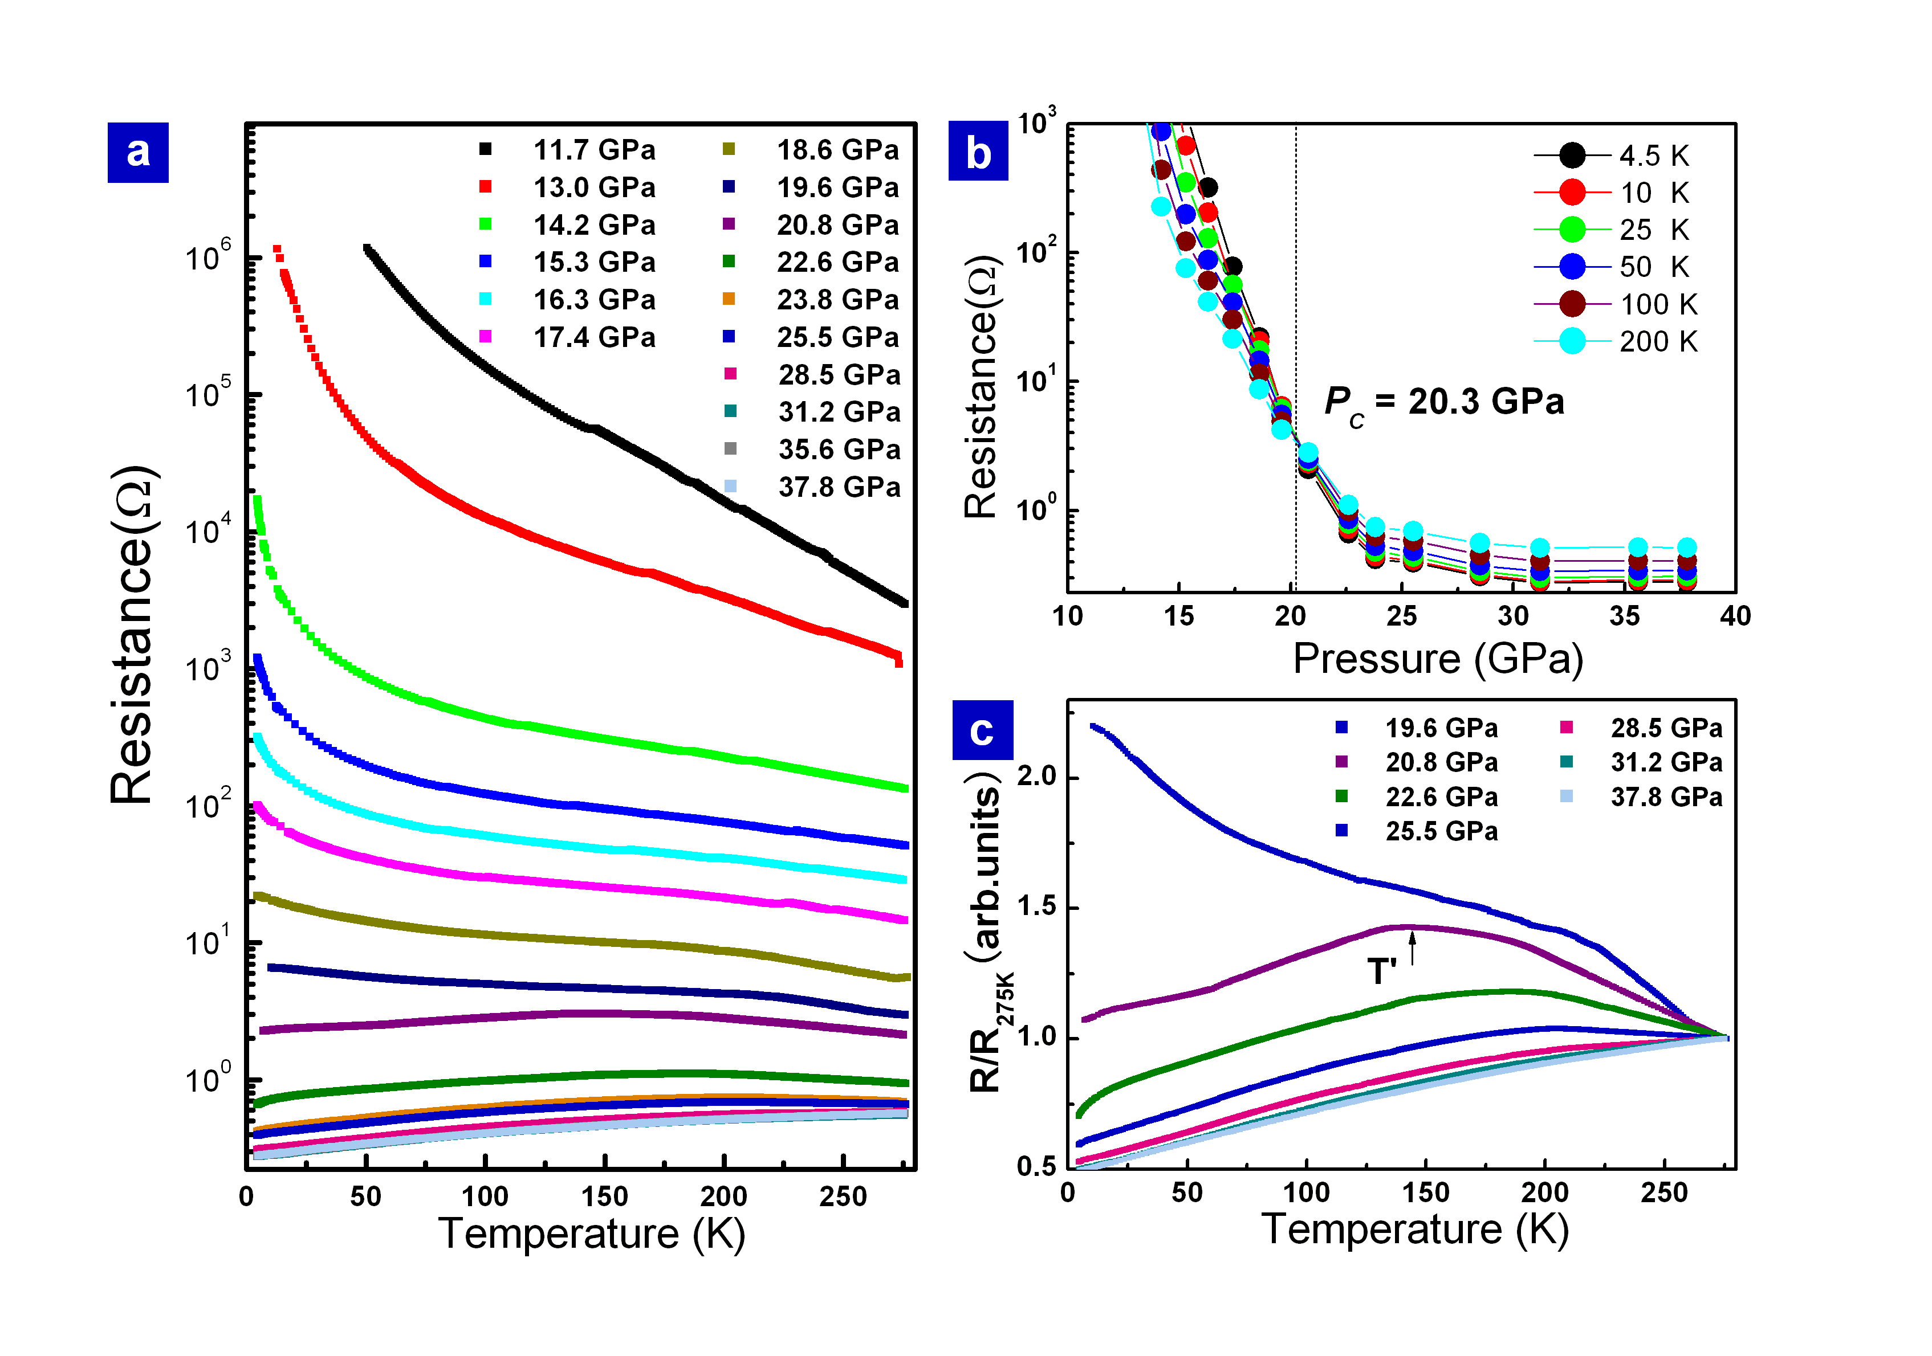
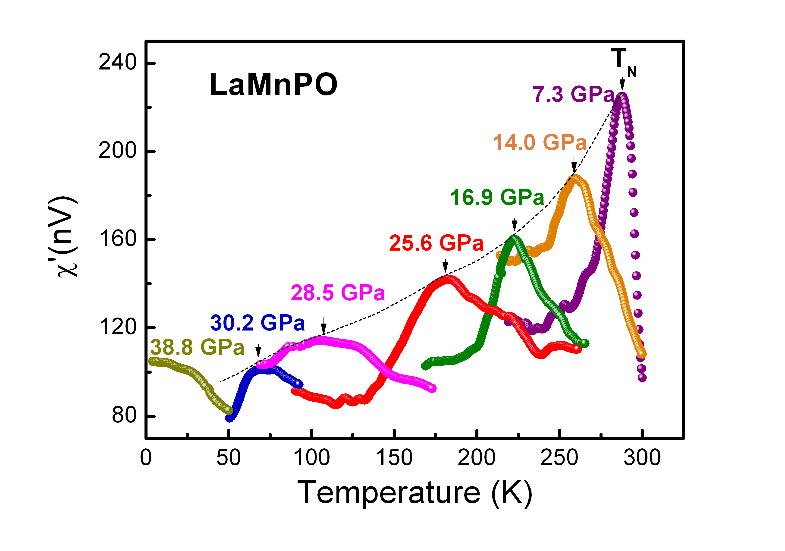
Separate Metallization /Moment Collapse in LaMnPO
(Uniaxial Pressure)
Guo 2013
Guo 2013
T_{N}→0: ~30 GPa (uniaxial)
E_{g}→0: 28 GPa
Volume collapse (XRD): ~30 GPa (hydrostatic)
Moment collapse(LSDA): ~30 Gpa (hydrostatic)
MIT (uniaxial pressure): 20 GPa
MIT(hydrostatic pressure): 12 GPa
Two step delocalization transition:
-insulator-metal transition (20 GPa),
-collapse of AF order and AF moment (30 GPa), charge gap E_{g} (28 GPa)
Insulator-Metal transition strongly dependent on uniaxial component of pressure, while
AF collapse is not. Origin of MIT: overlap of in-gap states?

Slide 16
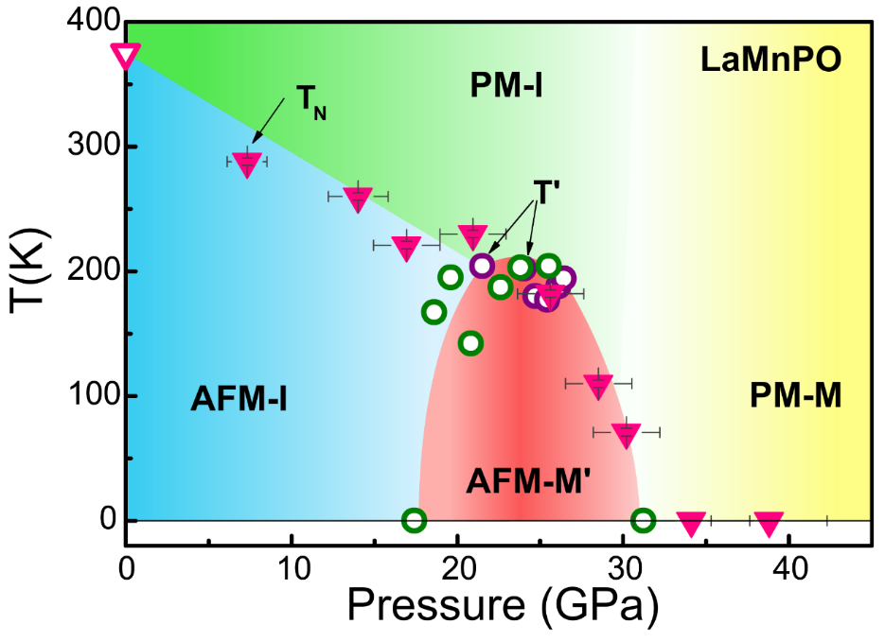
Pressure vs Charge Doping in LaMnPO and LaMnAsO
Guo 2013
AF-I
AF-M
PM-M
Pressure
LaMnPO (1 bar)
doping
U/W

Slide 17
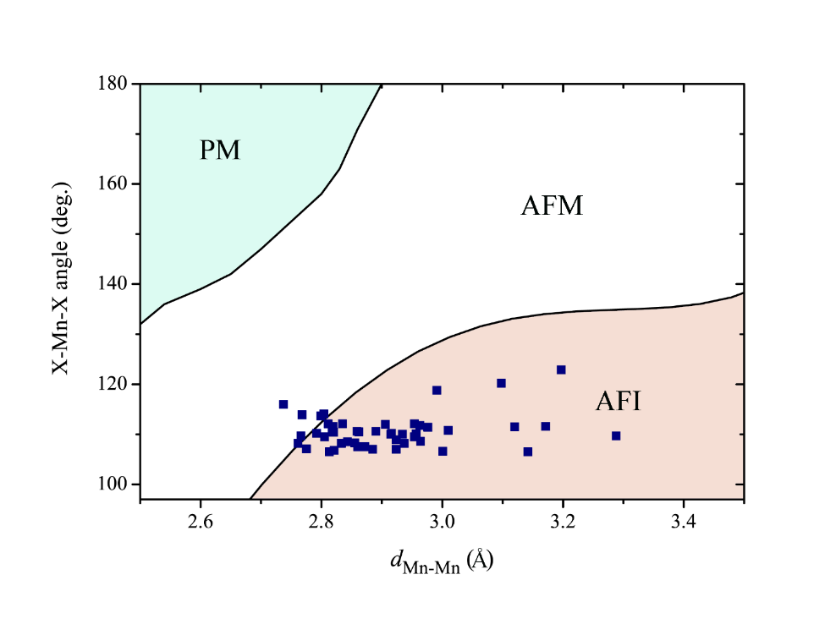
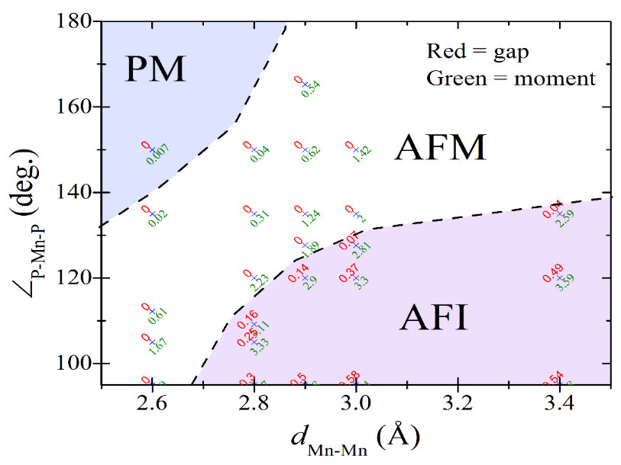
A first hint of how to implement `Theory Assisted Synthesis’’
LaMnPO
30 GPA
LaMnPO
1 bar
LSDA results in good agreement with Δ(P) for measured pressures: interpolate to determine behavior for conditions that are found in other compounds at ambient pressure.
Next steps:
-identify new starting points for materials that could be SC at 1 bar.
-in silico doping experiments: how much doping of a given type is needed to collapse gap or moment?
Predictive theory will be problematic without knowing pressure dependent structures, (in general) cannot test validity of theory without spectroscopic tools. Resource intensive: limit to generic systems (like LaMnPO).

Slide 18

Can Theory Speed Convergence of the Synthesis of New Materials with Specific Functionalities?
Wish to find a new family of superconductors with high SC onset temperatures: requires a new methodology.
Need a guiding principle: (Unconventional) SC is found near the breakdown of magnetic order. High SC onset temperatures require proximity to an electronic delocalization (Mott) transition.
In LaMnPO, survival of magnetic moment into metallic state may disfavor SC.
Need a structural motif: layered compounds, square net transition metals (Fe,Mn)
Many possibilities, Mn and Fe based square net compounds
Need to verify that electronic structure calculations adequately reproduce basic quantities like charge gap, magnetic moment, etc in a prototype materials from the desired class.
Good agreement with experimental Δ and μ (1 bar, and at critical pressures)
Need to extrapolate electronic structure calculations to increase proximity to desired electronic phases (electronic delocalization, collapse of moments) via doping or chemical pressure. Results must be expressed in terms of (key) atomic spacings and angles.
Possible for current parameterizations, but may need to consider others in future.
New materials from data bases may exemplify these new properties for synthesis.
☒
☑
☑
☑

Slide 19
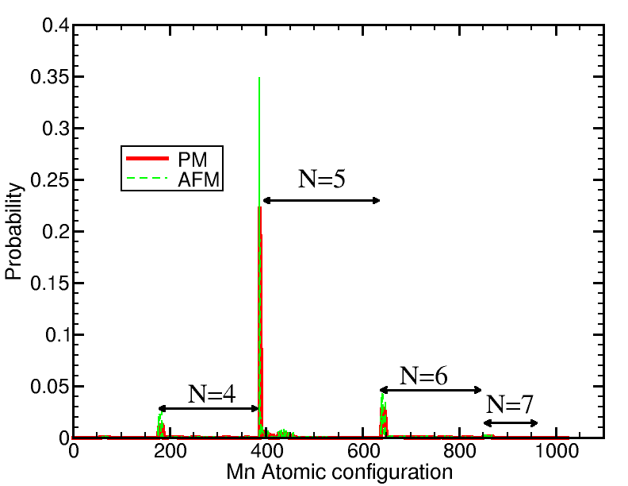
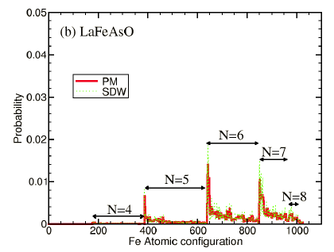
Moderate Valence Fluctuations in LaMnPO
LaMnPO
LaFeAsO
Substantial valence fluctuations from expected d⁵ (Mn²⁺) state in (La³⁺O²⁻)⁺(Mn²⁺P³⁻)
in DMFT histogram of states.
Valence fluctuations are weaker than in Fe-pnictides and stronger than in cuprates.
X-ray absorption measurements: not pure d⁵. Possible d⁶-ligand hole state.

Slide 20
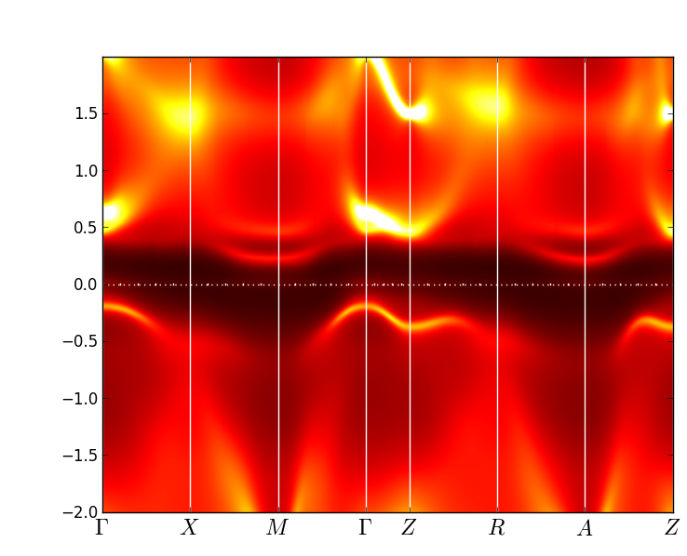
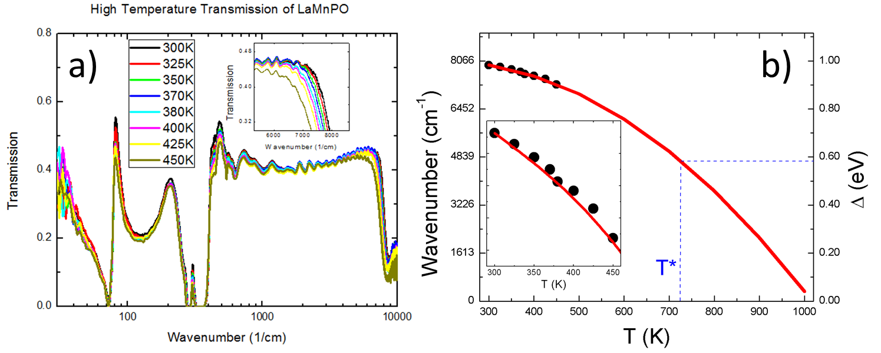


Sizeable Exchange Component of the Charge Gap
With AF exchange (T<T_{N})
No AF exchange (k_{B}T>SJ₁)
Mn²⁺(d⁵)
Mn²⁺(d⁵)
Energy cost for electron to hop
from Mn to Mn:
on-site Coulomb interaction U
Hund’s interaction I
AF exchange energy J
D. Basov, K. Post
San Diego
Post 2013
About half of the charge gap in AF LaMnPO is due to antiferromagnetic exchange

Slide 21
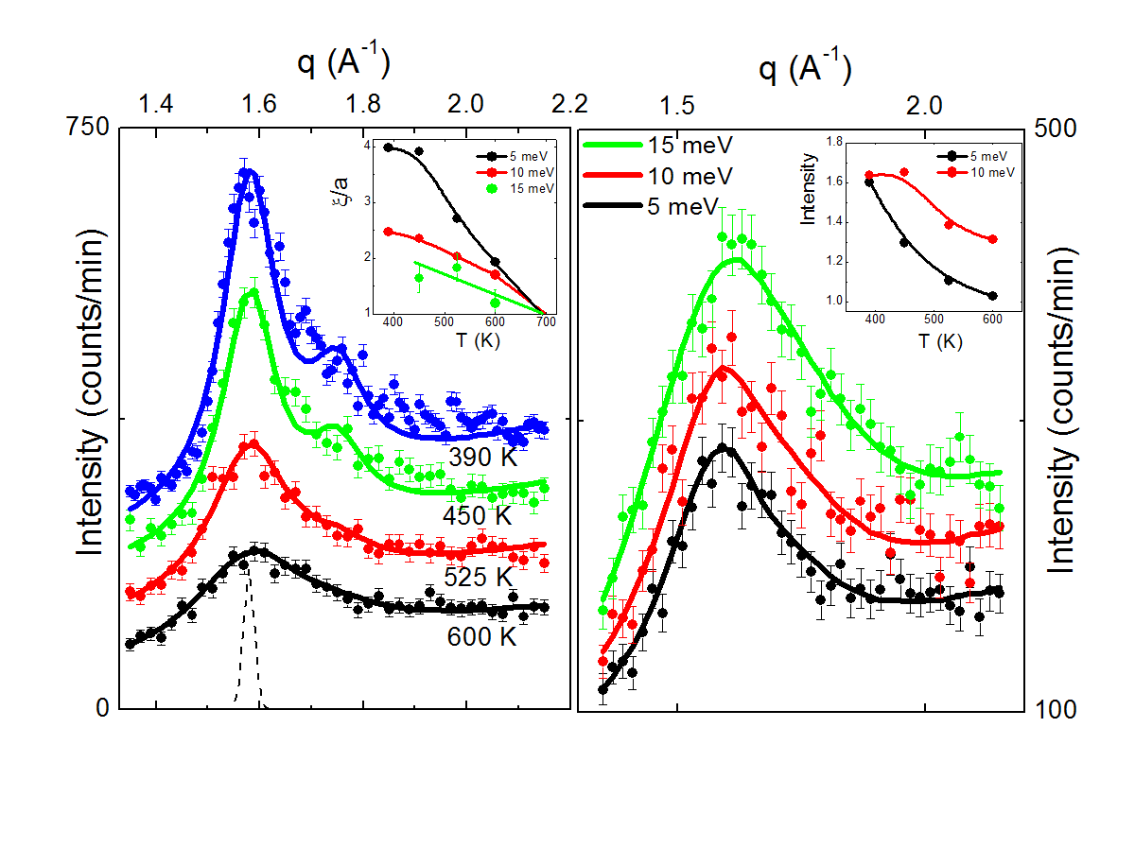
Robust 2-d Antiferromagnetic Correlations for T>T_{N}
T=600 K
100
101
Neutron scattering experiments carried out on 13 g sample of powdered LaMnPO
using BT-7 triple axis spectrometer at the NIST Center for Neutron Research.
Antiferromagnetic correlations are limited to Mn-Mn distance for T>700 K. Defines
Effective paramagnetic limit, T>T_{N,MF}.
Strong fluctuations due to quasi-two dimensionality of LaMnPO reduces T_{N} from
mean field value of ~700 K to observed T_{N}=375 K.

Slide 22
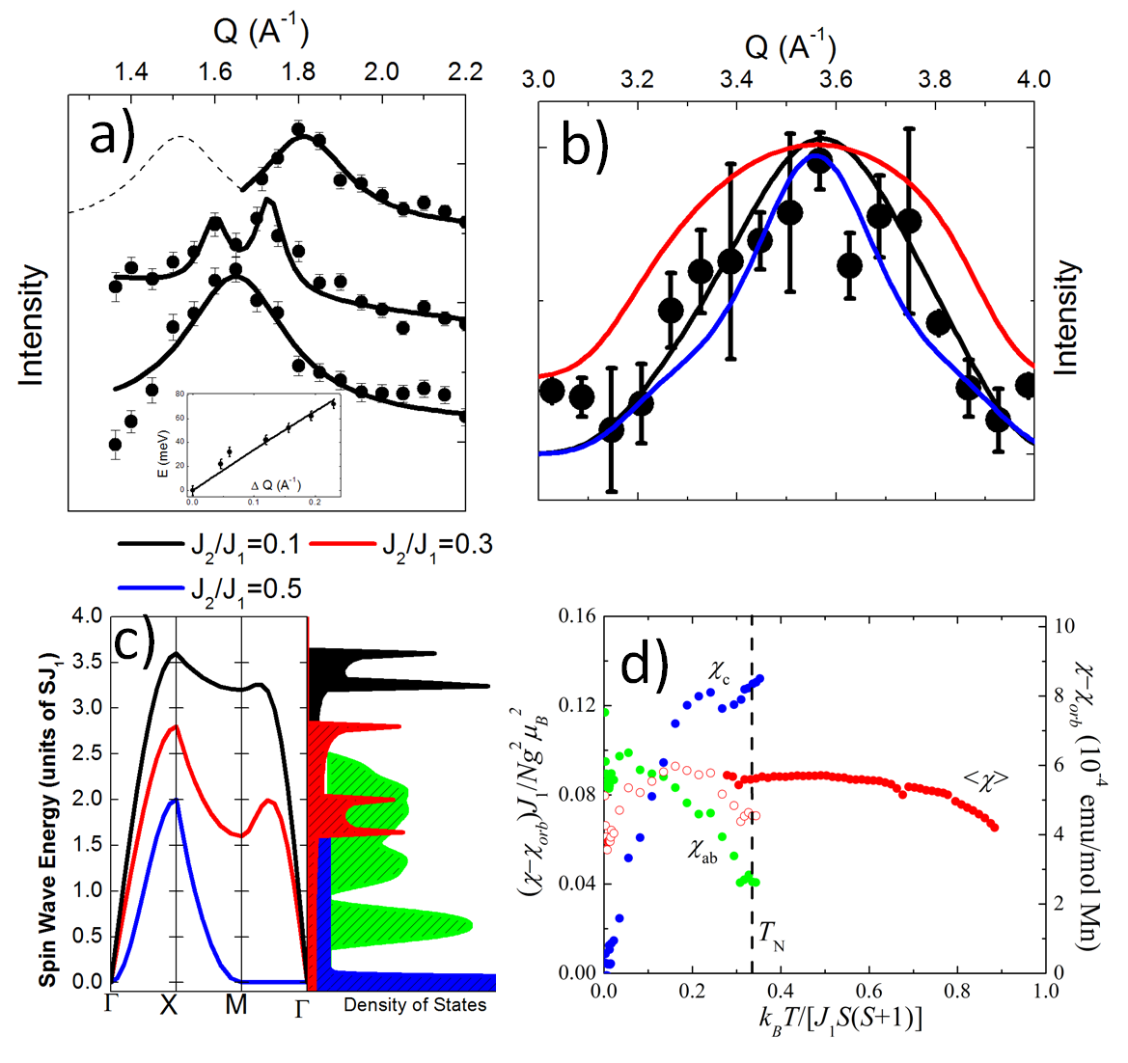
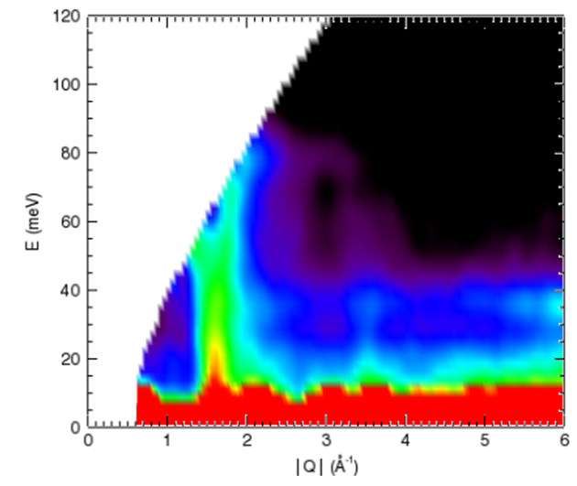
Antiferromagnetic Spin Waves
T=5 K
62 meV
42 meV
22 meV
T=5 K
SJ₁=39 ±4 meV
S=3/2, J₁=16 meV
Experiments on 13 g sample of powdered LaMnPO using SEQUOIA time of flight spectrometer at Spallation Neutron Source (SNS) in Oak Ridge.
Incident neutron energy E_{i}=250 meV. Maximum spin wave energy: ~85 meV
Two branches of dispersing spin waves centered at |Q|=1.6Å⁻¹ (100 zone center) and 3.5 Å⁻¹ (210 zone center).

Slide 23
S=3/2 Heisenberg Spins in LaMnPO
J₂
J₁
J_{C}
J₂/J₁~ 0.3: maximum energy for spin wave density of states for SJ₁~2.5
Ferromagnetic J_{C}<<J₁
 | LaMnPO | LaFeAsO | BaFe₂As₂ | CaFe₂As₂ | SrFe₂As₂
Spin Gap (meV) | 7 | 11 | 9.8 | 7 | 6.5
SJ₁ (meV) | > 85 |  | 59.2 | 49.9 | < 100

Slide 24
An Explanation for the temperature independent susceptibility
0
T(K)
500
1000
Temperature independent susceptibility: T<<J₁S(S+1)/k_{B} = T_{max} ~ 560 K
Curie-Weiss susceptibility for T>T_{max}.
Spin wave contribution to T=0 susceptibility: χ(T=0)=0.05 J₁/Ng²μ_{B}² = 0.06879 ✓
LaMnPO: strong deviations from mean field behavior, likely from quasi-2d
magnetic structure.
Values of J₁, J₂, J_{C} all consistent with checkerboard type magnetic structure.

