Slide 1

Development of density functional theory for
unconventional superconductors
Ryotaro Arita
Univ. Tokyo/JST-PRESTO

Slide 2
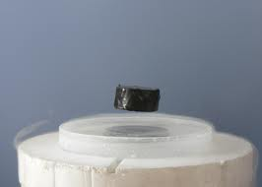
Outline
Materials design of high T_{c} superconductors
Theoretical materials design of high T_{c} superconductors is one of the holy grails of condensed matter theory
To achieve this goal, we need to develop a predictive method to calculate T_{c}

Slide 3
Q1.
What was the most important development in your subfield in the last several years ?
A1.
Development of superconducting density functional theory (SCDFT): A predictive method to calculate T_{c}
Oliveira et al., PRL 60, 2430 (1988)
Kreibich & Gross PRL 86, 2984 (2001)
M. Lüders et al., PRB 72, 024545 (2005)
M. Marques et al., PRB 72, 024546 (2005)

Slide 4
DFT for normal state
Hohenberg-Kohn theorem
v ←⎯→ ρ
one-to-one correspondence
Kohn-Sham equation

Slide 5
DFT for superconductors
electron density
anomalous density
Hohenberg-Kohn theorem for superconductors
[v,Δ] ←⎯→ [ρ,χ]

Slide 6
Gap equation
Linearized gap equation
Exchange-correlation functional
Anomalous density
Once F_{xc} is given, we can calculate T_{c} without adjustable parameters

Slide 7
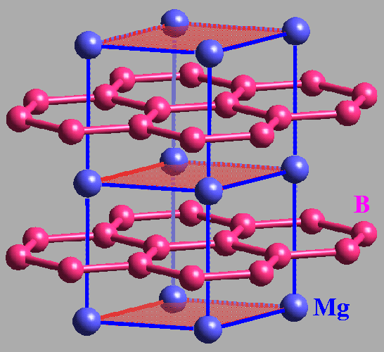
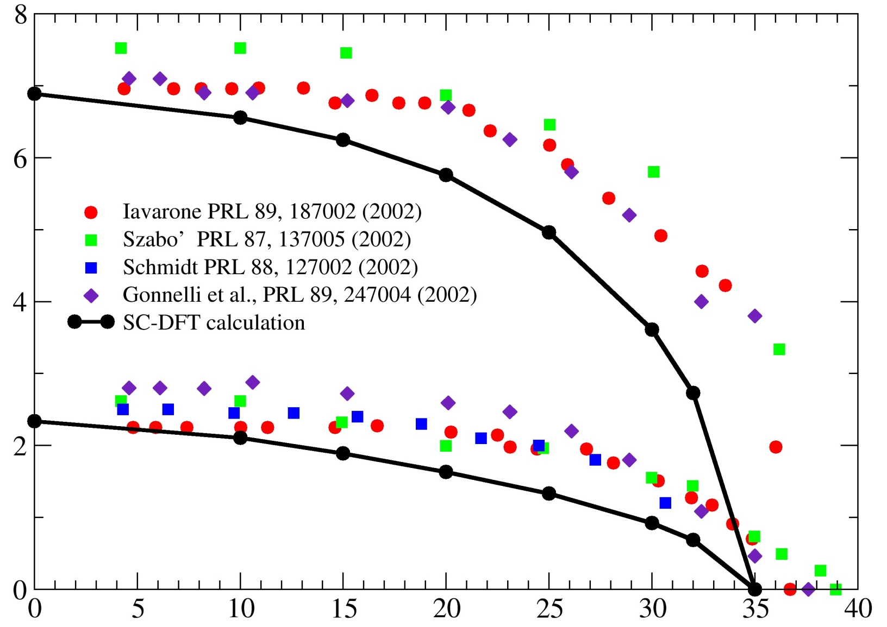
Application to MgB₂
A. Floris et al, Phys. Rev. Lett. 94, 037004 (2005)
Δ [ meV]
T [ K]

Slide 8
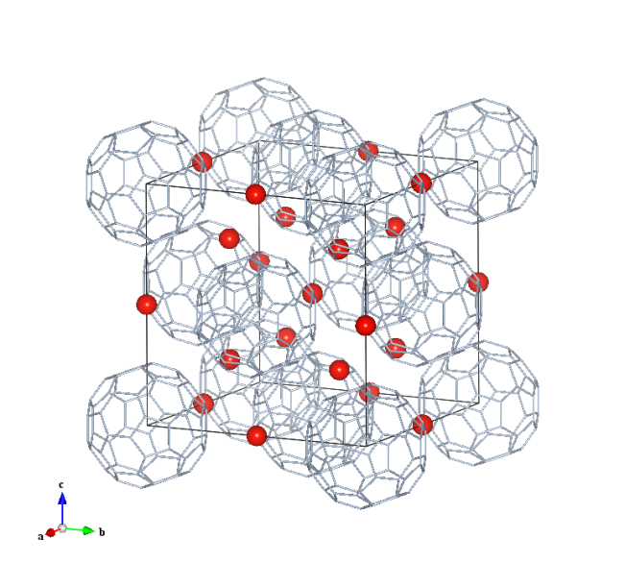
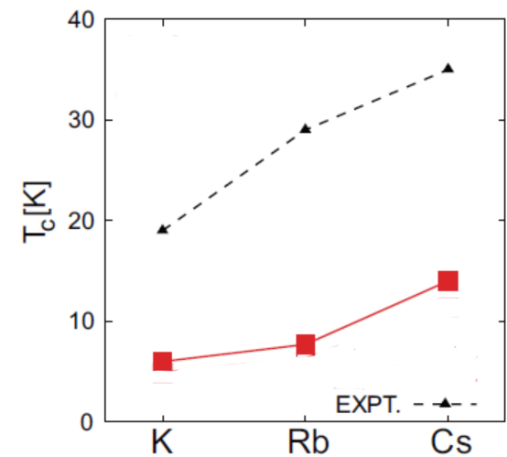
Application to unconventional SC
R. Akashi and RA, PRB 88 054510 (2013)
A₃C₆₀

Slide 9
Q2. What do you envision as the most important direction in the future for finding materials with desirable properties ?
A2.
Development of DFT for unconventional SC

Slide 10
DFT for unconventional SC
Various mechanism of unconventional SC
• spin-fluctuation mediated SC
• orbital-fluctuation mediated SC
• exciton mechanism
• plasmon mechanism
…
R. Akashi & RA, PRL111 057006 (2013)

Slide 11
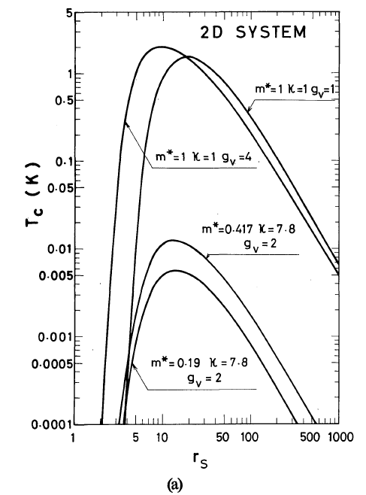
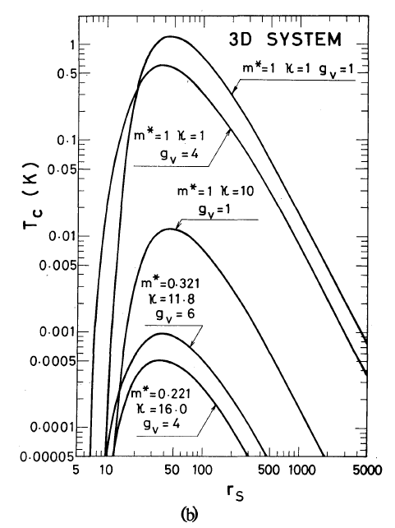

Plasmon mechanism
Y. Takada JPSJ 45 786 (1978)
Superconducting ground state for large r_{s}
(Low carrier density superconductor)

Slide 12
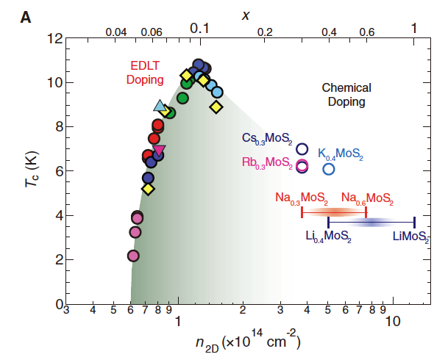
Superconductivity in doped band insulators
Field-induced SC has been observed in a variety of band insulators
J.T. Ye et al.,
Science 338 1193 (2012)
T_{c} has a dope-like shape
Peak in low density region

Slide 13
DFT for unconventional SC
Various mechanism of unconventional SC
• spin-fluctuation mediated SC
• orbital-fluctuation mediated SC
• exciton mechanism
• plasmon mechanism
…
R. Akashi & RA, PRL111 057006 (2013)

Slide 14

Conventional SCDFT
To construct F_{xc} , we calculate Free energy F
For interactions between electrons in F, there are two contributions
e⁻
e⁻
e⁻
e⁻
Phonon-mediated interaction D(ω)
Energy scale ~ Debye frequency
Static screened Coulomb V_{c}

Slide 15
SCDFT for plasmon mechanism
To construct F_{xc} , we calculate Free energy F
For interactions between electrons in F, there are two contributions
e⁻
e⁻
e⁻
e⁻
Phonon-mediated interaction D(ω)
Energy scale ~ Debye frequency
Dynamical screened Coulomb V_{c} (ω)
(using RPA)
R. Akashi & RA, PRL111 057006 (2013)

Slide 16
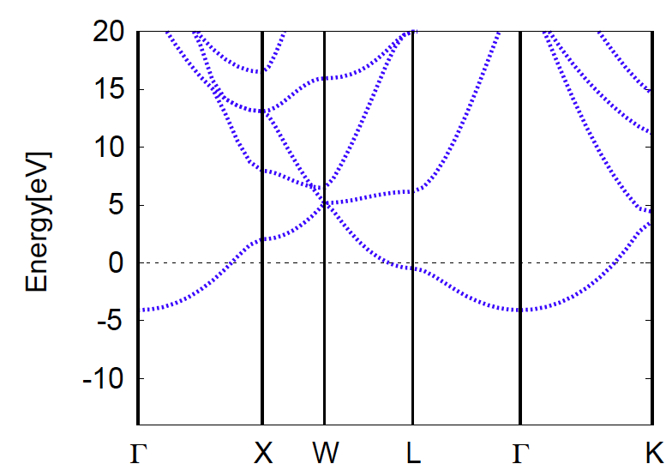
Li: band structure
Band structure ~ Nearly Free Electron (NFE) model

Slide 17
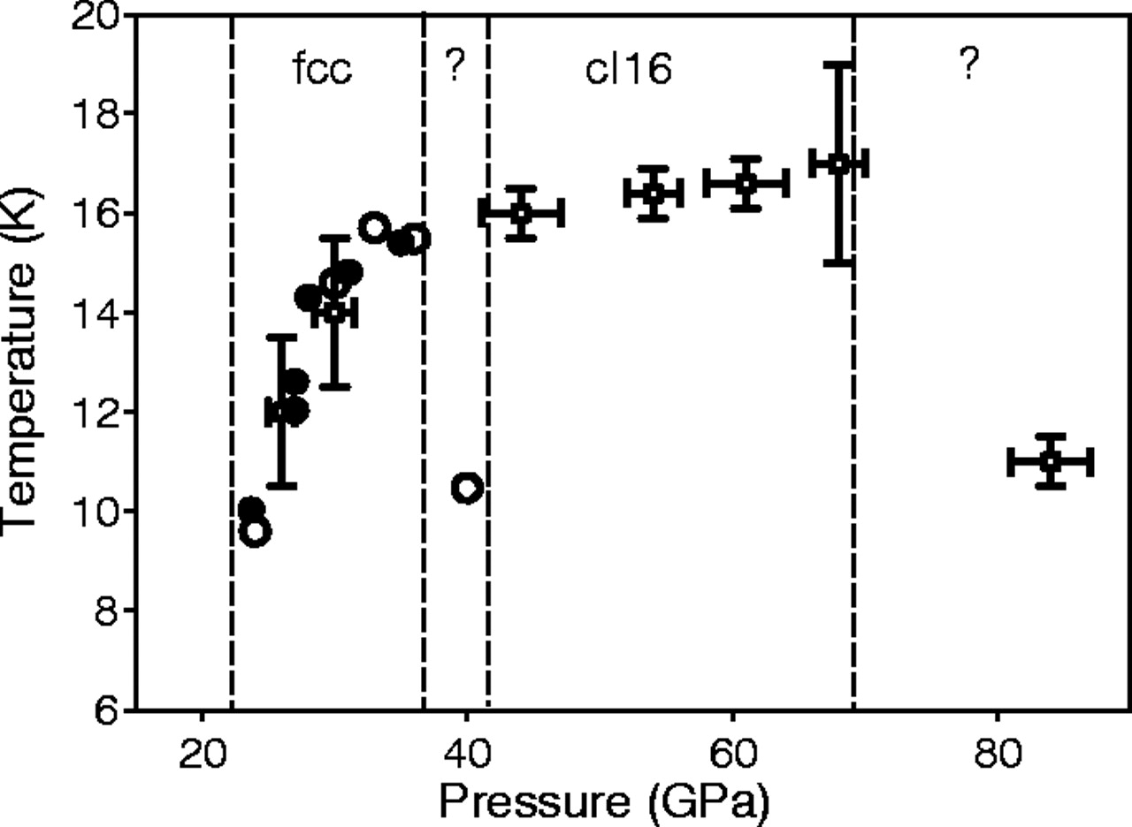
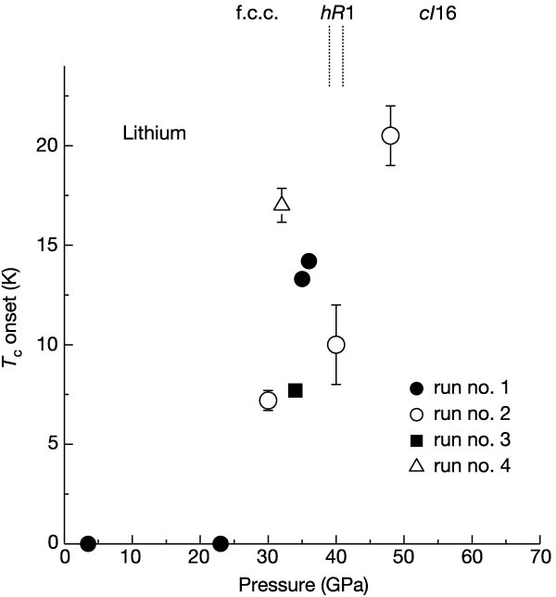
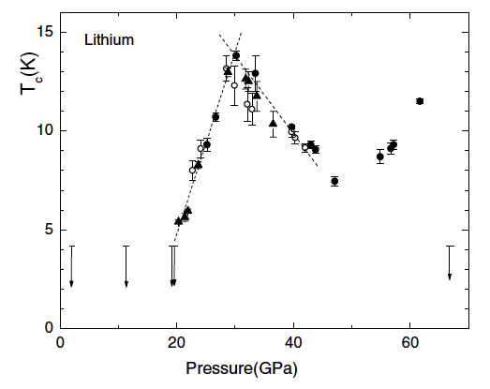
High T_{c} SC in Li under high pressure: experiments
Struzhkin et al., Science 298, 1213 (2002)
Shimizu et al., Nature 419, 597 (2002)
T_{c}~20K at 48GPa
Deemyad and Schilling, PRL 91, 167001 (2003)

Slide 18

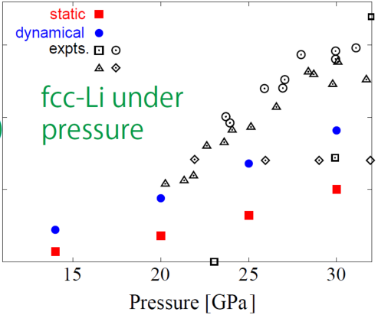

Application to Li: T_{c}

Slide 19

Application to Li: T_{c}
R. Akashi & RA, PRL111 057006 (2013)

Slide 20
Q3. What do you consider the most outstanding obstacles towards designing materials starting from first principles ?
A3.
LDA-based SCDFT can not describe Mottness, Hundness → Obstacle to describe cuprates, iron-based superconductors, and go beyond

Slide 22
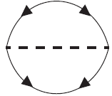
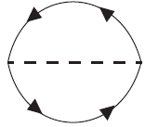

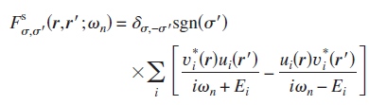

Phonon contribution to F_{xc}
Kohn-Sham perturbation theory
M. Lüders et al, PRB 72, 024545 (2005)
F
G
F_{xc}ª =
D
F_{xc}^{b} =
D
F_{xc} does not have ω dependence

Slide 23
Phonon contribution to F_{xc}
M. Lüders et al, PRB 72, 024545 (2005)
G
F
F_{xc}^{b} =
D
F_{xc}ª =
D

Slide 24
Comparison between SCDFT and ME
SCDFT, if Z and K=const for |ε|<ω_{D}
McMillan, μ*=0
N(0)K^{ph} ~ − λ
Z ~ λ
so that SCDFT ~ McMillan

Slide 25
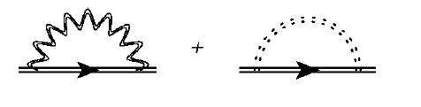
Coulomb term in Migdal-Eliashberg
In Migdal-Eliashberg theory …
~ω_{D}
~E_{F}

Slide 26
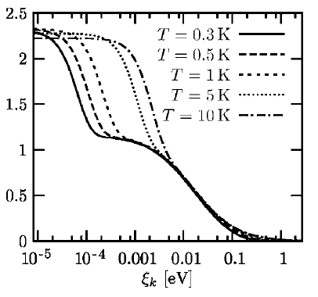
Comparison between SCDFT and ME
Gap equation in SCDFT→ No ω dependence, but state dependent
Nb
Z_{i}: Diagonal part of the kernel
Damping effect (due to electron-phonon coupling) is represented
~ ω_{D}
Kohn-Sham energy ξ of φ_{i} [eV]

Slide 27
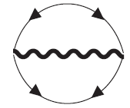
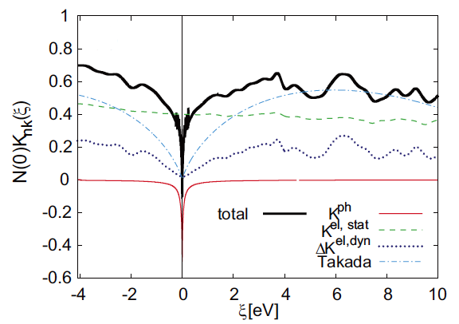
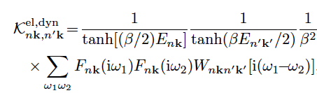
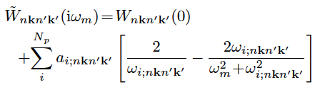
Application to Li: Exch-Corr. Kernel
Dynamical screened Coulomb V_{c}(ω)
F_{xc}^{ee} =

Slide 28
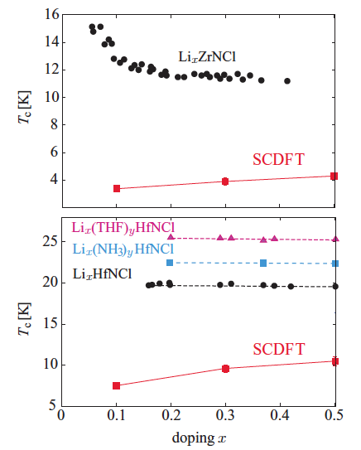
Application to nitride SC
R. Akashi, K. Nakamura, RA and M. Imada PRB2012
MNX
M=Zr, Hf
X= Cl, Br, I
unconventional SC ?

Slide 29
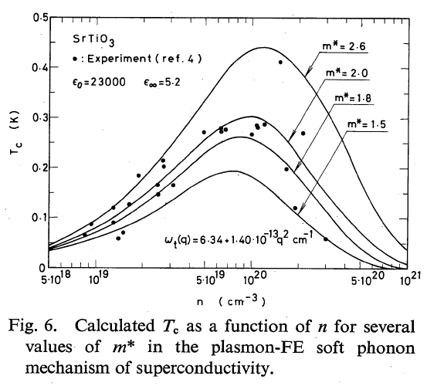
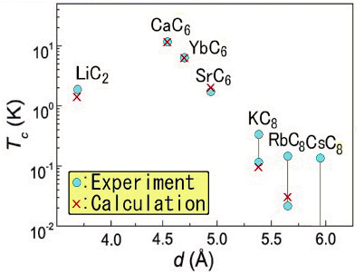
Plasmon mechanism
SrTiO₃
Y. Takada JPSJ 49 1267 (1980)
GIC
Y. Takada JPSJ 51 63 (1982),
JPSJ 78 013703 (2009)
Cooperation of phonon & plasmon enhances pairing instability

Slide 31
Kohn-Sham BdG equation

Slide 32
Gap equation
Linearized gap equation
Once F_{xc} is given, we can calculate T_{c} without adjustable parameters

Slide 33
Migdal-Eliashberg Theory
Self-consistent perturbation theory:
lowest-order dressed-phonon and dressed Coulomb contribution to Σ retained
(Nambu-Gor’kov formalism)
McMillan’s formula
Damping and retardation effect are considered
Can we take account of these effects in the framework of DFT ?
In DFT, everything is represented in terms of density …

Slide 34
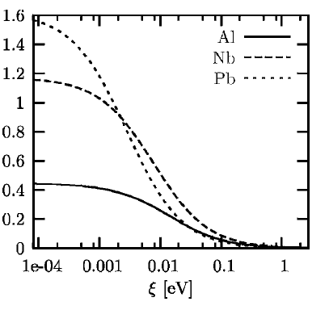
Retardation effect in SCDFT
Diagonal part of the kernel: damping effect
Off-diagonal part of the kernel: pairing interaction
No ω dependence, but state dependent
No significant ξ dependence
Different ξ dependence
→ Retardation effect is automatically considered
K^{ph}
~ ω_{D}
Kohn-Sham energy ξ of φ_{i} [eV]

Slide 35
Application to simple metals
M. Lüders et al, PRB 72, 024545 (2005), M. Marques et al, PRB 72, 024546 (2005)
Transition temperatures from DFT calculation
Gap at zero temperature

Slide 36
Conventional SCDFT
Kohn-Sham perturbation theory (F, D, V_{c} are obtained from first-principles calc.)
F (anomalous Green fn.)
F (anomalous Green fn.)
D(ω)
F_{xc}^{e-ph} =
F_{xc}^{e-e} =
Static screened Coulomb V_{c}

Slide 37
SCDFT for plasmon mechanism
Kohn-Sham perturbation theory (F, D, V_{c} are obtained from first-principles calc.)
F (anomalous Green fn.)
F (anomalous Green fn.)
D(ω)
F_{xc}^{e-ph} =
F_{xc}^{e-e} =
Dynamical screened Coulomb V_{c}(ω)
with plasmon-pole approximation

Slide 38
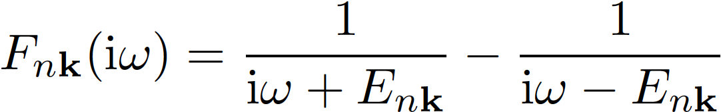
SCDFT for plasmon mechanism
Kohn-Sham perturbation theory (F, D, V_{c} are obtained from first-principles calc.)
F (anomalous Green fn.)
F (anomalous Green fn.)
D(ω)
F_{xc}^{e-ph} =
F_{xc}^{e-e} =
Dynamical screened Coulomb V_{c}(ω)
with plasmon-pole approximation

Slide 39
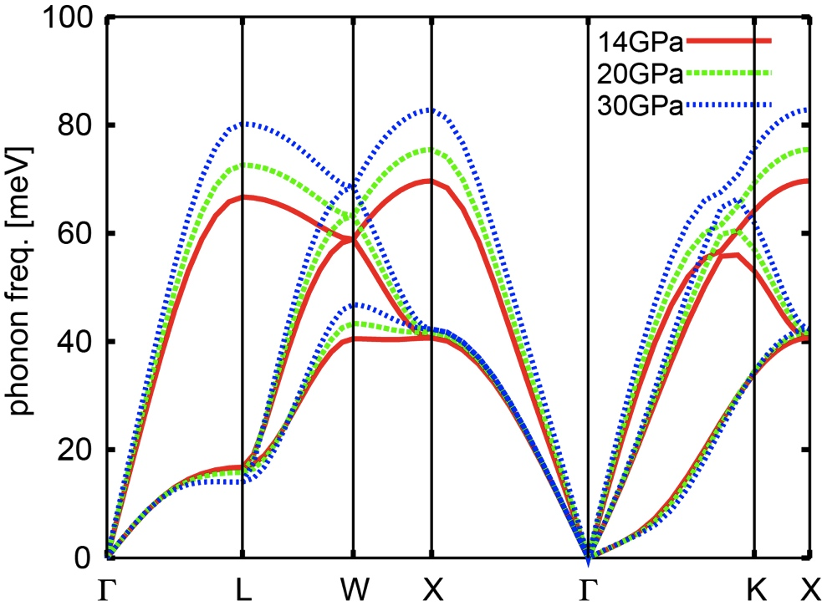
Li under high pressure: conventional scenario ?
Pressure [GPa] | 14 | 20 | 30
Ele-ph coupling (λ) | 0.522 | 0.623 | 0.812
Consistent with T. Bazirov et al., PRB 82, 184509 (2010)

Slide 40
High T_{c} SC in Li under high pressure: experiments
Struzhkin et al., Science 298, 1213 (2002)
Shimizu et al., Nature 419, 597 (2002)
T_{c}~20K at 48GPa
(highest T_{c} of any elements)
Deemyad and Schilling, PRL 91, 167001 (2003)

Slide 41
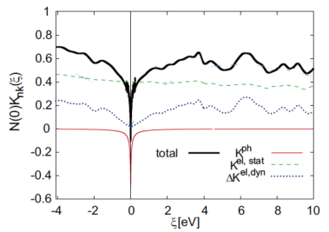
Application to Li: Exch-Corr. Kernel
Dynamical screened Coulomb V_{c}(ω)
F_{xc}^{e-e} =
Kohn-Sham energy ξ of φ_{i} [eV]

Slide 42
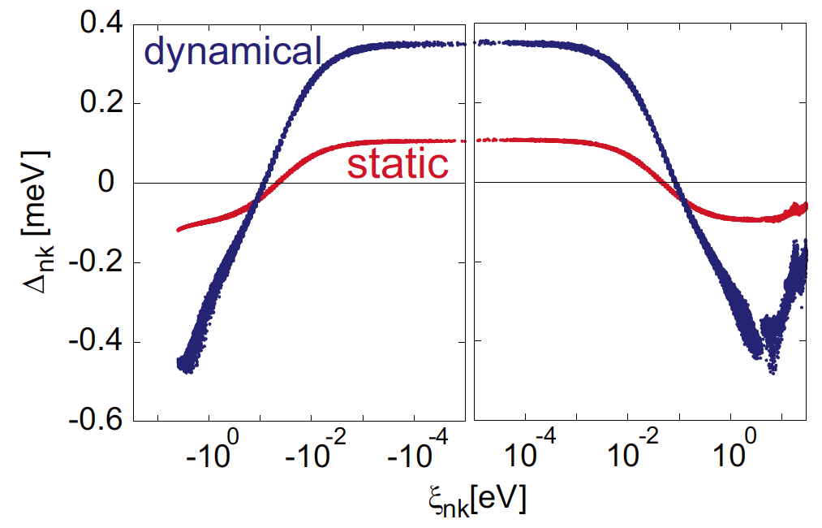
Application to Li: Gap function at T=0

Slide 43
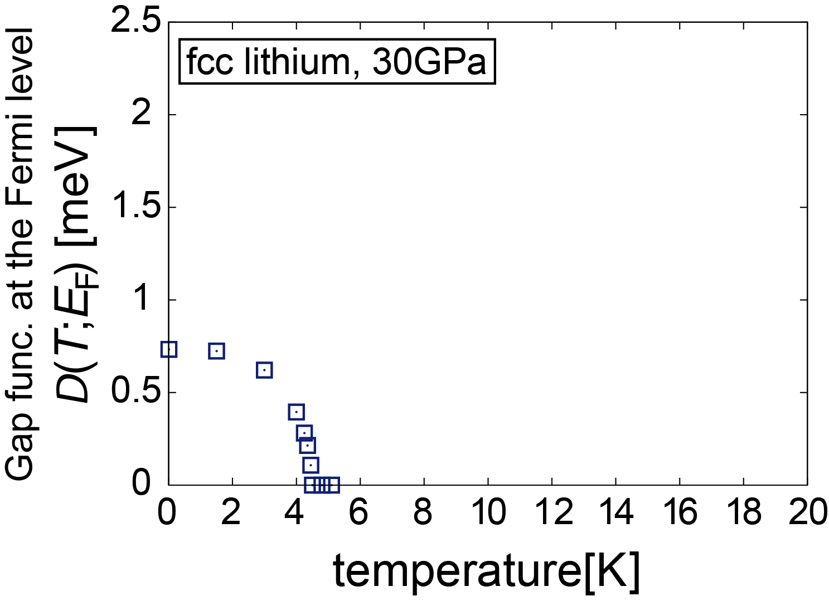
Conventional SCDFT calc. for Li
Δ

Slide 44
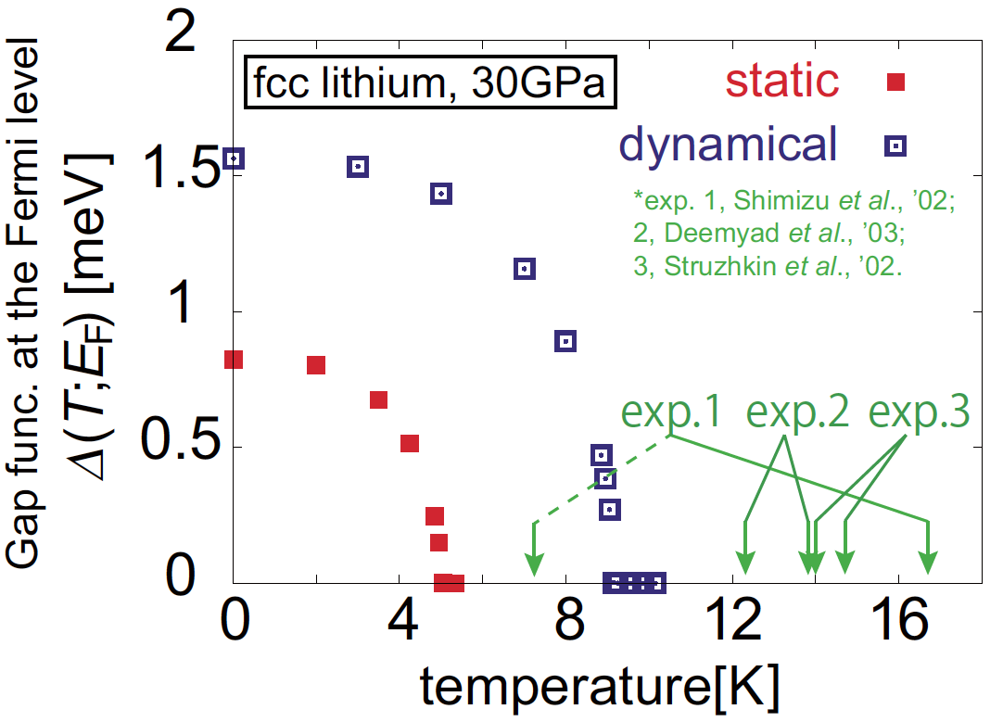
Application to Li: Gap function

Slide 45
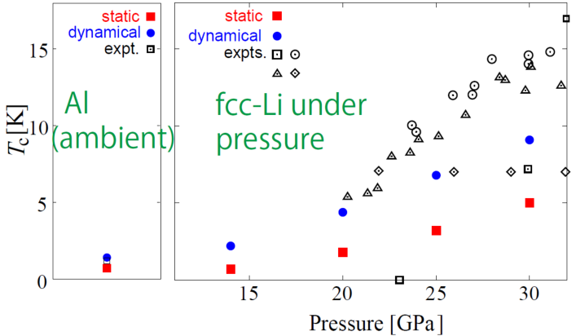
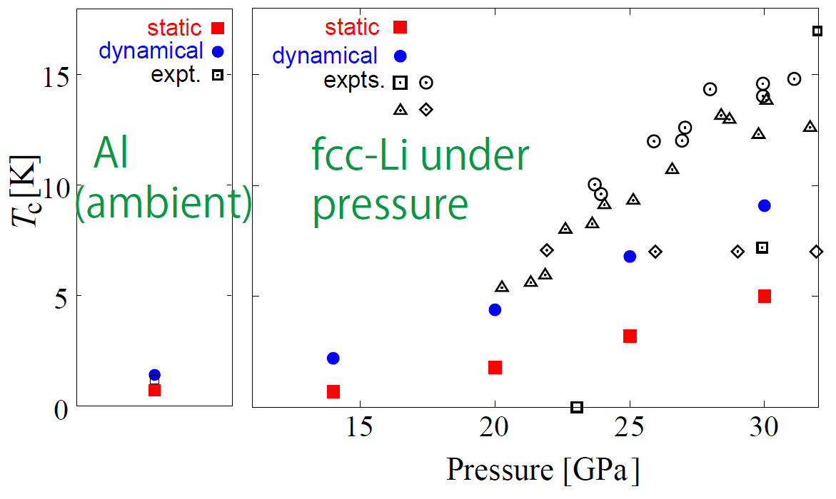
Application to Al: T_{c}

Slide 46
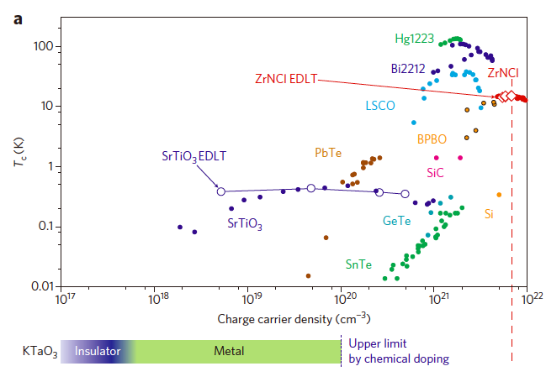
Superconductivity in doped band insulators
Field-induced SC has been observed in a variety of band insulators
K. Ueno et al.,
Nature Nanotechnology 6 408 (2011)
J.T. Ye et al.,
Science 338 1193 (2012)
T_{c} has a dope-like shape
Peak in low density region

Slide 47
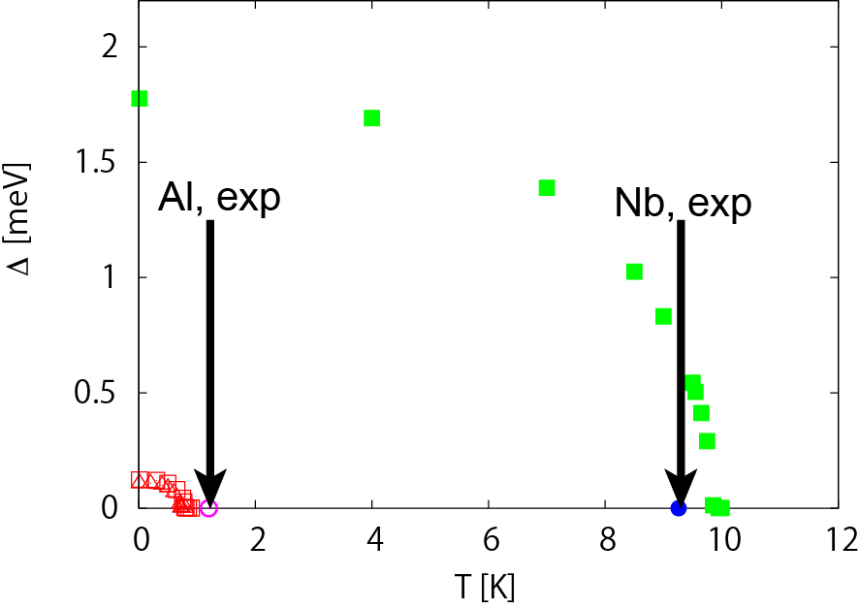
Application to simple metals

