Slide 1
Setup
CONN17
Preprocessing
Prepare data (functional & anatomical) for analyses
Correct known sources of variation / noise
Speechlab Q: Why preprocessing in CONN?
a) CONN wraps SPM functionality: easy to use, transparent parallelization SCC cluster, QC
b) exactly same preprocessing steps are typically used for activation or connectivity analyses
c) new speechlab preprocessing & analysis pipeline uses CONN functionality

Slide 2
Prepares data
(realignment, unwarp? field-map correct? slice-timing correction? coregistration/ indirect normalization/ direct normalization? outlier identification, smoothing)
Seed-based
connectivity
ROI-to-ROI
Removes physiological, artifacts, residual subject movement effects
Imports data into CONN
Hypothesis testing
Population-level inferences
Graph
analyses
Functional
& Structural
data
Preprocess
Denoise
2nd-level
analyses
QA
QA
ICC
LCOR
GCOR
ALFF
QA
Setup GUI
Setup GUI
Denoising GUI
second-level
Results GUI
Task-based
gPPI
Experiment
design
Setup GUI
Independent
Component
Analyses
first-level
Analyses GUI
ROIs
Dynamic
connectivity
Computes connectivity measures
Setup GUI

Slide 3
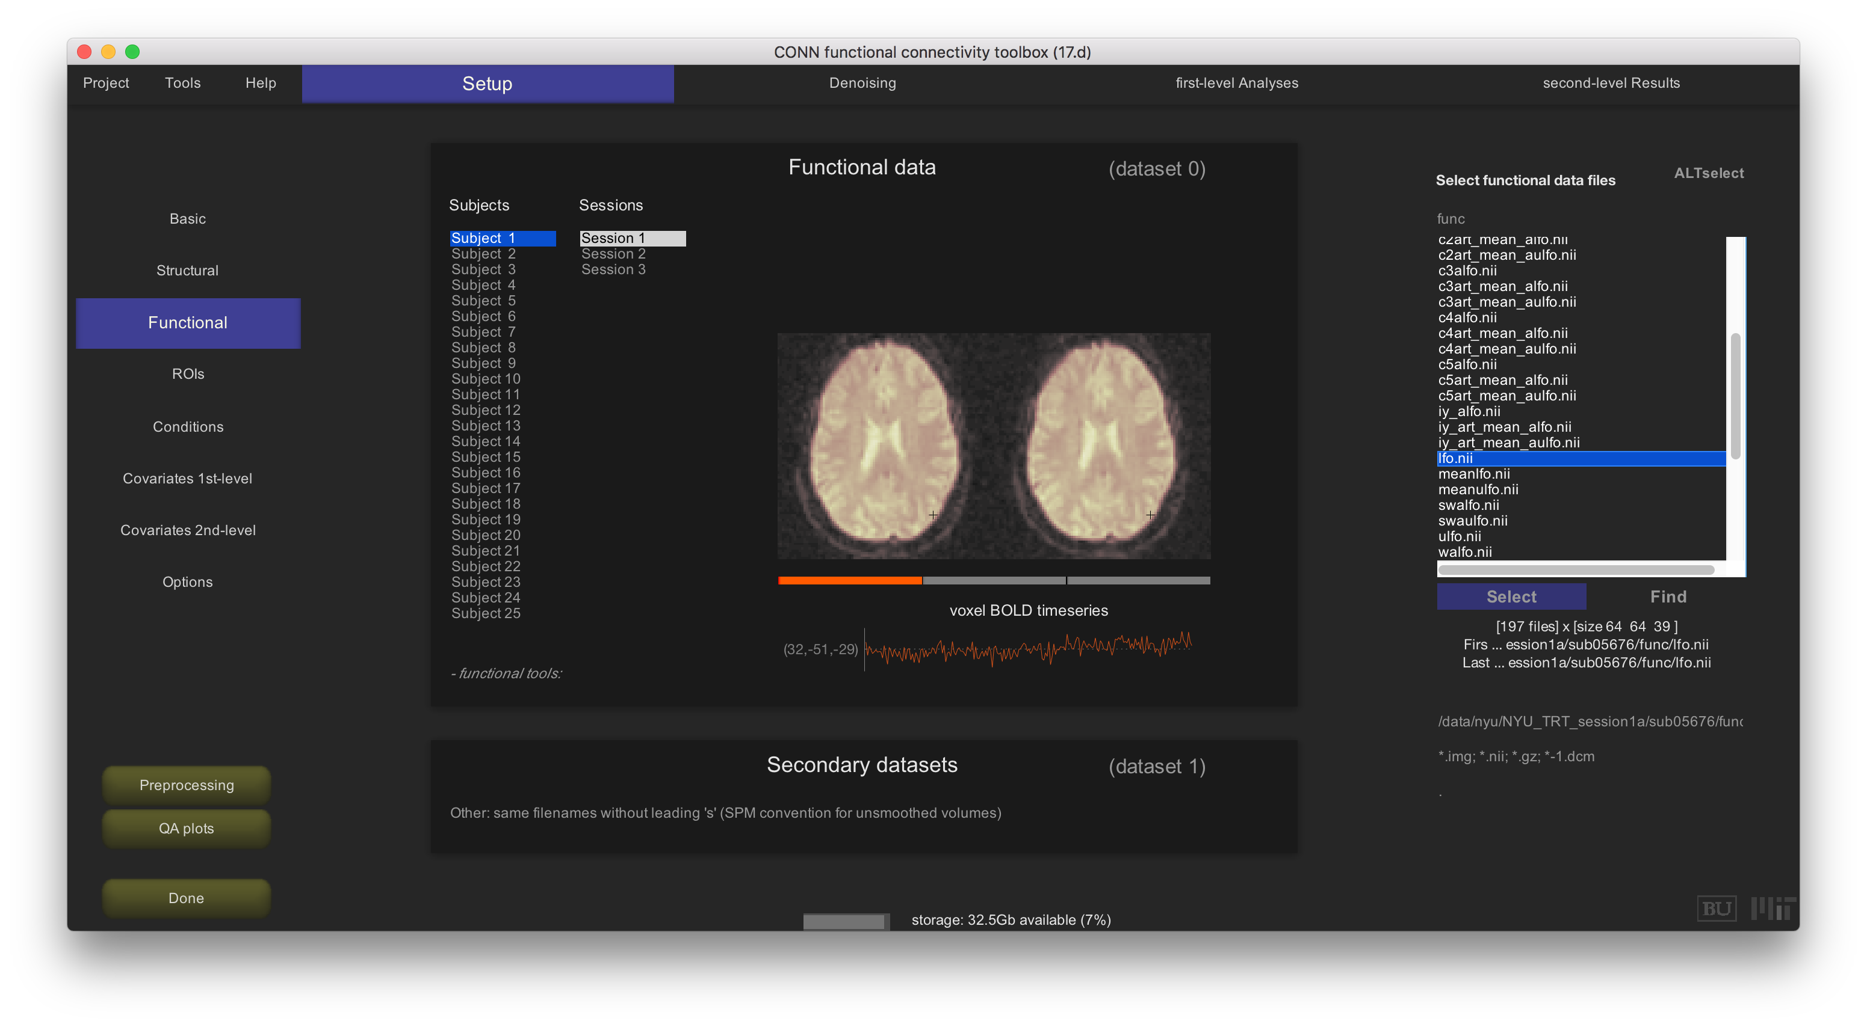
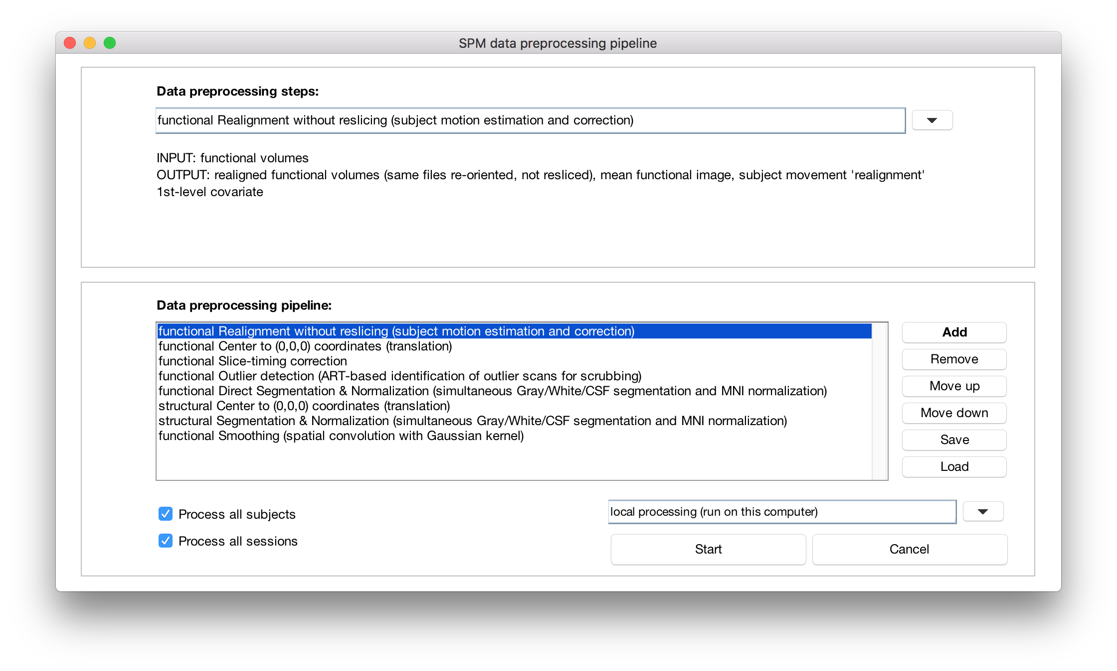
Functional
& Structural
data
Setup
Define number of subjects and sessions/runs
Enter raw Structural and Functional volumes
Preprocess functional/structural data
Preprocess
Setup
Preprocessing pipeline:
Series of preprocessing steps (applied sequentially)

Slide 4
CONN’s default Preprocessing pipelines:
1. MNI-space direct normalization
Struct.nii
Funct.nii
Realignment
uFunct.nii
rp_Funct.txt
auFunct.nii
Slice-timing
Structural Segmentation & Normalization (direct)
Outlier detection
art_regression_outliersauFunc.txt
wStruct.nii
wauFunct.nii
Functional Normalization
(direct)
SPM prefix conventions
u : realign&unwarp
vdm write
r : realign (write)
coregister (write)
a : slice-timing correction
w : normalize (write)
s : smooth
c1 c2 c3 : gray/white/csf
c4 c5 c6 : bone/soft/air
+ wc1Struct.nii
wc2Struct.nii
wc3Struct.nii
swauFunct.nii
Smoothing

Slide 5
CONN’s default Preprocessing pipelines:
2. MNI-space indirect normalization FieldMaps available
Struct.nii
Funct.nii
vdmFunct.nii
Realign & Unwarp
(+fieldmaps)
uFunct.nii
rp_Funct.txt
auFunct.nii
Slice-timing
Outlier detection
art_regression_outliersFunc.txt
(auFunct.nii)
Coregistration
Structural Segmentation & Normalization (indirect)
(apply same deformation field to functional data)
wStruct.nii
wauFunct.nii
+ wc1Struct.nii
wc2Struct.nii
wc3Struct.nii
swauFunct.nii
Smoothing

Slide 6
CONN’s default Preprocessing pipelines:
3. Subject-space
surface-based analyses
Struct.nii
Funct.nii
Realignment
uFunct.nii
rp_Funct.txt
auFunct.nii
Slice-timing
Outlier detection
art_regression_outliersFunc.txt
(auFunct.nii)
Coregistration
Structural Segmentation
+ c1Struct.nii
c2Struct.nii
c3Struct.nii

Slide 7
CONN’s default Preprocessing pipelines:
4. Subject-space
surface-based analyses / FieldMaps available
Struct.nii
Funct.nii
vdmFunct.nii
Realignm & Unwarp (+fieldmaps)
uFunct.nii
rp_Funct.txt
auFunct.nii
Slice-timing
Outlier detection
art_regression_outliersFunc.txt
(auFunct.nii)
Coregistration
Structural Segmentation
+ c1Struct.nii
c2Struct.nii
c3Struct.nii

Slide 8
conn_setup_preproc
Runs individual preprocessing steps
conn_setup_preproc(steps)
runs preprocessing pipeline (default_*) or one/multiple individual preprocessing steps (structural_* and functional_*). Valid step names are (enter as cell array to run multiple sequential steps):
PIPELINES:
default_mni : default MNI-space preprocessing pipeline
default_mniphase : same as default_mni but with vdm/phasemap information
default_ss : default subject-space preprocessing pipeline
default_ssphase : same as default_ss but with vdm/phasemap information
default_ssnl : same as default_ss but with non-linear coregistration
INDIVIDUAL STRUCTURAL STEPS:
structural_center : centers structural data to origin (0,0,0) coordinates
structural_manualorient : applies user-defined affine transformation to structural data
structural_manualspatialdef : applies user-defined spatial deformation to structural data
structural_normalize : structural normalization to MNI space
structural_segment : structural segmentation (Gray/White/CSF tissue classes)
structural_segment&normalize : structural unified normalization and segmentation
INDIVIDUAL FUNCTIONAL (or combined functional/structural) STEPS:
functional_art : functional identification of outlier scans (from motion displacement and global signal changes)
functional_center : centers functional data to origin (0,0,0) coordinates
functional_centertostruct : centers functional data to approximate structural-volume coordinates
functional_coregister_affine : functional affine coregistration to structural volumes
functional_coregister_nonlinear : functional non-linear coregistration to structural volumes
functional_manualorient : applies user-defined affine transformation to functional data
functional_manualspatialdef : applies user-defined spatial deformation to functional data
functional_motionmask : creates functional motion masks (mean BOLD signal spatial derivatives wrt motion parameters)
functional_normalize_direct : functional direct normalization
functional_normalize_indirect : functional indirect normalization (coregister to structural; normalize structural; apply same transformation to functionals)
functional_realign : functional realignment
functional_realign_noreslice : functional realignment without reslicing (applies transformation to source header files)
functional_realign&unwarp : functional realignment & unwarp (motion-by-inhomogeneity interactions)
functional_realign&unwarp&fieldmap : functional realignemnt & unwarp & inhomogeneity correction (from vdm/phasemap files)
functional_removescans : removes user-defined number of initial scans from functional data
functional_segment : functional segmentation (Gray/White/CSF tissue classes)
functional_segment&normalize_direct : functional direct unified normalization and segmentation
functional_segment&normalize_indirect : functional indirect unified normalization and segmentation (coregister to structural; normalize and segment structural; apply same transformation to functionals)
functional_slicetime : functional slice-timing correction
functional_smooth : functional spatial smoothing
conn_setup_preproc(steps,'param1_name',param1_value,'param2_name',param2_value,...)
defines additional non-default values for parameters specific to individual steps
fwhm : (functional_smooth) Smoothing factor (mm) [8]
coregtomean : (functional_coregister/segment/normalize) 0: use first volume; 1: use mean volume (computed during realignment); 2: use user-defined source volume (see Setup.coregsource_functionals field) [1]
sliceorder : (functional_slicetime) acquisition order (vector of indexes; 1=first slice in image; note: use cell array for subject-specific vectors)
alternatively sliceorder may also be defined as one of the following strings: 'ascending','descending','interleaved (middle-top)','interleaved (bottom-up)','interleaved (top-down)','interleaved (Siemens)','BIDS'
alternatively sliceorder may also be defined as a vector containing the acquisition time in milliseconds for each slice (e.g. for multi-band sequences)
ta : (functional_slicetime) acquisition time (TA) in seconds (used to determine slice times when sliceorder is defined by a vector of slice indexes; note: use vector for subject-specific values). Defaults to (1-1/nslices)*TR where nslices is the number of slices
art_thresholds : (functional_art) ART thresholds for identifying outlier scans
art_thresholds(1): threshold value for global-signal (z-value; default 5)
art_thresholds(2): threshold value for subject-motion (mm; default .9)
additional options: art_thresholds(3): 1/0 global-signal threshold based on scan-to-scan changes in global-BOLD measure (default 1)
art_thresholds(4): 1/0 subject-motion threshold based on scan-to-scan changes in subject-motion measure (default 1)
art_thresholds(5): 1/0 subject-motion threhsold based on composite-movement measure (default 1)
art_thresholds(6): 1/0 force interactive mode (ART gui) (default 0)
art_thresholds(7): [only when art_threshold(5)=0] subject-motion threshold based on rotation measure
art_thresholds(8): N number of initial scans to be flagged for removal (default 0)
note: when art_threshold(5)=0, art_threshold(2) defines the threshold based on the translation measure, and art_threhsold(7) defines the threshold based on the rotation measure; otherwise art_threshold(2) defines the (single) threshold based on the composite-motion measure
note: the default art_thresholds(1:2) [5 .9] values correspond to the "intermediate" (97th percentile) settings, to use the "conservative" (95th percentile) settings use [3 .5], to use the "liberal" (99th percentile) settings use [9 2] values instead
note: art needs subject-motion files to estimate possible outliers. If a 'realignment' first-level covariate exists it will load the subject-motion parameters from that first-level covariate; otherwise it will look for a rp_*.txt file (SPM format) in the same folder as the functional data
subject-motion files can be in any of the following formats: a) *.txt file (SPM format; three translation parameters in mm followed by pitch/roll/yaw in radians); b) *.par (FSL format; three Euler angles in radians followed by translation parameters in mm); c) *.siemens.txt (Siemens MotionDetectionParameter.txt format); d) *.deg.txt (same as SPM format but rotations in degrees instead of radians)
removescans : (functional_removescans) number of initial scans to remove
reorient : (functional/structural_manualorient) 3x3 or 4x4 transformation matrix or filename containing corresponding matrix
respatialdef : (functional/structural_manualspatialdef) nifti deformation file (e.g. y_*.nii or *seg_sn.mat files)
voxelsize_anat : (normalization) target voxel size for resliced anatomical volumes (mm) [1]
voxelsize_func : (normalization) target voxel size for resliced functional volumes (mm) [2]
boundingbox : (normalization) target bounding box for resliced volumes (mm) [-90,-126,-72;90,90,108]
interp : (normalization) target voxel interpolation method (0:nearest neighbor; 1:trilinear; 2 or higher:n-order spline) [4]
template_anat : (structural_normalize SPM8 only) anatomical template file for approximate coregistration [spm/template/T1.nii]
template_func : (functional_normalize SPM8 only) functional template file for normalization [spm/template/EPI.nii]
affreg : (normalization) affine registration before normalization ['mni']
tpm_template : (structural_segment, structural_segment&normalize in SPM8, and any segment/normalize option in SPM12) tissue probability map [spm/tpm/TPM.nii]
tpm_ngaus : (structural_segment, structural_segment&normalize in SPM8&SPM12) number of gaussians for each tissue probability map
conn_setup_preproc('steps')
returns the full list of valid preprocessing step names
>> help conn_setup_preproc

Slide 9
CONN’s default Preprocessing pipelines:
Check your inputs
Before running an entire preprocessing pipeline or a subset of preprocessing steps make sure that the Structural/Functional data in your CONN project is set correctly (does it point to your raw or appropriately pre-processed data?)
Save / Load
Remember to save your own pipeline (particularly if you do not use one of the default pipelines) to more easily apply the same preprocessing steps to other subjects/datasets/studies
Folder conn/utils/preprocessingpipelines contains a few additional pipelines (e.g. no slice-timing correction for fast acquisitions, indirect normalization without FieldMaps, …)
Check your outputs
Visualize your structural/functional data, look for potential problems (Quality Assurance plots)

Slide 10
Prepares data
(realignment, unwarp? field-map correct? slice-timing correction? coregistration/ indirect normalization/ direct normalization? outlier identification, smoothing)
Seed-based
connectivity
ROI-to-ROI
Removes physiological, artifacts, residual subject movement effects
Imports data into CONN
Hypothesis testing
Population-level inferences
Graph
analyses
Functional
& Structural
data
Preprocess
QA plots
Denoise
2nd-level
analyses
QA
QA
ICC
LCOR
GCOR
ALFF
QA
Setup GUI
Setup GUI
Denoising GUI
second-level
Results GUI
Task-based
gPPI
Experiment
design
Setup GUI
Independent
Component
Analyses
first-level
Analyses GUI
ROIs
Dynamic
connectivity
Computes connectivity measures
Setup GUI

Slide 11
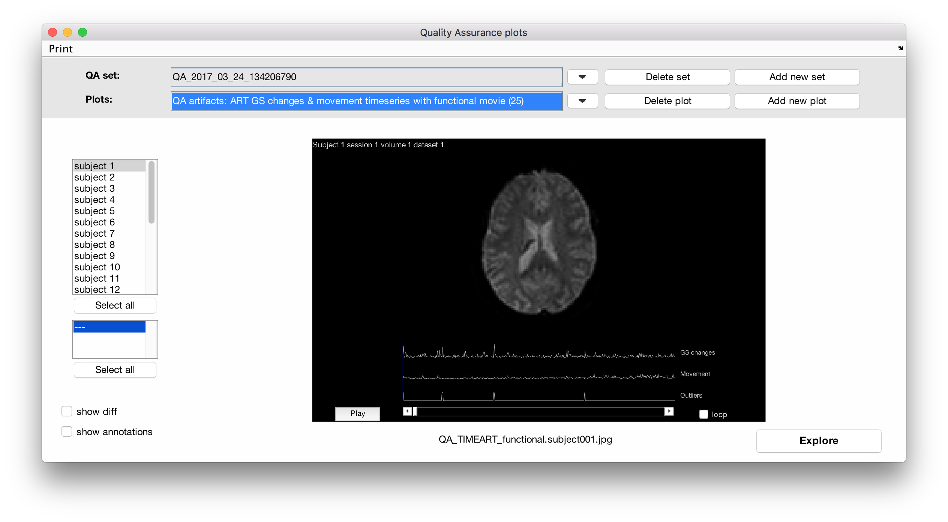
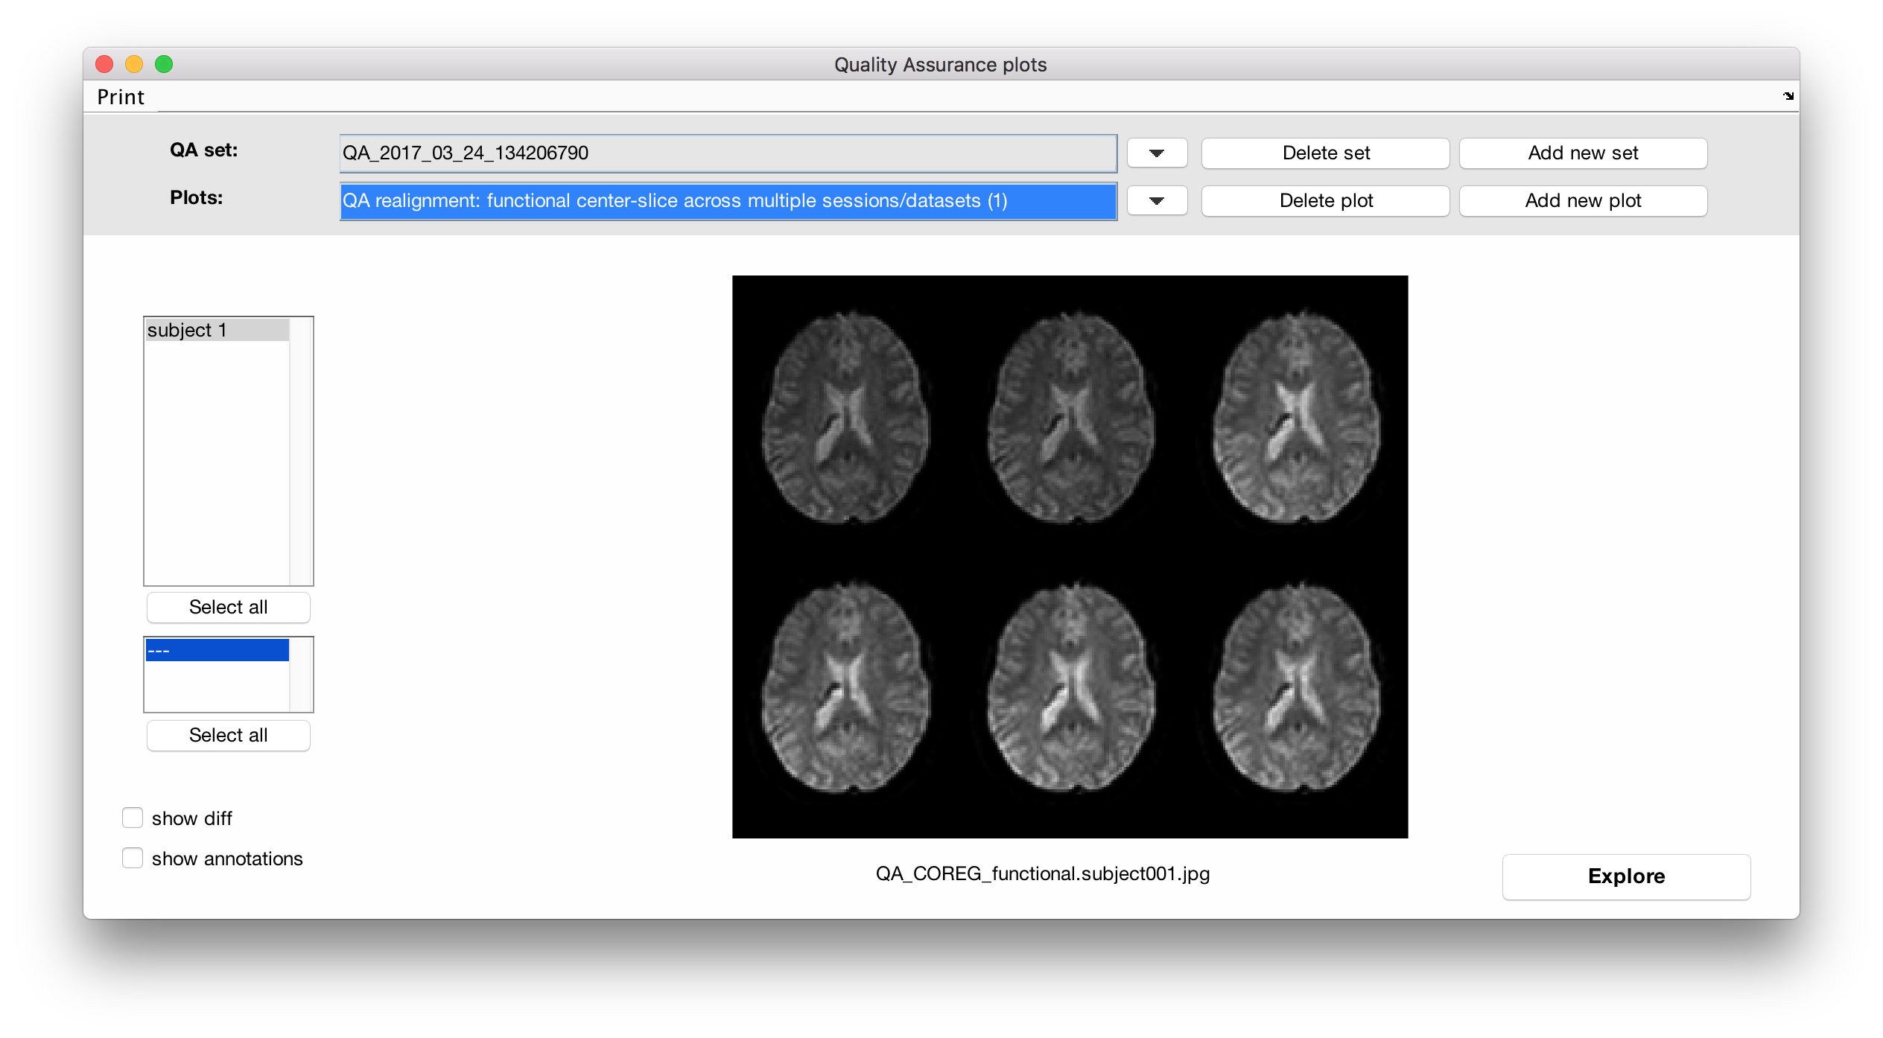
CONN’s
Quality Assurance plots
(preprocessing)
Does your data show subject-motion or other visible artifacts?
QA artifacts
Movie of functional data with timeseries:
Global Signal scan-to-scan changes
Subject motion scan-to-scan displacement
Artifacts (outlier scans identified by ART)
OK: no visible outliers beyond those already identified by ART (bottom timeseres)
QA measures: QA_validscans: second-level covariate computing number of valid scans (discounting outlier scans)
QA realignment
First- and last- acquisition across multiple sessions
OK: no visible differences between all images
QA measures: QA_maxmotion: second-level covariate computing maximum framewise displacement

Slide 12
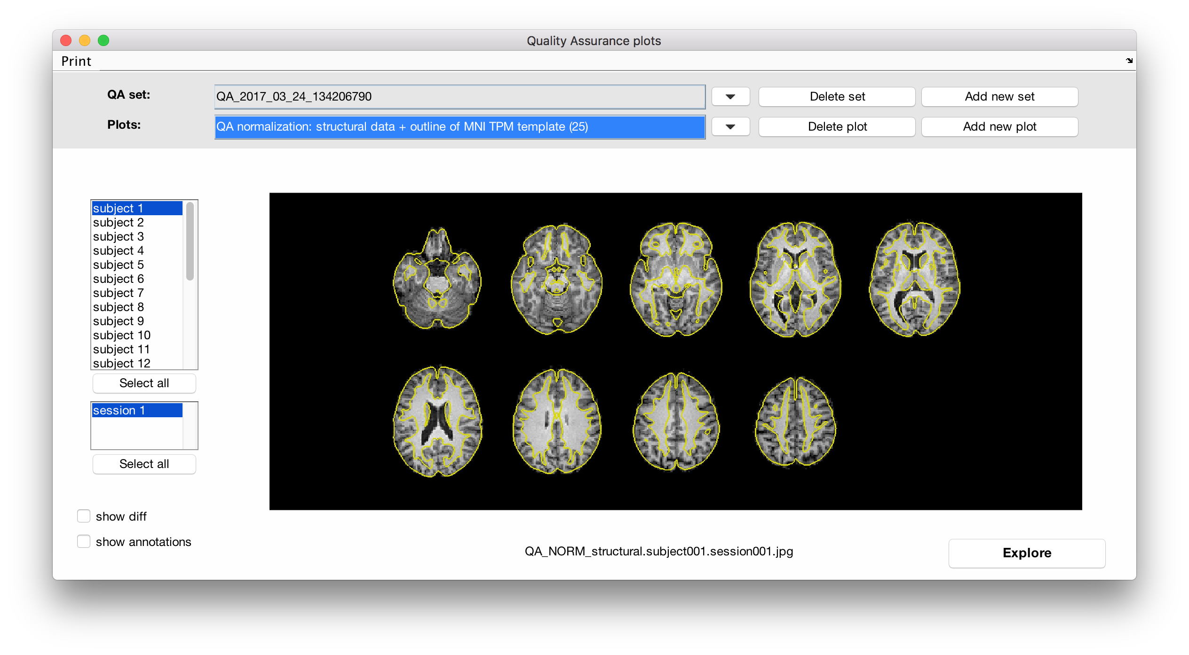
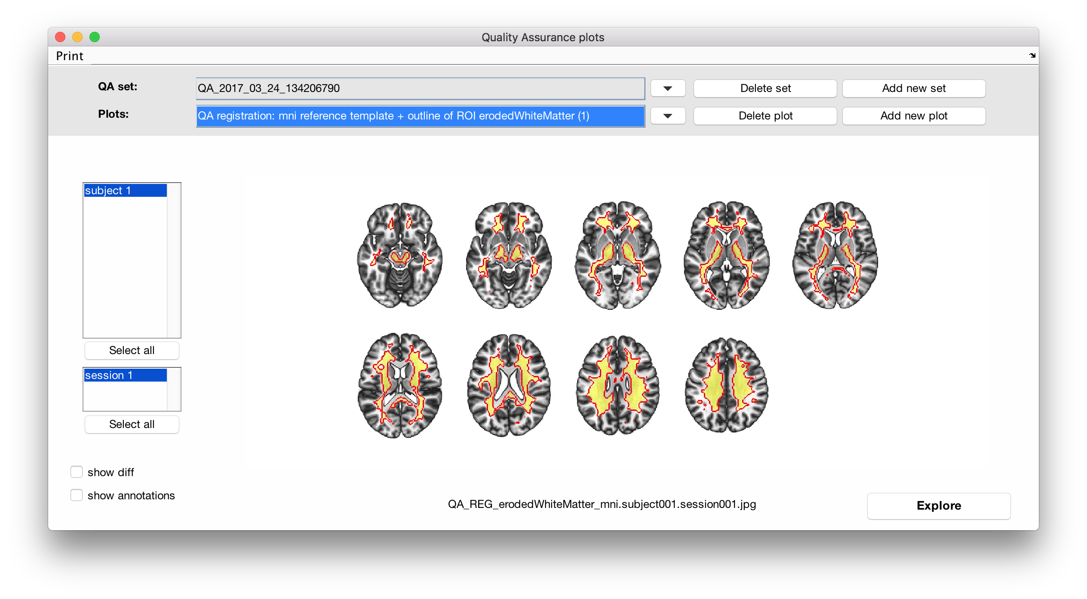
CONN’s
Quality Assurance plots
(preprocessing)
Is your data in MNI space?
Plot MNI-reference together with your functional/structural/ROI files
QA normalization functional
QA normalization structural
Overlay your functional data to MNI gray matter boundaries (25% gray matter MNI tissue probability maps)
OK: reasonably good match, particularly when averaged across all subjects. No visible consistent anatomical differences between subjects
QA measures: QA_Gray/white/CSF_vol
QA registration MNI reference
Overlay your ROIs onto an MNI template (e.g. gray/white/CSF ROIs: computed by preprocessing-pipeline segmentation step)
OK: white matter and CSF areas (particularly after erosion) do not overlap MNI template cortical gray matter regions

Slide 13
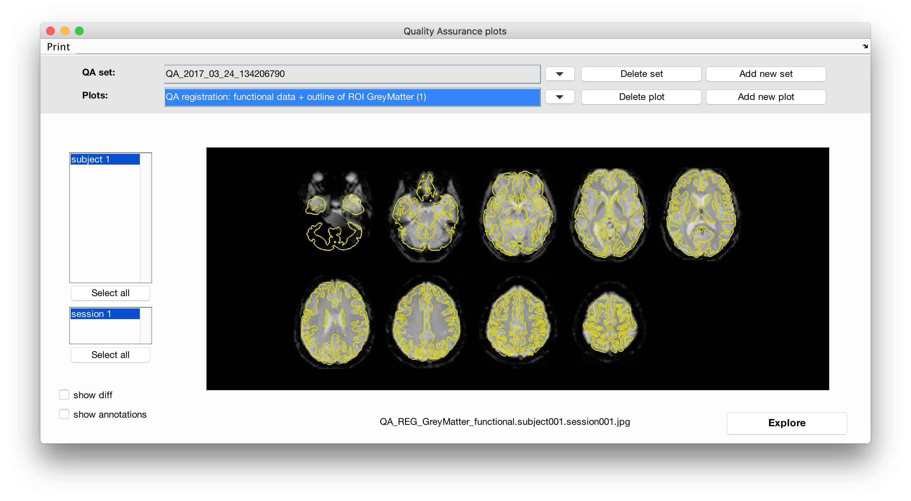
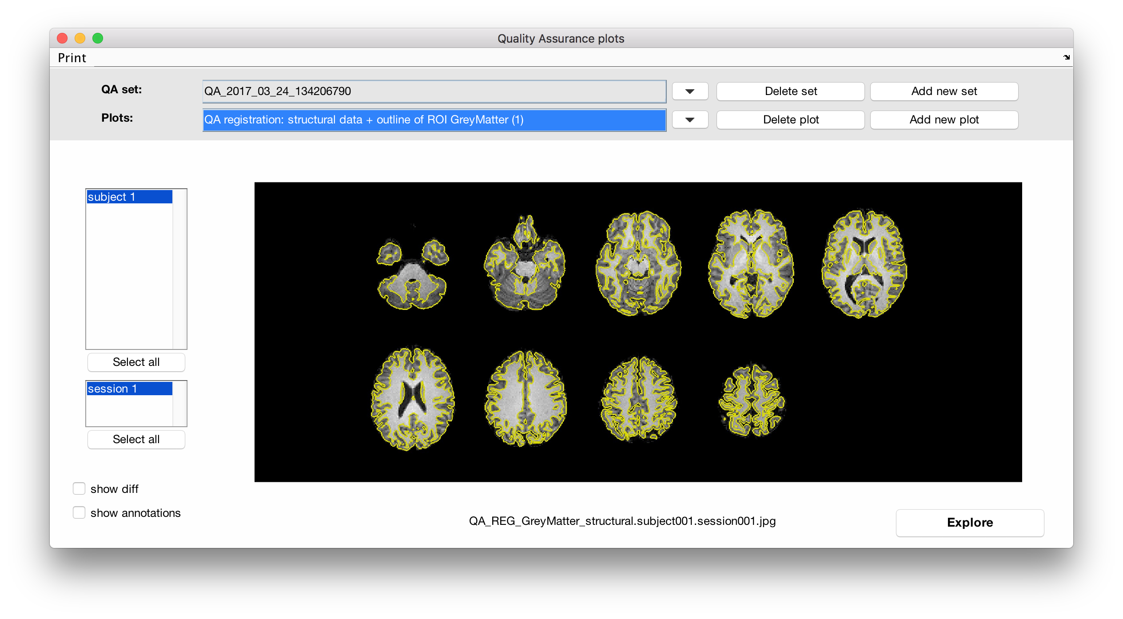
CONN’s
Quality Assurance plots
(preprocessing)
Are your functional and structural data properly co-registered?
QA registration functional
Plot functional data with gray matter boundary (from ROIs: filled by preprocessing-pipeline segmentation step)
OK: reasonable match between functional and anatomical modalities
QA registration structural
Plot structural data with gray matter boundary (gray/white/CSF ROIs: computed by preprocessing-pipeline segmentation step)
OK: reasonable match between functional and anatomical modalities

Slide 14
Additional info / references
SPM manual: http://www.fil.ion.ucl.ac.uk/spm/doc/manual.pdf
YouTube channels: Principles of fMRI (Martin Lindquist and Tor Wager)
Andrew Jahn
SPM: www.fil.ion.ucl.ac.uk/spm
FSL: fsl.fmrib.ox.ac.uk/fsl
CONN: www.conn-toolbox.org
matlab: help conn_setup_preproc

