Slide 1
The Complexity Model of Communication in the AI Age: the case of Japanese Engagement with Artificial Intelligence and Robots in Everyday Life
Toshie Takahashi
Professor, Waseda U.
Visiting scholar, U of Cambridge
the technology advisory committee, the Tokyo Olympic Games 2020
@Boston university, april 11, 2019

Slide 2
Society 5.0: paradigm shift of japan
By keidanren

Slide 3
How can we understand the paradigm shift?
Theoretical framework

Slide 4
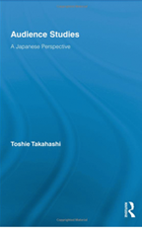
“the complexity model of communication” (2016)
☆winning the first prize for the Telecommunication social science award
“Audience Studies”
(NY: Routledge, 2009)

Slide 5
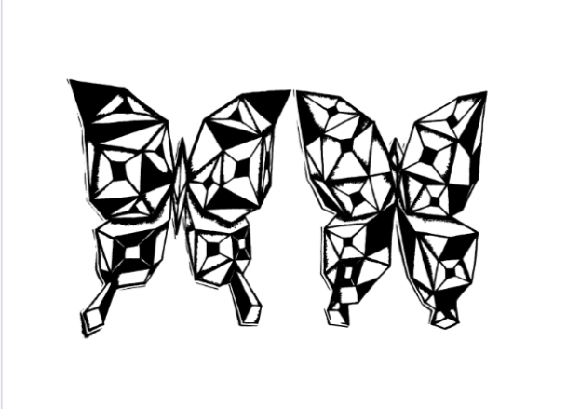
The Paradigm of Complexity
Chaos theory
‘butterfly effect’
Edward Lawrence, meteorologist MIT, in 1963
“a butterfly fluttering its wings in Peking one day could possibly cause, a month later, a storm in New York.”

Slide 6
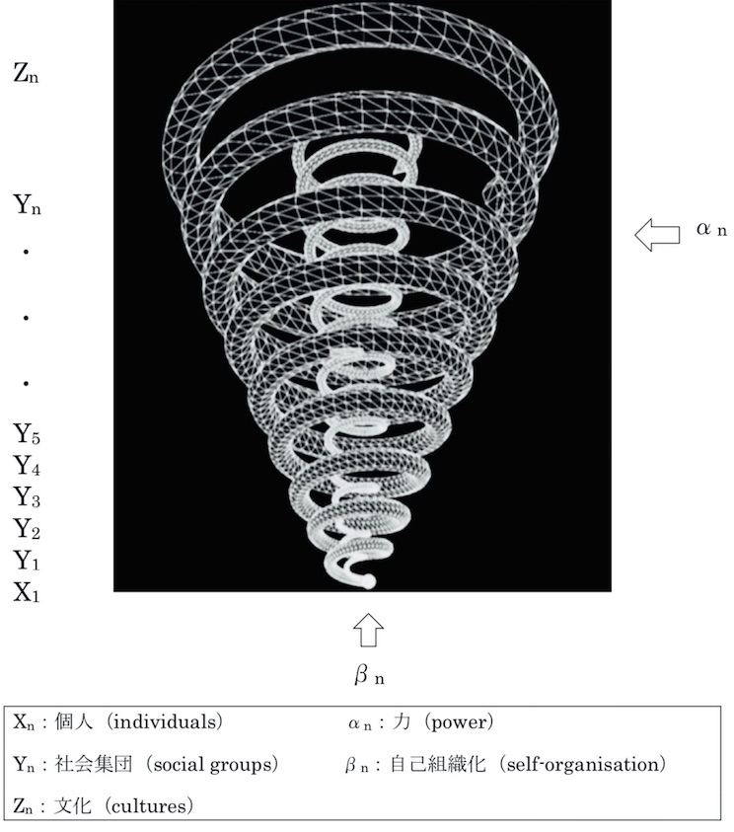
The Complexity Model of Communication
Power from
macro-level
National
Global
Communication Revolution
Smart city, community,
company, school,
home
Power from
micro-level
Agency; Empowerment;
Engagement with
AI/robots

Slide 7
The complexity model of communication

Slide 8
Ai narratives: Public Trust for AI
“it is essential to build a common agreement across governments internationally to make sure that, bluntly, artificial intelligence is our servant, not our master.”
By Lord Clement Jones,
Chair of the House of Lords, Select Committee on Artificial Intelligence

Slide 9
Ai nArratives
West (Negative)
Japan (Positive)

Slide 10
The Posters of baymax
Love & friendship (Japan)
Action & battle (US)

Slide 11
Mighty atom (astroboy) 1951

Slide 12
Tokyo olympic 1964: olympic of science

Slide 13
Macro-level: power from revolution of communication technology Smart japan Ict strategy
Ministry of Internal Affairs and Communications
Mission
To be the most active country in the world
Action
Realizing the world’s most advanced ICT environment for Tokyo 2020 Olympic and Paralympic Games

Slide 14
Young people and AI images
Survey: 354 young people (age between 15-29)

Slide 15
Tendencies toward AI/robots
Survey: 354 young people (age between 15-29)

Slide 16
Robot engagement project Fieldwork on therapeutic robot, “Paro” @ nursing home with prof takanori shibata

Slide 17
Fieldwork on human-robot interaction @ nursing home
Before
After

Slide 18
Fieldwork on Therapeutic robot

Slide 19
Aibo funeral

Slide 20
Fieldwork on AIBO in tokyo

Slide 21
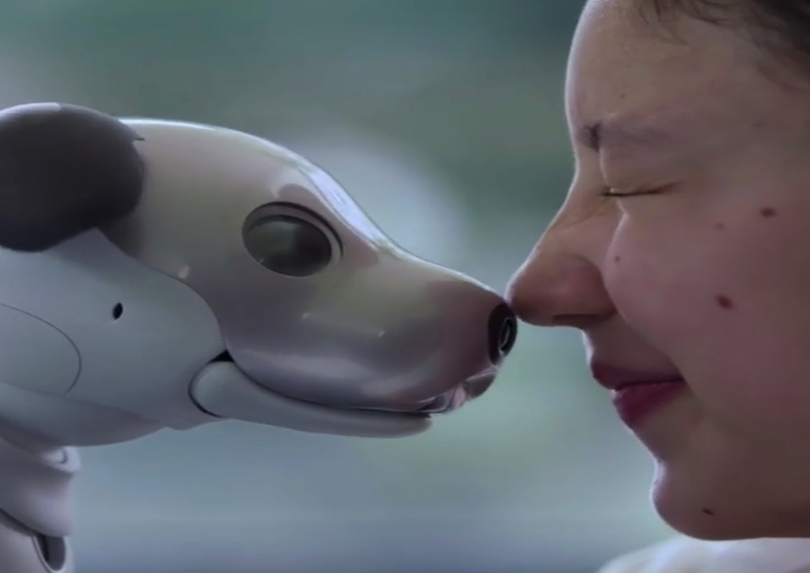
Internet of robots and AI
aibo TV CM

Slide 22
Human First
Cross-disciplinary Innovation
Smart Wisdom
Human First Innovation

Slide 23
1. From AI first to human first “Ai for social good” with Harvard univ. Mar 6-7, 2017 @waseda univ.

Slide 24
2. cross-disciplinary innovation necessity for life skill education (James D. Plummer, Standford univ.)
IEEE Vision, Innovation, Challenges Summit 2017

Slide 25
yuval noah Harari, 2015
“the rise of the useless class”
People will have to reinvent themselves again and again!

Slide 26
Self-creation
Thompson’s “self- formation”, Giddens’ “self-identity”, and Hall’s “identification”
how people create and recreate themselves, even momentarily, through both mediated and non-mediated interaction, thus ‘deserving the name of life.’

Slide 27
3. Smart wisdom
emerges as people reflexively create and recreate themselves as they make sense of life and their place in an AI society,
while appropriating the power and possibilities offered by new technological innovation.
Image: “Astro Boy”, one of the most well-known image of robots in Japan, illustrated by Osamu Tezuka from 1952
(2005 Tezuka Osamu Nengajyo Sozaishu ©Tezuka Productions)

Slide 28
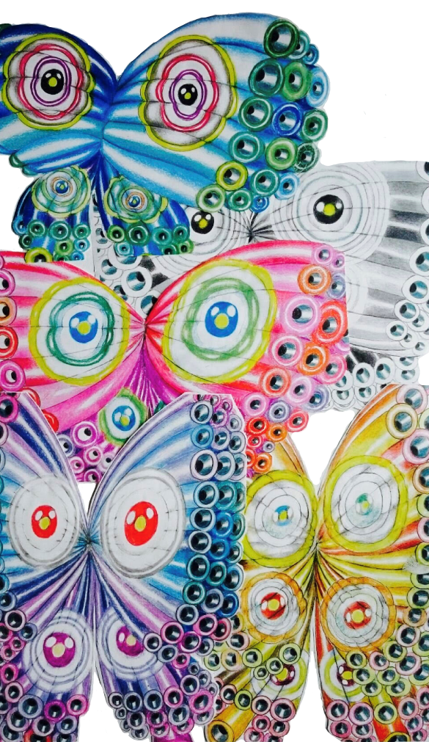
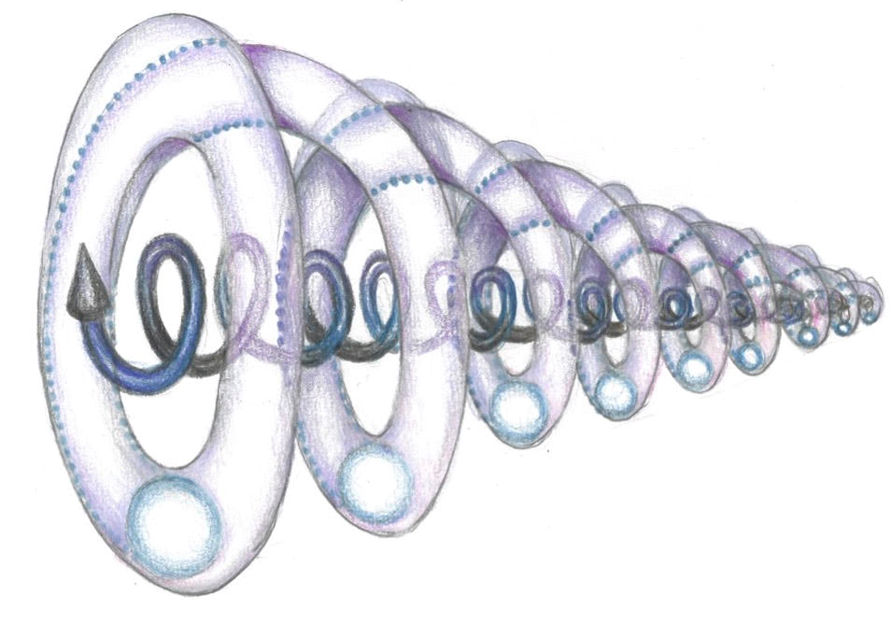
Self-organising Japan 2040
In 2040: Society 5.0 sustainable
Self-organising
with smart wisdom
In 2019: the edge of chaos
Notes:
----- 会議メモ (17/09/07 20:13) -----
These butterflies represent the robots which we already have in our digital society by industries. They look really robotic with metallic, functional lines. But they interact with each other and human and self-organize with Art-thinking in Tokyo, just as my complexity model of communication described. In 2030, we might have autonomous robots which reflexively create themselves through interaction with human and other robots. They might even express emotions like happiness, sadness, anger and pleasure. I hope the robots we create in the future can actually make people happier. Tokyo should be such a smart city created by interaction between human and technologies with Art-thinking.

Slide 29
creating a better AI society together with smart wisdom

Slide 30
Thank you!
Toshie Takahashi
Professor, Waseda University
Visiting scholar, U of Cambrdige
toshie.takahashi@waseda.jp
http://blogs.law.harvard.edu/toshietakahashi/

