Slide 1
Shayne McKenna | EE 529 | 10/25/22

Slide 2
Outline
What and why? – terms and motivation
Potential tree coverage: observation and modeling
Global tree restoration potential
Effects of climate change – serious!
Conclusions & further action

Slide 3
Motivation
IPCC: increase of 1 billion ha of forest necessary to limit warming
Some things unclear: how much is possible? Where could they exist? Will this change as climate changes?
Previous efforts: coarse approximations of global forest degradations
Definitions
Forest: land of at least 0.5 ha covered by at least 10% tree cover and without agricultural activity or human settlements
Canopy cover: area of the land covered by tree crown vertically projected to ground

Slide 4
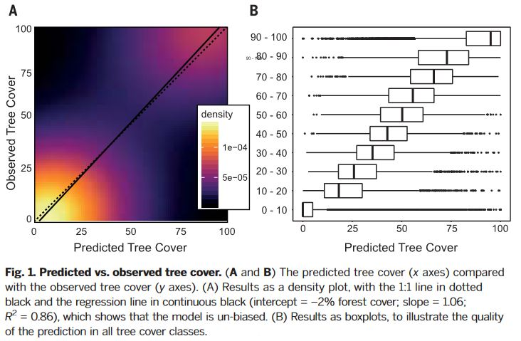
Evaluating Global Potential Tree Coverage
Direct measurements of tree cover from protected areas
Interpolate “natural tree cover” estimates globally
Used a random forest machine-learning approach to generate predictive model
Result: Earth’s tree carrying capacity

Slide 5
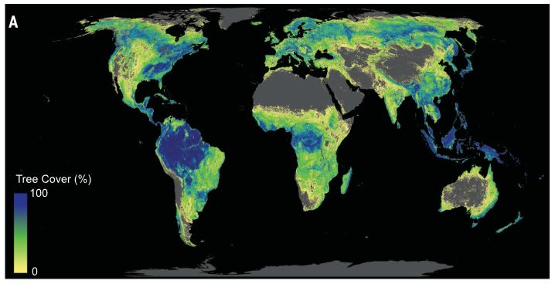

Slide 6
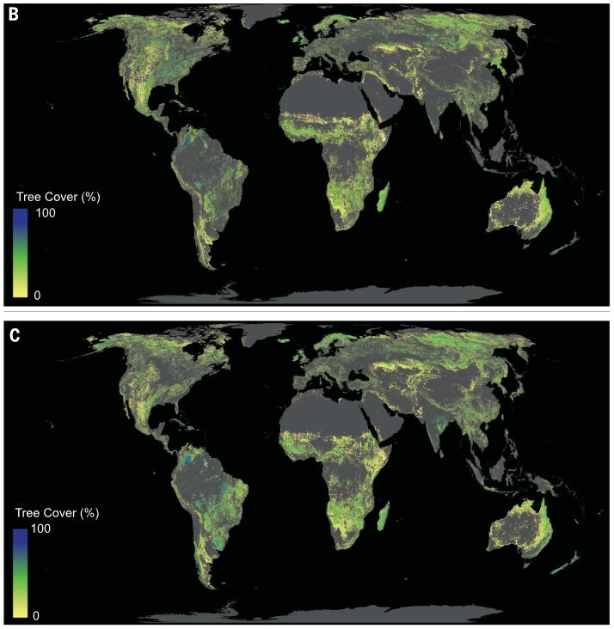
Tree Restoration Potential
Canopy cover
Accounting for human development & agriculture: used two existing models
Clustered in several countries
Estimate that vegetation in potential restoration areas could store 205 GtC

Slide 7
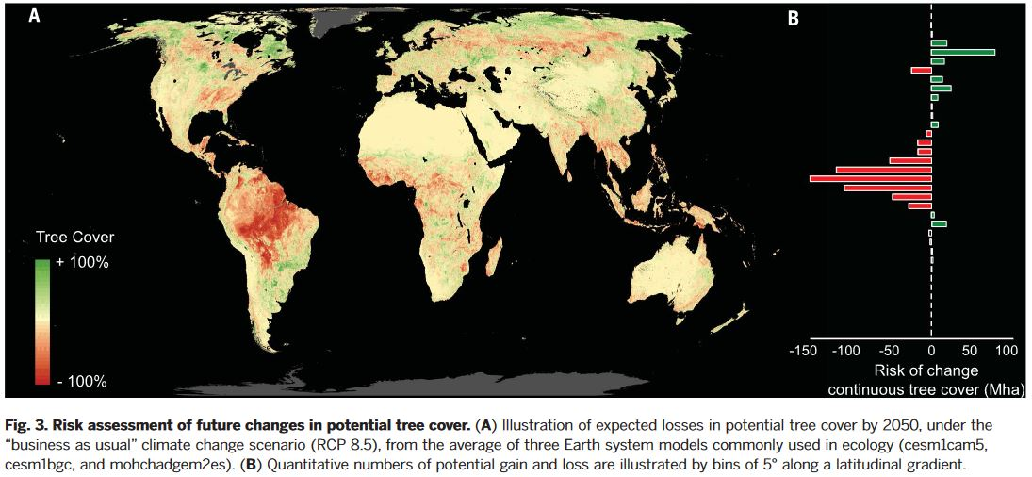
Potential Tree Cover in a Future Climate

Slide 8
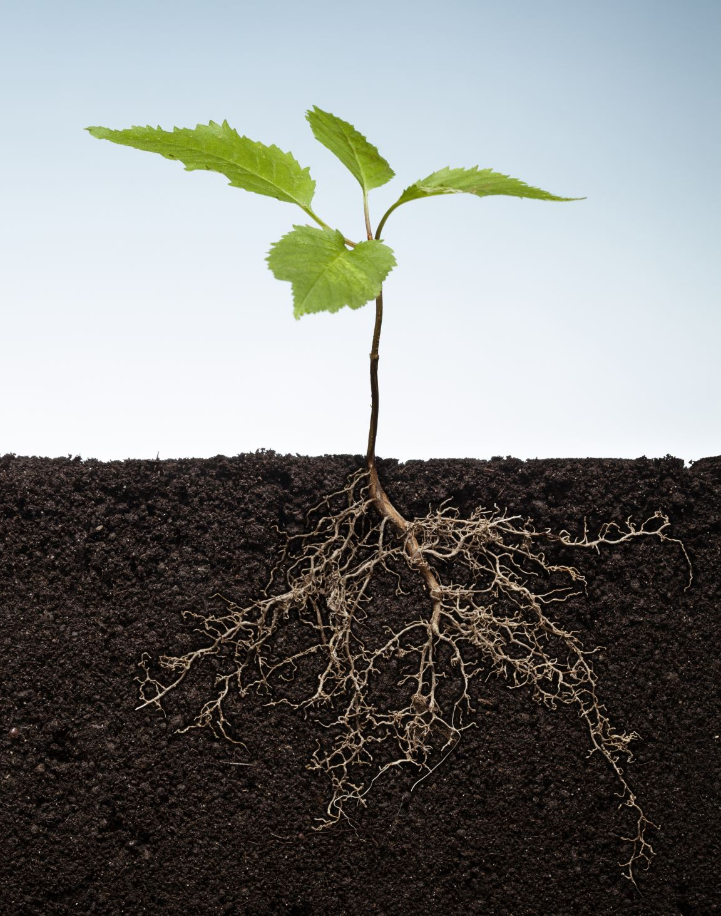
Conclusions
Potential for tree planting exists globally
Tree restoration is an effective way to capture carbon now
Future climate will be different: urgency needed along with other mitigation methods

Slide 9
Citation
Bastin, Jean-Francois, et al., “The global tree restoration potential.” Science, vol. 365, July 2019, pp. 76-79, 10.1126/science.aax0848

