Slide 1
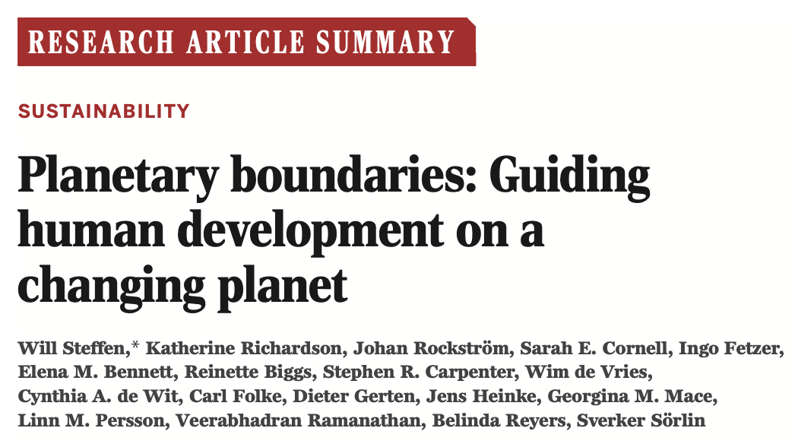
DOI: 10.1126/science.1259855
Notes:
In term of the method and how the calculation works, it won’t be talked about in this presentation and it’s also not the focus of this paper either. They are a bunch of other papers in the references which talked about the methods in detail which you can refer to if you’re interested.

Slide 2
What is planetary boundary and why should I care?
Thresholds are defined as non-linear transitions in the functioning of coupled human–environmental systems (Schellnhuber 2002, Lenton et al. 2008)
Thresholds VS. Boundaries
Boundaries, on the other hand, are human-determined values of the control variable set at a “safe” distance from its global threshold or from a dangerous level
Notes:
First, we want to answer the question – what is planetary boundary and why should we care.

Slide 3
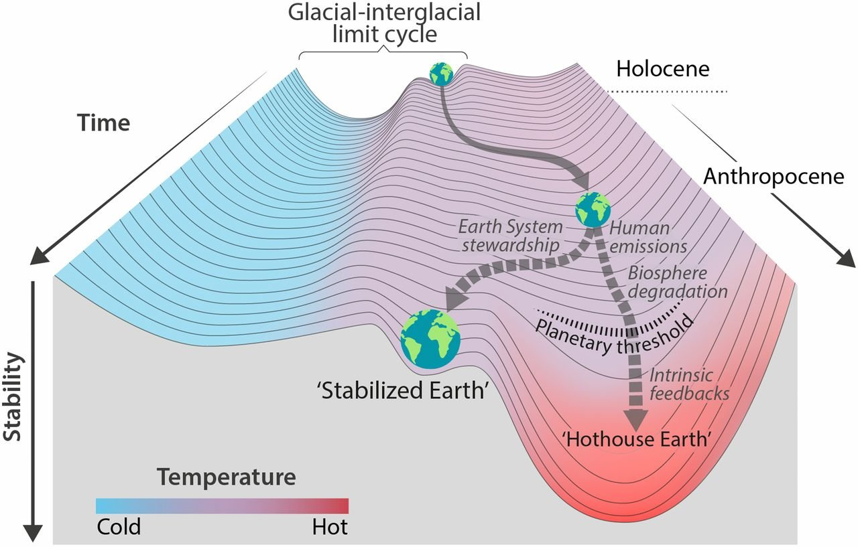
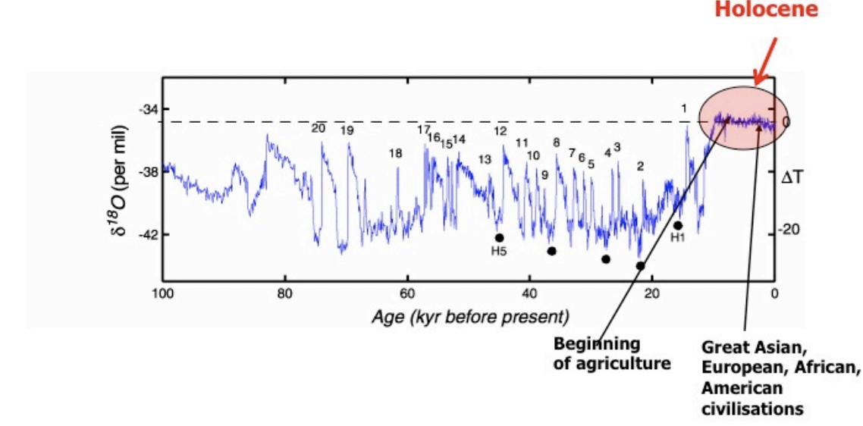
Is the earth falling into a pit?
Holocene VS. Anthropocene
The Holocene is the name given to the last 11,700 years* of the Earth's history.
(Steffen et al 2018)
Notes:
Do we really need to concern ourselves with that concept, considering that the earth we’re living on is abundant in resources. Is the earth really falling into a pit? We can take a look at some figures.
The figure on the left shows the temperature anomalies estimated from the ice core records from the Greenland ice sheet project. The bubbles from the ice core contain the air from epochs ago, which can be used to estimate temperature. The Holocene is the time since the end of the last major glacial epoch, or "ice age.” In general, the Holocene has been a relatively warm period in between ice ages.
As it’s shown in this figure, the Holocene epoch, the last 11,700-year-long period, the only state of the planet that we know for certain can support contemporary human societies shows minor variations in climate compared to the huge climate variations throughout the earth history.
However, the human enterprise has grown so dramatically since the mid-20th century that the relatively stable Holocene epoch is now being destabilized. In fact, a new geological epoch, the Anthropocene, has been proposed.
Stability landscape on the right shows the pathway of the Earth System out of the Holocene, to its present position in the hotter Anthropocene. Two divergent pathways that the Earth System might take in the future are shown here. Currently, the Earth System is on a Hothouse Earth pathway driven by human emissions of greenhouse gases and biosphere degradation toward a planetary threshold, beyond which the system follows an essentially irreversible pathway driven by intrinsic biogeophysical feedbacks.
The precautionary principle suggests that human societies would be unwise to drive the Earth system substantially away from a Holocene-like condition. A continuing trajectory away from the Holocene could lead, with an uncomfortably high probability, to a very different state of the Earth system, one that is likely to be much less hospitable to the development of human societies.
The Planetary boundary framework exactly aims to help guide human societies away from such a trajectory by defining a “safe operating space” in which we can continue to develop and thrive.

Slide 4
Earth-system Processes | Key Parameters
Climate Change | Atmospheric carbon dioxide concentration Change in radiative forcing
Biosphere Integrity | Extinction rate
Land-system Change | Percentage of global land cover converted to cropland
Freshwater Use | Consumption of fresh water by human
Biochemical Flows | Amount of N₂ removed from atmosphere for human use Quantity of P flowing into the oceans
Ocean Acidification | Global mean saturation state of aragonite in surface sea water
Atmospheric Aerosol loading | Overall particulate concentration of particulate in the atmosphere
Stratospheric Ozone Depletion | Concentration of ozone
Novel Entities | New substances, new forms of existing substances, and modified life forms that have the potential for unwanted geo- physical and/or biological effects
Notes:
In 2009, Scientist Rockström led a group of internationally renowned scientists to identify the nine processes that regulate the stability and resilience of the Earth system and proposed quantitative planetary boundaries within which humanity can continue to develop and thrive.

Slide 5
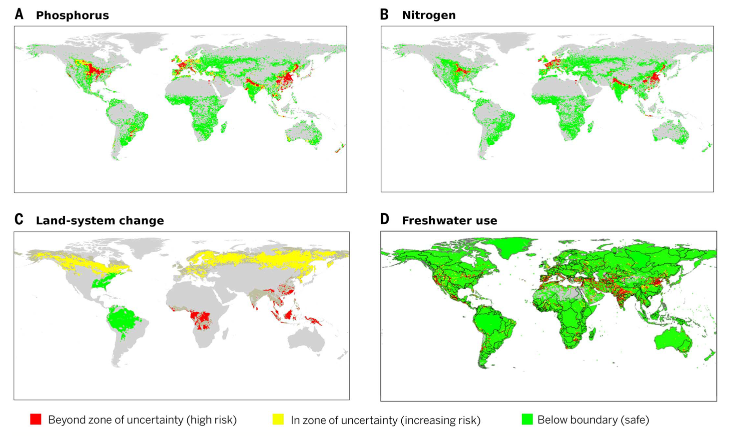
It varies spatially !
Notes:
According to some previous studies, some processes have been accessed regionally and they vary regionally, as this figure shows, the status of boundaries for phosphorus, nitrogen, land-system change and freshwater use vary dramatically from a spatial perspective, the mid-west part of the united states, eastern part of China and Europe have the worst situations, a lot of area in these regions is in the red zone, which represents high risk.

Slide 6
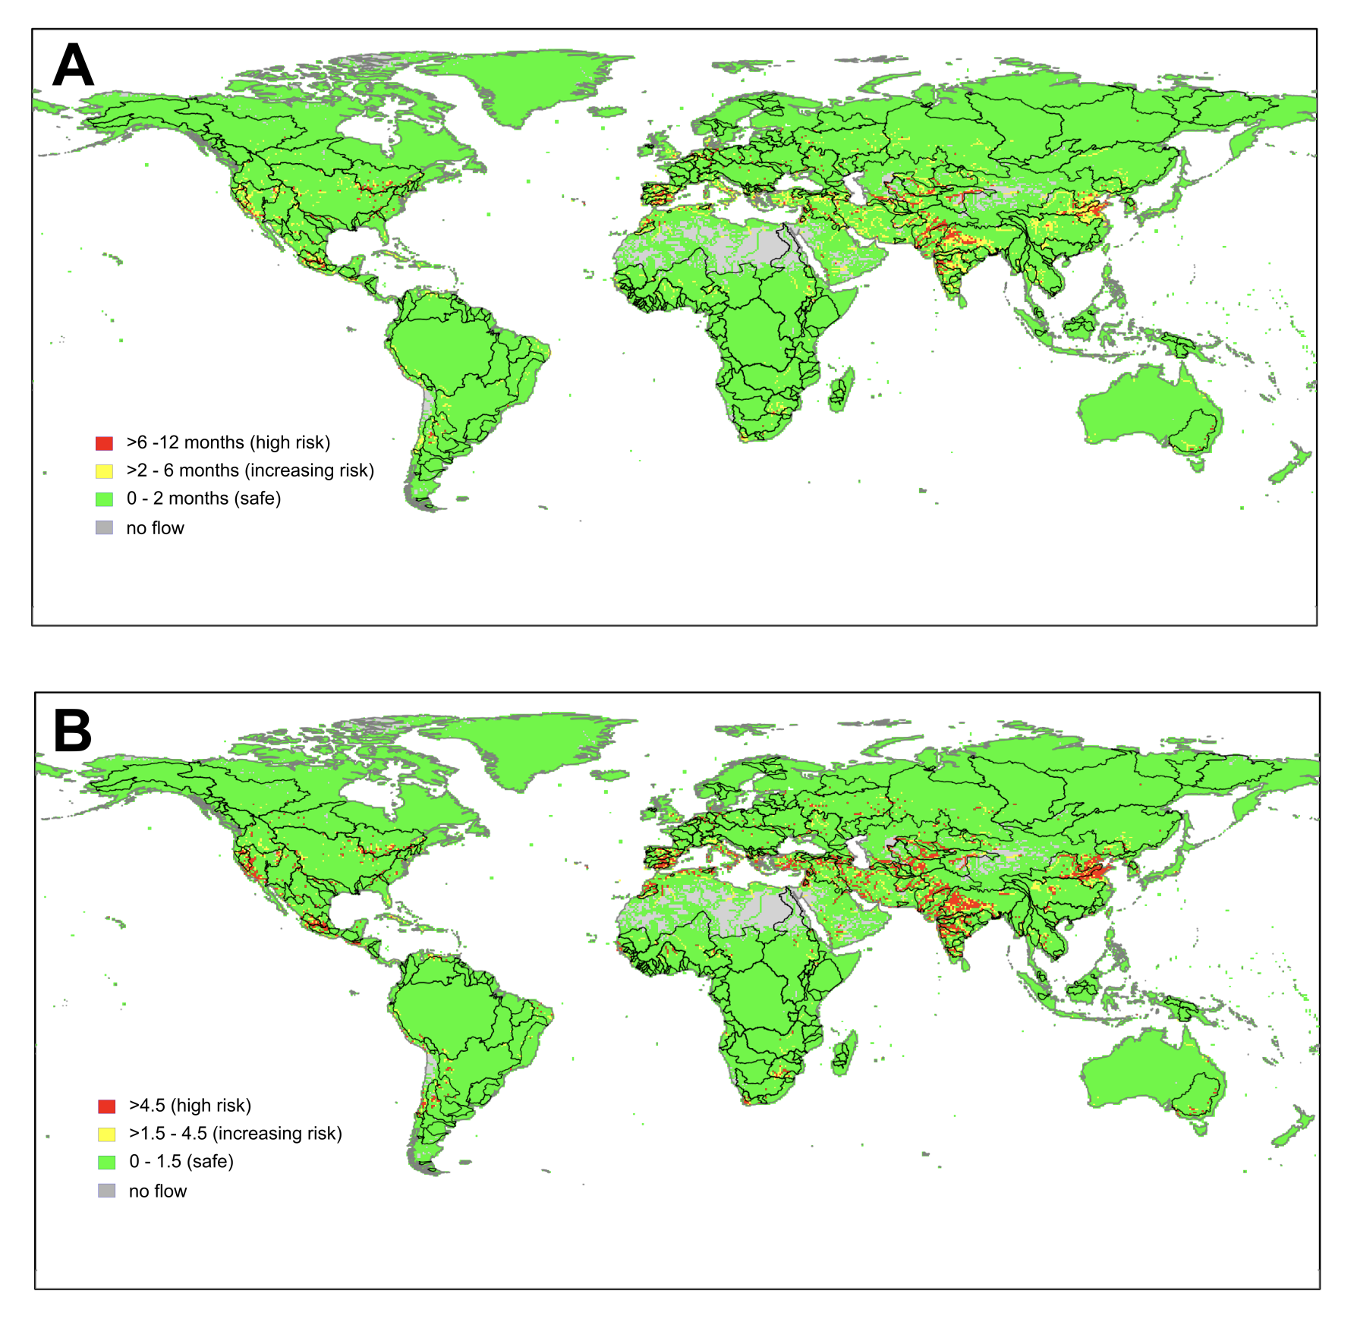
Also, temporally!
Number of months per year with a transgression (by any degree) of allowed water withdrawals
Risk index, defined as the product of duration and severity of transgression
Notes:
the situation also varies temporally, this figure shows the regional boundary of freshwater use. As we can observe here, most of the area on earth is in the green zone which is the safe area where the number of months per year with a transgression is below 2, as opposed to only a small portion of aera in India and China show great risk, where the number of months of transgression is over 6 months. We have risk index down below showing spatial variance.

Slide 7
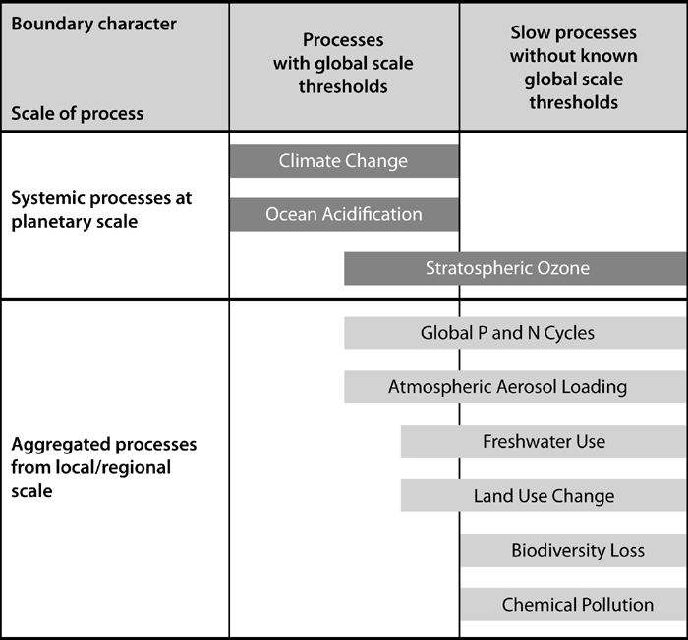
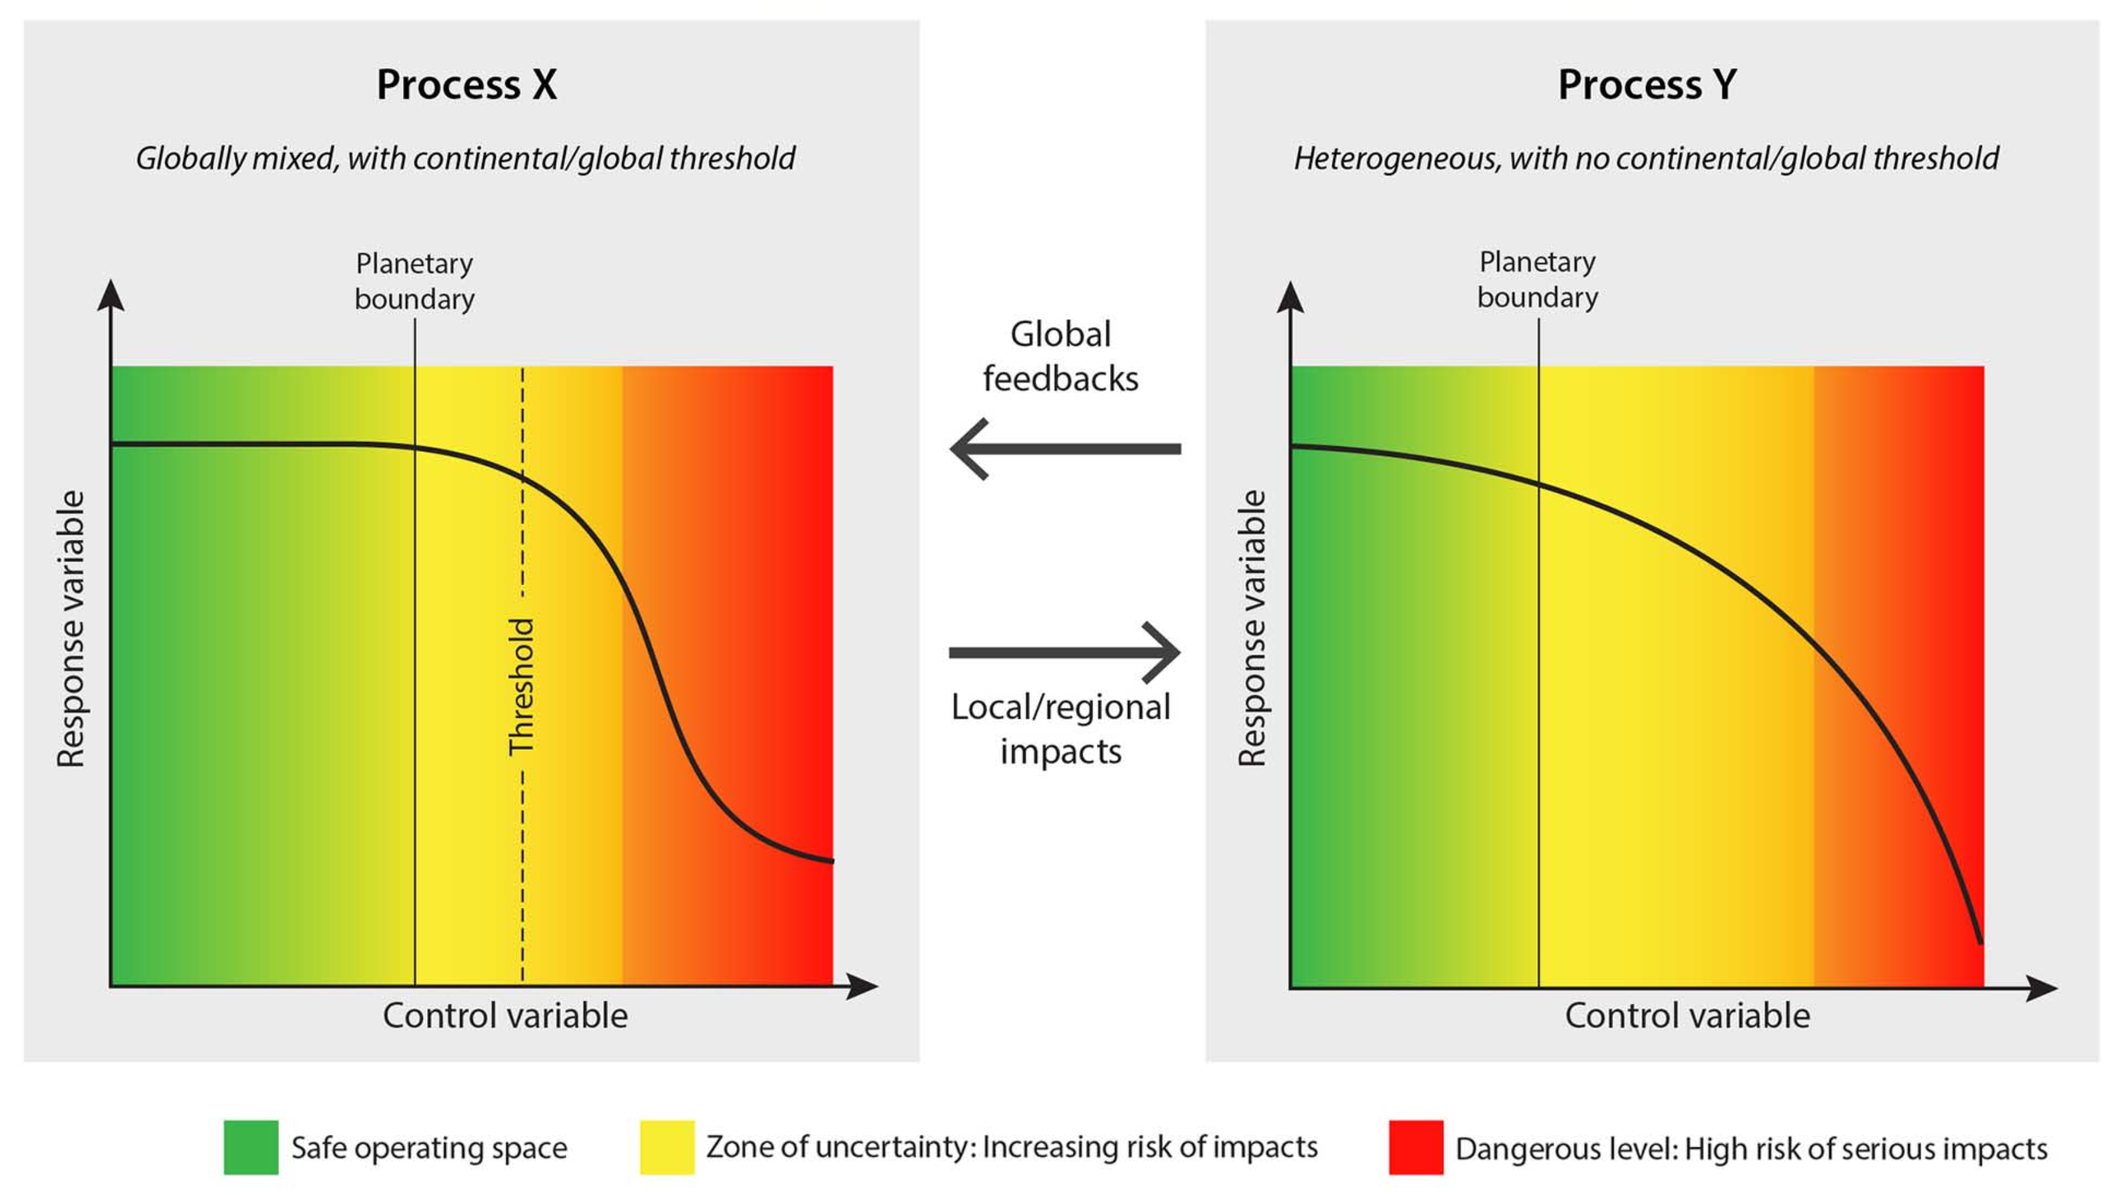
Are there global-scale planetary boundaries?
Notes:
Considering of the complexity of the earth system and human activities, are there global-scale planetary boundaries? It’s even possible to derive planetary boundaries. Fortunately, the answer is positive.

Slide 8
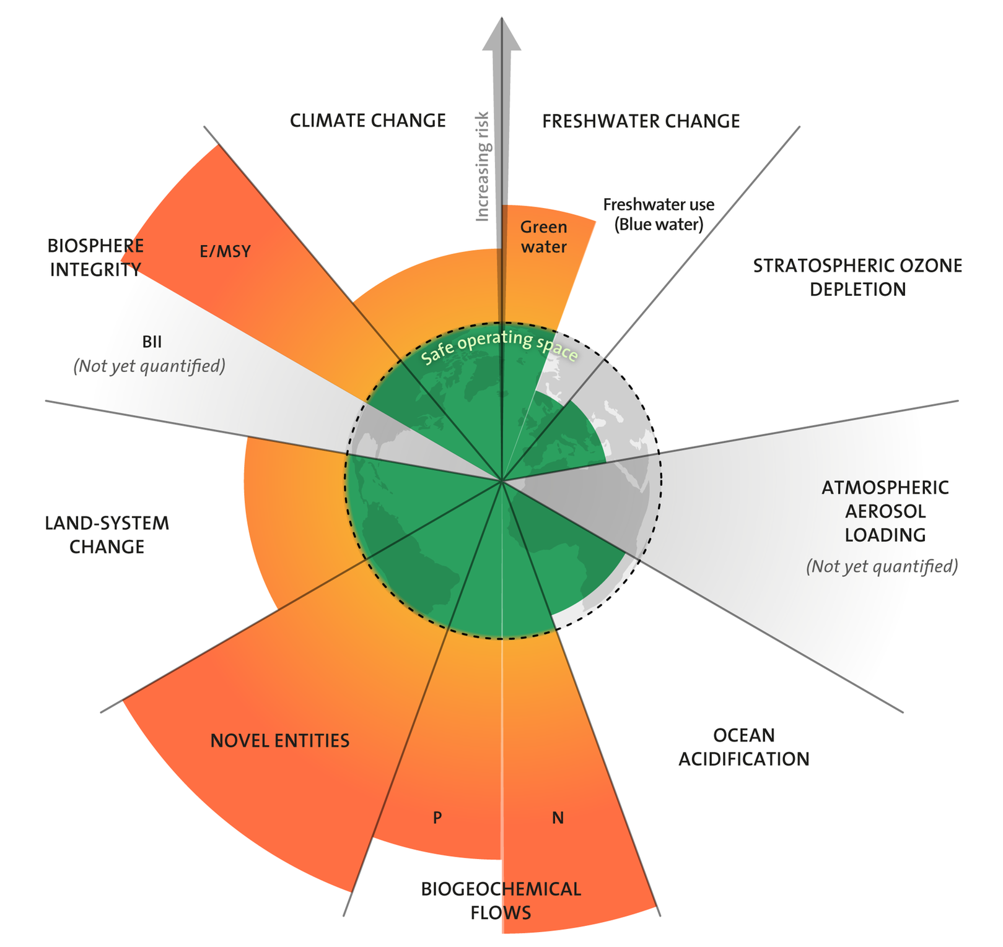
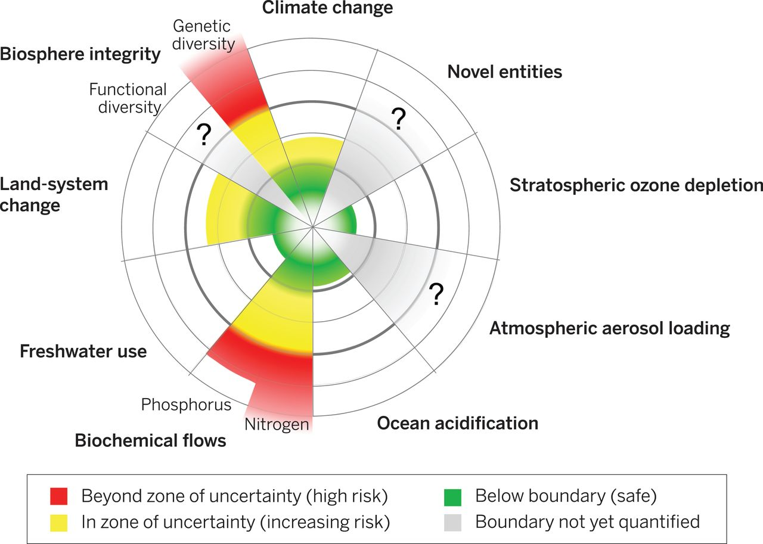
Current status of the the seven boundaries that can be quantified at the global level
(Steffen et al 2015)
(Wang-Erlandsson et al 2022)
Notes:
After answering all of these questions, we might want to now take a look at the current status of the boundaries and wonder how the earth is doing so far.
(Does this approach or the whole concept oversimplify the problem?)

Slide 9
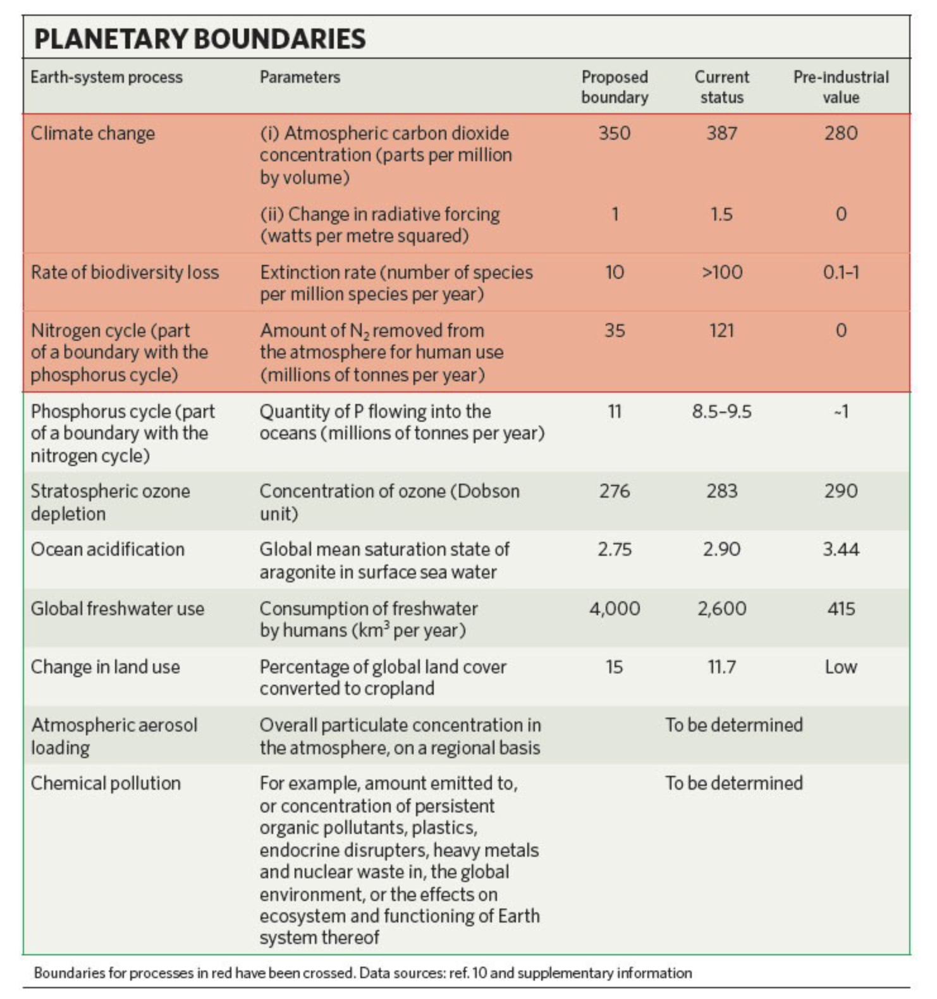
Updated in Steffen et al 2015
Proposed | Current
350(350~450) | 398.5
 | 2.3
 | 100~1000
62(62~82) | 150
 | 22
290 | 200
75~54%* | 62%*
* Area of forested land as % of original forest cover
Notes:
On this slide, we have a table which shows the actual numbers of these boundaries and where we are right now.

Slide 10
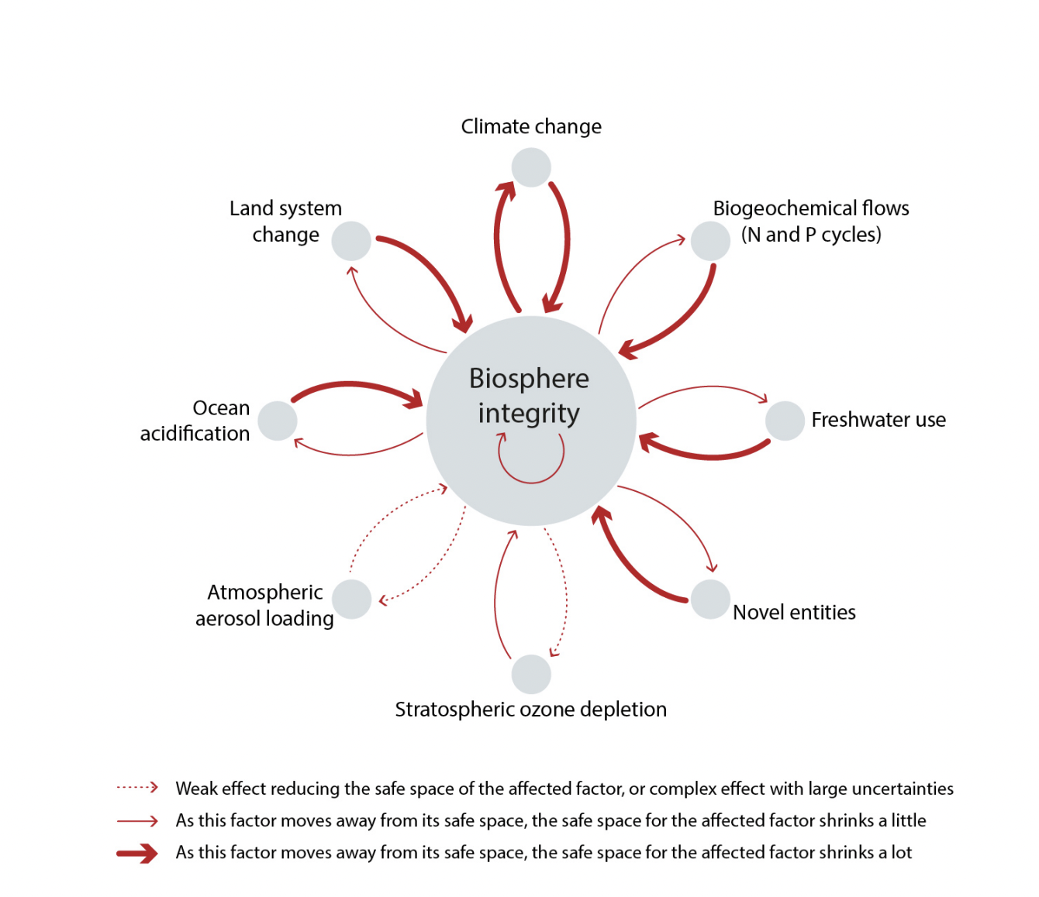
Does it really look that simple as it seems to be?
Notes:
It looks like we are in a not good situation, but does it mean we will be good if we bring those values down respectively? Does it really look that simple as it seems to be? Addressing this problem might be way complicated that we thought.
This has profound implications for global sustainability, because it emphasizes that we can’t address the problems separately but need to address multiple interacting environmental processes simultaneously.

Slide 11
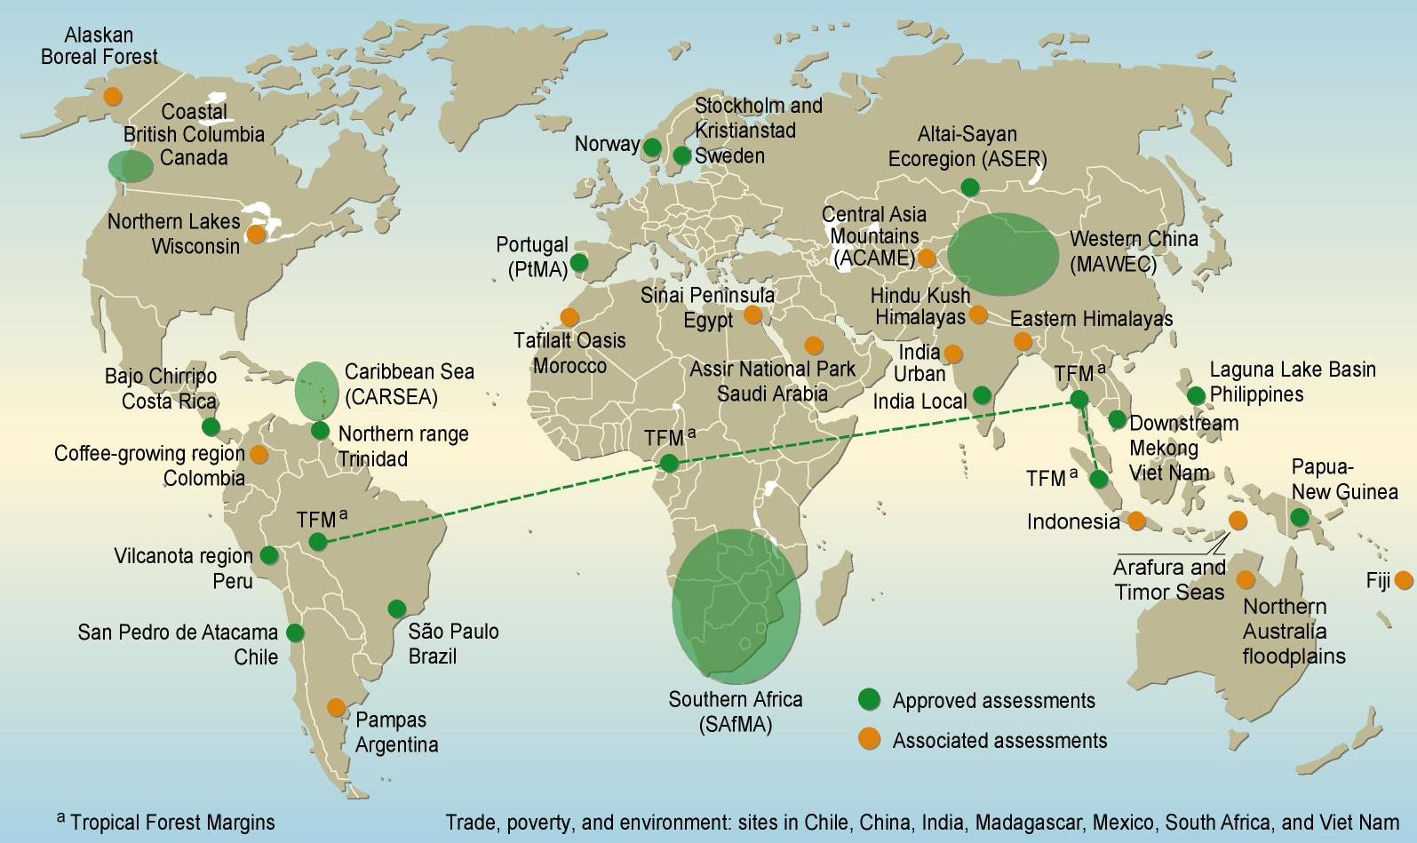
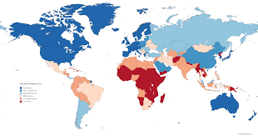
Is it good enough for guiding policy-making?
Maybe Not
The PB framework recognizes the importance of changes at the level of subsystems in the Earth system
Policy actions mostly occur at lower levels (nations, basins, and regions)
Notes:
Is the concept of global planetary boundary good enough for guiding policy-making? Maybe not, It’s a good concept but it might not have been very practical.

Slide 12
Is it really making any difference?
Former UN Secretary-General Ban Ki-moon urged global society to “Help us defend the science that shows we are de-stabilising our climate and stretching planetary boundaries to a perilous degree.”
The World Business Council on Sustainable Development, a forum for 200 companies including some of the best-known brands in the world, used the planetary boundaries framework to shape their Action 2020 strategy.
Stockholm Resilience Centre became the scientific partner in a research project with the Ellen MacArthur Foundation and the Swedish clothing retailer H&M group, working to integrate the planetary boundaries framework and the circular economy concept.
2011
2013～2016
2017
Notes:
Even though the PB concept is not good enough, it has started to make difference in the policy making.
In 2011, two years after the first paper about planetary boundary, Former UN Secretary urged that we should defend the science that shows we are stretching planetary boundaries to a perilous degree.
From 2013 to 2016, the world business council used used the planetary boundaries framework to shape their Action 2020 strategy.
In 2017, the Stockholm Resilience center partnered with the Swedish clothing retail H&M, working to integrate the planetary boundaries framework and the circular economy concept.

Slide 13
What do we learn from this paper?
Planetary boundary
Why it is important
How well our earth is doing from a PB perspective
The earth-system thinking with the “Planetary” as a relevant level of complex system understanding

Slide 14
Additional references
Rockström, Johan, Will Steffen, Kevin Noone, Åsa Persson, F. Stuart Chapin, et al. “A Safe Operating Space for Humanity.” Nature, vol. 461, no. 7263, Sept. 2009, pp. 472–75, https://doi.org/10.1038/461472a.
Rockström, Johan, Will Steffen, Kevin Noone, Åsa Persson, F. Stuart III Chapin, et al. “Planetary Boundaries: Exploring the Safe Operating Space for Humanity.” Ecology and Society, vol. 14, no. 2, Nov. 2009, https://doi.org/10.5751/ES-03180-140232.
Steffen, Will, et al. “Trajectories of the Earth System in the Anthropocene.” Proceedings of the National Academy of Sciences, vol. 115, no. 33, Aug. 2018, pp. 8252–59, https://doi.org/10.1073/pnas.1810141115.
Wang-Erlandsson, Lan, et al. “A Planetary Boundary for Green Water.” Nature Reviews Earth & Environment, vol. 3, no. 6, June 2022, pp. 380–92, https://doi.org/10.1038/s43017-022-00287-8.
Notes:
I still encourage all of you to read the original paper as it’s really really well written and contains tons of more information that what’s covered in my today’s presentation.

Slide 15
