Slide 1
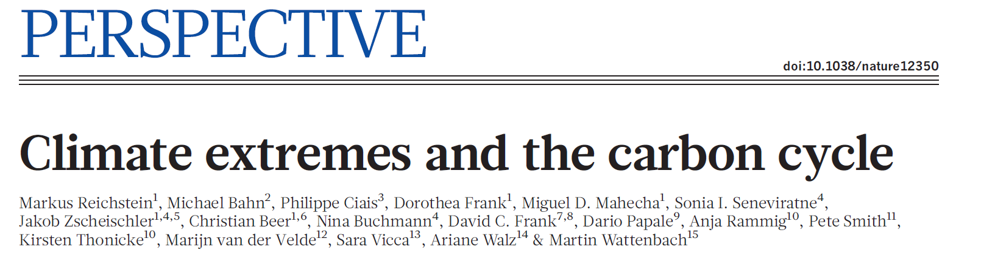
EE 529 Presentation
Luofan Dong

Slide 2
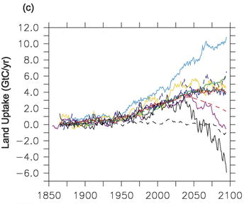
Background
Terrestrial ecosystems have been absorbing 25–30% of anthropogenic carbon dioxide (CO2) emissions
The future of Land sinks is highly uncertain
Global carbon budget (2021)
Friedlingstein. (2006)

Slide 3
Climate Extreme is poorly understood
The purposes of this paper:
Define climate extremes from an impact point of view
Analyze the susceptibility of the carbon cycle in different ecosystem types
Estimate of the carbon loss resulted from climate extreme

Slide 4
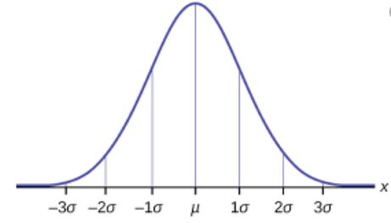
What is “Climate Extreme”
If the annual precipitation has always been between 500mm – 510mm, then 499mm is considered an extreme year.
Traditional statistics
500mm
510mm
499mm?
Impact point of view
A climate extreme is “an episode or occurrence in which a statistically rare or unusual climatic period alters ecosystem structure and/or functions well outside the bounds of what is considered typical or normal variability”

Slide 5
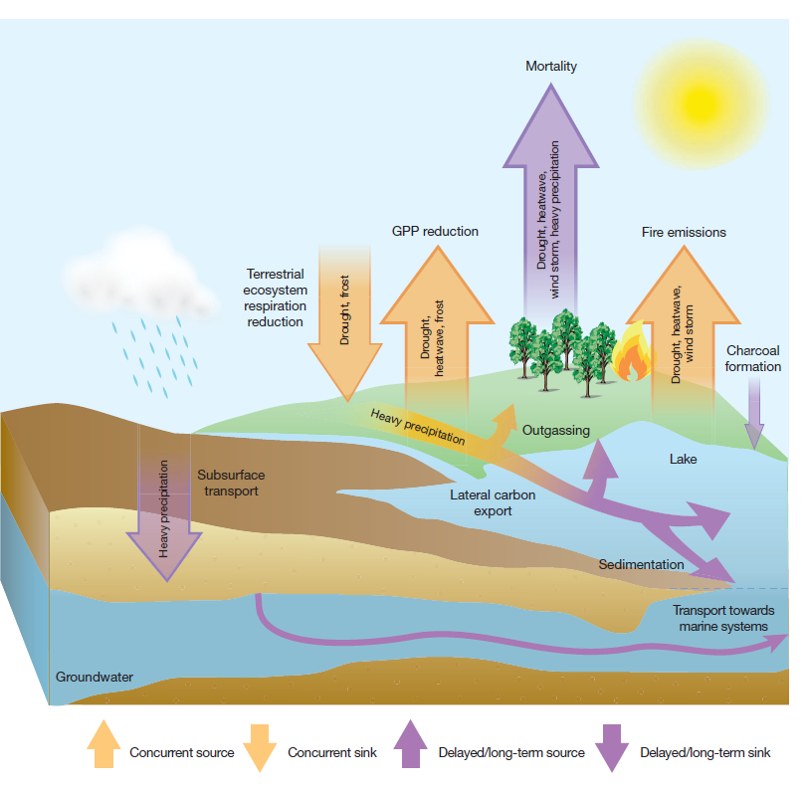
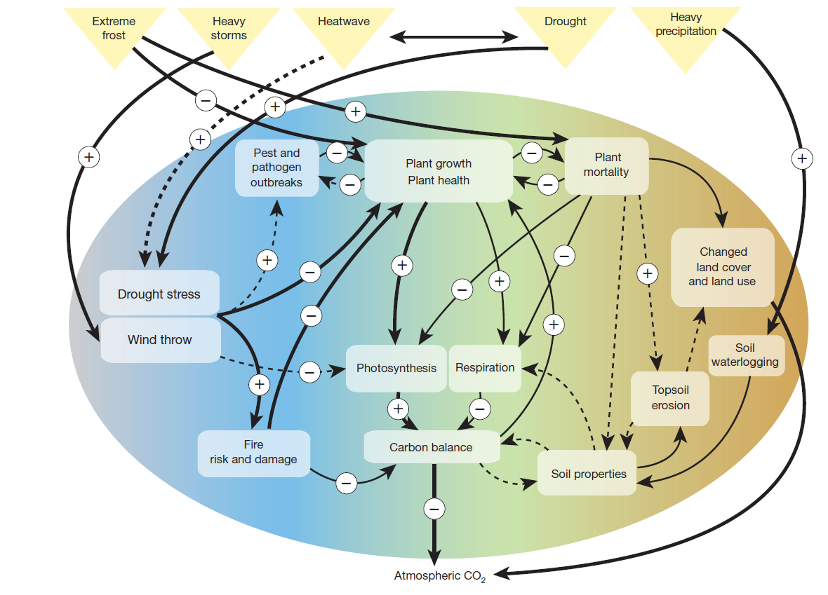
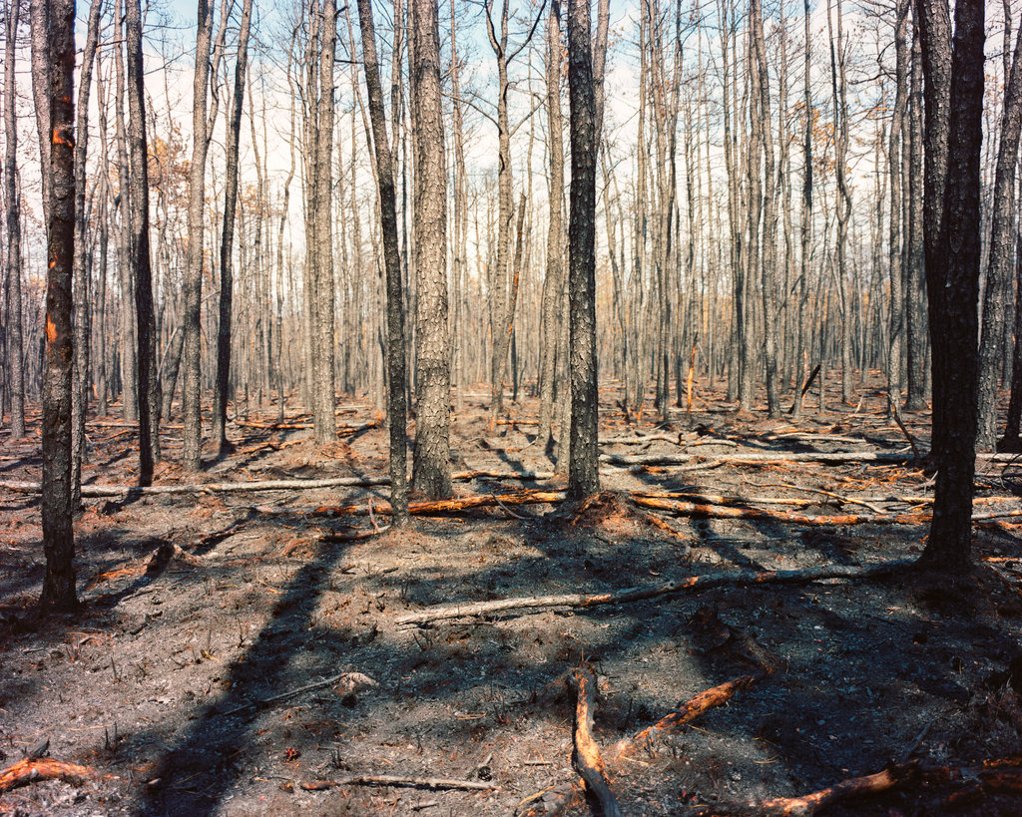
How does Climate Extreme impact terrestrial carbon cycle?
Extreme events can trigger immediate and time-lagged responses of ecosystems

Slide 6
How does Climate Extreme impact ecosystem functions?
Climate Extreme can cause
shifts in plant, microbial and animal species composition
effects on soil physical and chemical characteristics
diminished plant resistance to abiotic stress
changes in the amount, quality and timing of litter

Slide 7
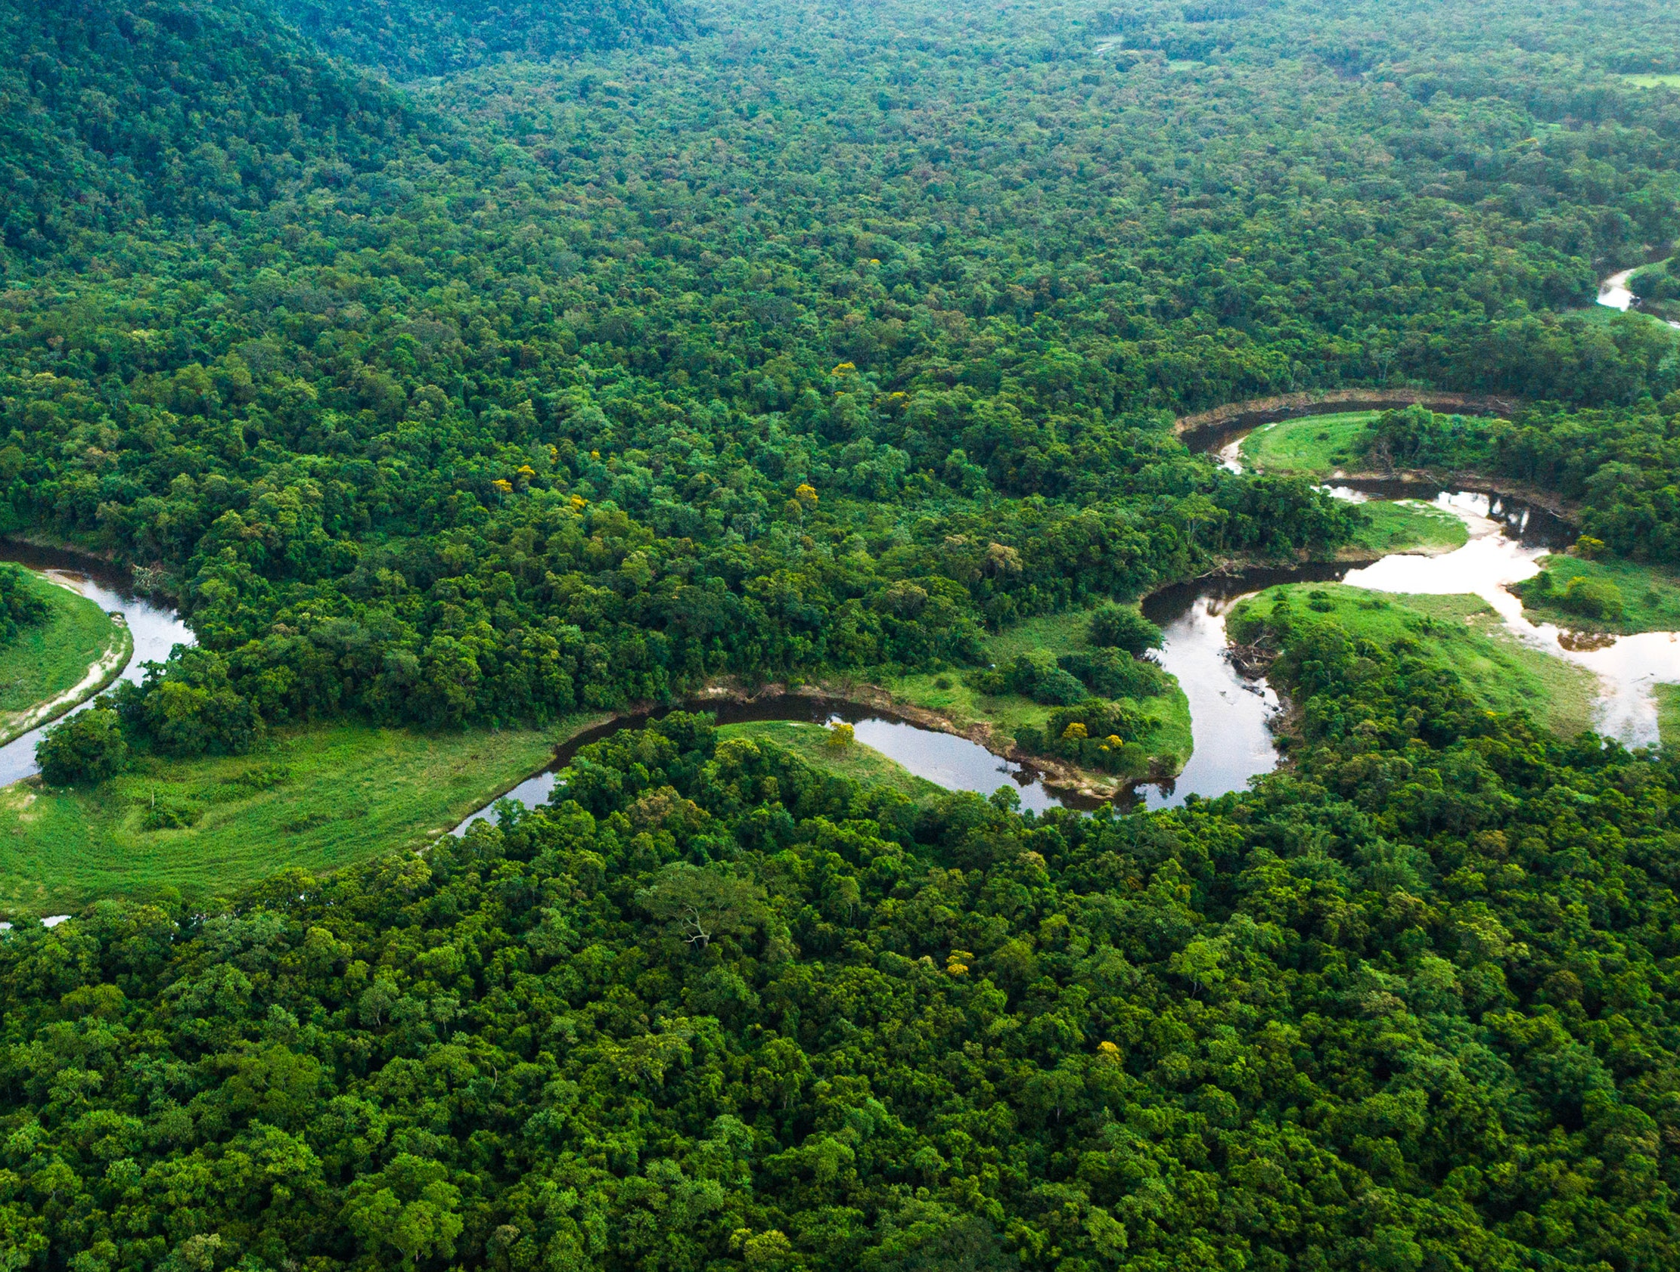
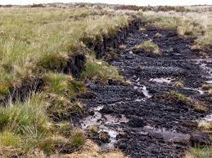
Forest and peatland
Large carbon stock
Peatland: high water table restrict decomposition
Storm
Tree mortality, increases risk of pest and fire
Drought and heat
Tree mortality, increases risk of pest and fire, Shifts in vegetation composition
Fire
Tree mortality, fast impact on large carbon stocks in forests
Ice storm and frost
Physical damage can include destruction of whole forest

Slide 8
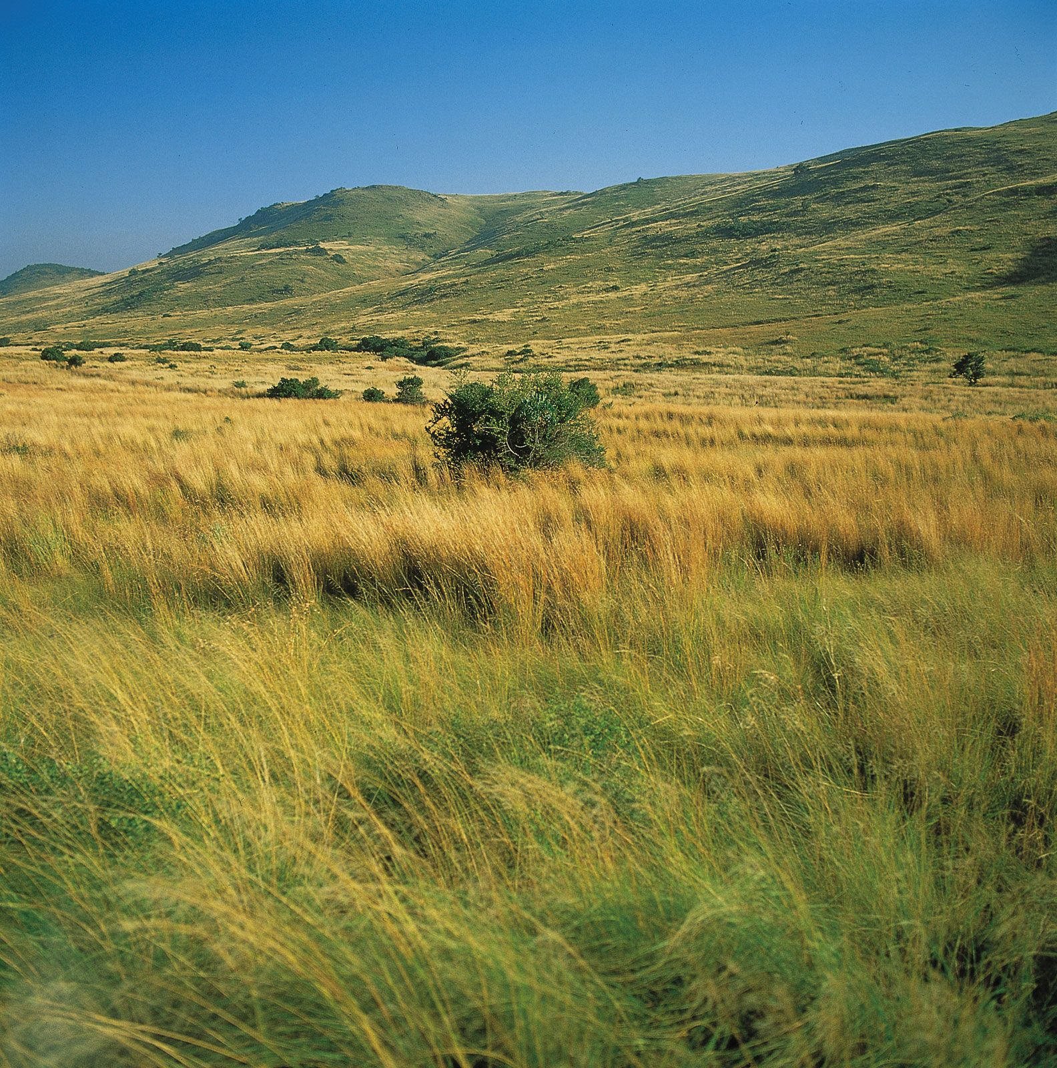
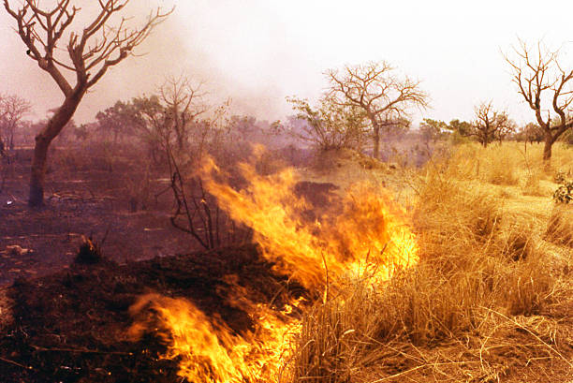
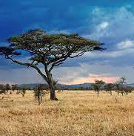
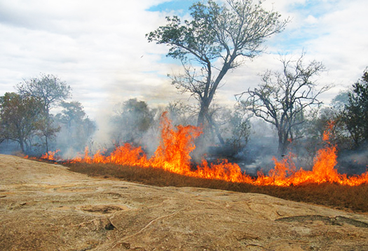
Grassland and savanna
Drought
Other climate extremes play smaller parts
Fire suppresses trees
Species composition shifts
Other stresses
(if strong enough)
Degradation and desertification
Soil erosion

Slide 9
Cropland
Cropland systems are entirely managed.
Soil–vegetation system is reset regularly through harvest and agricultural management
Type and duration of crop cover are highly variable, and the soil can be bare for an extended period of time
Cropland system is vulnerable to specific stress for a certain period of time
Rice pollen can become sterile if air temperature passes a 37 C threshold during the short pollination phase in spring
Heavy
precipitation
Drought, heat, and extreme cold
Storms

Slide 10
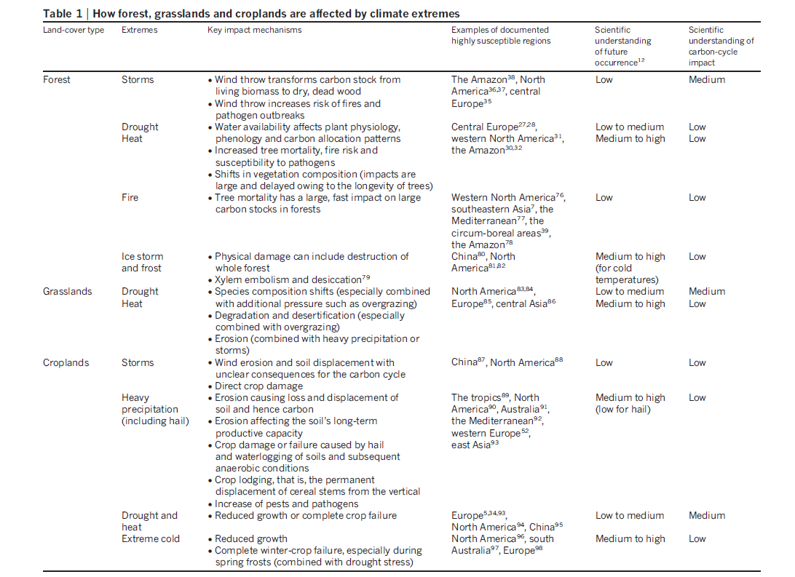

Slide 11
Climate extremes affected GPP
fAPAR: fraction of absorbed photosynthesis active radiation
Use fAPAR anomalies as the indicator. If fAPAR is lower than normal values, then
a climate extreme is detected. Try to assign this to a certain climate extreme.
fAPAR
fAPAR less than 10 percentile
fAPAR from MODIS
Reduced GPP
Machine learning
GPP from eddy covariance towers

Slide 12
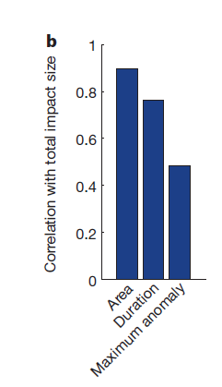
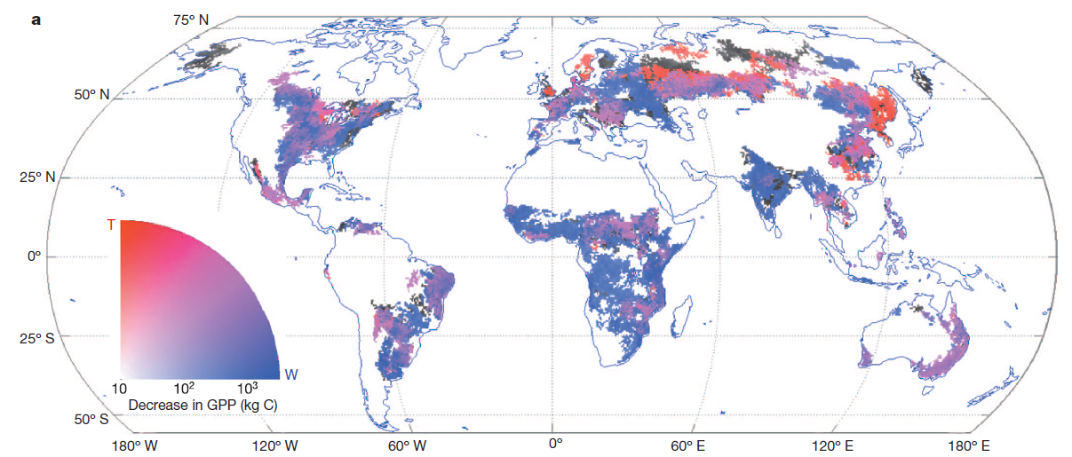
Climate extremes affected GPP

Slide 13
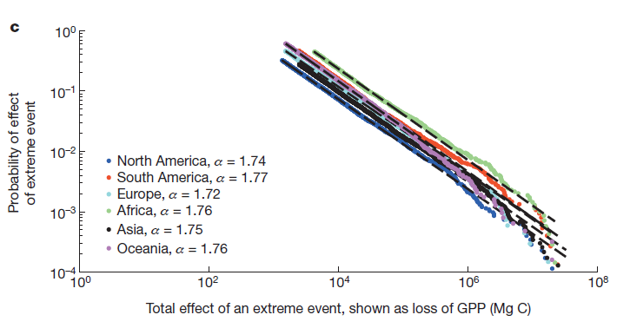







Climate extremes affected GPP
$$P\left(x\right)=b∗x^{−α}$$
$${P\left(x\right)=10}^{P′\left(x′\right)}$$
$$x:effect as quantified in GPP$$
$${x=10}^{x′}$$
$${10}^{P′\left(x′\right)}={10}^{−x′∗α+b′}$$
$${b=10}^{b′}$$
$$a:scaling factor$$
Africa and South America are
most likely to be hit by an extreme GPP impact of a given magnitude

Slide 14
Future directions
Although climate extremes caused large amounts of carbon emissions, there is no evidence that climate extremes will greatly affect land sinks in foreseeable future.
We need a better understanding of lagged response
We need more data and better models for specific ecosystems, especially tropical forests
Complex earth system models at higher resolution is important
Future event-based manipulation experiments

Slide 15
Thanks!
Questions?

