Slide 1
EE529 Fall 2022
Chapter 02: Vegetation-Carbon-Models
Part-04
Prof. Ranga B. Myneni
(ranga.myneni@gmail.com)

Slide 2
Outline
Heterotrophic Respiration
Simple Model for HR
Global Warming and HR
Trends in HR
References

Slide 3
1. Heterotrophic Respiration
Respiration from decomposing litter (on the soil and possibly upper layers of the soil) and soil carbon pools (inside the soil) is called Heterotrophic Respiration
Represents a major carbon efflux from the ecosystems to the atmosphere
About 50 Gt C/yr
Note: Net Ecosystem Productivity = Net Primary Productivity – Heterotrophic Respiration
Heterotrophic Respiration depends on:
Soil Temperature
Soil Moisture
Litter Quality

Slide 4
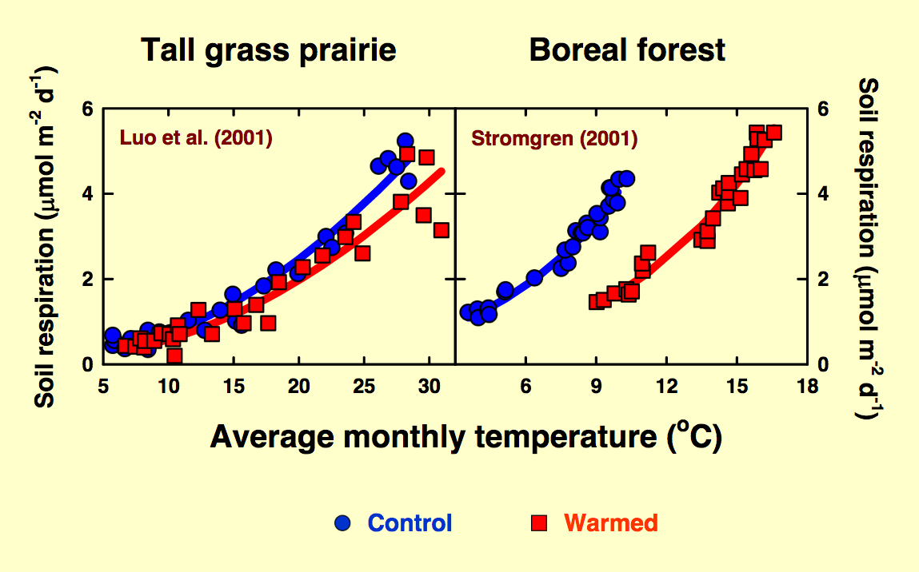
1. Temperature Dependence
Temperature dependence:
An increase in soil temperature leads to an increase in microbial respiration rates due to increased activity of soil micro-organisms
Optimal temperatures for microbial activity are between 25 and 35 degrees C
Credit: Kirschbaum, ANU, Australia

Slide 5
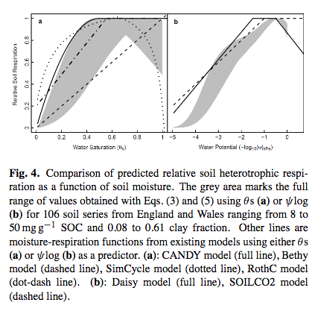
1. Moisture Dependence
Soil moisture dependence:
Low soil moisture values constrains microbial activity and resulting respiration rates
When soils are saturated, then the lack of Oxygen to microbes restricts their activity and respiration rates
Litter quality is usually expressed in terms of C:N or Lignin:N ratios but these effects are not included in the simple model described in this lecture
Credit: Moyano et al., Biogeosciences, 9, 1173–1182, 2012

Slide 6
2. Simple Model for HR
Model for heterotrophic respiration (part of the Canadian Terrestrial Ecosystem Model)
Daily time step
Coarse spatial resolution
Developed by Arora in 2003
Heterotrophic respiration, R_{h}, is sum of respiration from the:
litter pool = R_{hD}
soil carbon pool = R_{hH}
R_{h} = R_{hD} + R_{hH}
These two rates are estimated in a similar way
Let us focus on the litter pool respiration model first

Slide 7
2. Simple Model for HR
Litter pool = litter from the mortality of leaf, stem, and root components
Modeled as:
C_{D} amount of carbon in the litter pool (kg C/m²)
β_{D} is the specified vegetation-dependent respiration rate (kg C/kg C/day) for the litter pool (kilograms of Carbon respired per kilogram of Carbon in the litter pool per day)
Function f₁₅(Q₁₀) is a temperature dependent function given by:
where T in degrees C is the litter temperature
Litter temperature is modeled as the weighted average of soil temperature of the top layer and root temperature
The Q₁₀ value used in the above equation is estimated as a function of temperature using the following expression:
where T in degrees C is the litter temperature
Note: Respiration rate is estimated using specified respiration rates at 25C
That leaves the moisture function, to be explained later

Slide 8
2. Simple Model for HR
Modeled as:
C_{H} amount of carbon in the soil carbon (humus) pool (kg C/m²)
β_{H} is the specified vegetation-dependent respiration rate (kg C/kg C/day) for the soil C pool (kilograms of Carbon respired per kilogram of Carbon in the soil carbon pool per day)
Function f₁₅(Q₁₀) is a temperature dependent function given by:
where T in degrees C is the soil carbon temperature
Assumed same as root temperature
The Q₁₀ value used in the above equation is estimated as a function of temperature using the following expression:
where T in degrees C is the root temperature
Note: Respiration rate is estimated using specified respiration rates at 25C
That leaves the moisture function, to be explained next

Slide 9
2. Simple Model for HR
Modeled as:
ψ is the soil matrix potential (use absolute value, see next slide)
Evaluated as:
where ψ_{sat} and θ_{sat} (saturated soil moisture content) and c are parameters related to soil type
For ψ between 0.04 and 0.06 MP: optimal soil moisture conditions
For ψ between 0.06 and 100 MP: f_{H}(ψ) decreases linearly with the logarithm of ψ
For ψ greater than 100 MP: no microbial respiration (too dry)
For ψ between 0.04 and Saturation: f_{H}(ψ) decreases linearly with the logarithm of ψ
At saturation: Half the optimal respiration rate
For [f_{H}(ψ)]: Use root zone soil moisture
For [f_{D}(ψ)]: Use only top soil layer moisture content

Slide 10
2. Simple Model for HR
When water is in contact with solid particles (e.g., particles within soil), adhesive intermolecular forces between the water and the solid can be large and important
The magnitude of matrix potential depends on the distances between solid particles and the chemical composition of the solid matrix
The matrix potential is always negative because the water attracted by the soil matrix has an energy state lower than that of pure water.
Matrix potential only occurs in unsaturated soil above the water table.
If the matrix potential approaches a value of zero, nearly all soil pores are completely filled with water, i.e., the soil is saturated with water
Strong (very negative) matrix potentials bind water to soil particles within very dry soils
More: https://en.wikipedia.org/wiki/Water_potential

Slide 11
3. Global Warming and HR
Data:
“The sensitivity of soil carbon efflux to warming is a major uncertainty in projections of carbon dioxide concentration and climate. Experimental studies overwhelmingly indicate increased soil organic carbon (SOC) decomposition at higher temperatures, resulting in increased carbon dioxide emissions from soils.”
“In soil warming experiments, the initially increased carbon dioxide efflux returns to pre-warming rates within one to three years and apparent carbon pool turnover times are insensitive to temperature.”

Slide 12
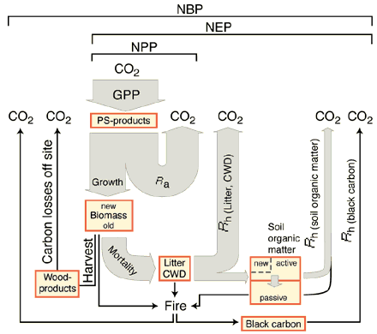
3. Global Warming and HR
Knorr et al., 2005:
“We show that the results of all the soil-warming experiments are compatible with long-term temperature sensitivity of SOC turnover: they can be explained by rapid depletion of labile SOC combined with the negligible response of non-labile SOC on experimental timescales.”
“Furthermore, we present evidence that non-labile SOC is more sensitive to temperature than labile SOC, implying that the long-term positive feedback of soil decomposition in a warming world may be even stronger than predicted by global models

Slide 13
3. Global Warming and HR
Carey et al., 2016:
“Based on a global synthesis of 27 experimental warming studies spanning nine biomes, we find that although warming increases soil respiration rates, there is limited evidence for a shifting respiration response with experimental warming.”
“Together, our data indicate that future respiration rates are likely to follow the current temperature response function, but higher latitudes will be more responsive to warmer temperatures.”

Slide 14
4. Trends in HR
Huang et al., 2020:
Developed an annual global Rs dataset at 1 km by 1 km spatial resolution for the time period from 2000 to 2014.
The product was generated by combining globally distributed in situ Rs measurements, satellite remote sensing data, and biome-specific statistical models, including parametric models and nonparametric machine learning models.

Slide 15
4. Trends in HR
Huang et al., 2020:
We show that land-cover change played a more important role than climate change in regulating Rs changes in temperate and boreal regions during 2000–2014
Climate Change
Land-cover Change

Slide 16
4. References
Recommended Readings:
1. Arora, 2003. Simulating energy and carbon fluxes over winter wheat using coupled land surface and terrestrial ecosystem models. Agric. For. Meteorol., 118: 21–47.
2. Knorr et al., 2005. Long-term sensitivity of soil carbon turnover to warming. Nature, 433: 298-301.
3. Carey et al., 2016. Temperature response of soil respiration largely unaltered with experimental warming. PNAS, 113: 13797-13802.
4. Huang et al., 2020. Spatial and temporal variations in global soil respiration and their relationships with climate and land cover. Sci. Adv., 6, eabb8508

