Slide 1
EE529 Fall 2022
Chapter 02: Vegetation-Carbon-Models
Part-03
Prof. Ranga B. Myneni
(ranga.myneni@gmail.com)

Slide 2
Outline
Canopy Light Model
Single Leaf Photosynthesis Model
Canopy Photosynthesis Model
References

Slide 3
Prelude
Calculate GPP_{dir} and GPP_{dif} separately and then sum them to get total photosynthetic rate
The remaining questions are:
1) what is Q_{dir} and Q_{dif}
2) what is model A

Slide 4
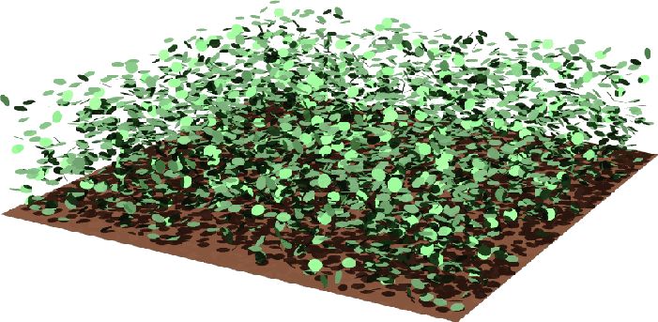
1. Canopy Light Model
Q_{dir}(L,Ω_{L}) : direct PAR absorbed by a leaf elements at “depth” L of orientation Ω_{L}
Note that “L” is cumulative leaf area index
(γPAR) is direct flux (μ mol E/m²/s) on a horizontal plane above the canopy (L=0)
(γPAR)
Canopy top L = 0
Depth L
Credit: RAMI

Slide 5
1. Canopy Light Model
[(γPAR)/(|cosine θ_{o}|)] is direct flux perpendicular to the solar beams above the canopy
Here, θ_{o} is the polar angle of the solar beam (orientation: Ω_{o})
The corresponding solar azimuthal angle is φ_{o}
(γPAR)/(cosine θ_{o})
(γPAR)
Canopy top L = 0
Depth L
Credit: RAMI

Slide 6
1. Canopy Light Model
The amount of direct PAR flux at depth L is:
[(γPAR)/(|cosine θ_{o}|)] [exp(-KL)]
Where “K” is the extinction coefficient (0.5/|cosine θ_{o}|)
Because we assumed leaf normal orientation to be uniform
This is the famous “Beers Law”
[(γPAR)/(cosine θ_{o})] exp(-KL)
Canopy top L = 0
Depth L
Credit: RAMI

Slide 7
1. Canopy Light Model
Note that our leaf has an orientation Ω_{L}
Direct PAR flux incident on the leaf along its normal is:
[(γPAR)/(|cosine θ_{o}|)] exp(-KL) |Ω_{o} Ω_{L}|
Where |Ω_{o} Ω_{L}| is the absolute value of the cosine of the angle between the two vectors
This is given by |cos θ_{o} cos θ_{L} + sin θ_{o} sin θ_{L} cos (φ_{o}-φ_{L})|
Ω_{L}
Ω_{o}
Leaf
Layer at depth L
Plane perpendicular to the solar beam

Slide 8
1. Canopy Light Model
Direct PAR flux incident on the leaf along its normal is:
[(γPAR)/(|cosine θ_{o}|)] exp(-KL) |Ω_{o} Ω_{L}|
The absorbed fraction is:
Q_{dir}(L,Ω_{L}) = (1-ω) [(γPAR)/(|cosine θ_{o}|)] exp (-KL) |Ω_{o} Ω_{L}|
Where ω is the leaf albedo (=0.1)
O_{L}
O_{o}
Leaf
Layer at depth L
Plane perpendicular to the solar beam

Slide 9
1. Canopy Light Model
Let us look at this:
Q_{dir}(L,Ω_{L}) = (1-ω) [(γPAR)/(|cosine θ_{o}|)] exp (-KL) |Ω_{o} Ω_{L}|
This can be simplified to:
Q_{dir}(L,θ_{L,}φ_{L}) = 0.9 [(0.7PAR)/(cos θ_{o})] exp (-0.5L/cos θ_{o}) |cos θ_{o} cos θ_{L} + sin θ_{o} sin θ_{L} cos (φ_{o}-φ_{L})|
L, θ_{L,} φ_{L}, θ_{o,} φ_{o} : known
PAR: Measured

Slide 10
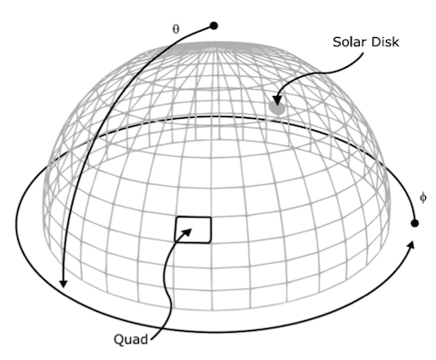
1. Canopy Light Model
Now, we want to calculate:
Q_{dif}(L,Ω_{L}) : diffuse PAR absorbed by a leaf at “depth” L of orientation Ω_{L}
Diffuse sky light is incident on the canopy from all downward directions in the hemisphere
(1-γ) PAR is the diffuse PAR Flux incident at the top of the canopy (μ mol E/m²/s)
Assume the sky to be uniformly bright
Then, the diffuse intensity is independent of incident direction (I = F/π, Intensity=Flux/π)
Let I_{d} denote the diffuse sky intensity [I_{d} = (1-γ) PAR /π]
Credit: Radiometry Solvers

Slide 11
1. Canopy Light Model
Divide the sky-hemisphere into equal number M discrete solid angles
The diffuse intensity is equal in each of these solid angles is: I_{d}ΔΩ_{d} = [(1-γ) PAR /π] ΔΩ_{d}
The diffuse intensity at depth L in the canopy is: I_{d}ΔΩ_{d} exp(-K_{d}L) [Note : K_{d} = (0.5/|cosine θ_{d}|)]
The diffuse intensity incident along the normal to a leaf is: I_{d}ΔΩ_{d} exp(-K_{d}L) |Ω_{d} Ω_{L}|
The absorbed portion of the above is: (1-ω) I_{d} ΔΩ_{d}exp(-K_{d}L) |Ω_{d} Ω_{L}|
Finally, sum this over all M discrete solid angles to obtain Q_{dif}(L,Ω_{L})
Q_{dif}(L,Ω_{L}) = Σ^{M}_{m=1} (1-ω) I_{d} exp(-K_{d}L) |Ω_{d} Ω_{L}| ΔΩ_{d}
The corresponding continuous expression is:
Credit: Radiometry Solvers

Slide 12
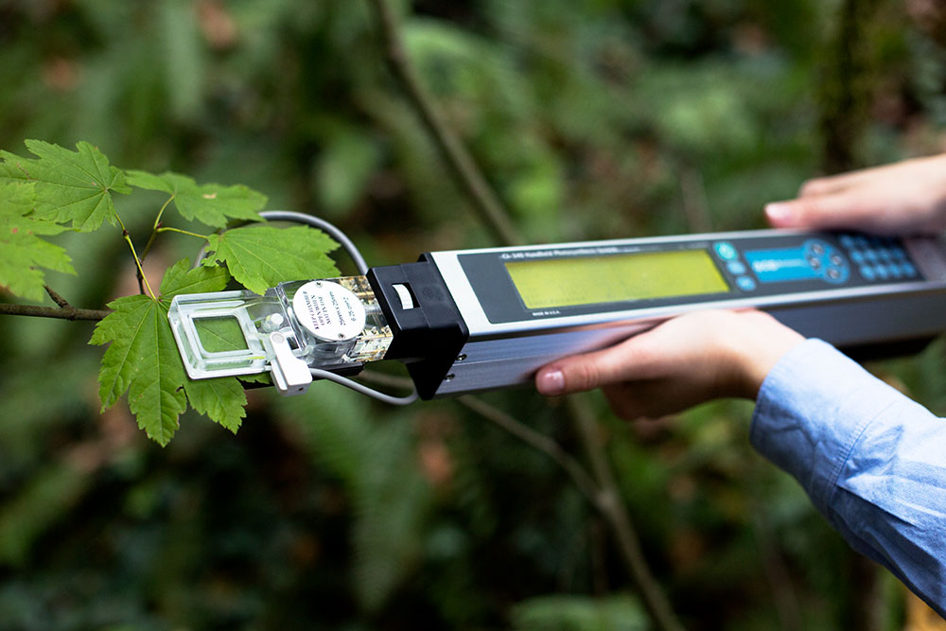
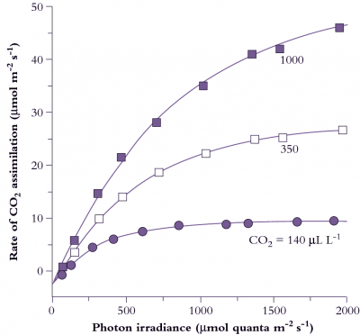
2. Single Leaf Photosynthesis Model
The remaining questions are:
1) what is Q_{dir} and Q_{dif}
2) what is model A
The simplest model is: Leaf Light-Photosynthesis Response Function
Commercial instruments available to measure leaf photosynthetic rates and corresponding light levels
Exhaustive measurements show a non-linear response
Credit: CID Bio-Science Inc.
Credit: Evans and von Caemmerer, Australian National University

Slide 13
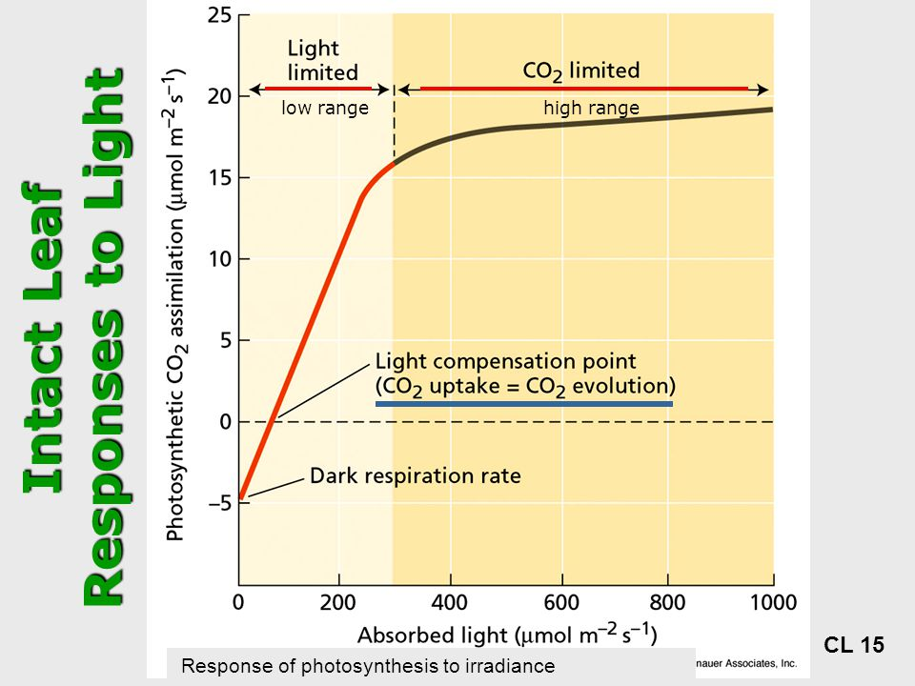
2. Single Leaf Photosynthesis Model
Light-limited rate (initial slope)
CO2 limited rate (maximal rate of photosynthesis)
Transitioning between these two rates (curvature of the response)
Compensation Point
Dark respiration
Credit: Merry Chambers

Slide 14
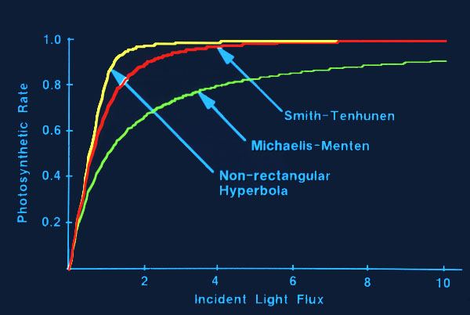
2. Single Leaf Photosynthesis Model
Many functions approximate the leaf light-photosynthesis response
We shall use the non-rectangular hyperbola
Which has 3 parameters (measurable, meaningful)
Credit: Prof. T. J. Herbert, Univ. of Miami
Credit: Merry Chambers

Slide 15
2. Single Leaf Photosynthesis Model
Non-rectangular Hyperbola:
Alpha: initial yield (assume 0.05 mol CO₂/mol PAR)
Beta: curvature parameter (between 0 and 1)
A_{max}: Maximal rate of photosynthesis
Q is leaf absorbed photon flux density (μ mol E/m²/s)
A is the leaf photosynthetic rate (μ mol CO₂/m²/s)
The inverse of α is quantum requirement
Approximately 19 absorbed quanta per CO₂ fixed for C₄ leaves, and varies between 15 and 22 for C3 leaves, depending on temperature
The response function parameters depend on the leaf’s physiological and developmental stage
Estimate from data

Slide 16
2. Single Leaf Photosynthesis Model
Collatz et al. (1991 and 1992) developed models for C3 and C4 leaf photosynthesis
Given light flux density per unit leaf area incident on a leaf, the models calculate the corresponding leaf photosynthetic rate, per unit leaf area, as the minimum of three potential capacities –
J_{E} which describes the light-photosynthesis response
J_{C} which is the Rubisco-limited rate
J_{S} which is the capacity for the export or utilization of the products of photosynthesis

Slide 17
3. Canopy Photosynthesis Model
Q_{dir}(L,Ω_{L}) = (1-ω) [(γPAR)/(|cosine θ_{o}|)] exp (-KL) |Ω_{o} Ω_{L}|

Slide 18
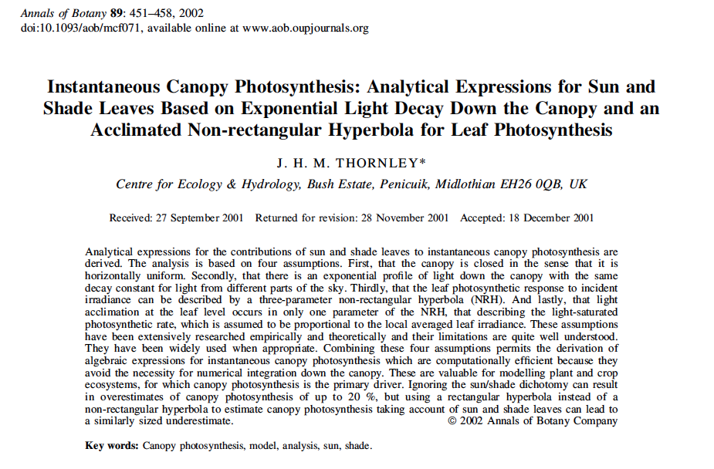
3. Canopy Photosynthesis Model
Possible to do more algebra with exponential-decay light model and non-rectangular hyperbola model of leaf light-response function
Thornley (2002) does this

Slide 19
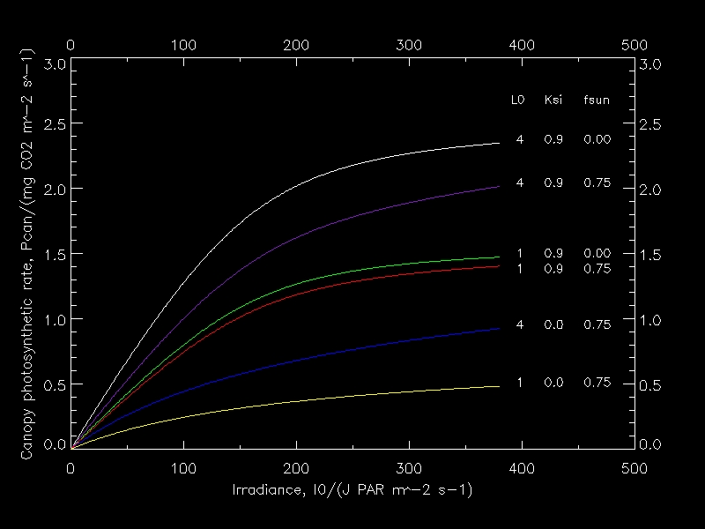
3. Thornley’s Correct Result
Equations have errors. Fixed by Chi Chen

Slide 20
4. References
Recommended Readings:
1. Thornley, 2002. Instantaneous canopy photosynthesis … Annals of Botany, 89: 451-458.
2. Collatz et al., 1991. Physiological and environmental regulation of stomatal conductance, photosynthesis and transpiration: a model that includes a laminar boundary layer. Agric. For. Meteorol., 54: 107-136.
3. Collatz et al., 1992. Coupled Photosynthesis-Stomatal Conductance Model for Leaves of C₄ Plants. Australian Journal of Plant Physiology 19(5): 519 - 538 .
4. Gu et al., 2003. Response of a Deciduous Forests to the Mount Pinatubo Eruption: Enhanced Photosynthesis. Science, 299: 2035-2038.
5. Rogers et al., 2017. A roadmap for improving the representation of photosynthesis in Earth system models. New Phytologist, 213: 22–42.

