Slide 1

EE529 Fall 2022
Chapter 02: Vegetation-Carbon-Models
Part-02
Prof. Ranga B. Myneni
(ranga.myneni@gmail.com)

Slide 2
Outline
Background
Canopy Structure
Incident Radiation Field
Canopy Photosynthesis Model
References

Slide 3
1. Background
We know how to model NPP using the Production Efficiency Model (PEM)
PEM does not represent process-level mechanisms
Therefore, PEM works well at coarse (large-scale) spatial and temporal resolutions
Often, we require models that include representation of processes
Such models represent fine scale (spatial and temporal) variations
The goal is to evaluate instantaneous canopy photosynthetic rates
  at a field site
  that resolve diurnal variations

Slide 4
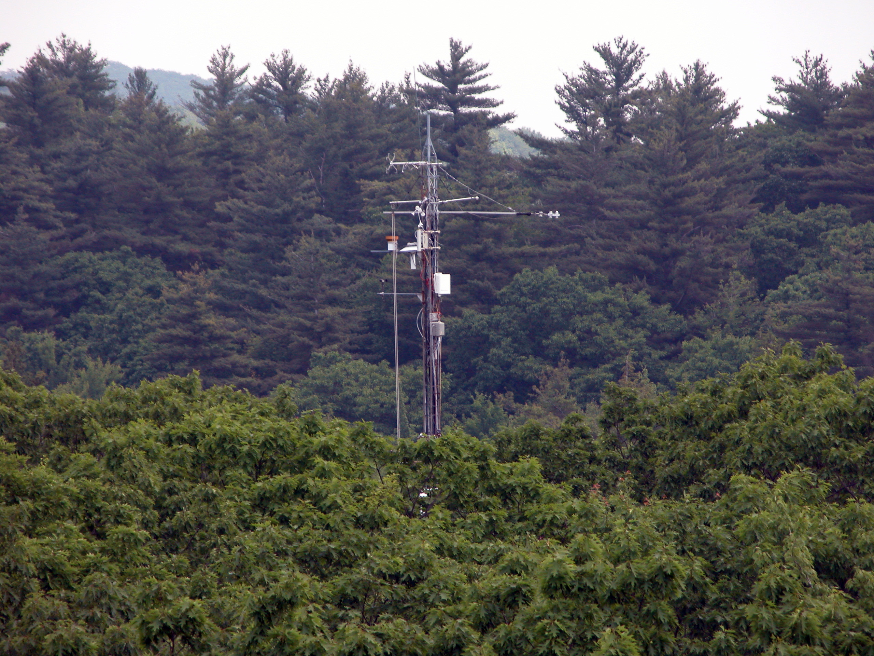
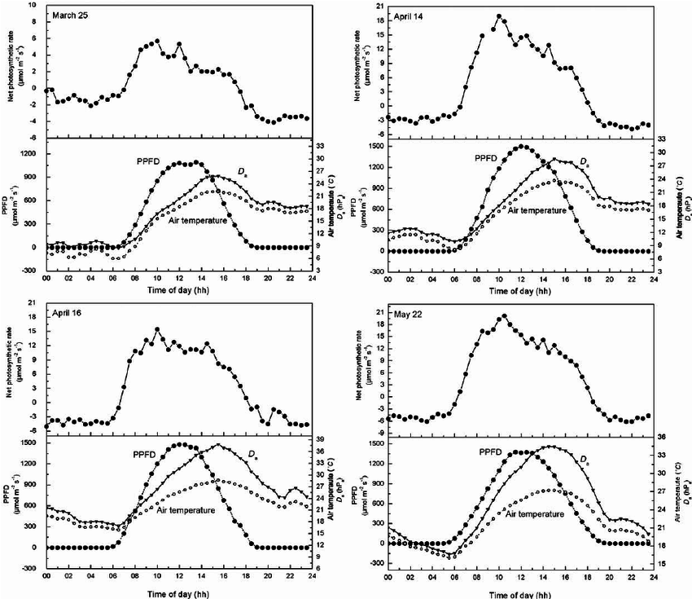
1. Background
Credit: Harvard Forest Flux Tower
Credit: Wang et al., Agric. For. Meteorol., 137: 194-219, 2006.
Light seems to be the dominant variable at this scale
Note the finer scales (spatial and temporal)

Slide 5
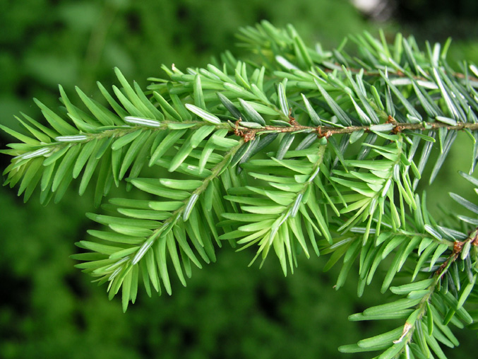
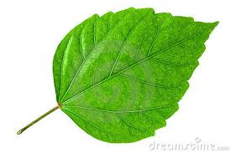
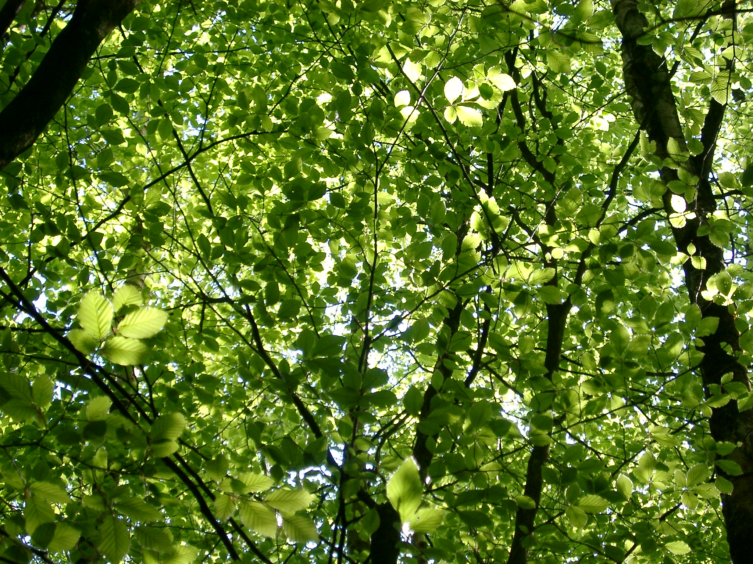
2. Canopy Structure (LAI)
Leaf Area Index of a vegetation canopy = one-sided green leaf area per unit ground area
In needle leaf canopies, one-half the total green needle surface area
Assume a horizontally homogeneous vegetation canopy
Consisting of green planar (broad) leaves
Let “LAI” be the leaf area index of this canopy
Typical LAI values tend to be about 1-2 for grasses, 3-4 for crops and 5-6 in forests
Let “L(z)” denote one-sided green leaf area accumulated from the top of the canopy to some
depth “z” per unit ground area

Slide 6
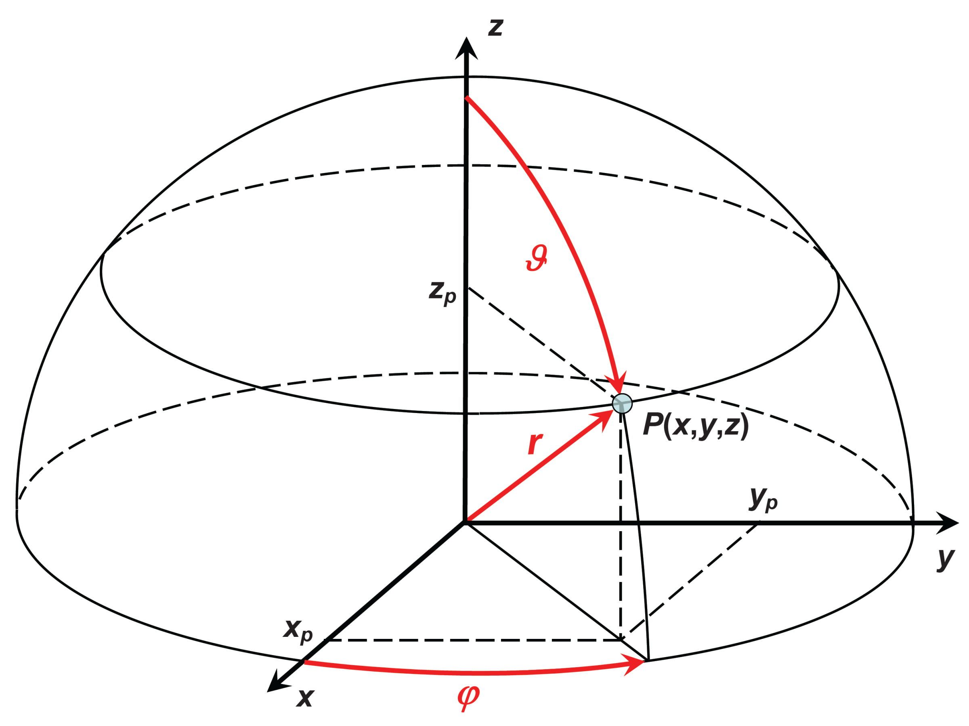
2. Canopy Structure (LAD)
(Unit) Vector
Polar Angle, or
Inclination Angle
(0 to 180 degrees)
Azimuthal Angle
(0 to 360 degrees)
Credit: http://www.seos-project.eu/modules/laser-rs/laser-rs-c03-s01-p01.html

Slide 7
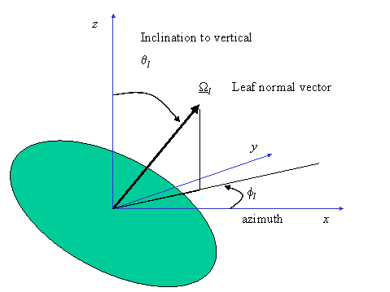
2. Canopy Structure (LAD)
Credit: P. Lewis & P. Saich, RSU, Dept. Geography, University College London, 26 Bedford Way, London WC1H 0AP, UK

Slide 8
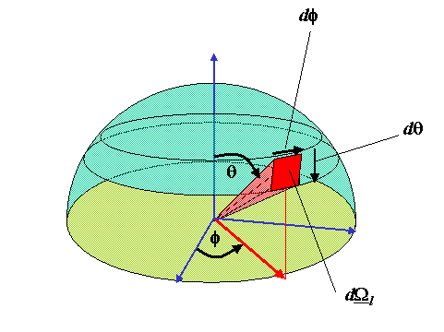
2. Canopy Structure (LAD)
Credit: P. Lewis & P. Saich, RSU, Dept. Geography, University College London, 26 Bedford Way, London WC1H 0AP, UK

Slide 9
2. Canopy Structure (LAD)
Let (1/2π)g_{L}(Ω_{L}) be the probability density function (PDF) of leaf normal orientation
That means, (1/2π)g_{L}(Ω_{L}) dΩ_{L} gives the probability of finding of leaf normals in a unit solid angle dΩ_{L}
If the leaf normals are equally (uniformly) oriented in the upper hemisphere, g_{L}(Ω_{L}) = 1
Let us assume this going forward (for ease of progress)
As with any pdf, the following holds:

Slide 10
2. Canopy Structure (LAD)
Figure. The for (a) planophile (mostly horizontall leaves), (b) erectrophile (mostly vertical leaves), (c) plagiophile (leaves inclined mostly at about 45 degrees), (d) extremophile (mostly horizontal and vertical leaves) and (e) uniform (all inclinations equally probable) distributions.

Slide 11
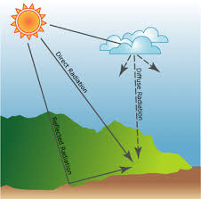
3. Incident Radiation Field
The sun emits Electro-Magnetic Radiation between 0.3 and 4.0 micrometers (μm, or 10⁻⁶ m)
The part of solar radiation between 0.4 and 0.7 μm is called Photosynthetically Active Radiation (PAR)
The human eye can see radiation at PAR wavelengths. Thus PAR is also called “light”
The PAR field incident on a horizontal plane at the top of a vegetation canopy consists
  Direct PAR (from the sun to the horizontal plane, along direction Ω_{o})
  Diffuse PAR (from the sun, scattered in the atmosphere and down to the horizontal plane)
Let γ denote the fraction of direct PAR flux in the total incident PAR flux on a horizontal plane
Therefore,
  γ PAR denotes direct PAR Flux
  (1-γ) PAR denote diffuse PAR Flux
  γ = 0.7 (clear sunny day)
Credit: http://desktop.arcgis.com/en/arcmap/10.3/tools/spatial-analyst-toolbox/modeling-solar-radiation.htm

Slide 12
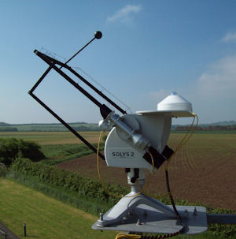
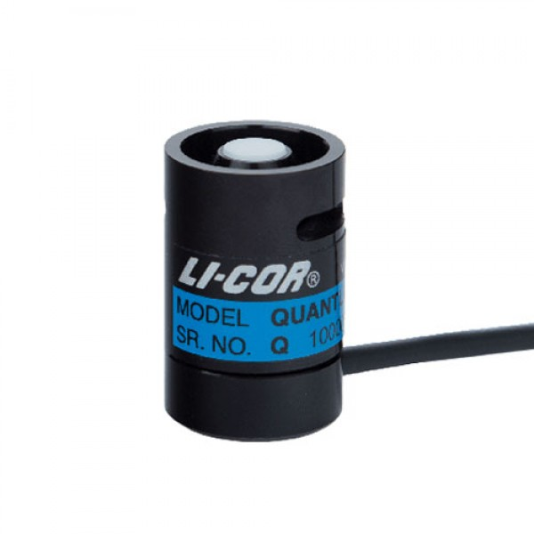
3. Incident Radiation Field
The radiation field incident on a horizontal plane above the vegetation canopy can be measured
Sensors can measure total PAR and diffuse PAR
From which direct PAR can be estimated
Credit: LI-COR Company
Credit: Chilbolton Observatory, UK

Slide 13
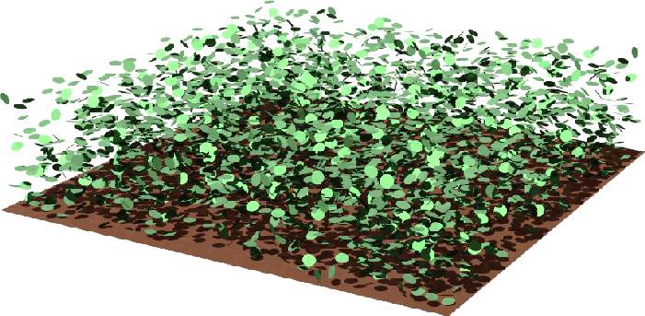
4. Canopy Photosynthesis Model
Below is our view of the vegetation canopy (turbid medium)
Divide the canopy in “N” layers of equal thickness “ΔL”
Consider a thin layer “ΔL” at depth “L”
“L” is cumulative leaf area index (cumulated from the top)
Example: LAI = 5, N = 20, ΔL = 0.25
For layer 8 (counting from the top), L = (NxΔL) – (ΔL/2) = 1.875
Canopy top L = 0
Depth L
Credit: RAMI

Slide 14
4. Canopy Photosynthesis Model
Further, divide the upper hemisphere in which our leaf normals are contained in a discrete number “M” of equal sized solid angles ΔΩ_{L}
We want to calculate photosynthesis of all these leaves in this layer whose normals are distributed “uniformly” in the upper hemisphere
Canopy top L = 0
Depth L
Credit: RAMI

Slide 15
4. Canopy Photosynthesis Model
Consider area of leaf elements in this layer (ΔL) of orientation Ω_{L} within a finite solid angle ΔΩ_{L}
Let [ΔL Q_{dir}(L,Ω_{L})] be direct PAR absorbed by this leaf area (μ mol E/m²/s)
Denote the instantaneous rate of photosynthesis as {ΔL A[Q_{dir}(L,Ω_{L})]}
In units: (μ mol CO₂/m²/s)
Where “A” is a model which given absorbed PAR returns the Photosynthetic rate (details later)
Canopy top L = 0
Depth L
Credit: RAMI

Slide 16
4. Canopy Photosynthesis Model
The probability of finding leaf elements in this layer with their normal in solid angle ΔΩ_{L} is:
[(1/2π)g_{L}(Ω_{L}) ΔΩ_{L} ]
Therefore, the photosynthetic rate of such leaf elements within this layer is:
[(1/2π)g_{L}(Ω_{L}) ΔΩ_{L}] {ΔL A[Q_{dir}(L,Ω_{L})]}
Because our leaves are oriented uniformly, the above simplifies to
(1/2π) ΔΩ_{L} ΔL A[Q_{dir}(L,Ω_{L})]
Similarly, the photosynthetic rate in this layer due to diffuse PAR is
(1/2π) ΔΩ_{L} ΔL A[Q_{dif}(L,Ω_{L})]
Canopy top L = 0
Depth L
Credit: RAMI

Slide 17
4. Canopy Photosynthesis Model
The photosynthetic rate of all leaf elements in layer ΔL of all orientations Ω_{L} in the upper hemisphere is:
GPP_{dir} = Σ^{M}_{m=1} (1/2π) ΔΩ_{L} ΔL A[Q_{dir}(L,Ω_{L})]
Where the summation Σ is over “M” number of discrete solid angles
Similarly, the photosynthetic rate in this layer due to diffuse PAR is
GPP_{dif} = Σ^{M}_{m=1} (1/2π) ΔΩ_{L} ΔL A[Q_{dif}(L,Ω_{L})]
Canopy top L = 0
Depth L
Credit: RAMI

Slide 18
4. Canopy Photosynthesis Model
The photosynthetic rate of the canopy is obtained by summing over N layers
GPP_{dir} = Σ^{N}_{n=1} Σ^{M}_{m=1} (1/2π) ΔΩ_{L} ΔL A[Q_{dir}(L,Ω_{L})]
Similarly, the photosynthetic rate in this layer due to diffuse PAR is
GPP_{dif} = Σ^{N}_{n=1} Σ^{M}_{m=1} (1/2π) ΔΩ_{L} ΔL A[Q_{dif}(L,Ω_{L})]
In continuous notation, the above is:
Canopy top L = 0
Depth L
Credit: RAMI

Slide 19
4. Canopy Photosynthesis Model
Calculate GPP_{dir} and GPP_{dif} separately and then sum them to get total photosynthetic rate
The remaining questions are:
  1) what is Q_{dir} and Q_{dif}
  2) what is the model A

Slide 20
5. References
Recommended Readings:
Thornley, 2002. Instantaneous canopy photosynthesis … Annals of Botany, 89: 451-458.

