Slide 1

EE529 Fall 2022
Chapter 01: Carbon Cycle
Part-01
Prof. Ranga B. Myneni
(ranga.myneni@gmail.com)

Slide 2
Outline
  1. Carbon Pools
  2. Simple View of Global Carbon Cycle
  3. Atmospheric Carbon Dioxide
  4. References

Slide 3
1. Carbon Pools
Carbon on our planet is stored in these major pools:
  Biosphere: organic molecules in living and dead organisms
  Atmosphere: the gas carbon dioxide
  Soils: organic matter
  Lithosphere: fossil fuels and sedimentary rock deposits such as limestone
  Oceans: dissolved atmospheric carbon dioxide and as calcium carbonate shells in marine organisms
Recommended Reading:
What is carbon? (https://en.wikipedia.org/wiki/Carbon)

Slide 4
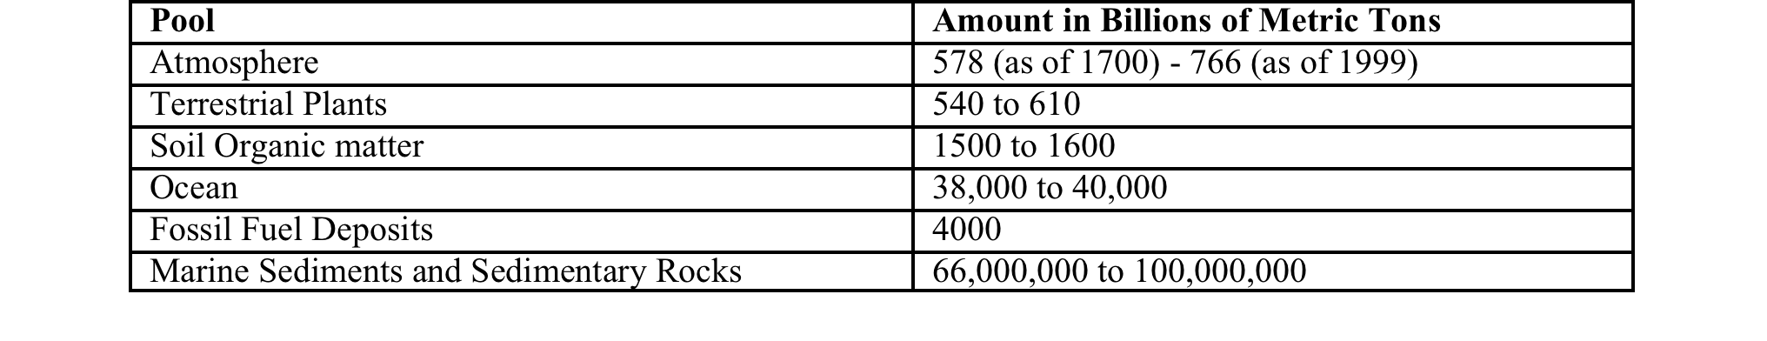
1. Carbon Pools
Table 1. Estimated major carbon pools on the Earth
Kilogram = 1,000 grams
Ton = 1,000 kg
Million (Mega) = 1,000,000
Billion (Giga) = 1,000 Million
1 Giga Ton Carbon = 10^15 g C (Peta gram)

Slide 5
2. Simple View of Global Carbon Cycle
Carbon is exchanged (fluxes) between the active pools due to various processes:
  photosynthesis and respiration between the land and the atmosphere
  diffusion between the ocean and the atmosphere
Figure 1. The global carbon cycle. Credit: http://en.wikipedia.org/wiki/Carbon_cycle

Slide 6
2. Simple View of Global Carbon Cycle
Carbon is exchanged (fluxes) between the active pools due to various processes:
Pools can be sinks (grow) or sources (decline)

Slide 7
2. Simple View of Global Carbon Cycle
Carbon is exchanged (fluxes) between the active pools due to various processes:
  photosynthesis and respiration between the land and the atmosphere
What is photosynthesis? (https://en.wikipedia.org/wiki/Photosynthesis)
What is respiration? (https://en.wikipedia.org/wiki/Respiration_(physiology))

Slide 8
2. Simple View of Global Carbon Cycle
Carbon is exchanged (fluxes) between the active pools due to various processes:
  diffusion between the ocean and the atmosphere

Slide 9
2. Simple View of Global Carbon Cycle
Carbon is exchanged (fluxes) between the active pools due to various processes:
Solubility pump
Biological pump
How does CO2 enter the ocean? (http://www.waterencyclopedia.com/Bi-Ca/Carbon-Dioxide-in-the-Ocean-and-Atmosphere.html)

Slide 10
2. Simple View of Global Carbon Cycle
Disturbing the carbon cycle through emissions (fossil fuel burning, land clearing, etc.)

Slide 11
2. Simple View of Global Carbon Cycle
Only 50% of the emissions appear in the atmosphere, which means
  The land and oceans are acting as carbon sinks
Figure 1. The global carbon cycle. Credit: http://en.wikipedia.org/wiki/Carbon_cycle

Slide 12
3. Atmospheric Carbon Dioxide
The Mauna Loa, Hawaii, CO2 record (started by Prof. Charles David Keeling)
(Credit: NOAA-ESRL)
What is ppmv? (https://en.wikipedia.org/wiki/Parts-per_notation)

Slide 13
3. Atmospheric Carbon Dioxide
In 1958, the concentration of CO₂ was about 315 ppmv.
In Aug 2020 the concentration was about 420 ppmv.
The growth rate has generally been increasing:
  0.8 ppmv/yr in the 1960s
  1.5 ppmv/yr during the 1990s
  2.5 ppmv/yr during the 2010s.
Data from Mauna Loa are close to, but are not precisely the global mean value.
Figure 3. Growth rate of atmospheric CO₂ concentration at Mauna Loa Observatory (Credit: NOAA-ESRL).

Slide 14
3. Atmospheric Carbon Dioxide
The annual cycle in the Mauna Loa record is due to the seasonality of vegetation.
In early spring, the concentration of CO₂ is at its maximum, and as the plants green-up, the concentration drops, reaching a minimum value towards the end of the summer, and when leaves fall, it starts to build up again.
The amplitude is most pronounced in northern high latitudes (15 ppmv)
Figure 4. The graph shows recent monthly mean carbon dioxide measured at Mauna Loa Observatory, Hawaii. (Credit: NOAA-ESRL).

Slide 15
3. Atmospheric Carbon Dioxide
The atmospheric CO₂ record prior to 1957 comes mainly from air bubbles in ice cores.
Over the last 900 years, CO₂ concentration has been +/- 10 ppmv around 280 ppmv
Figure 5. Law Dome Ice Core CO2 concentration (Credit: Etheridge et al., GRL, 1996).

Slide 16
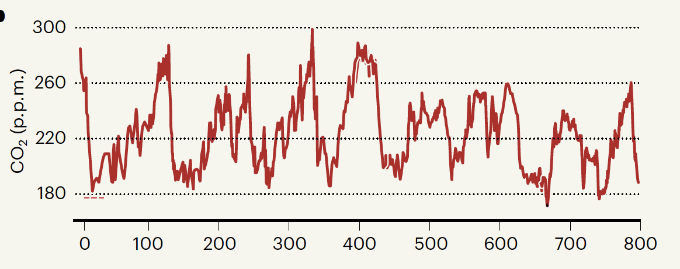
3. Atmospheric Carbon Dioxide
In fact, the CO2 concentration has never been greater 300 ppmv over the past 800,000 years!
Figure 6. Vostok, Antarctica ice core atmospheric CO₂ record (Credit: Petit & Raynaud, Nature, 2020).

Slide 17
4. References
Recommended Readings:
The history of the Keeling Curve
https://scripps.ucsd.edu/programs/keelingcurve/2013/04/03/the-history-of-the-keeling-curve/
2) Forty years of ice-core records of CO₂
https://www.nature.com/articles/d41586-020-00809-8

