Slide 1
EE529 Fall 2020
Chapter 03: Advanced Topics
Supplement on Emergent Constrains
Prof. Ranga B. Myneni
(ranga.myneni@gmail.com)

Slide 2
Schematic of Emergent Constraints in Terrestrial Carbon Cycle Research
Based on:
Wenzel et al., 2016. Projected land photosynthesis constrained by changes in the seasonal cycle of atmospheric CO2. Nature. doi:10.1038/nature19772
Predictand
A difficult to observe but important variable
Change in Arctic Vegetation Gross Primary Production (GPP) as atmospheric CO₂ concentration increases
Let GPP₂₈₀ be GPP at pre-industrial atmospheric CO₂ concentration of 280 ppm
Let GPP₅₆₀ be GPP at double the pre-industrial atmospheric CO₂ concentration
Let ΔGPP be the difference between the two, i.e.
ΔGPP = GPP₅₆₀ – GPP₂₈₀

Slide 3
Schematic of Emergent Constraints in Terrestrial Carbon Cycle Research
Earth System Model (ESM) Simulations
Assume you have access to 10 different ESMs
Run each of the 10 ESMs as follows:
Pre-industrial (say, year 1860) to current year (say 2020) with historical CO₂ forcings
From year 2021 to some year out in the future with business-as-usual CO₂ forcing
Stop when atmospheric CO₂ concentration is 560 ppm (“some year out in the future”)

Slide 4
Schematic of Emergent Constraints in Terrestrial Carbon Cycle Research
Predictands from the Earth System Model (ESM) Simulations
Calculate ΔGPP_{i} from each of the ESM simulations (i = 1, 2, … , 10)
They will span a range because of disagreement between the models
Typically, the multi-model mean is used
Not satisfactory
7
6
5
ΔGPP_{i}
ΔGPP
(arbitrary units)
4
3
2
1
0

Slide 5
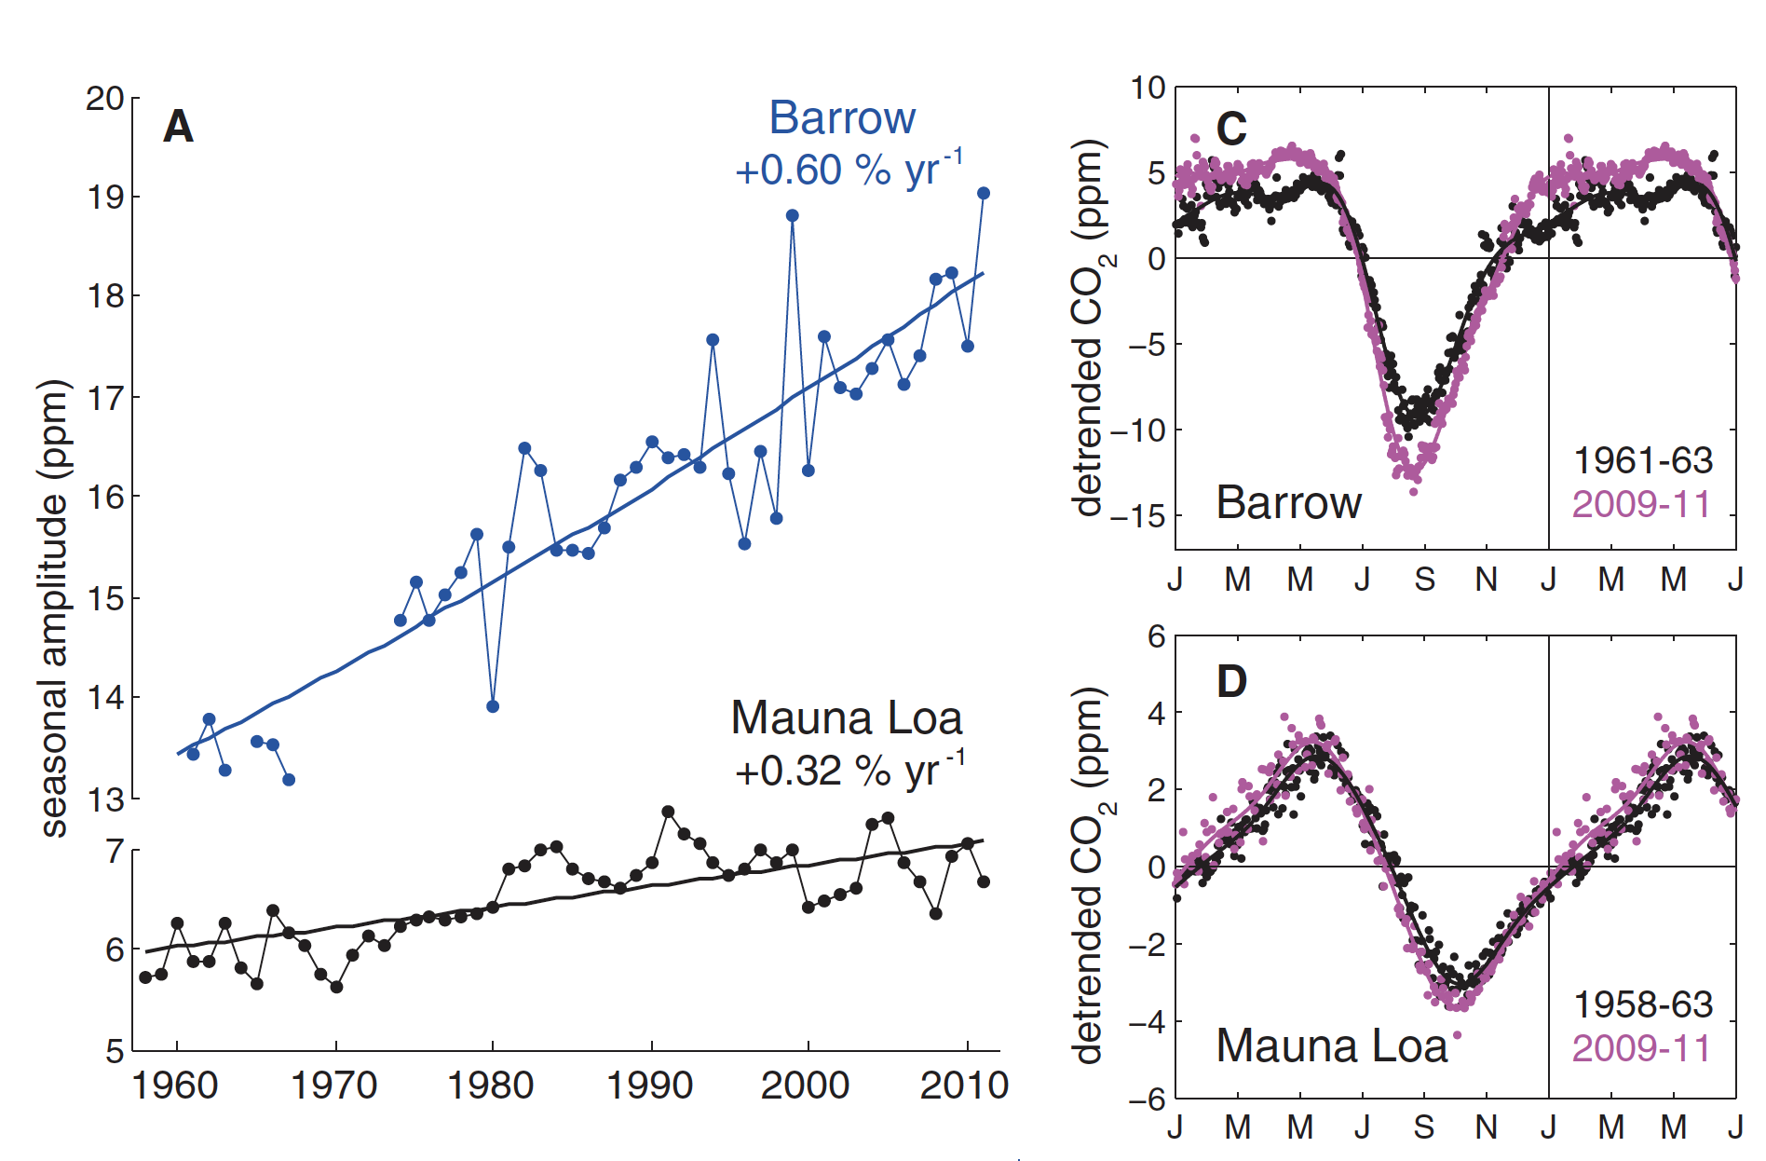
Schematic of Emergent Constraints in Terrestrial Carbon Cycle Research
Find a Predictor Based on Causal Mechanisms
We know that the amplitude of seasonal CO₂ concentration in the northern latitudes increases as Arctic vegetation GPP increases
The amplitude is the difference between the max and min values during one cycle
This can be estimated from both measurements and model simulations

Slide 6
Schematic of Emergent Constraints in Terrestrial Carbon Cycle Research
Evaluate the Predictor from ESM simulations
We have atmospheric CO₂ measurements for the period 1960 to 2020 (previous slide)
These measurements are from Point Barrow in Alaska (lat & long known)
Take simulation from the first ESM for the grid cell that includes Point Barrow location
For each year between 1960 and 2020 evaluated the simulated amplitude
Plot that against the simulated yearly average CO₂ concentration
Let α_{i} be the slope of that linear line
This is the sensitivity of the “i”th ESM
Repeat the same for other 9 ESM simulated results
We thus 10 modelled sensitivities, or Predictors

Slide 7
Schematic of Emergent Constraints in Terrestrial Carbon Cycle Research
Plot simulated Predictands against Predictors
Remember our Predictand is ΔGPP_{i} from each of the ESM simulations (i = 1, 2, … , 10)
We also have 10 Predictors corresponding to each of those Predictands
7
6
5
ΔGPP
(arbitrary units)
4
3
2
1
0
0
1
2
3
4
5
6
7
Sensitivity (arbitrary units)

Slide 8
Schematic of Emergent Constraints in Terrestrial Carbon Cycle Research
Note that the sensitivities are taken from the historical period (1960 to 2020 in our example)
The inter-model variation between the predictand and the predictor should result in a linear relation
Else, we got a problem
7
6
5
ΔGPP
(arbitrary units)
4
3
2
1
0
0
1
2
3
4
5
6
7
Sensitivity (arbitrary units)

Slide 9
Schematic of Emergent Constraints in Terrestrial Carbon Cycle Research
Obtaining a Constrained Estimate
Now plot the sensitivity estimated from Point Barrow measurements
Find the constrained estimated of ΔGPP
7
6
5
ΔGPP
(arbitrary units)
4
3
2
1
0
0
1
2
3
4
5
6
7
Sensitivity (arbitrary units)

Slide 10
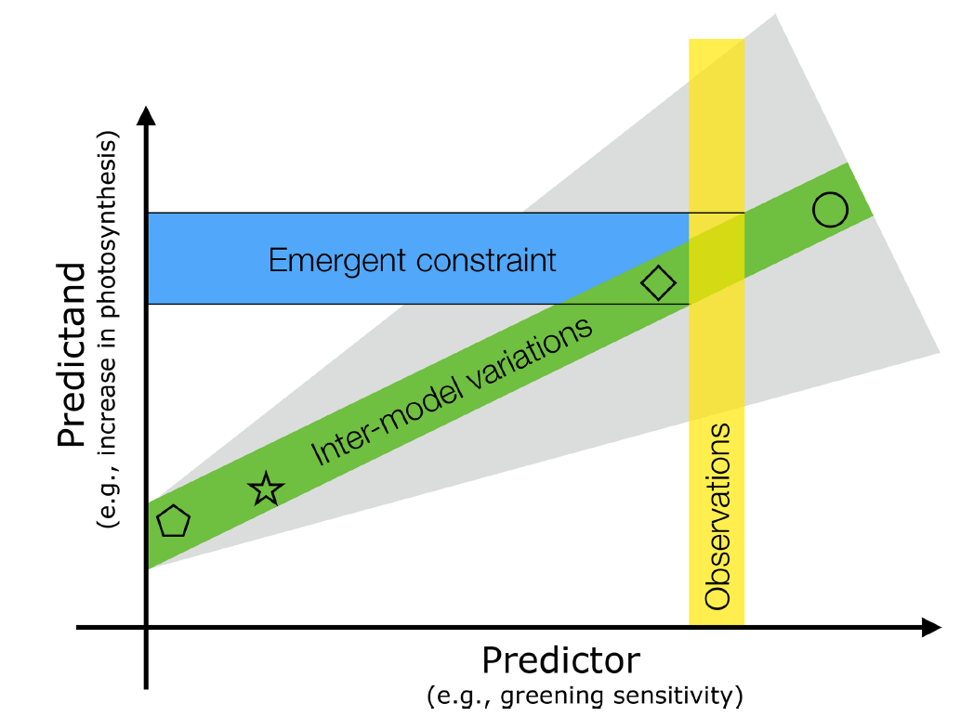
1. Guest Lectures on Advanced Topics
Topic: Emergent Constraints in Terrestrial Carbon Cycle Research
Speaker: Dr. Alexander Winkler (Max Planck Institute for Biogeochemistry, Jena, Germany)
Date: Oct-20-2020

