Slide 1
Regression Discontinuity:
A New Quality Improvement Paradigm?
Alexandra Yurkovic, MD and Nick Cordella, MD
CIIS: Implementation in Progress
January 17th 2017

Slide 2
Outline
Current Quality Improvement (QI) Approach
The Case for Innovation
Intro to Quasi-Experimental Design
Hospital Readmissions as a Case Study
Regression Discontinuity and Readmissions
A New Paradigm for Improvement and Implementation

Slide 3
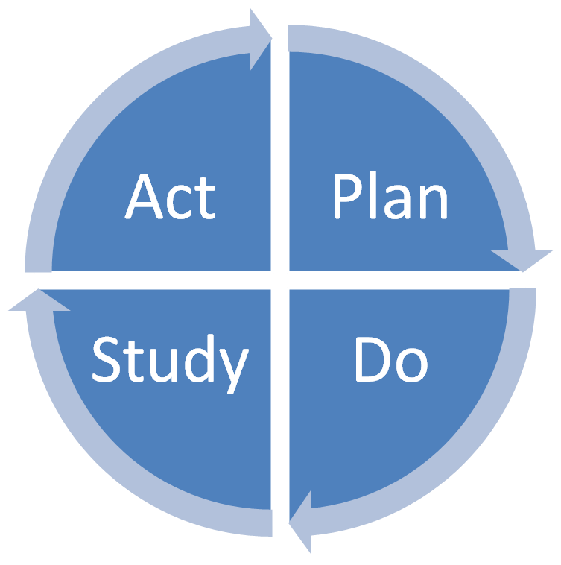
Traditional QI Approach
Plan
Identify Problem
Propose Plausible Intervention
Do
Implement Pilot Intervention
Study
Unadjusted Pre-Post Analysis
Act
Wider Implementation
Continued Analysis of Efficacy

Slide 4
Weakness of Traditional QI
Plan
Intervention not evidence based
Do
Is intervention actually occurring?

Slide 5
Weakness of Traditional QI
Study
Non-rigorous methods
No control for confounding
Misinterpret seasonal or secular trends
Is the intervention actually improving outcomes?
Unwarranted casual inference
Waste resources: money, time

Slide 6
Weakness of Traditional QI
Act
Lacks sustainability/generalizability
No real-time info on efficacy

Slide 7
Evaluating QI Programs
Significant Improvement in Outcomes?
YES
NO
YES
Ultimate Goal
Next Step: Generalize and Disseminate
Is improvement attributable to the intervention? No?
Next Steps: Examine and Redesign
Does Not Work
Next Step: Why? Modify Intervention
Successful Implementation?
NO
Other Factors Driving Change
Next Step: Reexamine Assumptions
Poor Implementation
Next Step: Study Barriers

Slide 8
Innovating Quality Improvement
Need a framework to reliably answer those questions of implementation and improvement
Why?
Isolate what’s actually driving outcomes in a sea of parallel interventions and complex array of confounders
Improve patient outcomes, increase efficiency
How?
Break down barriers between “QI” and “Research”
New Methodological Toolbox → Quasi-Experimental Designs

Slide 9
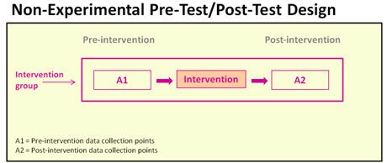
Quasi-Experimental Design
Current
QI Approach
(Weak)

Slide 10
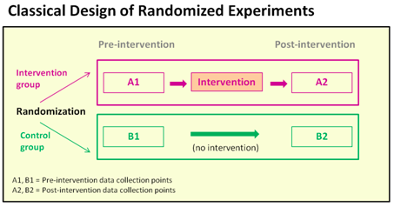
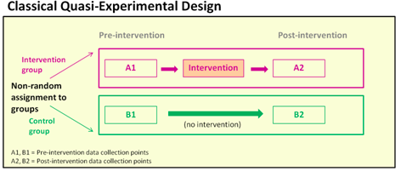
Quasi-Experimental Design
RCTs: Gold Standard (Stongest)
Proposed Approach
(Stronger)

Slide 11
Quasi-Experimental Design
Advantages
Analyze Real World Data
When RCT not Feasible/Ethical
No Exclusions → Analyze All-comers
Create/Leverage ‘Natural Experiments’
Increase Validity of Conclusions→ Stronger Causal Inference
Representative Examples
Regression Discontinuity Design (RDD)
Difference in Difference
Interrupted Time Series
Instrumental Variables
Notes:
Real world data

Slide 12
CIIS Study: Hospital Readmissions
Introduce real world example of the power of QE analysis
Multidisciplinary collaboration between clinicians, administration and researchers
Regression Discontinuity
What is it?
How to apply RDD to readmissions?

Slide 13
Preventing unnecessary readmissions represents good patient care and will prepare BMC for the future of medicine
Reducing unnecessary readmissions represents good patient care
As healthcare (hopefully?) transforms to global payments, managing hospital (re)admissions remains our most powerful driver for cost savings
Readmissions are an oft-reported metric of hospital quality
Readmissions contribute to patient flow / bed demand challenges, as well as staff and provider morale
BMC has a history of innovation relating to care transitions that can benefit smaller hospitals facing similar challenges

Slide 14
BMC’s centralized readmission prevention strategy seeks to thoughtfully refocus existing resources to address barriers
Focus on the highest-yield patient cohorts, given limited resources
Attention to patient knowledge and understanding, social determinants of health, and clinical factors
Inpatient focus to start (given existing resources that could be re-deployed), with plans to engage with outpatient care management programs as able

Slide 15
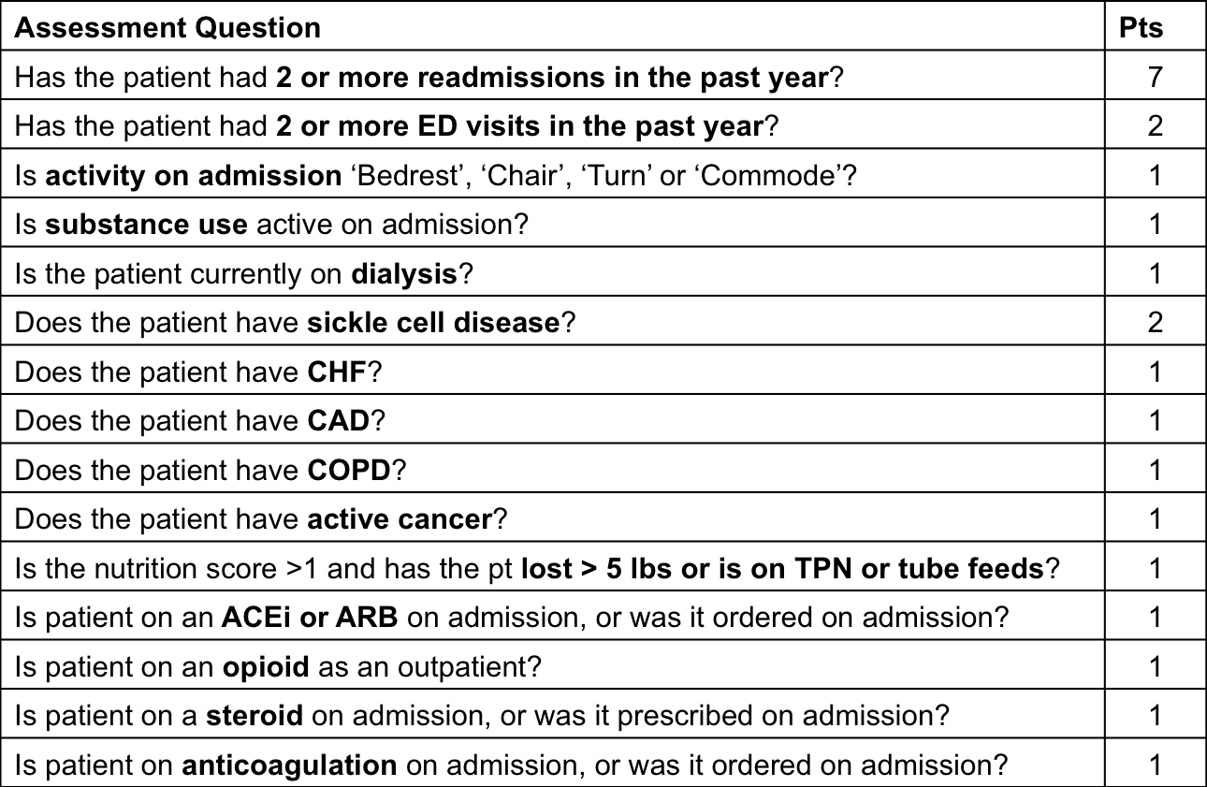
BMC’s internal Readmissions Risk Assessment rolled out on medical services in Spring 2016, with an update in August 2016

Slide 16
The Readmission Risk Assessment identifies patients at risk for readmission and aligns resources against them
Schematic for revised Readmission Risk Assessment initiative
Launched in 2016 on medical services
Super Utilizers (14-23)
5% of pts Readmit rate: 63%
Readmission Risk Assessment score calculated daily for all medical inpatients
High Risk (9-13)
15% of pts Readmit rate : 54%
Moderate Risk (4-8)
50% of pts Readmit rate : 14%
Low Risk (0-3)
30% of pts Readmit rate : 8%

Slide 17
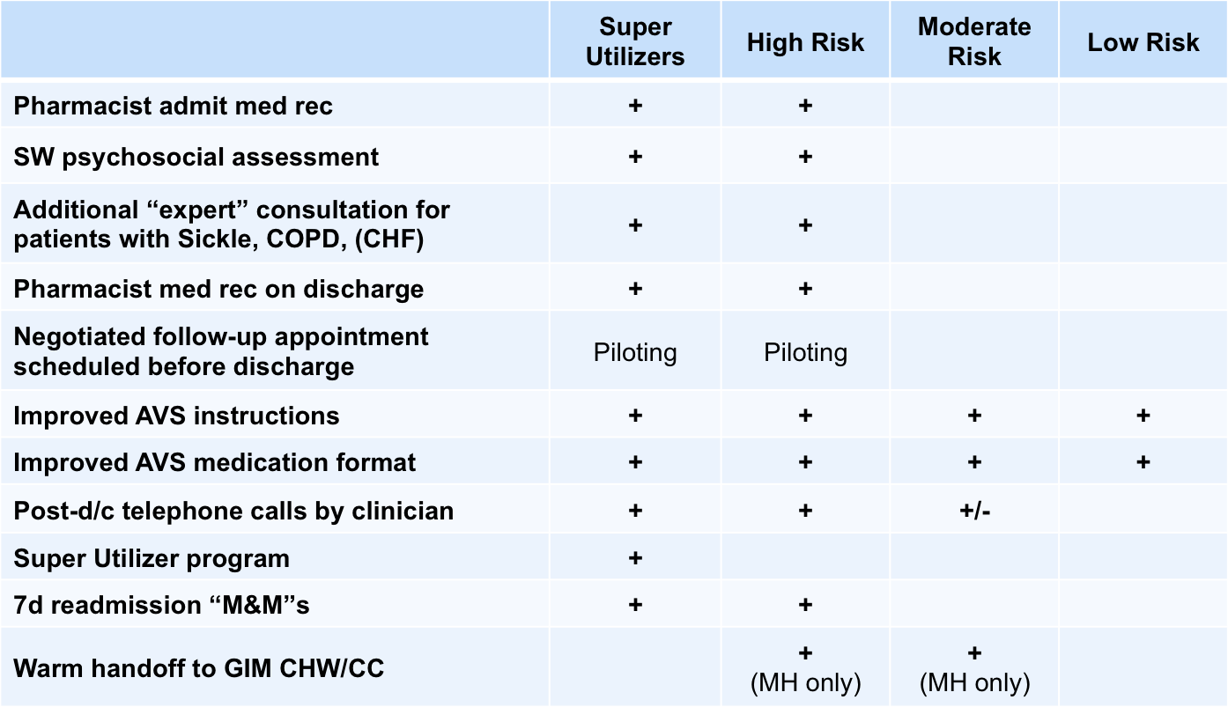
A variety of evidence-based interventions have been developed and rolled out for the most at-risk medical cohorts

Slide 18
Back to QE Design: Regression Discontinuity
Widely used in econometrics + education
Minimal use in Clinical Medicine/QI
Quasi-Experimental Design
Treatment/Intervention allocation by numeric score
Score is measure of clinical or disease severity
Choose Cutoff Point
Above Cutoff → Gets Intervention → “Treatment” Group
Below Cutoff → No Intervention → “Control” Group
Individuals just above and below cutoff very similar in measured/unmeasured confounders
Like an RCT at the cutoff point
Only difference is treatment or no-treatment

Slide 19
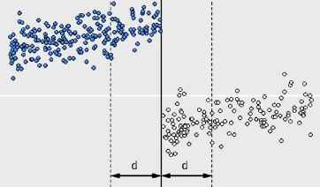
Familiar Example: New Drug for Hypertension
Expensive New Drug X
Measure initial SBP (assignment variable)
Give to patients with SBP>165 (cutoff point)
Mortality (outcome variable)
Plot Assignment vs. Outcome Variable
Look for break/ “discontinuity” at cutoff points
Does Drug X change relationship b/t SBP and Mortality?
Cutoff of SBP> 165
Mortality
Baseline Systolic Blood Pressure

Slide 20
RDD in Readmission
CAVEAT: Preliminary Data
1 Month → Small Sample Size
Interpret With Caution

Slide 21
RDD in Readmissions
Calculate Readmission Risk Score (Assignment Variable)
Package of Case Mgmt, Social Work and Pharmacist Interventions (Treatment)
Assign CM, SW and PharmD interventions for those above certain risk threshold (Cutoff)
Comparing interventions for MR to those for HR (Risk score > 8)
Comparing intervention for HR to those for SU (Risk Score> 13)
Measure 30-day readmissions (outcome)
Plot Risk Score vs. Readmission Rate
Look for discontinuity at the cut-point(s)

Slide 22
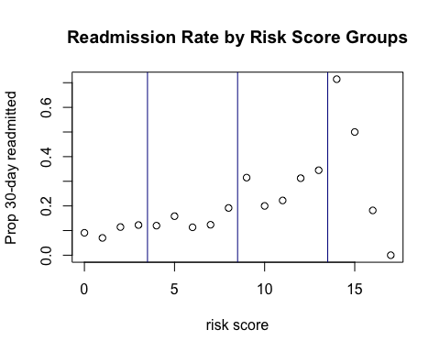
LR
MR
HR
SU

Slide 23
The Fine Print: RDD Assumptions
No existing natural discontinuity at the cutpoint
Analyze historical data (in process)
Individual and researchers cannot manipulate the score
Not an issue for the risk score → automatically calculated by EMR, score components opaque to clinicians
Individuals are actually similar near the cutpoint
Compare a few measures variables → Table 1 in an RCT
Acquiring more data, but so far similar across diagnosis/disease characteristics
Consistency of treatment assignment (next slide)
Did those above threshold actually receive the intervention
Did those below consistently NOT receive the intervention
Notes:
Change order

Slide 24
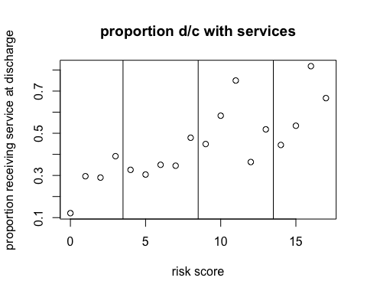
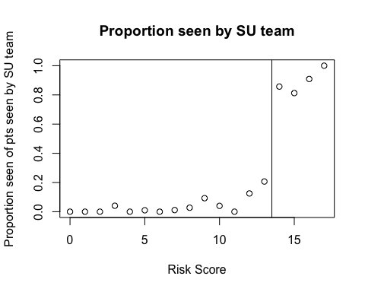
No discontinuity of
Exposure/Intervention at the
Cutpoint → Contamination
Clear discontinuity of
Exposure/Intervention at
the Cutpoint → Minimal
Contamination

Slide 25
Advantages of RD Design in QI
Made for ‘Real World’ Analysis
Titrate intervention based on resources
Target to those most in need of treatment
Higher Cutoff for expensive interventions
Real time program analysis
Identify issues in implementation
Expand Program and readjust cutpoint
Improved Causal Inference!!
Notes:
Who needs it most

Slide 26
A New QI Paradigm
Scores abound in Clinical Medicine
Lab/Clinical Values
A1C, SBP, BMI
Prediction Scores
APACHE, BICEPS, ASCVD
Bold Proposal
From the Start: Develop QI Intervention Leveraging RD Design

Slide 27
A New QI Paradigm
Example Beyond Readmission
Project to Improve Outpatient HTN Management
Traditional
Pilot: Shapiro 6C Primary Care Suite Gets a “HTN” Pharmacist
Measure Mean suite BPs 3 Weeks Before and After Pilot Implementation
Average BP Decreases by a Few Points
Maintain expensive intervention, heterogeneous roll-out to different suites, stop collecting data

Slide 28
A New QI Paradigm
RD Model
Pilot: Provide Pharmacy Appt. to Patients with SBP > 165
Is Implementation Effective? → Are Patients Going to the Appts?
Use RDD to make strong causal inference about efficacy of pharmacy appointment
Expand to other suites and readjust cutpoint to SBP>160
Continuously reanalyze efficacy in real-time

Slide 29
Conclusion
Stay Tuned for Final Readmissions Analysis
Further Break Down Barriers Between:
Research and QI
Administration and Academia
Consider Integrating QE Methods and RDD into the Fabric of Existing QI Practice

Slide 30
Acknowledgments
Allan Walkey
Evans Center for Implementation and Improvement Science (CIIS)
BMC Data Analytics
Readmissions Reduction Team
Hospital Leadership, CM, SW, Pharmacy
Jacob Bor

Slide 31
Questions?

