Slide 1
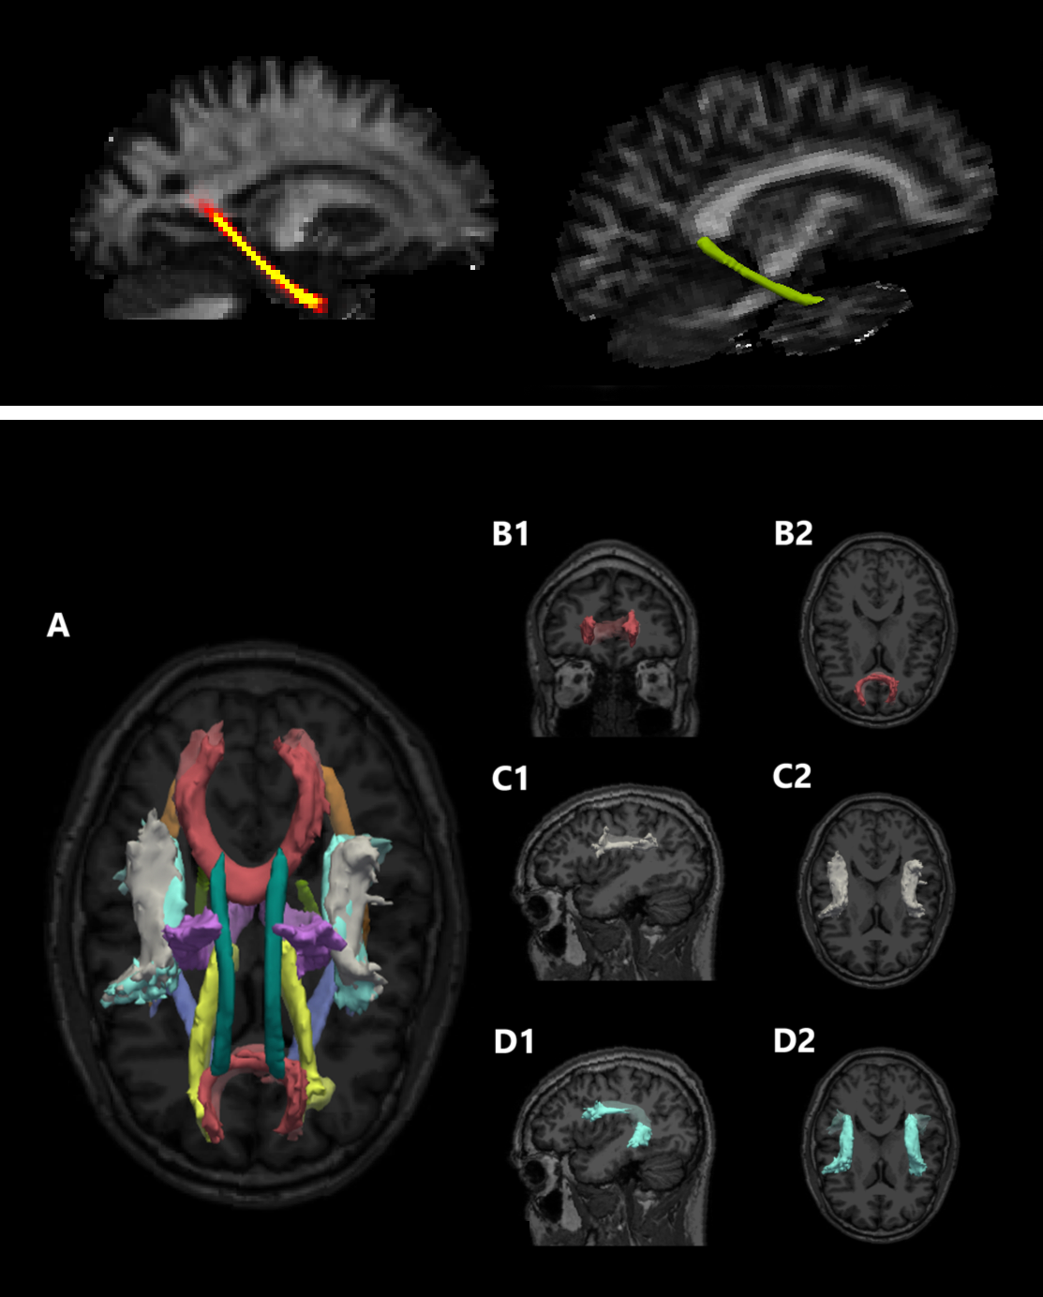
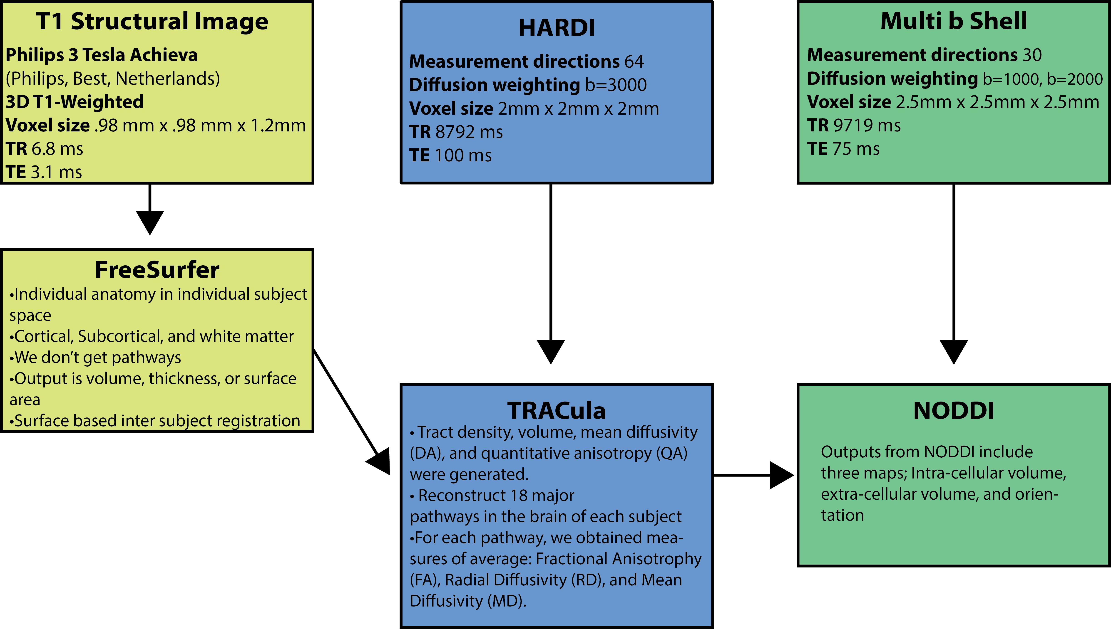
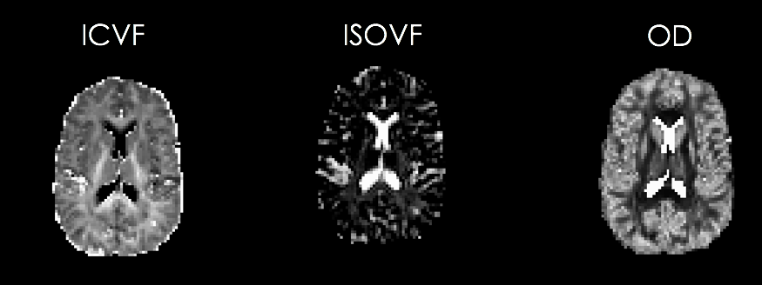
ALTERATIONS IN THE INTEGRITY OF MAJOR WHITE MATTER PATHWAYS IN VETERANS WITH GULF WAR ILLNESS (GWI)
Yashar Rahimpour, MS, Bang-Bon Koo, Ph.D., Joy Ajama, Deborah Little, Ph.D., Lea Steele, Ph.D., R. Douglas Fields, Ph.D., Ron Killiany, Ph.D., and Kimberly Sullivan, Ph.D.
Boston University School of Medicine, Boston University School of Public Health, National Institutes of Health, and University of Texas Houston
Introduction
Approximately one third of veterans who deployed to the 1991 Gulf War suffer from a chronic disorder called Gulf War Illness (GWI) which is characterized by symptoms including cognitive dysfunction, debilitating fatigue, joint and muscle pain, skin rashes, and gastrointestinal problems. Meta-analyses of cognitive data from these veterans has shown significant decrements in visuospatial skills, executive function, attention, and learning and memory. Magnetic Resonance Imaging (MRI) of veterans with GWI have found reduced white matter volumes in the brain. In order to gain a better understanding of the microstructural changes in the remaining white matter, we assessed the major white-matter pathways using diffusion-weighted MRI (DWI).
A1
Participants
Participants: Data were obtained from 58 veterans of the 1991 Gulf War (13 healthy and 45 with symptoms of GWI) Age 42-72 (At the time of scan) as part of the Boston University Gulf War Illness Consortium (GWIC).
2
Methods
*
Figure A1 illustrates an FA heat map and its representation of the Cingulum-Angular Bundle in green
Figure A2 represents all 18 tract outputs from TRACULA
Figure B1 and B2 are coronal and transverse views of the forceps minor, which contain fibers connecting the lateral and medial surfaces of the frontal lobes
Figure C1 and C2 are sagittal and transverse views of the SLF-T, which contain fibers from frontal and temporal lobes
Figure D1 and D2 are sagittal and transverse views of the SLF-P which contain fibers from frontal and parietal lobes
Results
Independent sample t-tests were used to identify differences between the groups. These analyses revealed that the microstructural integrity of the several white matter tracts were compromised in veterans with GWI.
ICVF – Intra-Cellular Volume Fraction
Can be used with OD to better understand regional FA variations
ISOVF – Extra-Cellular Volume Fraction
Cerebrospinal Fluid
OD – Orientation Dispersion
To view microstructural changes in vivo
*
*
Summary
*
*
*
These results add to the evidence indicating that alterations to the white matter of the brain is one element of GWI.
These analyses revealed that a number of white matter pathways are disrupted in Gulf War Illness.
Classic forms of probabilistic tractography indicate diverse pathways disrupted bilaterally while neurite orientation analysis highlight somewhat independent changes and less bilateral.
Contrast in Orientation Dispersion is similar to FA but with better accuracy for neurites, further works needs to be done.

